Slide 1
Project: IEEE P802.15 Working Group for Wireless Personal Area Networks (WPANs)
Submission Title: [UWB channel usage coordination for hyper-block mode]
Date Submitted: [10 March, 2023]
Source: [Lei Huang, Kuan Wu, Rojan Chitrakar, David Xun Yang] Company [Huawei Technologies]
E-Mail:[lei.huang1@huawei.com]
Abstract: [UWB channel usage coordination mechanism is extended to support hyper-block mode.]
Purpose: [To enable UWB channel usage coordination for hyper-block mode.]
Notice: This document has been prepared to assist the IEEE P802.15. It is offered as a basis for discussion and is not binding on the contributing individual(s) or organization(s). The material in this document is subject to change in form and content after further study. The contributor(s) reserve(s) the right to add, amend or withdraw material contained herein.
Release: The contributor acknowledges and accepts that this contribution becomes the property of IEEE and may be made publicly available by P802.15.

Slide 2
PAR Objective | Proposed Solution (how addressed)
Safeguards so that the high throughput data use cases will not cause significant disruption to low duty-cycle ranging use cases | UWB channel usage coordination
Interference mitigation techniques to support higher density and higher traffic use cases | UWB channel usage coordination
Other coexistence improvement | UWB channel usage coordination
Backward compatibility with enhanced ranging capable devices (ERDEVs)
Improved link budget and/or reduced air-time
Additional channels and operating frequencies
Improvements to accuracy / precision / reliability and interoperability for high-integrity ranging
Reduced complexity and power consumption
Hybrid operation with narrowband signaling to assist UWB
Enhanced native discovery and connection setup mechanisms
Sensing capabilities to support presence detection and environment mapping
Low-power low-latency streaming
Higher data-rate streaming allowing at least 50 Mbit/s of throughput
Support for peer-to-peer, peer-to-multi-peer, and station-to-infrastructure protocols | Hyper block-based mode to support usage of NBA-MMS mode
Infrastructure synchronization mechanisms

Slide 3
Previous Contributions Related To
Discovery
[1] DCN 0059r0 (January 2023) “Hyper block concept for use of NBA-MMS”
[2] DCN 0067r0 (January 2023) Updates on UWB Channel Usage Coordination
[3] DCN 0573r1 (November 2022) “Follow-up on UWB Channel Usage Coordination”
[4] DCN 0456r0 (September 2022) “UWB Channel Usage Coordination for better UWB Coexistence”

Slide 4
Recap: Hyper-block Based Mode for NBA-MMS
4ab supports various NBA-MMS based ranging modes (e.g. one-to-one ranging & one-to-many ranging) in a session which may require different ranging round duration.
Hyper-block based mode can satisfy such requirements of NBA-MMS based ranging in an efficient manner [1].
Hyper Block
Block 0
Block 1
Block 2
Round
0
Round
1
Round
0
Round
1
Round
2
……
Round 5
Round
0
POLL
POLL
RESPONSE
REPORT
POLL
RESPONSE
REPORT
POLL
RESPONSE
REPORT
POLL
RESPONSE
REPORT
POLL
RESPONSE
REPORT
RESPONSE
REPORT
POLL
RESPONSE
REPORT
POLL
RESPONSE
REPORT
[NB] :
……
[UWB] :
1
1
2
2
3
3
4
4
1
1
2
2
3
3
4
4
1
1
1
1
1
1
1
1
2
2
3
3
4
4
1
1
1
1
2
2
3
3
4
4
5
5
6
6
One Ranging Round
One Ranging Round
One Ranging
Round
One Ranging
Round
One Ranging
Round
One Ranging Round

Slide 5
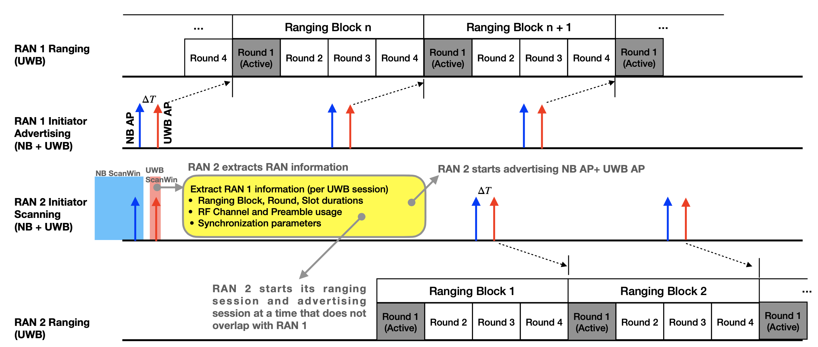
Recap: UWB Channel Usage Coordination
UWB channel usage coordination can be used for better UWB coexistence. [2][3][4].
The UWB channel usage coordination mechanism is primarily designed for block based mode
  NB AP and/or UWB AP is periodically transmitted before each ranging block.
  Each NB/UWB AP includes UWB per-session info related to a particular block.

Slide 6
Problem
The existing UWB channel usage coordination mechanism needs to be adapted for hyper-block based mode.
  Different blocks within a hyper block may have different block duration.
The existing UWB channel usage coordination mechanism needs to take into account the characteristics of NBA-MMS based ranging.
  NBA-MMS based ranging can use NBA-UWB MMS packet or UWB-only MMS packet.
  NBA-MMS based ranging supports complementary sets based MMRS (multi-millisecond ranging sequence) and Ipatov sequence as MMRS

Slide 7
Proposal
NB AP and/or UWB AP is broadcast in an aperiodic manner for hyper-block based mode.
  NB AP and/or UWB AP is transmitted before each ranging block.
  An NB AP includes timing information of next NB AP
  An UWB AP includes timing information of next UWB AP

Slide 8
Proposal (cont.)
  For NBA-MMS based ranging, UWB Session Info field may contain preamble code field, MMRS code field, and MMRS gap size field depending on NBA-MMS configuration..
MMS Packet Type | MMRS Type | Preamble code | MMRS Code | MMRS Gap Size
NBA-UWB Mixed/RSF-only MMS Packet | Complementary set based | x | √ | √
 | Ipatov sequence based |  |  | x
UWB-only Mixed MMS Packet | Complementary sets based | √ | √ | √
 | Ipatov sequence based |  |  | x
UWB-only RIF-only MMS Packet | N.A. | √ | x | x

Slide 9
NB AP Payload
MAC Payload |  | Bits | Bytes | Description
Common Info Field | NB AP Type | 3 | 1 | Indicates NB AP type 0: Coordination NB AP for periodic mode; 1: Coordination NB AP for aperiodic mode, 2:7 reserved
 | Reserved | 5
 | UWB AP Present | 1 | 1 | If NB AP Type = 0 or 1, 0: No UWB AP sent after each NB AP 1: UWB AP sent after each NB AP If UWB AP Present = 1, then UWB AP Info field is present in the NB AP with the NB AP Type = 0 or 1 If UWB AP Present = 0, then UWB AP Info field is NOT present in the NB AP with the NB AP Type = 0 or 1
 | UWB Per-Session Info field Type | 3 |  | If NB AP Type = 0 or 1, 0: No UWB Per-Session Info field present in the NB AP 1: UWB Per-Session Info field Type 1 present in the NB AP 2: UWB Per-Session Info field Type 2 present in the NB AP 3: UWB Per-Session Info field Type 3 present in the NB AP 4-7: reserved
 | Reserved | 4
 | Next NB AP | 16 | 2 | Time remaining in RSTU until the start of the next NB AP. It is not present when the NB AP Type = 0
UWB AP Info Field | Delta T | 16 | 2 | Time remaining in RSTU until the start of the next UWB AP relative to the start of the current packet
 | UWB CH | 5 | 1 | UWB channel number on which UWB AP occurs after Delta T
 | Reserved | 3
 | Preamble Code | 8 | 1 | Preamble code used by UWB AP
UWB Per-Session Info Field(s) | If UWB Per-Session Info field Type!=0, then UWB Per-Session Info field present. All UWB Per-Session Info Fields included in a NB AP MAC Payload are of same Type (to ease parsing)

Slide 10
UWB AP Payload
MAC Payload |  | Bits | Bytes | Description
Common Info Field | UWB AP Type | 3 | 1 | Indicates UWB AP type 0: Coordination UWB AP for periodic mode; 1: Coordination UWB AP for aperiodic mode, 2:7 reserved
 | Reserved | 5
 | UWB Per-Session Info field Type | 3 | 1 | If UWB AP Type = 0, 0: Reserved 1: UWB Per-Session Info field Type 1 present in the UWB AP 2: UWB Per-Session Info field Type 2 present in the UWB AP 3: UWB Per-Session Info field Type 3 present in the UWB AP 4-7: Reserved
 | Reserved | 5
 | Next UWB AP | 16 | 2 | Time remaining in RSTU until the start of the next UWB AP. It is not present when the UWB AP Type = 0
UWB Per-Session Info Field(s) | If UWB AP Type ==0, then UWB Per-Session Info field present. All UWB Per-Session Info Fields included in a UWB AP MAC Payload are of same Type (to ease parsing) NOTE: If UWB Per-Session Info Field are included in both NB AP and UWB AP then ensure sequence of UWB Per-Session Info Fields is identical. For e.g., UWB Session i information followed by UWB Session i+1 information in both NB AP and UWB AP

Slide 11
UWB Per Session Info
[Type = 1]
MAC Payload |  | Bits | Bytes | Comments
Per-Session Info field | Preamble code present | 1 | 1 | 0: preamble code field is not present; 1: preamble code field is present.
 | MMRS code present | 1 |  | 0: MMRS code field is not present; 1: MMRS code field is present.
 | MMRS gap size present | 1 |  | 0: MMRS gap size field is not present; 1: MMRS gap size field is present.
 | Reserved | 5
 | Block Duration | 24 | 3 | In RSTU (Ranging Scheduling Time Unit)
 | Session CH | 5 | 1 | UWB CH used by session
 | Hop Mode | 1 |  | 0: no hopping; 1: hopping. Hopping sequence NOT required to be known to all devices
 | RFU | 2 |  | RFU
 | Preamble Code | 8 | 1 | Preamble code used by UWB session
 | MMRS Code | 8 | 1 | MMRS code used by UWB session
 | Gap Size | 8 | 1 | 0-64: gap size used by MMRS; 65-255: reserved

Slide 12
UWB Per Session Info
[Type = 2]
MAC Payload |  | Bits | Bytes | Comments
Per-Session Info field 1 | Preamble code present | 1 | 1 | 0: preamble code field is not present; 1: preamble code field is present.
 | MMRS code present | 1 |  | 0: MMRS code field is not present; 1: MMRS code field is present.
 | MMRS gap size present | 1 |  | 0: MMRS gap size field is not present; 1: MMRS gap size field is present.
 | Reserved | 5
 | Delta T | 24 | 3 | Time remaining in RSTU until the start of active period
 | UWB CH | 5 | 1 | UWB channel used by the UWB session
 | RFU | 3 |  | RFU
 | Preamble Code | 8 | 1 | Preamble code used by UWB session
 | MMRS Code | 8 | 1 | MMRS code used by UWB session
 | Gap Size | 8 | 1 | 0-64: gap size used by MMRS; 65-255: reserved
 | Active Period Duration | 24 | 3 | Duration of active period of UWB session

Slide 13
UWB Per Session Info (cont.)
[Type = 3]
MAC Payload |  | Bits | Bytes | Comments
Per-Session Info field | Preamble code present | 1 | 1 | 0: preamble code field is not present; 1: preamble code field is present.
 | MMRS code present | 1 |  | 0: MMRS code field is not present; 1: MMRS code field is present.
 | MMRS gap size present | 1 |  | 0: MMRS gap size field is not present; 1: MMRS gap size field is present.
 | Reserved | 5
 | Delta T | 24 | 3 | Time remaining in RSTU until the start of block
 | UWB CH | 5 | 1 | UWB CH used by session
 | Hop Mode | 1 |  | 0: no hopping; 1: hopping. Hopping sequence NOT required to be known to all devices
 | RFU | 2 |  | Unused
 | Preamble Code | 8 | 1 | Preamble code used by UWB session
 | MMRS Code | 8 | 1 | MMRS code used by UWB session
 | Gap Size | 8 | 1 | 0-64: gap size used by MMRS; 65-255: reserved
 | Round Duration | 24 | 3 | Round duration in a block of UWB session
 | Number of Rounds in a Block | 8 | 1 | In units of rounds
 | Active Rounds | 24 | 3 | Bitmap indicates the index of active rounds

Slide 14
Summary
This contribution proposes to adapt the existing UWB channel usage coordination mechanism for hyper-block based mode
  NB AP and/or UWB AP is broadcast in an aperiodic manner for hyper-block based mode.
  For NBA-MMS based ranging, UWB Session Info field may contain MMRS code field, preamble code field and MMRS gap size field depending on NBA-MMS configuration.

