Slide 1
Project: IEEE P802.15 Working Group for Wireless Personal Area Networks (WPANs)
Submission Title: Latest Consensus on UWB Sensing for 802.15.4ab
Date Submitted: March 16, 2023
Authors: Pooria Pakrooh, Bin Tian, Steve Shellhammer, Koorosh Akhavan (Qualcomm), Xiaohui Peng, David Xun Yang, Bin Qian, Lei Huang, Li Sun (Huawei), Frank Leong, Wolfgang Küchler, Riku Pirhonen, Bernhard Großwindhager (NXP Semiconductors), Dag Wisland, Håkon Hjortland, Kristian Granhaug, Jan Roar Pleym (Novelda), Dries Neirynck (Ultra Radio Ltd), Claudio da Silva, Carlos Aldana, Kangjin Yoon (Meta), Billy Verso, Carl Murray, Igor Dotlic, Michael McLaughlin (Qorvo), Xiliang Luo, Vinod Kristem, Jinjing Jiang (Apple), Aniruddh Rao, Mingyu Lee (Samsung), Li Ma, Li-Hsiang Sun (MediaTek)
Abstract: Latest consensus among co-authors on UWB sensing topics for 802.15.4ab
Notice: This document has been prepared to assist the IEEE P802.15. It is offered as a basis for discussion and is not binding on the contributing individual(s) or organization(s). The material in this document is subject to change in form and content after further study. The contributor(s) reserve(s) the right to add, amend or withdraw material contained herein.
Release: The contributor acknowledges and accepts that this contribution becomes the property of IEEE and may be made publicly available by P802.15.

Slide 2
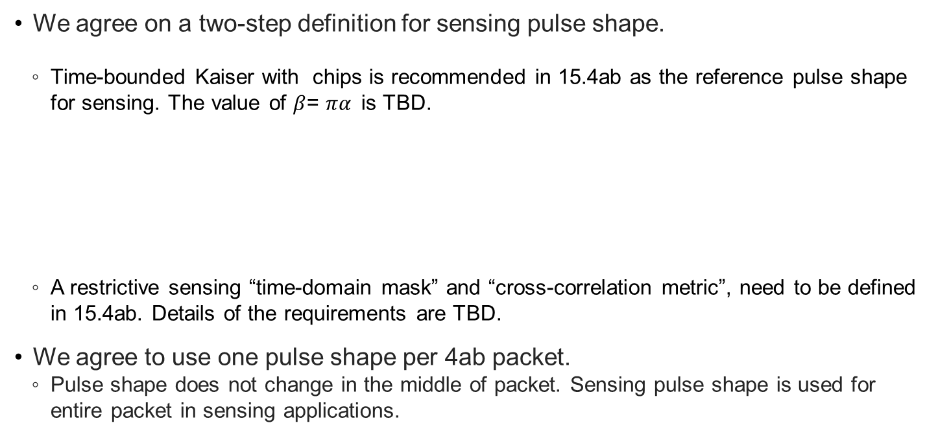
Sensing Pulse Shape
We agree on a two-step definition for sensing pulse shape.
Time-bounded Kaiser with chips is recommended in 15.4ab as the reference pulse shape for sensing. The value of $β$= $πα$is TBD.
A restrictive sensing “time-domain mask” and “cross-correlation metric”, need to be defined in 15.4ab. Details of the requirements are TBD.
We agree to use one pulse shape per 4ab packet.
Pulse shape does not change in the middle of packet. Sensing pulse shape is used for entire packet in sensing applications.
$$p(t)=\left\{\begin{aligned}\frac{1}{L}\frac{I_{0}\left[πα\sqrt{1−{\left(\frac{2t}{L}\right)}^{2}}\right]}{I_{0}\left[πα\right]}, \left|t\right|≤L/2 \\ 0, \left|t\right|>L/2\end{aligned}\right.$$
Slide 2
Pakrooh et al. (Qualcomm)

Slide 3
Sensing Sequence and Pulse Pattern
We agree on the HPRF pulse pattern for sensing.
We agree on the Ipatov sequences as the mandatory sequences for sensing.
We agree on mandatory support of Ipatov sequences of length 91, with spreading factor of L=4 for sensing.
Other sequences and pulse patterns are under discussion and will be added as optional scheme upon convergence.
Slide 3
Pakrooh et al. (Qualcomm)

Slide 4
Sensing Packet Format
We agree to define the following PPDUs for bi/multi-static sensing.
SENS0: Mandatory sensing packet format, SHR + sensing
SENS1: Optional packet format, sensing + data comm
SENS2: Optional packet format, data comm + sensing
SENS0
SYNC
SFD
SENS
Mandatory
SENS1
SYNC
SFD
SENS
PHR
Payload
Optional
SENS2
SYNC
SFD
PHR
Payload
SENS
Optional
Arrow shows RMARKER
reference position.
Slide 4
Pakrooh et al. (Qualcomm)

Slide 5
Sensing Packet Structure
Segments
We agree that in the baseline mandatory mode, SENS field has one segment.
We agree on optional support for 2, 3 and 4 segments in the SENS field.
Gap
We agree that SENS field includes silent intervals called “gaps”
When multiple segments are used, we agree to include gaps between segments.
The duration of each gap interval is one SENS symbol.
See next slides for figures
RMARKER
We agree to have one RMARKER for sensing packets. The position of the RMARKER is at the peak of first pulse after SFD (as per 4z).
Slide 5
Pakrooh et al. (Qualcomm)

Slide 6
Sensing Packet Structure
Number of SENS Symbols
Each symbol corresponds to one period of SENS sequence with spreading
We agree to support 32, 64, 128 (Mandatory) 16, 256, 512 (optional) symbols per segment for SENS.
Sequence selection
We agree that when both SENS and SYNC use length 91 Ipatov sequence, they shall use same Ipatov code index.
CIR Report
For sensing packets, we agree to support one CIR report per SENS segment per Rx.
Slide 6
Pakrooh et al. (Qualcomm)

Slide 7
SENS0 Packet
Support for one segment is mandatory, 2,3 and 4 segments is optional
RMARKER
SYNC
SFD
SENS
Gap
SENS active
Gap
SENS active
Single segment SENS
Two segment SENS
Slide 7
Pakrooh et al. (Qualcomm)

Slide 8
SENS1 Packet
Support for one segment is mandatory, 2,3 and 4 segments is optional
RMARKER
SYNC
SFD
SENS
PHR
Payload
Gap
SENS active
Gap
SENS active
Gap
Single segment SENS
Two segment SENS
Slide 8
Pakrooh et al. (Qualcomm)

Slide 9
SENS2 Packet
Support for one segment is mandatory, 2,3 and 4 segments is optional
RMARKER
SYNC
PHR
Payload
SFD
SENS
Gap
SENS active
Gap
SENS active
Single segment SENS
Two segment SENS
Slide 9
Pakrooh et al. (Qualcomm)

Slide 10
Sensing Packet Fields
We agree on the following values for SYNC and SFD configs for sensing packets
SYNC PSR: 32, 64 (mandatory), 16, 128, 256 (optional).
SFD length: Same as 15.4z, as specified in table 15-7c.
For sensing, we agree that fixed PSR is negotiated at higher layers, and the value does not change from packet to packet.
We agree to use 4z PHR, with payload data rates of 1.95, 7.8, 31.2, 62.4 (mandatory), and 124.8Mbps (optional).
FEC: We agree on BCC K=7 as the FEC for SNES1 and SENS2 packets.
Slide 10
Pakrooh et al. (Qualcomm)

Slide 11
Sensing Report
We agree to have window-based CIR report, as shown in the figure below.
A sensing report bitmap is used to signal the taps present in the CIR report. The bitmap length is equal to the CIR window length.
Additionally, we agree that other processed results may be included in the sensing report.
For monostatic sensing, or for bi-static sensing with external synchronization, CIR report may be optionally processed, to generate range/velocity for each object. The definition of computation method is TBD.
Angle of Arrival (AoA) for each object may be reported.
Reference Point: Earliest detected tap
Noise Threshold
$$t_{0}$$
$$t_{0}+W_{offset}$$
$t_{0}+W_{offset}$+ $W_{length}$
$${BM}_{offset}$$
$${BM}_{length}$$
Sensing window parameters defined relative to the earliest detected tap
Slide 11
Pakrooh et al. (Qualcomm)

Slide 12
Sensing Report
We agree on the following parameters for the window-based CIR report.
Reference: The earliest detected tap can be specified as the mandatorily supported reference for the CIR report. Other reference options under consideration, to be supported optionally:
Other specific time instances can be specified as reference points (for example via OOB) when there is external synchronization.
The strongest detected tap, if there are multiple equally strongest taps, then the earliest one is selected.
CIR sampling rate: We agreed on OSR=2, to balance reasonable accuracy, complexity and report overhead. OSR is defined with respect to signal BW.
For frequency stitching, OSR is defined with respect to the aggregated BW.
Bit-width: Bit-width is defined for encoding signed I/Q values each, normalized per Rx chain.
16 bits (mandatory), 10, 12 bits, and other values are under consideration as optional values.
Slide 12
Pakrooh et al. (Qualcomm)

Slide 13
Sensing Report
We agree on the following points for the window-based CIR report.
The CIR report window has configurable duration and position, to cover a large sensing area.
Further agreements regarding CIR report bitmap
Single CIR window with bitmap of a fixed length is specified through OOB means.
The bitmap length is negotiated and determined through other means, and it is fixed during sensing session.
In the mandatory mode, initiator proposes the bitmap, based on its sensing area of interest, from a limited set of bitmap options.
Bitmap is fixed during the session and does not change from packet to packet.
For the optional modes, the bitmap can change from packet to packet
Slide 13
Pakrooh et al. (Qualcomm)

Slide 14
Modes for Report Bitmap
In the mandatory bitmap mode, we agreed that a limited set of reasonable bitmap options will be defined in the standard. Initiator proposes one bitmap based on its area of interest. The allowed configs are one or two continuous strings of 1s within the bitmap length.
The SDEVs shall support the mandatory window configurations → No need for negotiation.
In the optional bitmap mode, we agreed that the bitmap can change from packet to packet
The responder reports CIR taps above a threshold, and the associated bitmap
Initiator determines the threshold value
The responder reports taps above a threshold level T (for example, strongest tap level – T)
T is determined by initiator
If initiator does not want the CIR report to be thresholded, it specifies a very low value for T (for example, -100dB).

Slide 15
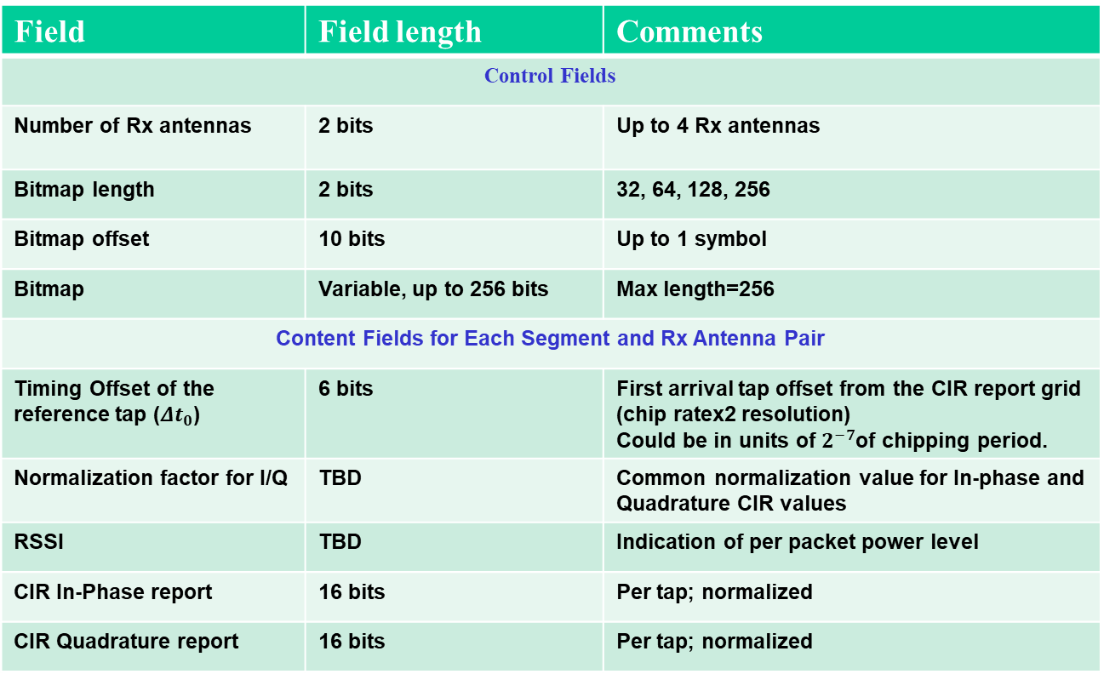
Baseline Sensing Report Parameters
We agree that the baseline CIR report contain the following fields
Field | Field length | Comments
Control Fields
Number of Rx antennas | 2 bits | Up to 4 Rx antennas
Bitmap length | 2 bits | 32, 64, 128, 256
Bitmap offset | 10 bits | Up to 1 symbol
Bitmap | Variable, up to 256 bits | Max length=256
Content Fields for Each Segment and Rx Antenna Pair
Timing Offset of the reference tap (${Δt}_{0}$) | 6 bits | First arrival tap offset from the CIR report grid (chip ratex2 resolution) Could be in units of $2^{−7}$of chipping period.
Normalization factor for I/Q | TBD | Common normalization value for In-phase and Quadrature CIR values
RSSI | TBD | Indication of per packet power level
CIR In-Phase report | 16 bits | Per tap; normalized
CIR Quadrature report | 16 bits | Per tap; normalized
Slide 15
Pakrooh et al. (Qualcomm)

Slide 16
Other Topics
Details of sensing procedure are being discussed.
Definition of block/round/slot structure for sensing
Control message for sensing
We agreed to define the sensing control field format for AC IE based on the proposal in document 15-23-0136-01-04ab.
We agreed that more parameters may need to be added to the proposed sensing control field in 15-23-0136-01-04ab, such as bitmap related parameters, and additional frequency stitching parameters.
We agree to adopt frequency stitching across carrier frequencies to improve sensing link budget and accuracy, as an optional feature for mono-static, bi/multi-static modes.
Consider to limit channels where this option is available to avoid interference with multiple UWB channels

