Slide 1
Project: IEEE P802.15 Working Group for Wireless Personal Area Networks (WPANs)
Submission Title: 15.7a Higher Rate, Longer Range OCC TG Closing Report (January 2023)
Date Submitted: January 18, 2023
Source: Sangsung Choi, Kookmin University
Address
Voice: +82-2-910-5068 E-Mail: sschoi@kookmin.ac.kr
Re:
Abstract: IEEE 802.15.7a Higher Rate, Longer Range OCC TG Closing Report for January 2023
Purpose: [Report progress to WG]
Notice: This document has been prepared to assist the IEEE P802.15. It is offered as a basis for discussion and is not binding on the contributing individual(s) or organization(s). The material in this document is subject to change in form and content after further study. The contributor(s) reserve(s) the right to add, amend or withdraw material contained herein.
Release: The contributor acknowledges and accepts that this contribution becomes the property of IEEE and may be made publicly available by P802.15.

Slide 2
IEEE 802.15.7a Higher Rate, Longer Range OCC TG
Closing report
January 18, 2023

Slide 3
Session Objectives
Complete comment resolution on initial LB #192
- Approval of CRG Teleconference minutes
- Approval of comment resolutions for LB192
Seek TG approval to start LB Recirculation
- TG Motion to start recirculation
- TG Motion to approve the formation of TG7a CRG
Seek WG approval to start LB Recirculation
- WG Motion to start LB Recirculation
- WG Motion to approve the formation of TG7a CRG

Slide 4
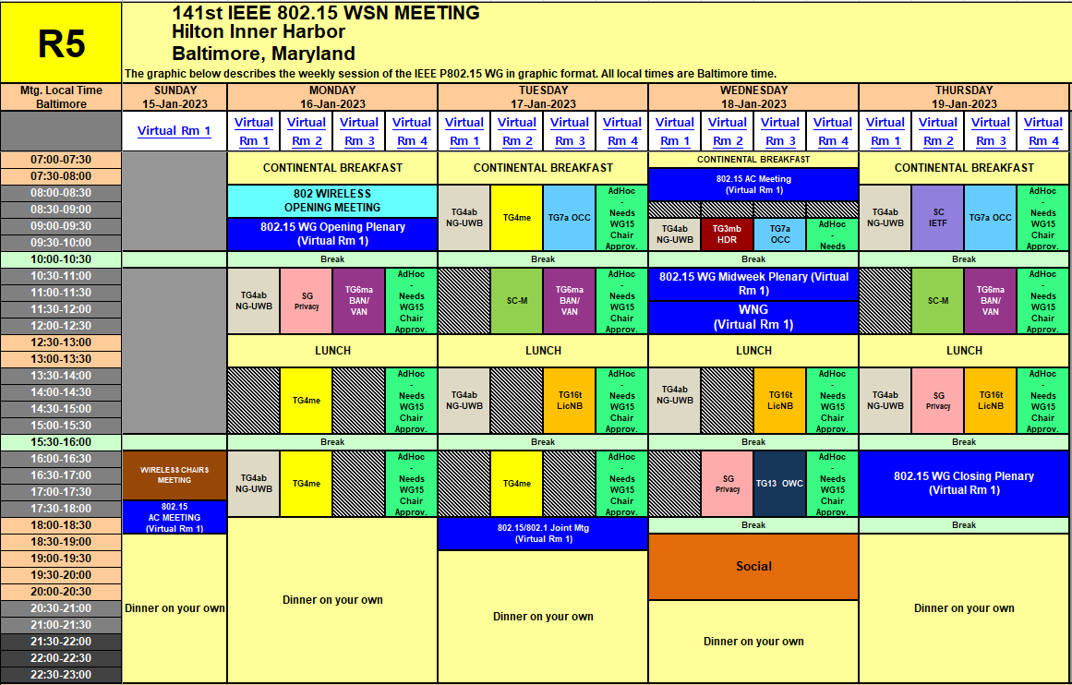
Session Schedule
TG 7a scheduled 3 time slots in this meeting
- Tuesday AM1, Wednesday AM1, Thursday AM1
- Thursday AM1 is cancelled

Slide 5
Accomplishment for the meeting
1st Slot: Tuesday AM1
  Meeting Objectives and Agenda Approval (052-00)
  Approval of CRG Teleconference Minutes - December 07, 2022 (046-00)
  Approval of CRG Teleconference Minutes - December 21, 2022 (047-00)
  Approval of CRG Teleconference Minutes - December 28, 2022 (049-00)
  Presentation-Discussion on the Issues of Draft D2 comments (027-00)
  TG Motion to start WG Letter Ballot Recirculation
  Discussion of WG Motion
  Preparation of LB package document

Slide 6
Accomplishment for the meeting
2nd Slot: Wednesday AM1
  Meeting Objectives and Agenda Approval (052-01)
  Motion to create CRG formation for LB Recirculation
  Discussion of WG Motion
  Discussion of CRG teleconference schedule
  Preparation of Closing Report
3rd Slot: Thursday AM1
  Cancelled

Slide 7
TG Motion #1
TG7a Motion to approve December CRG Teleconference minutes
Motion to approve the December CRG Teleconference minutes of TG7a in IEEE P802.15-23-0046-00-007a, IEEE P802.15-23-0047-00-007a, and IEEE P802.15-23-0049-00-007a
Moved By: Sangsung Choi
Seconded By: Sang-Kyu Lim
Approved by unanimous consent

Slide 8
TG Motion #2
TG Motion to approve comment resolutions for LB192
Move that the TG7a approve the comment resolutions for LB192 as described in document IEEE P802.15-22-0674-03-007a
Moved By: Sangsung Choi
Seconded By: Sang-Kyu Lim
Approved by unanimous consent

Slide 9
TG Motion #3
      TG Motion to start recirculation
Motion that 802.15 WG start a WG recirculation requesting approval of CA document [15-22-0292-r3] and document P802.15.7a/D3 edited as instructed in document IEEE P802.15-22-0674-03-007a and to forward document P802.15.7a/D3, to Standards Association ballot.
Moved By: Sangsung Choi
Seconded By: Sang-Kyu Lim
Approved by unanimous consent

Slide 10
TG Motion #4
    TG Motion to approve the formation of CRG for the WG recirculation ballot
Move that 802.15.7a TG approve the formation of a Comment Resolution Group (CRG) for the WG recirculation balloting of the P802.15.7a/D3 with the following membership: Yeong Min Jang(Chair), Sang-Kyu Lim, Ryuji Kohno, and Seongsoon Joo. The 802.15.7a CRG is authorized to approve comment resolutions, edit the draft according to the comment resolutions, and to approve the start of recirculation ballots of the revised draft on behalf of the 802.15 WG. Comment resolution on recirculation ballots between sessions will be conducted via reflector email and via teleconferences announced to the reflector as per the LMSC 802 WG P&P.
Moved By: Sangsung Choi
Seconded By: Sang-Kyu Lim
Approved by unanimous consent

Slide 11
WG Motion #1
      Draft needs to be edited prior to letter ballot
Move that 802.15 WG start a WG Letter Ballot requesting approval of CA document [15-22-0292-r3] and document P802.15.7a/D3 (as edited in accordance with the instructions in document 15-22-0674-03-007a) and to forward document P802.15.7a/D3, as edited in accordance with the instructions in document 15-22-0674-03-007a, and CA document [15-22-0292-r3] to Standards Association ballot pending the completion and inclusion of the edits in the draft.
Moved By Sangsung Choi
Seconded By Phil Beecher
Approved by

Slide 12
WG Motion #2
    CRG formation for a WG Letter Ballot
Move that 802.15 WG approve the formation of a Comment Resolution Group (CRG) for the WG balloting of the P802.15.7a/D3 with the following membership: Yeong Min Jang(Chair), Sang-Kyu Lim, Ryuji Kohno, and Seongsoon Joo. The 802.15.7a CRG is authorized to approve comment resolutions, edit the draft according to the comment resolutions, and to approve the start of recirculation ballots of the revised draft on behalf of the 802.15 WG. Comment resolution on recirculation ballots between sessions will be conducted via reflector email and via teleconferences announced to the reflector as per the LMSC 802 WG P&P.
Moved By Sangsung Choi
Seconded By Phil Beecher
Approved by

Slide 13
Plan for CRG Teleconference
3 times between February and March 2023
- Feb. 07 Tuesday 07:00 EST(21:00 KST)
- Feb, 21 Tuesday 07:00 EST(21:00 KST)
- Mar. 07 Tuesday 07:00 EST(21:00 KST)

Slide 14
Plan for March Meeting
3 Time Slots (8AM on Tue., Wed., and Thur.)
Complete Comment Resolution of 1st LB Recirculation
Start the 2nd LB Recirculation

