Slide 1
Project: IEEE P802.15 Working Group for Wireless Personal Area Networks (WPANs)
Submission Title: [Updates on UWB Channel Usage Coordination]
Date Submitted: [Jan 2023]
Source: Mingyu LEE, Taeyoung Ha, Youngwan So [Samsung] Lochan Verma [Apple]
E-Mail: [mg0218.lee] @samsung.com
Abstract: Further details on UWB channel usage coordination for better UWB coexistence
Purpose:
Notice: This document has been prepared to assist the IEEE P802.15. It is offered as a basis for discussion and is not binding on the contributing individual(s) or organization(s). The material in this document is subject to change in form and content after further study. The contributor(s) reserve(s) the right to add, amend or withdraw material contained herein.
Release: The contributor acknowledges and accepts that this contribution becomes the property of IEEE and may be made publicly available by P802.15.

Slide 2
PAR Objective | Proposed Solution (how addressed)
Safeguards so that the high throughput data use cases will not cause significant disruption to low duty-cycle ranging use cases | UWB channel usage coordination
Interference mitigation techniques to support higher density and higher traffic use cases | UWB channel usage coordination
Other coexistence improvement | UWB channel usage coordination
Backward compatibility with enhanced ranging capable devices (ERDEVs)
Improved link budget and/or reduced air-time
Additional channels and operating frequencies
Improvements to accuracy / precision / reliability and interoperability for high-integrity ranging
Reduced complexity and power consumption
Hybrid operation with narrowband signaling to assist UWB
Enhanced native discovery and connection setup mechanisms
Sensing capabilities to support presence detection and environment mapping
Low-power low-latency streaming
Higher data-rate streaming allowing at least 50 Mbit/s of throughput
Support for peer-to-peer, peer-to-multi-peer, and station-to-infrastructure protocols
Infrastructure synchronization mechanisms

Slide 3
Introduction
UWB CH usage coordination for better UWB coexistence is nice to have
In [1], UWB CH usage coordination method is presented
In [2], contents of AP (Acquisition Packet) were described
In this contribution, the contents of AP are updated

Slide 4
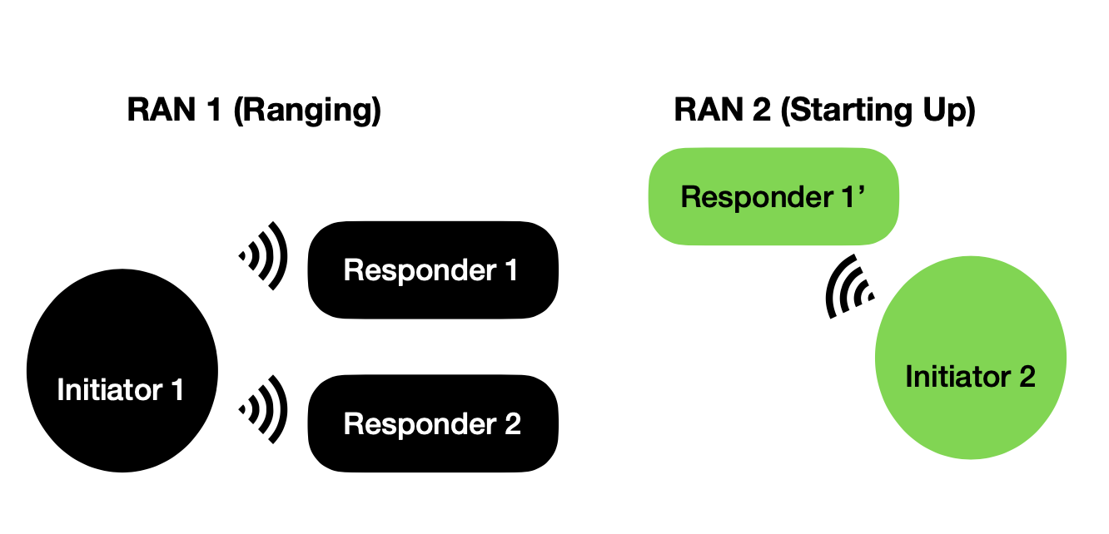
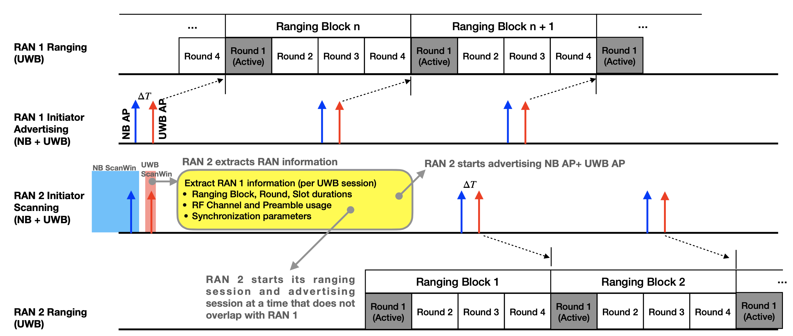
UWB CH Usage Coordination with UWB AP [1]

Slide 5
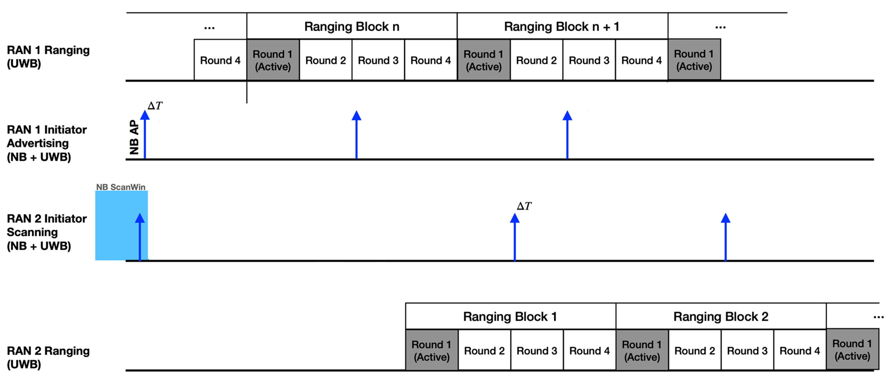
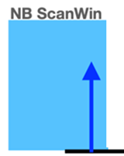

UWB CH Usage Coordination without UWB AP
RAN 2 extracts the active period of RAN 1
- Delta T, remaining time until the start of active round
- Active Round Duration
Active Round
Duration
RAN 2 starts its new session by selecting an idle period which is not overlapped with RAN 1

Slide 6
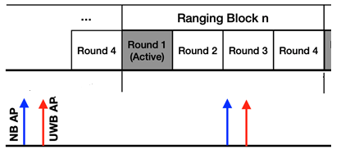
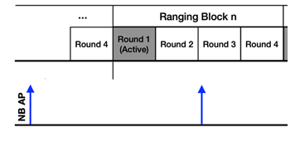
UWB AP Present Field in NB AP
UWB AP Transmission can be indicated by UWB AP Present field
  [ UWB AP Present = 1 ]
  UWB AP sent after each NB AP which includes UWB AP Info field
  [ UWB AP Present = 0 ]
  No UWB AP sent after each NB AP which has NO UWB AP Info field

Slide 7
UWB AP Info Field in NB AP
UWB AP Info is presented if UWB AP Present = 1 [2]
MAC Payload |  | Bits | Bytes | Comments
UWB AP Info field | Delta T | 16 | 2 | Time remaining in RSTU until the start of the next UWB AP relative to the start of the current packet
 | UWB CH | 5 | 1 | UWB CH number on which the UWB AP occurs after Delta T
 | RFU | 3 |  | Unused
 | Preamble Code | 8 | 1 | Preamble code used by UWB AP

Slide 8
UWB Per Session Info Type Field in NB AP
Presence of UWB Session info in NB AP can be indicated by UWB Per Session Info Type Field
UWB session info can be presented regardless of UWB AP transmission
4 Types of UWB session info are available

Slide 9
UWB Per Session Info
  [UWB Per Session Info Type = 0 ]
  UWB Per Session Info field is not presented
  [UWB Per Session Info Type = 1]
  UWB Per Session Info field in [2] is presented. This type requires the minimum set of session info
MAC Payload |  | Bits | Bytes | Comments
Per-Session Info field | Block Duration | 24 | 3 | In RSTU (Ranging Scheduling Time Unit)
 | Session CH | 5 | 1 | UWB CH used by session
 | Hop Mode | 1 |  | 0: no hopping; 1: hopping. Hopping sequence NOT required to be known to all devices
 | RFU | 2 |  | RFU
 | Preamble Code | 8 | 1 | Preamble code used by session

Slide 10
UWB Per Session Info (Cont.)
  [UWB Per Session Info Type = 2 ]
  This type requires the start time and the duration of active period
MAC Payload |  | Bits | Bytes | Comments
Per-Session Info field 1 | Delta T | 24 | 3 | Time remaining in RSTU until the start of active period
 | UWB CH | 5 | 1 | UWB channel used by the UWB session
 | RFU | 3 |  | RFU
 | Preamble Code | 8 | 1 | Preamble code used by UWB session
 | Active Period Duration | 24 | 3 | Duration of active period of UWB session
Active Period
Duration
Active Period
Duration

Slide 11
UWB Per Session Info (Cont.)
  [UWB Per Session Info Type = 3 ]
  This type requires the start time and the duration for the active rounds in a block
MAC Payload |  | Bits | Bytes | Comments
Per-Session Info field | Delta T | 24 | 3 | Time remaining in RSTU until the start of block
 | UWB CH | 5 | 1 | UWB CH used by session
 | Hop Mode | 1 |  | 0: no hopping; 1: hopping. Hopping sequence NOT required to be known to all devices
 | RFU | 2 |  | Unused
 | Preamble Code | 8 | 1 | Preamble code used by session
 | Round Duration | 24 | 3 | Round duration in a block of UWB session
 | Number of Rounds in a Block | 8 | 1 | In units of rounds
 | Active Rounds | 24 | 3 | Bitmap indicates the index of active rounds

Slide 12
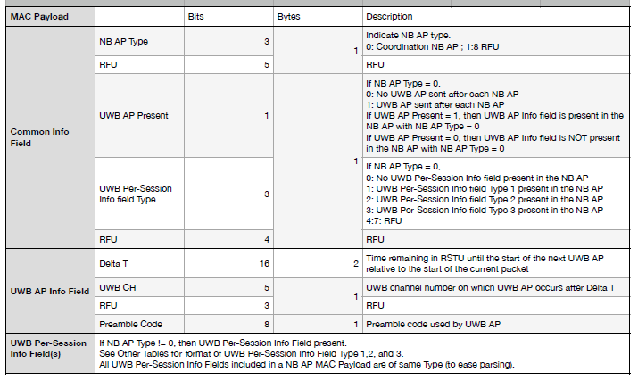
NB AP Payload

Slide 13
UWB Per Session Info in UWB AP
Type of UWB Session info in UWB AP can be indicated by UWB Per Session Info Type Field
UWB AP can includes UWB Per Session Info Type 1, 2, and 3 as in NB AP

Slide 14
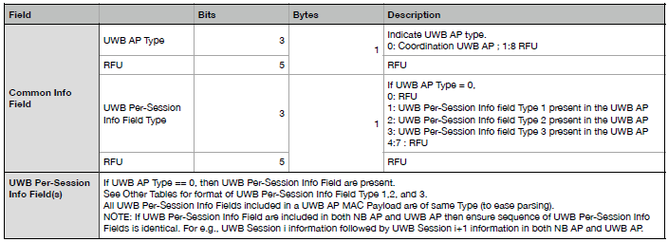
UWB AP Payload

Slide 15
Summary
This presentation provided updates on UWB CH usage coordination through AP [1][2]
If AP includes the UWB Per Session Info type with the start time and duration of active round(s), the collision between sessions can be avoided by selecting a proper start time of new session

Slide 16
References
[1] 15-22-0456-00-04ab, UWB Channel Usage Coordination for better UWB Coexistence
[2] 15-22-0573-01-04ab Follow-up on UWB Channel Usage Coordination

