Slide 1
Project: IEEE P802.15 Working Group for Wireless Personal Area Networks (WPANs)
Submission Title: LDPC Results for different PHR designs in 802.15.4ab
Source: Carlos Aldana (Meta), Carlos Bocanegra (Meta), Jack Zou (Meta)
Address : [1 Hacker Way, Menlo Park, CA 94025]
E-Mail: [caldana (at) meta.com, cbocanegra (at) meta.com, jackzou (at) meta.com]
Re: Study Group 4ab: UWB Next Generation
Abstract: [LDPC results for different PHR designs using 7.8 and 1.95 Mbps]
Purpose:
Notice: This document has been prepared to assist the IEEE P802.15. It is offered as a basis for discussion and is not binding on the contributing individual(s) or organization(s). The material in this document is subject to change in form and content after further study. The contributor(s) reserve(s) the right to add, amend or withdraw material contained herein.
Release: The contributor acknowledges and accepts that this contribution becomes the property of IEEE and may be made publicly available by P802.15.
Notes:
Jul 12, 2010
Page 1

Slide 2
Technical Guidance
PAR Objective | Proposed Solution (how addressed)
Safeguards so that the high throughput data use cases will not cause significant disruption to low duty-cycle ranging use cases.
Interference mitigation techniques to support higher density and higher traffic use cases
Other coexistence improvement
Backward compatibility with enhanced ranging capable devices (ERDEVs).
Improved link budget and/or reduced air-time | advanced codes provide improved link budgets
Additional channels and operating frequencies
Improvements to accuracy / precision / reliability and interoperability for high-integrity ranging;
Reduce complexity and power consumption;
Hybrid operation with narrowband signaling to assist UWB;
Enhanced native discovery and connection setup mechanisms;
Sensing capabilities to support presence detection and environment mapping;
Low-power low-latency streaming | advanced codes could be used for this case
higher data-rate streaming allowing at least 50 Mbit/s of throughput. | advanced codes will help enable this use case
Support for peer-to-peer, peer-to-multi-peer, and station-to-infrastructure protocols;
Infrastructure synchronization mechanisms.

Slide 3
Background
In 15-21-506-05 we described the latest LDPC results using 802.11n codes and provided
an initial set of results for joint PHR and LDPC using genie preamble, SYNC detection and perfect chanest
Various works have been devoted to PHR
In 15-21-475-01 we described a possible PHR for data communications where we discussed having a PHR having fixed data rates of either 7.8 Mbps, 1.95 Mbps, or 0.975 Mbps
In 15-22-653-00, an updated PHR proposal was made, where PHR is split into PHR1 and PHR2, with PHR1 being transmitted at 1.95 Mbps
In 15-22-691-00, PHR1, composed of 3 bits is mapped to a table and remaining bits are sent in PHR2.
In this work, we look at simulation results how 802.11n LDPC codes behave for 1.95 and 7.8 Mbps under various conditions for AWGN channels
Goal is to make a recommendation on PHR rate and LDPC transition points as well as examine the tradeoff of various SYNC repetition values.

Slide 4
Background
475-01 [1] PHR proposal
28 bits (including 8 CRC bits) using the same modulation as data, but with 2/3/4 repetitions for each symbol
653-0 [2] PHR proposal
PHR1 – 4 bits at rate 1.95Mb/s
PHR2 – 23 bits using the same modulation as data, but with 2/3/4 repetitions for each symbol
691-0 [3] PHR proposal
PHR1 – 3 bits mapped to 32 “coded” bits at rate 1.95Mb/s
PHR2 – 24 remaining bits are sent at either 2 or 4 repetitions

Slide 5
Simulation Assumptions
AWGN channel
Nsync preamble symbols using length 91 code
Non-coherent SYNC detector with half of the symbols used for preamble detection
No CFO and no phase noise
Perfect chanest
Imperfect SFD and PHR
Various SYNC reps are considered
Results are the 1% SNR point after gating gain has been taken into account
We consider 2,3, and 4 PHR reps, per the table below
PHR data rate (Mbps)
Num PHR reps/PHY data rate | 1.95 Mbps PHY rate | 7.8 Mbps PHY rate
2 reps | 0.975 Mbps | 3.9 Mbps
3 reps | 0.65 Mbps | 2.6 Mbps
4 reps | 0.4875 Mbps | 1.95 Mbps

Slide 6
Note : Red is best,
blue is second best
Bold is absolute best
Data Rate 7.8 Mb/s, PHR (BCC vs. LDPC) w (SYNC,SFD)=(32,8) using [2]
Payload Size (bytes) | Legacy (BCC, 19-bit legacy PHR) (Legacy) | Legacy (BCC, 19-bit legacy PHR) (Legacy) | Legacy (BCC, 19-bit legacy PHR) (Legacy) |  | LDPC (0.975Mb/s 4-bit PHR1, 23-bit PHR2 2 rep.) [2] | LDPC (0.975Mb/s 4-bit PHR1, 23-bit PHR2 3 rep.) [2] | LDPC (0.975Mb/s 4-bit PHR1, 23-bit PHR2 4 rep.) [2] | LDPC (1.95Mb/s 4-bit PHR1, 23-bit PHR2 2 rep.) [2] | LDPC (1.95Mb/s 4-bit PHR1, 23-bit PHR2 3 rep.) [2] | LDPC (1.95Mb/s 4-bit PHR1, 23-bit PHR2 4 rep.) [2]
 | sync = 32, sfd = 8 | sync = 64, sfd = 8 | sync = 128, sfd = 32 |  | sync = 32, sfd = 8 | sync = 32, sfd = 8 | sync = 32, sfd = 8 | sync = 32, sfd = 8 | sync = 32, sfd = 8 | sync = 32, sfd = 8
30 | -26.80dB / 63.91us | -25.48dB / 87.24us | -23.23dB / 151.41us | 648 LDPC | -27.84dB / 83.01us | -27.65dB / 86.73us | -27.47dB / 90.45us | -28.08dB / 77.88us | -27.90dB / 81.60us | -27.75dB / 85.32us
30 | -26.80dB / 63.91us | -25.48dB / 87.24us | -23.23dB / 151.41us | 1296 LDPC | -28.77dB / 103.78us | -28.78dB / 107.50us | -28.63dB / 111.22us | -28.95dB / 98.65us | -29.02dB / 102.37us | -28.84dB / 106.09us
 |  |  |  | 1944LDPC | -28.23dB / 124.55us | -28.95dB / 128.27us | -28.84dB / 131.99us | -28.38dB / 119.42us | -29.11dB / 123.14us | -29.06dB / 126.86us
60 | -24.79dB / 94.68us | -23.86dB / 118.01us | -22.11dB / 182.18us | 648 LDPC | -26.11dB / 119.17us | -25.96dB / 122.88us | -25.83dB / 126.60us | -26.26dB / 114.04us | -26.15dB / 117.76us | -26.01dB / 121.47us
60 | -24.79dB / 94.68us | -23.86dB / 118.01us | -22.11dB / 182.18us | 1296 LDPC | -26.61dB / 119.17us | -26.47dB / 122.88us | -26.34dB / 126.60us | -26.74dB / 114.04us | -26.63dB / 117.76us | -26.51dB / 121.47us
 |  |  |  | 1944 LDPC | -27.00dB / 139.94us | -27.02dB / 143.65us | -26.91dB / 147.37us | -27.20dB / 134.81us | -27.13dB / 138.53us | -27.02dB / 142.24us
Both 30 and 60 bytes are optimized by 1944 LDPC.
For 30 bytes, 3 PHR reps is optimal and for 60 bytes, 2 PHR reps is optimal.
2.3 dB LDPC gain (over BCC) seen in 30 bytes and 2.4 dB seen in 60 bytes
Note that 0.16 dB loss is seen if we go from 3 PHR reps to 2 PHR reps in 30 bytes.

Slide 7
Note : Red is best,
blue is second best
Bold is absolute best
Data Rate 7.8 Mb/s, PHR (BCC vs. LDPC) w (SYNC,SFD)=(64,8) using [2]
Payload Size (bytes) | Legacy (BCC, legacy PHR) (Legacy) | Legacy (BCC, legacy PHR) (Legacy) | Legacy (BCC, legacy PHR) (Legacy) |  | 1944-LDPC (0.975Mb/s PHR1, PHR2 2 rep.) [2] | 1944-LDPC (0.975Mb/s PHR1, PHR2 3 rep.) [2] | 1944-LDPC (0.975Mb/s PHR1, PHR2 4 rep.) [2] | 1944-LDPC (1.95Mb/s PHR1, PHR2 2 rep.) [2] | 1944-LDPC (1.95Mb/s PHR1, PHR2 3 rep.) [2] | 1944-LDPC (1.95Mb/s PHR1, PHR2 4 rep.) [2]
 | sync = 32, sfd = 8 | sync = 64, sfd = 8 | sync = 128, sfd = 32 |  | sync = 64, sfd = 8 | sync = 64, sfd = 8 | sync = 64, sfd = 8 | sync = 64, sfd = 8 | sync = 64, sfd = 8 | sync = 64, sfd = 8
30 | -26.80dB / 63.91us | -25.48dB / 87.24us | -23.23dB / 151.41us | 648 LDPC | -26.83dB / 106.35us | -26.70dB / 110.06us | -26.56dB / 113.78us | -27.06dB / 101.22us | -26.86dB / 104.94us | -26.76dB / 108.65us
30 | -26.80dB / 63.91us | -25.48dB / 87.24us | -23.23dB / 151.41us | 1296 LDPC | -27.98dB / 127.12us | -27.99dB / 130.83us | -27.89dB / 134.55us | -28.11dB / 121.99us | -28.16dB / 125.71us | -28.07dB / 129.42us
 |  |  |  | 1944LDPC | -27.58dB / 147.88us | -28.34dB / 151.60us | -28.28dB / 155.32us | -27.71dB / 142.76us | -28.49dB / 146.47us | -28.46dB / 150.19dB
60 | -24.79dB / 94.68us | -23.86dB / 118.01us | -22.11dB / 182.18us | 648 LDPC | -25.37dB / 142.50us | -25.25dB / 146.22us | -25.15dB / 149.94us | -25.54dB / 137.37us | -25.44dB / 141.09us | -25.28dB / 144.81us
60 | -24.79dB / 94.68us | -23.86dB / 118.01us | -22.11dB / 182.18us | 1296 LDPC | -25.85dB / 142.50us | -25.75dB / 146.22us | -25.64dB / 149.94us | -26.05dB / 137.37us | -25.90dB / 141.09us | -25.83dB / 144.81us
 |  |  |  | 1944 LDPC | -26.44dB / 163.27us | -26.43dB / 166.99dB | -26.26dB / 170.71us | -26.59dB / 158.14us | -26.50dB / 161.86us | -26.39dB / 165.58us
(64,8) combination is worse than (32,8) combination
Both 30 and 60 bytes are optimized by 1944 LDPC
3 dB gain seen in 30 bytes and 2.7 dB seen in 60 bytes
h

Slide 8
Note : Red is best,
blue is second best
purple is third best
Data Rate 7.8Mb/s, PHR ([1] vs. [2] vs [3])
Payload Size (bytes) | Legacy (BCC, 19-bit legacy PHR) (Legacy) | Legacy (BCC, 19-bit legacy PHR) (Legacy) | Legacy (BCC, 19-bit legacy PHR) (Legacy) |  | LDPC (1.95Mb/s 4-bit PHR1, 23-bit PHR2 2 rep.) [2] | LDPC (1.95Mb/s 4-bit PHR1, 23-bit PHR2 3 rep.) [2] | LDPC (28-bit PHR, 2 rep.) [1] | LDPC (28-bit PHR, 3 rep.) [1] | LDPC (1.95Mb/s 32-bit coded PHR1, 24-bit PHR2 2 rep.) [3] | LDPC (1.95Mb/s 32-bit coded PHR1, 24-bit PHR2 4 rep.) [3]
 | sync = 32, sfd = 8 | sync = 64, sfd = 8 | sync = 128, sfd = 32 |  | sync = 32, sfd = 8 | sync = 32, sfd = 8 | sync = 32, sfd = 8 | sync = 32, sfd = 8 | sync = 32, sfd = 8 | sync = 32, sfd = 8
30 | -26.80dB / 63.91us | -25.48dB / 87.24us | -23.23dB / 151.41us | 648 LDPC | -28.08dB / 77.88us | -27.90dB / 81.60us | -28.36dB / 74.04us | -28.11dB / 78.40us | -27.96dB / 81.22us | -27.51dB 88.91us
30 |  |  |  | 1296 LDPC | -28.95dB / 98.65us | -29.02dB / 102.37us | -29.09dB / 94.81us | -29.15dB / 99.17us | -28.86dB / 101.99us | -28.69dB / 109.68us
 |  |  |  | 1944LDPC | -28.38dB / 119.42us | -29.11dB / 123.14us | -28.38dB 115.58us | -29.21dB / 119.94us | -28.15dB / 122.76us | -28.90dB / 130.45us
60 | -24.79dB / 94.68us | -23.86dB / 118.01us | -22.11dB / 182.18us | 648 LDPC | -26.26dB / 114.04us | -26.15dB / 117.76us | -26.45dB / 110.19us | -26.22dB / 114.55us | -26.16dB / 117.37us | -25.88dB / 125.06us
60 |  |  |  | 1296 LDPC | -26.74dB / 114.04us | -26.63dB / 117.76us | -26.95dB / 110.19us | -26.74dB / 114.55us | -26.64dB / 117.37us | -26.39dB / 125.06us
 |  |  |  | 1944 LDPC | -27.20dB / 134.81us | -27.13dB / 138.53us | -27.32dB / 130.96us | -27.25dB / 135.32us | -27.10dB / 138.14us | -26.90dB / 145.83us
2 PHR repetitions are better
3 PHR repetitions are better
If parametrized correctly, PHR formats perform roughly the same.
2 or 3 PHR repetitions is best.
.

Slide 9
The LDPC performance is limited by preamble performance.
Data Rate 1.95Mb/s, PHR (BCC vs. LDPC) with (SYNC,SFD) = (32,8) using [2]
Payload Size (bytes) | Legacy (BCC, 19-bit legacy PHR) (Legacy) | Legacy (BCC, 19-bit legacy PHR) (Legacy) | Legacy (BCC, 19-bit legacy PHR) (Legacy) |  | LDPC (0.975Mb/s 4-bit PHR1, 23-bit PHR2 2 rep.) [2] | LDPC (0.975Mb/s 4-bit PHR1, 23-bit PHR2 3 rep.) [2] | LDPC (0.975Mb/s 4-bit PHR1, 23-bit PHR2 4 rep.) [2] | LDPC (1.95Mb/s 4-bit PHR1, 23-bit PHR2 2 rep.) [2] | LDPC (1.95Mb/s 4-bit PHR1, 23-bit PHR2 3 rep.) [2] | LDPC (1.95Mb/s 4-bit PHR1, 23-bit PHR2 4 rep.) [2]
 | sync = 32, sfd = 8 | sync = 64, sfd = 8 | sync = 128, sfd = 32 |  | sync = 32, sfd = 8 | sync = 32, sfd = 8 | sync = 32, sfd = 8 | sync = 32, sfd = 8 | sync = 32, sfd = 8 | sync = 32, sfd = 8
30 | -28.05dB / 168.14us | -27.93dB / 191.47us | -26.87dB / 255.64us | 648 LDPC | -27.06dB / 213.78us | -26.80dB / 228.65us | -26.49dB / 243.53us | -27.19dB / 208.65us | -26.87dB / 223.53us | -26.61dB / 238.40us
30 | -28.05dB / 168.14us | -27.93dB / 191.47us | -26.87dB / 255.64us | 1296 LDPC | -25.68dB / 296.86us | -25.39dB / 311.73us | -25.17dB / 326.60dB | -25.68dB / 291.73us | -25.48dB / 306.50us | -25.26dB / 321.47us
 |  |  |  | 1944LDPC | -24.54dB / 379.94us | -24.39dB / 394.81us | -24.20dB / 409.68us | -24.62dB / 374.81us | -24.45dB / 389.68us | -24.30dB / 404.55us
60 | -25.58dB / 291.22us | -25.50dB / 314.55us | -24.77dB / 378.72us | 648 LDPC | -24.74dB / 358.40us | -24.61dB / 373.27us | -24.48dB / 388.14us | -24.93dB / 353.27us | -24.68dB / 368.14us | -24.50dB / 383.01us
60 | -25.58dB / 291.22us | -25.50dB / 314.55us | -24.77dB / 378.72us | 1296 LDPC | -24.83dB / 358.40us | -24.67dB / 373.27us | -24.49dB / 388.14us | -24.87dB / 353.27us | -24.66dB / 368.14us | -24.52dB / 383.01dB
 |  |  |  | 1944 LDPC | -23.91dB / 441.47us | -23.82dB / 456.35us | -23.58dB / 471.22us | -23.98dB / 436.35us | -23.83dB / 451.22us | -23.67dB / 466.09us
2nd Best sensitivity SNR
1st Best sensitivity SNR
PHR1 at 1.95 Mbps PHR1 is better than 0.975 Mbps
For this case, 2 repetitions is the best

Slide 10
Data Rate 1.95Mb/s, PHR (BCC vs. LDPC) with (SYNC,SFD) = (64,8) using [2]
Payload Size (bytes) | Legacy (BCC, 19-bit legacy PHR) (Legacy) | Legacy (BCC, 19-bit legacy PHR) (Legacy) | Legacy (BCC, 19-bit legacy PHR) (Legacy) |  | LDPC (0.975Mb/s 4-bit PHR1, 23-bit PHR2 2 rep.) [2] | LDPC (0.975Mb/s 4-bit PHR1, 23-bit PHR2 3 rep.) [2] | LDPC (0.975Mb/s 4-bit PHR1, 23-bit PHR2 4 rep.) [2] | LDPC (1.95Mb/s 4-bit PHR1, 23-bit PHR2 2 rep.) [2] | LDPC (1.95Mb/s 4-bit PHR1, 23-bit PHR2 3 rep.) [2] | LDPC (1.95Mb/s 4-bit PHR1, 23-bit PHR2 4 rep.) [2]
 | sync = 32, sfd = 8 | sync = 64, sfd = 8 | sync = 128, sfd = 32 |  | sync = 64, sfd = 8 | sync = 64, sfd = 8 | sync = 64, sfd = 8 | sync = 64, sfd = 8 | sync = 64, sfd = 8 | sync = 64, sfd = 8
30 | -28.05dB / 168.14us | -27.93dB / 191.47us | -26.87dB / 255.64us | 648 LDPC | -28.10dB / 237.12us | -27.82dB / 251.99us | -27.63dB / 266.86us | -28.29dB / 231.99us | -28.00dB / 246.86us | -27.78dB / 261.73us
30 | -28.05dB / 168.14us | -27.93dB / 191.47us | -26.87dB / 255.64us | 1296 LDPC | -26.76dB / 320.19us | -26.57dB / 335.06us | -26.36dB / 349.94us | -26.84dB / 315.06us | -26.72dB / 329.94us | -26.45dB / 344.81us
 |  |  |  | 1944LDPC | -25.81dB / 403.27us | -25.65dB / 418.14us | -25.47dB / 433.01us | -25.82dB / 398.14us | -25.66dB / 413.01us | -25.56dB / 427.88us
60 | -25.58dB / 291.22us | -25.50dB / 314.55us | -24.77dB / 378.72us | 648 LDPC | -26.08dB / 381.73us | -25.95dB / 396.60us | -25.71dB / 411.47us | -26.11dB / 376.60us | -25.97dB / 391.47us | -25.79dB / 406.35us
60 | -25.58dB / 291.22us | -25.50dB / 314.55us | -24.77dB / 378.72us | 1296 LDPC | -26.11dB / 381.73us | -25.91dB / 396.60us | -25.74dB / 411.47us | -26.17dB / 376.60us | -25.99dB / 391.47us | -25.79dB / 406.35us
 |  |  |  | 1944 LDPC | -25.23dB / 464.81us | -25.06dB / 479.68us | -24.90dB / 494.55us | -25.25dB / 459.68us | -25.15dB / 474.55us | -24.98dB / 489.42us
2nd Best sensitivity SNR
1st Best sensitivity SNR
(64,8) combination is better than (32,8) combination

Slide 11
Data Rate 1.95Mb/s, PHR (BCC vs. LDPC) with (SYNC,SFD) = (128,32) using [2]
Payload Size (bytes) | Legacy (BCC, 19-bit legacy PHR) (Legacy) | Legacy (BCC, 19-bit legacy PHR) (Legacy) | Legacy (BCC, 19-bit legacy PHR) (Legacy) |  | LDPC (0.975Mb/s 4-bit PHR1, 23-bit PHR2 2 rep.) [2] | LDPC (0.975Mb/s 4-bit PHR1, 23-bit PHR2 3 rep.) [2] | LDPC (0.975Mb/s 4-bit PHR1, 23-bit PHR2 4 rep.) [2] | LDPC (1.95Mb/s 4-bit PHR1, 23-bit PHR2 2 rep.) [2] | LDPC (1.95Mb/s 4-bit PHR1, 23-bit PHR2 3 rep.) [2] | LDPC (1.95Mb/s 4-bit PHR1, 23-bit PHR2 4 rep.) [2]
 | sync = 32, sfd = 8 | sync = 64, sfd = 8 | sync = 128, sfd = 32 |  | sync = 128, sfd = 32 | sync = 128, sfd = 32 | sync = 128, sfd = 32 | sync = 128, sfd = 32 | sync = 128, sfd = 32 | sync = 128, sfd = 32
30 | -28.05dB / 168.14us | -27.93dB / 191.47us | -26.87dB / 255.64us | 648 LDPC | -28.27dB / 301.28us | -28.01dB / 316.15us | -27.81dB / 331.03us | -28.30dB / 296.15us | -28.05dB / 311.03us | -27.84dB / 325.90us
30 | -28.05dB / 168.14us | -27.93dB / 191.47us | -26.87dB / 255.64us | 1296 LDPC | -27.73dB / 384.36us | -27.57dB / 399.23us | -27.40dB / 414.10us | -27.66dB / 379.23us | -27.57dB / 394.10us | -27.39dB / 408.97us
 |  |  |  | 1944LDPC | -26.90dB / 467.44us | -26.77dB / 482.31us | -26.67dB/ 497.18us | -26.84dB / 462.31us | -26.72dB / 477.18us | -26.57dB / 492.05us
60 | -25.58dB / 291.22us | -25.50dB / 314.55us | -24.77dB / 378.72us | 648 LDPC | -26.38dB / 445.90us | -26.21dB / 460.77us | -26.08dB / 475.64us | -26.38dB / 440.77us | -26.23dB / 455.64us | -26.06dB / 470.51us
60 | -25.58dB / 291.22us | -25.50dB / 314.55us | -24.77dB / 378.72us | 1296 LDPC | -26.84dB / 445.90us | -26.69dB / 460.77us | -26.53dB / 475.64us | -26.79dB / 440.77us | -26.65dB / 455.64us | -26.48dB / 470.51us
 |  |  |  | 1944 LDPC | –26.30dB / 528.97us | -26.26dB / 543.85us | -26.15dB / 558.72us | 26.22dB / 523.85us | -26.07dB / 538.72us | -25.96dB / 553.59us
(128,32) combination is better than (64,8) combination
For 30 bytes and 60 bytes, 2 PHR2 reps is optimal.
Minimal LDPC gain over BCC seen in 30 bytes and 1.3 dB gain seen in 60 bytes

Slide 12
Data Rate 1.95Mb/s, PHR ([1] vs [2] vs [3]) with (SYNC,SFD)=(128,32)
Payload Size (bytes) | Legacy (BCC, 19-bit legacy PHR) (Legacy) | Legacy (BCC, 19-bit legacy PHR) (Legacy) | Legacy (BCC, 19-bit legacy PHR) (Legacy) |  | LDPC (0.975Mb/s 4-bit PHR1, 23-bit PHR2 2 rep.) [2] | LDPC (1.95Mb/s 4-bit PHR1, 23-bit PHR2 2 rep.) [2] | LDPC (28-bit PHR, 2 rep.) [1] | LDPC (28-bit PHR, 3 rep.) [1] | LDPC (1.95Mb/s 32-bit coded PHR1, 24-bit PHR2 2 rep.) [3] | LDPC (1.95Mb/s 32-bit coded PHR1, 24-bit PHR2 4 rep.) [3]
 | sync = 32, sfd = 8 | sync = 64, sfd = 8 | sync = 128, sfd = 32 |  | sync = 128, sfd = 32 | sync = 128, sfd = 32 | sync = 128, sfd = 32 | sync = 128, sfd = 32 | sync = 128, sfd = 32 | sync = 128, sfd = 32
30 | -28.05dB / 168.14us | -27.93dB / 191.47us | -26.87dB / 255.64us | 648 LDPC | -28.27dB / 301.28us | -28.30dB / 296.15us | -28.35dB / 296.15us | -28.09dB / 313.59us | -28.26dB / 300.26us | -27.81dB / 331.03us
30 |  |  |  | 1296 LDPC | -27.73dB / 384.36us | -27.66dB / 379.23us | -27.80dB / 379.23us | -27.59dB / 396.67us | -27.76dB / 383.33us | -27.41dB 414.10us
 |  |  |  | 1944LDPC | -26.90dB / 467.44us | -26.84dB / 462.31us | -26.92dB / 462.31us | -26.84dB / 479.74us | -26.90dB 466.41us | -26.61dB 497.18us
60 | -25.58dB / 291.22us | -25.50dB / 314.55us | -24.77dB / 378.72us | 648 LDPC | -26.38dB / 445.90us | -26.38dB / 440.77us | -26.45dB / 440.77us | -26.25dB / 458.21us | -26.39dB / 444.87us | -26.07dB / 475.64us
 |  |  |  | 1296 LDPC | -26.84dB / 445.90us | -26.79dB / 440.77us | -26.89dB / 440.77us | -26.70dB / 458.21us | -26.81dB / 444.87us | -26.53dB 475.64us
 |  |  |  | 1944 LDPC | –26.30dB / 528.97us | 26.22dB / 523.85us | -26.40dB / 523.85us | -26.24dB / 541.28us | -26.35dB / 527.95us | -26.16dB / 558.72us
Best configurations from previous slides
Difference is within 0.1dB
If parametrized correctly, PHR formats perform roughly the same.
2 PHR repetitions is best

Slide 13
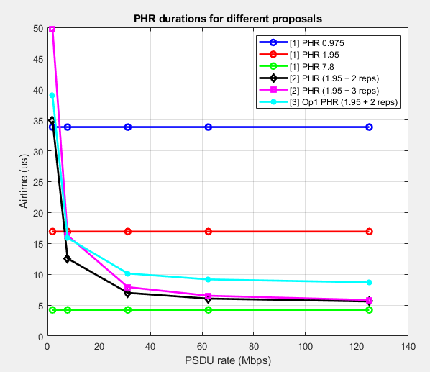
[1] vs [2] vs [3] PHR Airtime
27 total bits in PHR ([1] : 27, [2]: 4+23, [3]: 3+24)
[1] provides 3 static modes where [2] and [3] provide dynamic PHR airtime

Slide 14
1.95 (128,32) vs 7.8Mbps (32,8)
PHR [1]
LDPC

Slide 15
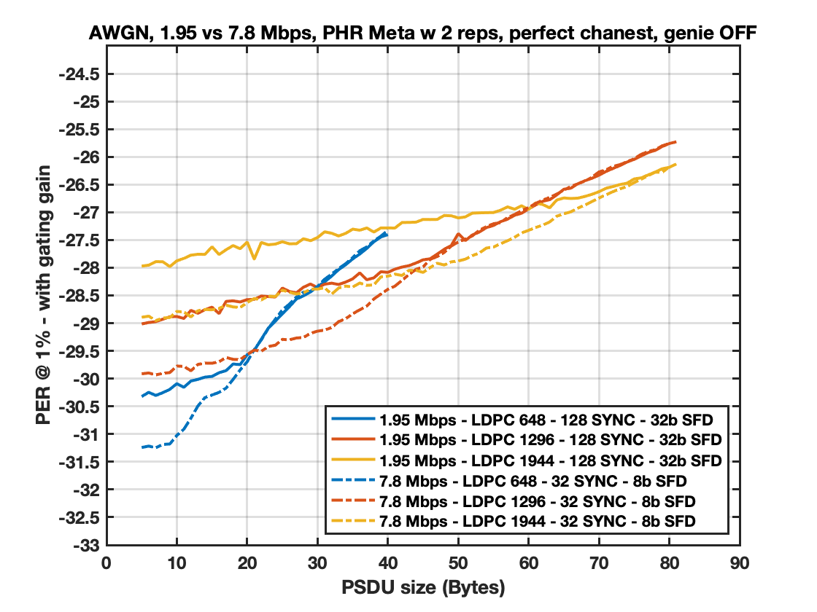
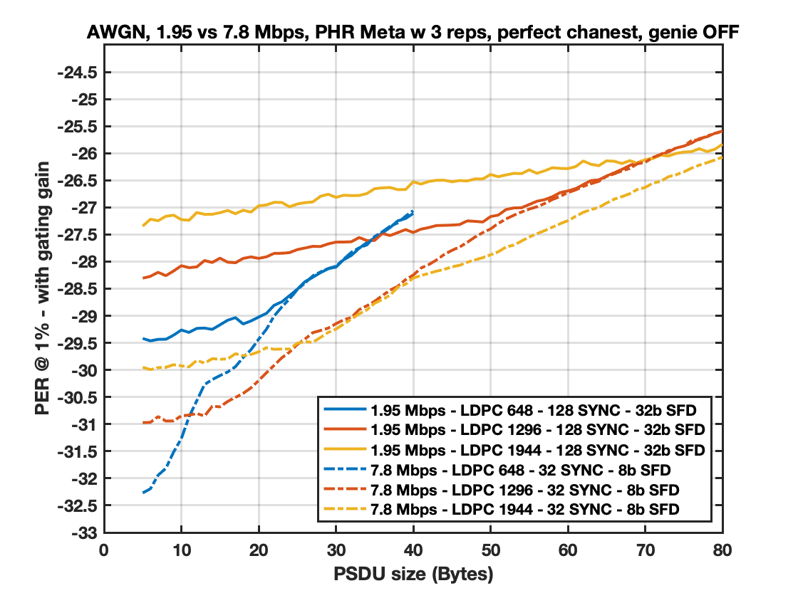
Non coherent detector for 2 and 3 PHR reps – Short Packets
For payloads less than 80 bytes, 1.95 Mbps offers a performance worse or equal than 7.8Mbps
The problem stems from deficiencies at preamble detection when operating at a very low SNR
Slide 15

Slide 16
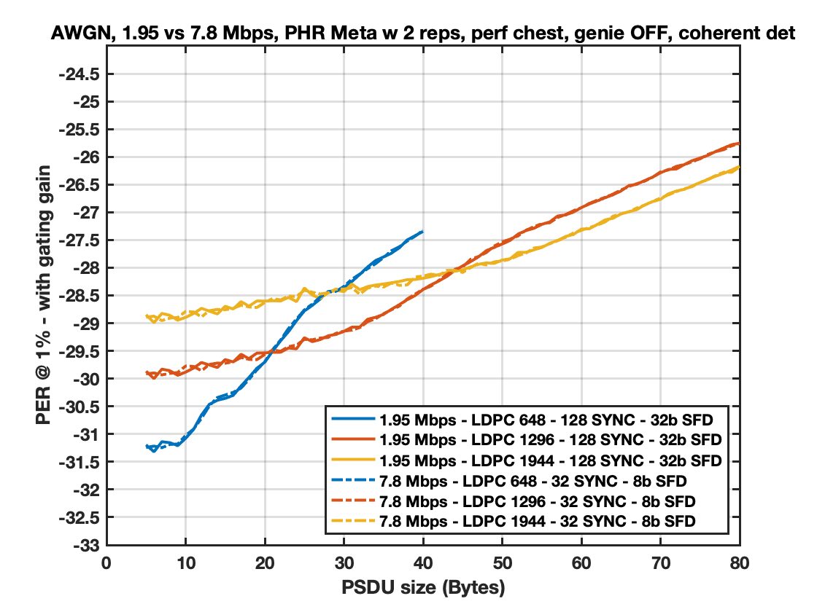
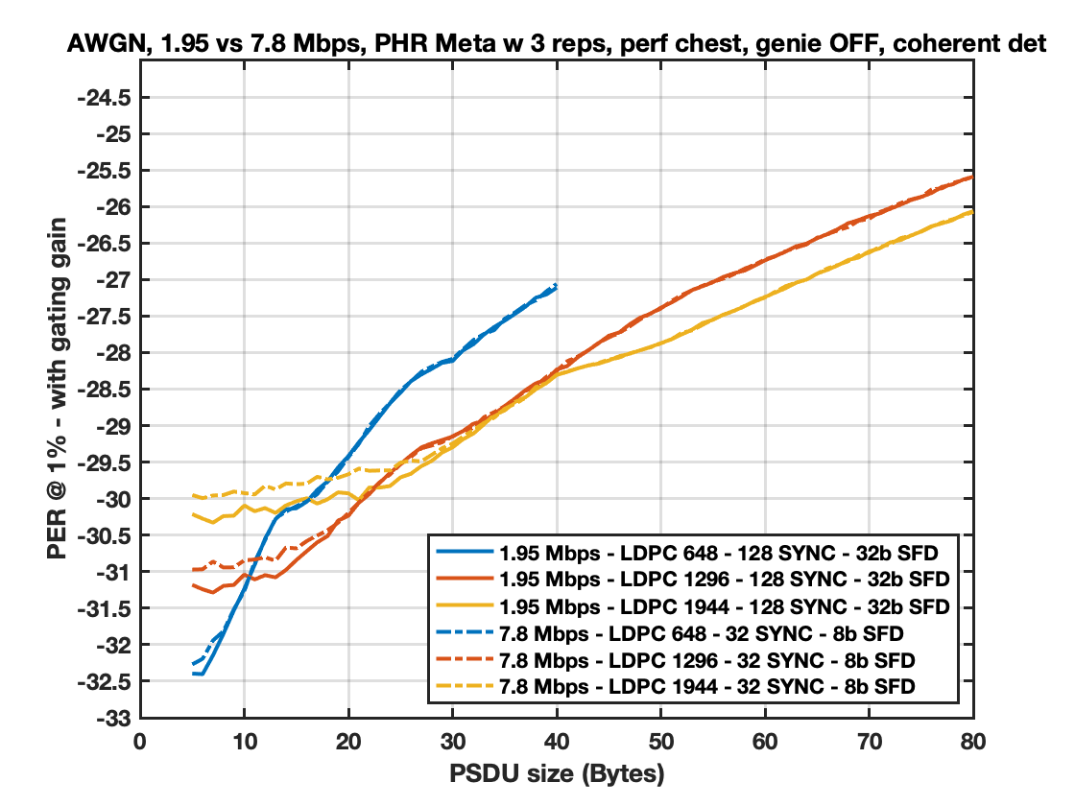
Coherent detector for 2 and 3 PHR reps – Short Packets
For 3PHR reps and payloads less than 30 bytes, 1.95 Mbps offers a better performance than 7.8Mbps
For 2PHR reps and payloads less than 80 bytes, 1.95 Mbps offers same performance
Coherent detector improves 1.95 Mbps performance significantly
The preamble detector for 1.95 Mbps plays a major role in performance.
Slide 16

Slide 17
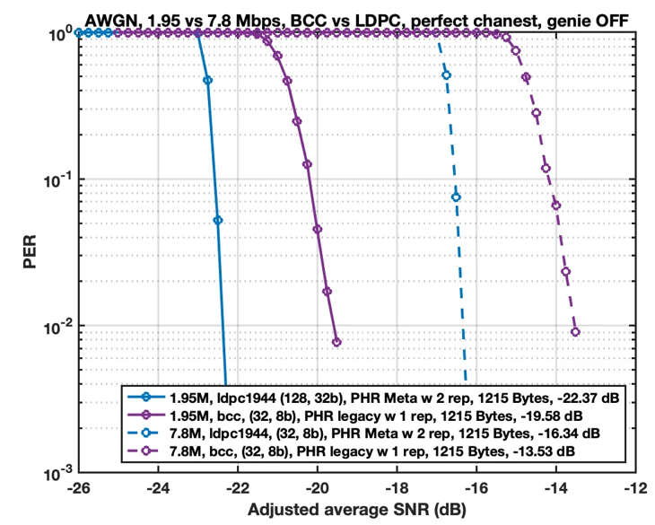
1.95 vs 7.8 for Long Packets (2 PHR Reps)
6dB gain for 1.95 Mbps LDPC vs 7.8 Mbps LDPC can be seen for long packets
2.8dB gain for LDPC vs BCC can be seen for long packets, for both 7.8 and 1.95
~8.8dB gain over 7.8 BCC can be expected when both 1.95 and LDPC are enabled

Slide 18
Conclusions
For low SNR, the performance of 1.95 Mbps LDPC is heavily dependent on preamble detector. Coherent detector performs much better than non-coherent detector.
For the data rates 1.95 and 7.8Mb/s,
2 PHR repetitions seems to be like a good compromise
PHR performances from [1],[2],and [3] are roughly the same
If 2 repetitions is agreed on
the LDPC design is simplified so that we have a PHY rate independent LDPC specification.
the LDPC transition point from 648 to 1296 seems to be between 18-20 bytes and the transition point from 1296 to 1944 seems to be from 40-43 bytes (see Appendix)

Slide 19
Appendix

Slide 20
References
[1] 475-01 PHR Content and rate
[2] 653-00 An updated PHY Header Proposal
[3] 691-00 More on PHR considerations

Slide 21
Preamble Detection
Consider the following 2 preamble detection methods
“Coherent Detection” - Long (multi-symbol) correlation
“Non-Coherent Detection” Sum of absolute values (p=1) (or its squared with p=2) of symbol correlator outputs
The 2nd detector is more robust to carrier frequency offset
s[n], n = 0, 1, …, KL-1, is the preamble symbol sequence
K – preamble code length
L – spreading factor
J – number of preamble symbols
used for detection
x[n] is the received signal
p

Slide 22
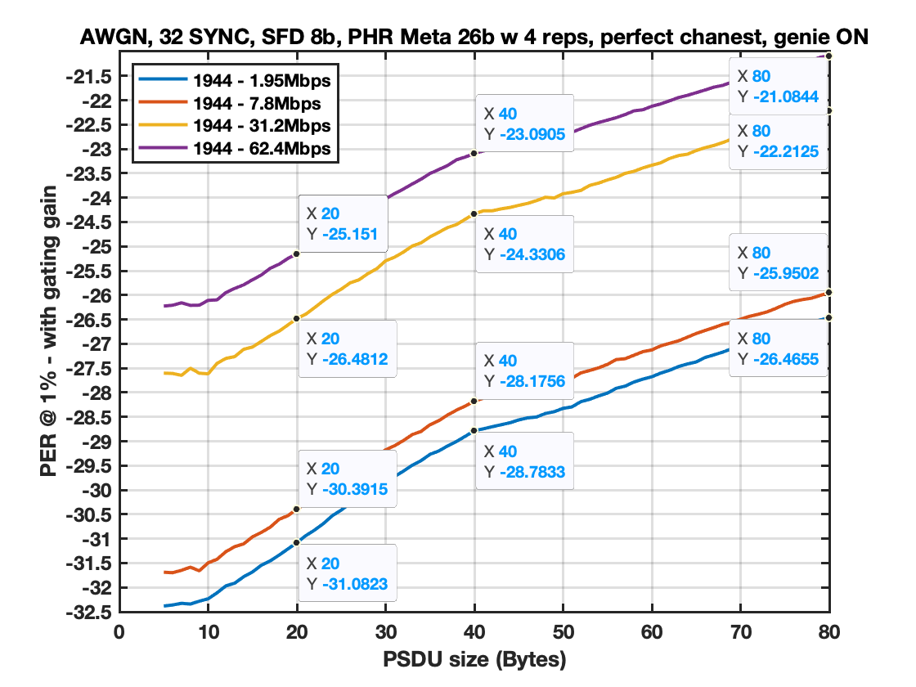
LDPC Results with (32,8)

Slide 23
What does performance look like for 7.8 Mbps when PHR reps =2 with perfect preamble detection?

Slide 24
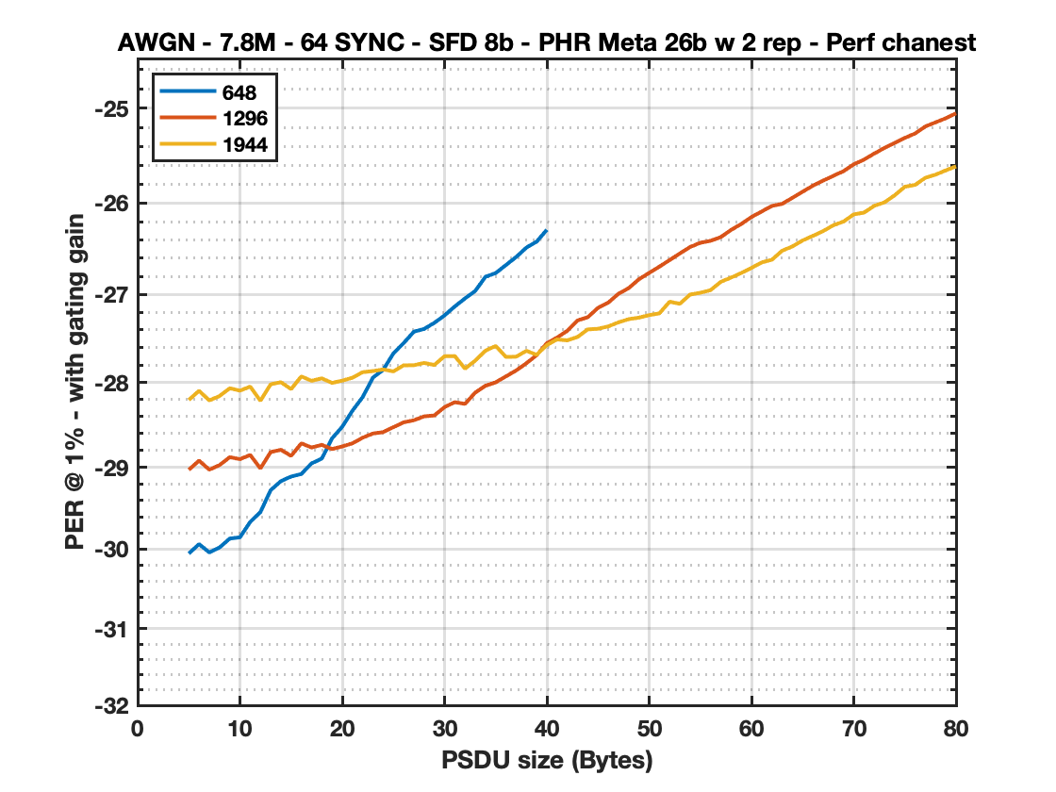
648 vs 1296 vs 1944 - 2 reps - genie ON (SYNC,SFD)
PSDU | 648 | 1296 | 1944
5 | -30.0543 | -29.0321 | -28.2054
6 | -29.9372 | -28.921 | -28.098
7 | -30.04 | -29.0298 | -28.2103
8 | -29.9801 | -28.9756 | -28.1597
9 | -29.8689 | -28.8802 | -28.0685
10 | -29.853 | -28.9038 | -28.0964
11 | -29.6645 | -28.8538 | -28.0497
12 | -29.5436 | -29.0148 | -28.2144
13 | -29.2771 | -28.8193 | -28.023
14 | -29.1679 | -28.7922 | -27.9987
15 | -29.1124 | -28.8643 | -28.0783
16 | -29.0817 | -28.7157 | -27.9317
17 | -28.9539 | -28.7651 | -27.9825
18 | -28.8971 | -28.7334 | -27.9539
19 | -28.6569 | -28.7834 | -28.0067
20 | -28.519 | -28.7525 | -27.9806
21 | -28.3298 | -28.7151 | -27.9463
22 | -28.1704 | -28.6482 | -27.8825
23 | -27.9459 | -28.5989 | -27.8701
24 | -27.8556 | -28.5828 | -27.8514
25 | -27.6674 | -28.524 | -27.8737
26 | -27.5495 | -28.4672 | -27.804
27 | -27.4198 | -28.4425 | -27.8028
28 | -27.3886 | -28.3974 | -27.7763
29 | -27.3199 | -28.3857 | -27.7999
30 | -27.2356 | -28.2891 | -27.6989
PSDU | 648 | 1296 | 1944
31 | -27.1352 | -28.2306 | -27.6979
32 | -27.0452 | -28.2506 | -27.8417
33 | -26.9616 | -28.1192 | -27.7499
34 | -26.8044 | -28.0393 | -27.6361
35 | -26.7632 | -27.9998 | -27.5822
36 | -26.6746 | -27.9312 | -27.7075
37 | -26.5858 | -27.863 | -27.7048
38 | -26.4828 | -27.78 | -27.6372
39 | -26.4176 | -27.6876 | -27.6834
40 | -26.2886 | -27.5503 | -27.5711
41 |  | -27.4864 | -27.5077
42 |  | -27.4095 | -27.5187
43 |  | -27.2921 | -27.4796
44 |  | -27.2563 | -27.3939
45 |  | -27.1511 | -27.3867
46 |  | -27.0926 | -27.36
47 |  | -26.9932 | -27.3141
48 |  | -26.9304 | -27.2779
49 |  | -26.8315 | -27.261
50 |  | -26.7613 | -27.2326
51 |  | -26.6922 | -27.2127
52 |  | -26.6199 | -27.0821
53 |  | -26.5468 | -27.1052
54 |  | -26.4767 | -27.0022
55 |  | -26.4299 | -26.982
56 |  | -26.4087 | -26.9531
PSDU | 648 | 1296 | 1944
57 |  | -26.3681 | -26.8604
58 |  | -26.2905 | -26.8135
59 |  | -26.2258 | -26.7629
60 |  | -26.1503 | -26.7065
61 |  | -26.0902 | -26.6456
62 |  | -26.0303 | -26.6162
63 |  | -26.0079 | -26.5167
64 |  | -25.9436 | -26.4706
65 |  | -25.878 | -26.4045
66 |  | -25.8137 | -26.3546
67 |  | -25.7603 | -26.3036
68 |  | -25.7082 | -26.2395
69 |  | -25.6588 | -26.1992
70 |  | -25.5866 | -26.1214
71 |  | -25.5361 | -26.1025
72 |  | -25.4731 | -26.0296
73 |  | -25.4138 | -25.9922
74 |  | -25.3619 | -25.916
75 |  | -25.3082 | -25.8245
76 |  | -25.2618 | -25.8048
77 |  | -25.1888 | -25.7292
78 |  | -25.146 | -25.6957
79 |  | -25.1036 | -25.6502
80 |  | -25.0526 | -25.6076
Through sims, we have found that the best combination is:
648 CBS when PSDU <= 18 Bytes
1296 CBS when PSDU in [19,39] Bytes
1944 CBS when PSDU >= 40 Bytes
Slide 24

Slide 25
What does performance look like for 1.95 Mbps when PHR reps =2 with perfect preamble detection?

Slide 26
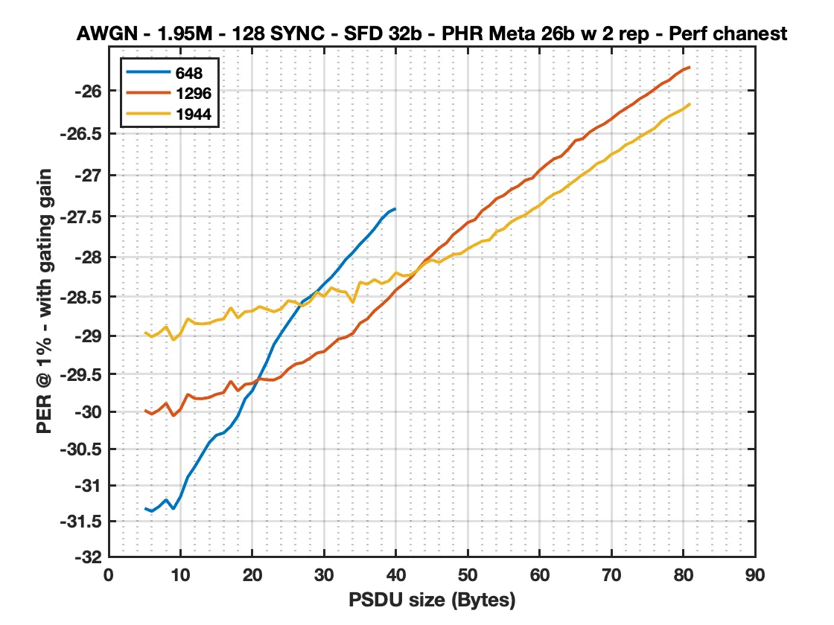
648 vs 1296 vs 1944 - 2 reps - genie ON (SYNC,SFD)
PSDU | 648 | 1296 | 1944
5 | -31.3199 | -29.9808 | -28.9555
6 | -31.3613 | -30.0328 | -29.0164
7 | -31.2956 | -29.9765 | -28.9662
8 | -31.2003 | -29.8886 | -28.8844
9 | -31.3299 | -30.0569 | -29.0599
10 | -31.1562 | -29.9667 | -28.9734
11 | -30.8881 | -29.7687 | -28.7816
12 | -30.7426 | -29.8243 | -28.8427
13 | -30.5777 | -29.8269 | -28.8503
14 | -30.4156 | -29.8102 | -28.839
15 | -30.316 | -29.7685 | -28.8026
16 | -30.2857 | -29.7469 | -28.7863
17 | -30.1965 | -29.5952 | -28.6404
18 | -30.0553 | -29.7229 | -28.7727
19 | -29.8277 | -29.6373 | -28.6931
20 | -29.7208 | -29.6248 | -28.6848
21 | -29.5337 | -29.5625 | -28.6281
22 | -29.3439 | -29.5775 | -28.661
23 | -29.1158 | -29.5798 | -28.6932
24 | -28.9721 | -29.5344 | -28.6586
25 | -28.8343 | -29.4367 | -28.5522
26 | -28.7049 | -29.3702 | -28.5736
27 | -28.5645 | -29.3515 | -28.6194
28 | -28.5067 | -29.2946 | -28.5665
29 | -28.4366 | -29.2262 | -28.4447
30 | -28.3406 | -29.2065 | -28.4981
PSDU | 648 | 1296 | 1944
31 | -28.2555 | -29.1253 | -28.3884
32 | -28.1513 | -29.0449 | -28.4314
33 | -28.0344 | -29.0216 | -28.4432
34 | -27.946 | -28.9715 | -28.5772
35 | -27.8417 | -28.8402 | -28.3177
36 | -27.7533 | -28.7864 | -28.3438
37 | -27.652 | -28.6822 | -28.286
38 | -27.5319 | -28.606 | -28.3366
39 | -27.4455 | -28.5216 | -28.3027
40 | -27.4046 | -28.4165 | -28.2005
41 |  | -28.3447 | -28.2392
42 |  | -28.2681 | -28.2282
43 |  | -28.1638 | -28.1679
44 |  | -28.057 | -28.0822
45 |  | -27.9808 | -28.0378
46 |  | -27.8925 | -28.0697
47 |  | -27.829 | -28.0184
48 |  | -27.7224 | -27.9689
49 |  | -27.6546 | -27.961
50 |  | -27.5756 | -27.9006
51 |  | -27.5407 | -27.8506
52 |  | -27.4309 | -27.8046
53 |  | -27.3692 | -27.7923
54 |  | -27.2842 | -27.6891
55 |  | -27.2443 | -27.6535
56 |  | -27.1751 | -27.5685
PSDU | 648 | 1296 | 1944
57 |  | -27.133 | -27.5214
58 |  | -27.0616 | -27.4806
59 |  | -27.0352 | -27.4159
60 |  | -26.9416 | -27.3668
61 |  | -26.869 | -27.2873
62 |  | -26.8043 | -27.2295
63 |  | -26.7734 | -27.1916
64 |  | -26.6883 | -27.1216
65 |  | -26.5858 | -27.0594
66 |  | -26.5657 | -26.9905
67 |  | -26.4855 | -26.9371
68 |  | -26.4321 | -26.8599
69 |  | -26.3898 | -26.8253
70 |  | -26.3312 | -26.7494
71 |  | -26.2636 | -26.7085
72 |  | -26.2092 | -26.6375
73 |  | -26.1571 | -26.5992
74 |  | -26.0937 | -26.5404
75 |  | -26.0457 | -26.4906
76 |  | -25.9852 | -26.4425
77 |  | -25.9232 | -26.3565
78 |  | -25.8832 | -26.3019
79 |  | -25.8143 | -26.2588
80 |  | -25.7605 | -26.2156
81 |  | -25.7293 | -26.1509
Through sims, we have found that the best combination is:
648 CBS when PSDU <= 20 Bytes
1296 CBS when PSDU in [21,42] Bytes
1944 CBS when PSDU >= 43 Bytes
Slide 26

Slide 27
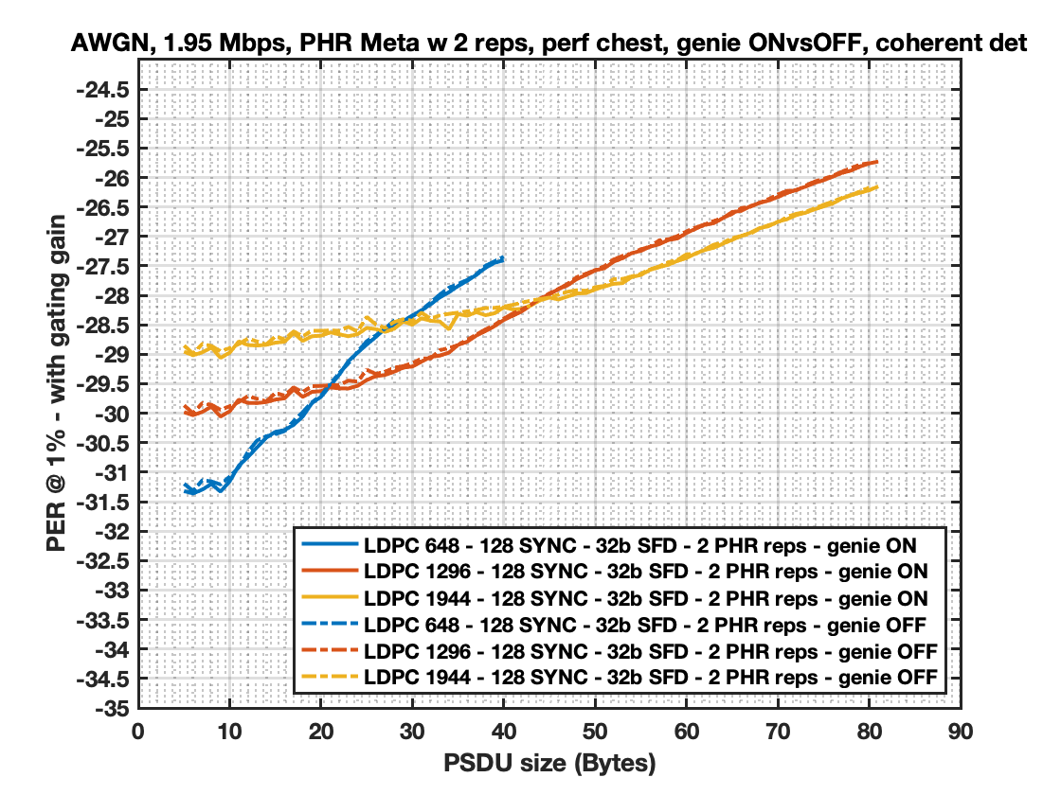
Genie on vs off with coherent detector
We see similar transition regions between genie on and genie off

