Slide 1
Project: IEEE P802.15 Working Group for Wireless Personal Area Networks (WPANs)
Submission Title: Channel Considerations for Next Generation Japanese Metering Applications
Date Submitted: 17th January, 2023
Source: Philip Orlik, Yukimasa Nagai, Takenori Sumi, Naotaka Sakaguchi, Benjiman Rolfe (Mitsubishi Electric)
E-Mail: porlik@merl.com
Re:
Abstract: Discusses concerns about the ability of existing 802.15 standards to support the expected metering application needs in Japan’s sub-1GHz frequency bands.
Purpose: Discuss issues unique to Japanese sub1-GHz frequency regulations and existing metering systems.
Notice: This document has been prepared to assist the IEEE P802.15. It is offered as a basis for discussion and is not binding on the contributing individual(s) or organization(s). The material in this document is subject to change in form and content after further study. The contributor(s) reserve(s) the right to add, amend or withdraw material contained herein.
Release: The contributor acknowledges and accepts that this contribution becomes the property of IEEE and may be made publicly available by P802.15.

Slide 2
Background (I)
Sub-1GHz device deployment and standard development continue to grow (802.15.4g, 802.11ah, …)
In Japan, sub-1GHz spectrum is scarce: at most 2.9MHz* is optimized for metering applications using carrier sense channel access
leads to congestion issues and interoperability issues as more devices with different protocols exists in narrower bandwidth
See IEEE802.19.3 for issues arising from limited spectrum availability and protocol differences among 802.15.4g and 802.11ah
* See pg. 113: 920MHz-BAND TELEMETER, TELECONTROL AND DATA TRANSMISSION RADIO EQUIPMENT ARIB STANDARD

Slide 3
Background (II)
Japanese electric utilities are updating their first-generation smart metering infrastructure
New requirements are coming to light:
Meter reporting duty cycles are expected to decrease from 30 minutes to 5 minutes -> at least a 6x increase in throughput will be needed, latency reduced by factor of 6 as well.
Likely need for multi-metering functionality on single radio
OTA firmware/software capability needed

Slide 4
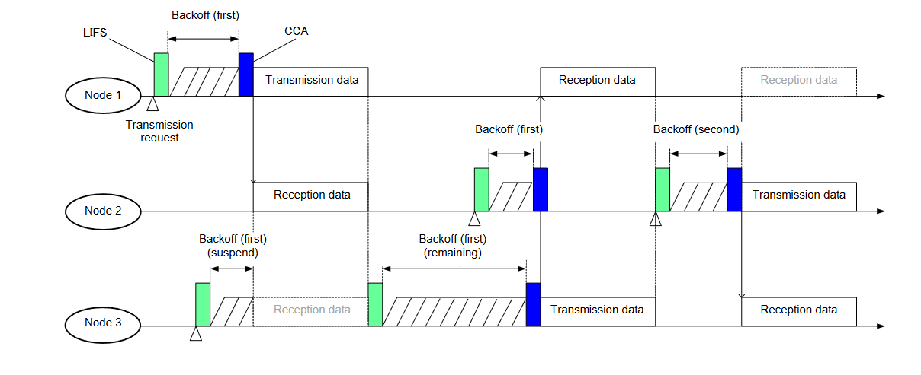
Japanese Metering Environment
Echonet protocols (based on JJ.300.10) are supported in Japan.
Some MAC layer behavioral differences are present.
EX. Treatment of channel access failures: consider congestion in the behavior of the channel access, (https://www.ttc.or.jp/application/files/2315/5443/0462/JJ-300.10Ev2.2.pdf )
JJ.300-10 CSMA/CA performs CCA during Backoff periods in addition to the traditional CCA period and will suspend back-off during other nodes’ transmissions. Reduces probability of transmission failures.

Slide 5
Summary
Existing sub-1GHz protocols may suffer performance degradation in very dense, higher throughput deployments like those expected in Japan.
Some existing protocols deployed in Japan have different MAC behavior then that described in 802.15.
It is suggested that we form an interest group to further evaluate impact of spectrum availability in Japan and alignment of CSMA behavior.

