Slide 1
IEEE P802.15.13 Architecture Overview (joint meeting IEEE 802.1 & 802.15 in January 2023)
Date: 2023-01-17
Author(s):
Name | Affiliations | Address | Phone | Email
Lennert Bober | Fraunhofer HHI |  |  | bober@ieee.org
Volker Jungnickel | Fraunhofer HHI

Slide 2
Abstract
This presentation summarizes IEEE P802.15.13’s use of the IEEE Std 802 architecture.
Extracted text is from P802.15.13-D10 [1].

Slide 3
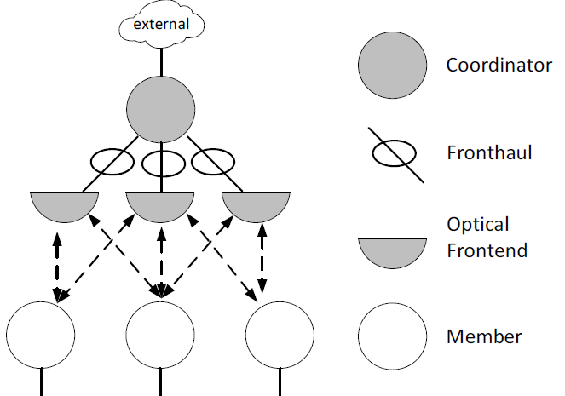
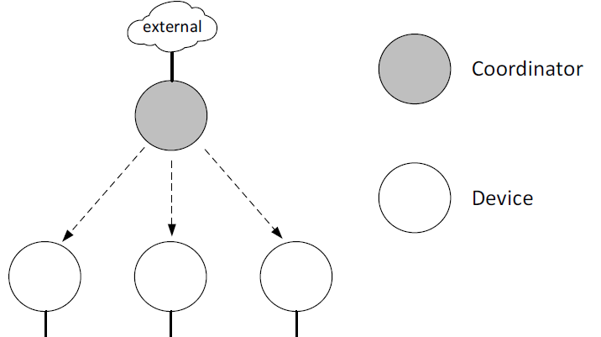
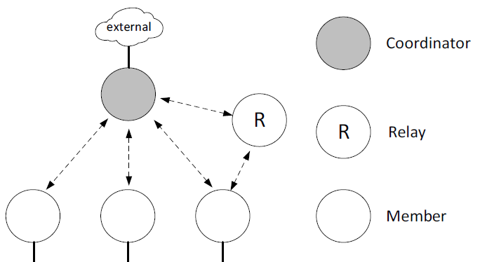
Network Architecture and Topology
Coordinator and Member devices
Coordinators maintain networks (“OWPANs”)
Coordinator transfers between members and external networks
Logical star topology with some subtypes
Distributed MIMO topology
Broadcast topology
Relay topology

Slide 4
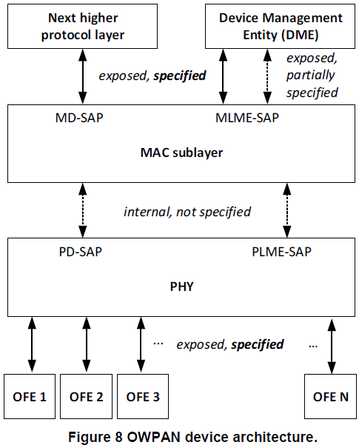
Device Architecture: (Sub)layers and Interfaces
IEEE P802.15.13-D10 5.5.1:
“The IEEE Std 802.15.13 device architecture is defined in terms of layers. […] Layers make use of service access points (SAPs) based on primitives, as described in the subclause 5.8, "Concept of primitives", in IEEE Std 802.15.4™-2020.”
Coordinators and Member devices have the same architecture.
Next higher protocol layer uses services provided by MD-SAP.
Device Management Entity (DME) [out of scope] manages devices.
MAC sublayer controls transmissions via the PHY layer, interface is internal.
Light-based transmission via optical frontends (OFE) allows data exchange with deterministic properties.

Slide 5
Addressing
IEEE P802.15.13-D10 6.2.2:
“Each device conforming to this standard shall have a MAC address that is a EUI-48 as specified by IEEE Std 802™”
“The MAC address shall be sent in the canonical format defined in IEEE Std 802”
“The MAC address value FF-FF-FF-FF-FF-FF shall be used as the broadcast address.”
“MSDUs that have a destination address that has the multicast bit set in the MD-DATA.request shall be treated as if the destination address was the broadcast address.”
“Each device has an AID assigned as part of the association process.”
16 bit, purely internal Association ID
“Each OWPAN is identified through its OWPAN ID. The OWPAN ID corresponds to the MAC address of the coordinator.”

Slide 6
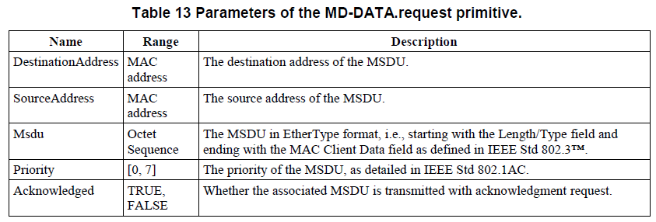
MD-SAP
Interface with higher layers for transmission and reception of MSDUs towards peer devices.
IEEE P802.15.13-D10 8.2.1:
“MSDUs shall be in EtherType protocol discrimination format, described in IEEE Std 802. Thus, the two octet wide EtherType shall be prepended to the MSDU in big endian byte order.”
EtherType Protocol Discrimination (EPD) is always used.
IEEE P802.15.13-D10 8.2.2:
Provides IEEE Std 802.1AC MAC service
Receives Priority 0 … 8

Slide 7
MAC Frames for Frame-based transmission
IEEE P802.15.13-D10 7.1.1:
“This standard defines a single general MAC frame format, also referred to as MPDU.”
MPDU includes MAC addresses of IEEE 802.15.13 receiver and transmitter
Data frames contain one or multiple MSDUs and their source and destination MAC addresses in the Payload field
MSDU Aggregation (6.7.3) and Fragmentation (6.6) for efficient data transfer and support of large frames.
No QoS information in MPDU header

Slide 8
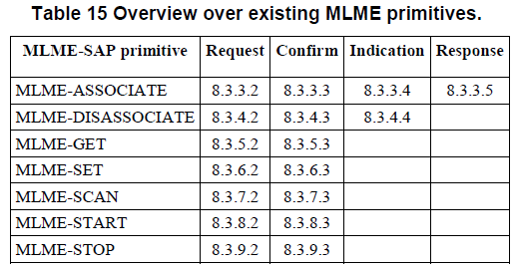
MLME
IEEE P802.15.13-D10 8.3.1:
“The MLME-SAP supports the management and usage of a device’s MLME functionality through the DME. The primitives supported by the MLME-SAP are given in Table 15.”
MLME interface is kept minimal
IEEE P802.15.13-D10 8.4 “MAC PIB attributes”:
PIB attributes determine device behavior; settable via MLME-SET
No managed objects registered
IEEE P802.15.13-D10 8.6 “Device capabilities”:
Devices have “capabilities” for negotiation of features used while associated with the network

Slide 9
Security
Encryption, authentication, cryptographic integrity protection are not part of IEEE P802.15.13-D10
Left for future addition; potential use of other IEEE standards
802.1X?
802.1AE?
802.1AR?
802.15.9?
…

Slide 10
MAC and PHY services
MAC with scheduled and polled medium access
Deterministic access
MSDUs potentially delayed while waiting for medium access
Transmit scheduling is implementation-specific
Frame-based PHYs with On-Off-Keying & OFDM
PHYs determine maximum frame size:
2044 octets for the “PM-PHY”
1 683 456 octets for the “HB-PHY”

Slide 11
Summary
IEEE P802.15.13-D10 architecture orientates itself towards IEEE 802.1.
Goal: integrate with existing IEEE Std 802 LANs.
Future plans: support real-time networking and relevant TSN standards.
Goal: coexist with RF as light-based infrastructure network for medium diversity and offloading together.
Draft D10 is currently with RevCom
Implementation to be evaluated
Possibly new functionality / fixes through amendments or revisions
Extended overview over latest draft in [2]

Slide 12
References
[1] IEEE P802.15.13-D10, see https://ieeexplore.ieee.org/document/9963940
[2] K. L. Bober et al., “The IEEE 802.15.13 Standard for Optical Wireless Communications in Industry 4.0.” https://ieeexplore.ieee.org/document/9968724

