Slide 1
Project: IEEE P802.15 Working Group for Wireless Personal Area Networks (WPANs)
Submission Title: Hyper block concept for use of NBA-MMS
Date Submitted: JANUARY 17, 2023
Source: Youngwan So, Mingyu Lee, Aniruddh Rao Kabbinale, Taeyoung Ha, Karthik Srinivasa Gopalan, Ankur Bansal and Clint Chaplin (SAMSUNG ELEC.), Jinjing Jiang, Alexander Krebs (Apple)
Kuan Wu, Lei Huang, Rojan Chitrakar, Bin Qian, David Xun Yang (Huawei), Kangjin Yoon (Meta)
Address: Seoul R&D Campus, 34, Seongchon-gil, Seocho-gu, Seoul, 06765, South Korea
E-Mail: youngwan.so@samsung.com
Abstract: Usage of Hyper block-based mode for NBA-MMS
Purpose: To show how hyper block-based mode can play a role for NBA-MMS.
Notice: This document has been prepared to assist the IEEE P802.15. It is offered as a basis for discussion and is not binding on the contributing individual(s) or organization(s). The material in this document is subject to change in form and content after further study. The contributor(s) reserve(s) the right to add, amend or withdraw material contained herein.
Release: The contributor acknowledges and accepts that this contribution becomes the property of IEEE and may be made publicly available by P802.15.

Slide 2
PAR Objective | Proposed Solution (how addressed)
Safeguards so that the high throughput data use cases will not cause significant disruption to low duty-cycle ranging use cases
Interference mitigation techniques to support higher density and higher traffic use cases
Other coexistence improvement
Backward compatibility with enhanced ranging capable devices (ERDEVs)
Improved link budget and/or reduced air-time
Additional channels and operating frequencies
Improvements to accuracy / precision / reliability and interoperability for high-integrity ranging
Reduced complexity and power consumption
Hybrid operation with narrowband signaling to assist UWB
Enhanced native discovery and connection setup mechanisms
Sensing capabilities to support presence detection and environment mapping
Low-power low-latency streaming
Higher data-rate streaming allowing at least 50 Mbit/s of throughput
Support for peer-to-peer, peer-to-multi-peer, and station-to-infrastructure protocols | Hyper block-based mode to support usage of NBA-MMS mode
Infrastructure synchronization mechanisms

Slide 3
Recap and Background
NBA-MMS is one of enhancement in 4ab to extend coverage and reliability.
Fundamentally, it gains performance improvement by transmitting preamble multiple times, which means it may occupy more slots than legacy. Moreover, the number of preamble transmission will be varying according to many factors such as channel condition, etc.
This trade-off may necessitates efficient use of slot resources in MMS, especially in dense area where slot resource may be scarce.
Hyper block configuration is being defined by HBS IE [1].
  Each block can be configured by the legacy IEs (e.g. ARC IE, RIU IE) or new IEs like AC IE.
We thought about hyper block-based mode as one of way to contribute efficient usage of slot resources in MMS.
[1] 15-22-0591-00-04ab-Proposed Text for 4ab MAC - Hyper Block-based Mode (November, 2022)

Slide 4




Motivation
MMS transmits the same signal multiple times which may differ per devices.
  The number of transmission in MMS can be determined based on link channel condition [2].
  It means every block/rounds may have different lengths each other upon channel condition.
POLL
RESPONSE
REPORT
[NB] :
……
Good Channel Condition
[UWB] :
1
1
Round
Bad Channel Condition
POLL
RESPONSE
REPORT
[NB] :
……
[UWB] :
1
1
2
2
3
3
4
4
Worse Channel Condition
Round
POLL
RESPONSE
REPORT
[NB] :
……
[UWB] :
1
1
2
2
3
3
4
4
5
5
6
6
7
7
8
8
Round
[2] 15-22-0378-00-04ab-On the selection of number of fragments in MMS UWB (July 22, 2022)

Slide 5
Example of Hyper block-based mode for NBA-MMS
Use Case : Supporting various ranging modes within a session.
  A session may be comprised of a concatenation of multiple different ranging modes.
  For example, a certain round may be comprised of a few one-to-one ranging, while another certain rounds are one-to-Many or Many-to-one ranging. That implies every round may require different length to do a certain ranging.
  MMS improves ranging performance such as link budget and reliability enhancement, but consumes more slots, which is a trade-off.
One-to-One Ranging
One-to-One Ranging
One-to-M Ranging
POLL
POLL
RESPONSE
REPORT
POLL
RESPONSE
REPORT
RESPONSE
REPORT
POLL
RESPONSE
REPORT
POLL
RESPONSE
REPORT
……
[NB] :
[UWB] :
1
1
1
1
2
2
3
3
4
4
1
1
2
2
3
3
4
4
1
1
1
1
2
2
3
3
4
4
5
5
6
6
One Ranging
Round
One Ranging Round
One Ranging Round

Slide 6
Example of Hyper block-based mode for NBA-MMS
Hyper Block K-1
Hyper Block K
Hyper Block K+1
Block 0
Block 1
Block 2
Block 0
Block 1
Block 2
Block 0
Block 1
Block 2
Hyper Block K
Block 0
Block 1
Block 2
Round
0
Round
1
Round
0
Round
1
Round
2
……
Round 5
Round
0
POLL
POLL
RESPONSE
REPORT
POLL
RESPONSE
REPORT
POLL
RESPONSE
REPORT
POLL
RESPONSE
REPORT
POLL
RESPONSE
REPORT
RESPONSE
REPORT
POLL
RESPONSE
REPORT
POLL
RESPONSE
REPORT
[NB] :
……
[UWB] :
1
1
2
2
3
3
4
4
1
1
2
2
3
3
4
4
1
1
1
1
1
1
1
1
2
2
3
3
4
4
1
1
1
1
2
2
3
3
4
4
5
5
6
6
One Ranging Round
One Ranging Round
One Ranging
Round
One Ranging
Round
One Ranging
Round
One Ranging Round
POLL
RESPONSE
REPORT
[NB] :
1ms
1ms
1ms
1ms
[UWB] :
1
1
2
2
3
3
4
4
1ms
1ms
1ms

Slide 7
Summary
Hyper block-based mode can be a good match with NBA-MMS.
Can allocate block/round (= time) resources adaptively to fit as demanded.
Especially, hyper block-based mode may contribute in aspect of improving slot resource usage efficiency.
We propose further development of hyper block-based mode as a tool for NBA-MMS enhancement.

Slide 8
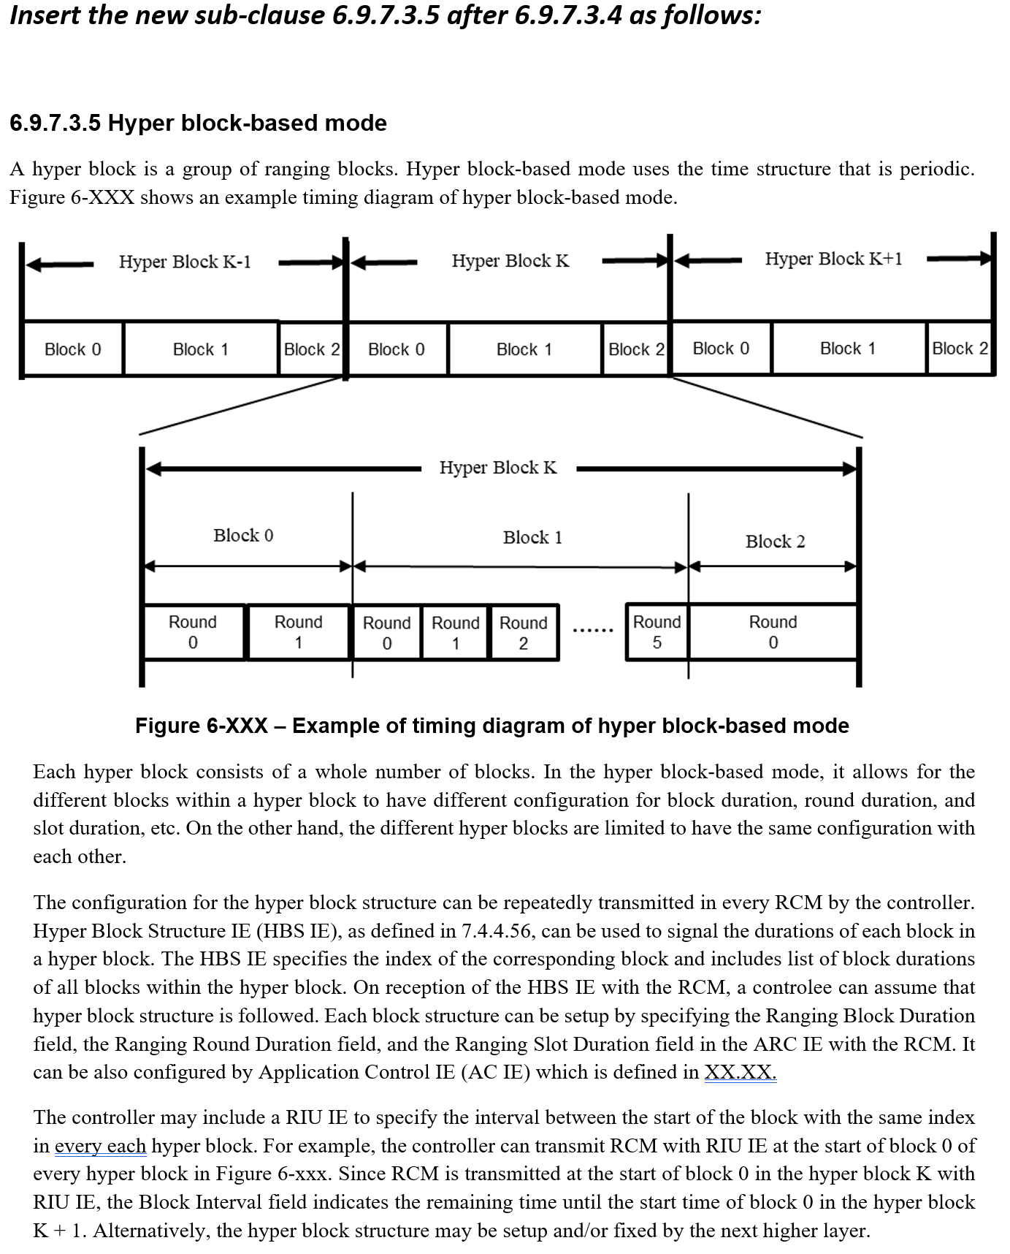
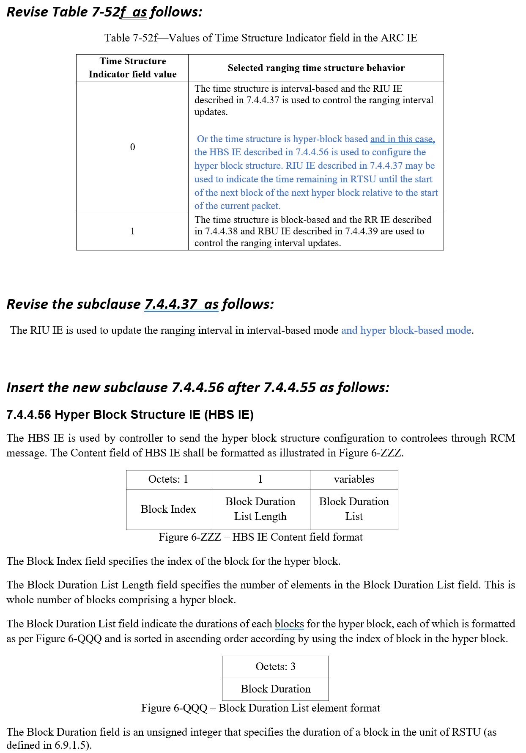
APPENDIX

