Slide 1
Project: IEEE P802.15 Working Group for Wireless Personal Area Networks (WPANs)
Submission Title: [Proposal Towards SENS Sequence Consensus in 4ab]
Date Submitted: [17 January 2023]
Source: [Igor Dotlic, Carl Murray, Michael McLaughlin, Billy Verso, and Jarek Niewczas]
Company [Qorvo]
Address [Adelaide Chambers, Peter Street, Dublin 8, Ireland]
E-Mail:[igor(dot)dotlic(at)qorvo(dot)com]
Re: [Study Group 4ab: UWB Next Generation.]
Abstract: [The document is proposing a way forward towards the consensus of the group in the area of the SENS field structure by combing several proposed ideas.]
Purpose: [To promote arriving to the consensus for the SENS field in the TG IEEE 802.15.4ab.]
Notice: This document has been prepared to assist the IEEE P802.15. It is offered as a basis for discussion and is not binding on the contributing individual(s) or organization(s). The material in this document is subject to change in form and content after further study. The contributor(s) reserve(s) the right to add, amend or withdraw material contained herein.
Release: The contributor acknowledges and accepts that this contribution becomes the property of IEEE and may be made publicly available by P802.15.
Notes:
Jul 12, 2010
Page 1

Slide 2
Proposal Towards SENS Sequence Consensus in 4ab
SENS field: a deterministic drop-in replacement for STS used for sensing.

Slide 3
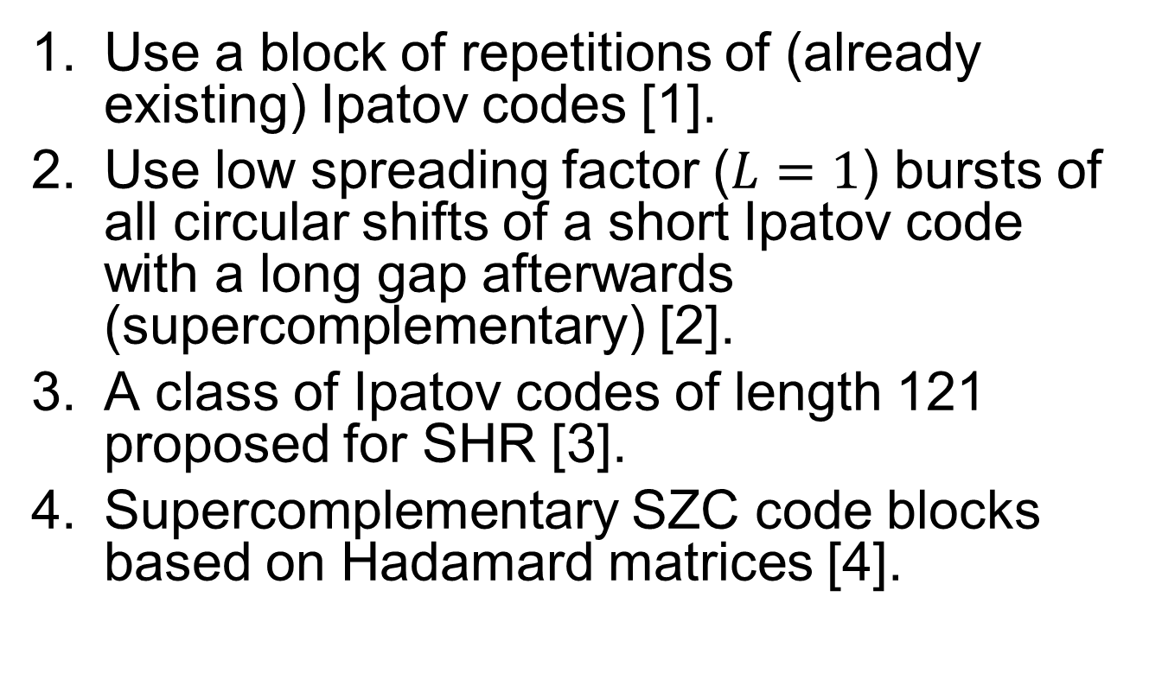
The Current Proposals
Use a block of repetitions of (already existing) Ipatov codes [1].
Use low spreading factor ($L=1$) bursts of all circular shifts of a short Ipatov code with a long gap afterwards (supercomplementary) [2].
A class of Ipatov codes of length 121 proposed for SHR [3].
Supercomplementary SZC code blocks based on Hadamard matrices [4].

Slide 4
Overall Goals
Relatively simple and elegant implementation.
Clear and concise standard text wording.
Encompass as many ideas as possible:
  Repetitive Ipatov with perfect periodic autocorrelation function (PACF) for the receivers that benefit from it.
  Supercomplementary for receivers that needing also the correlation resilience to signal distortions.

Slide 5
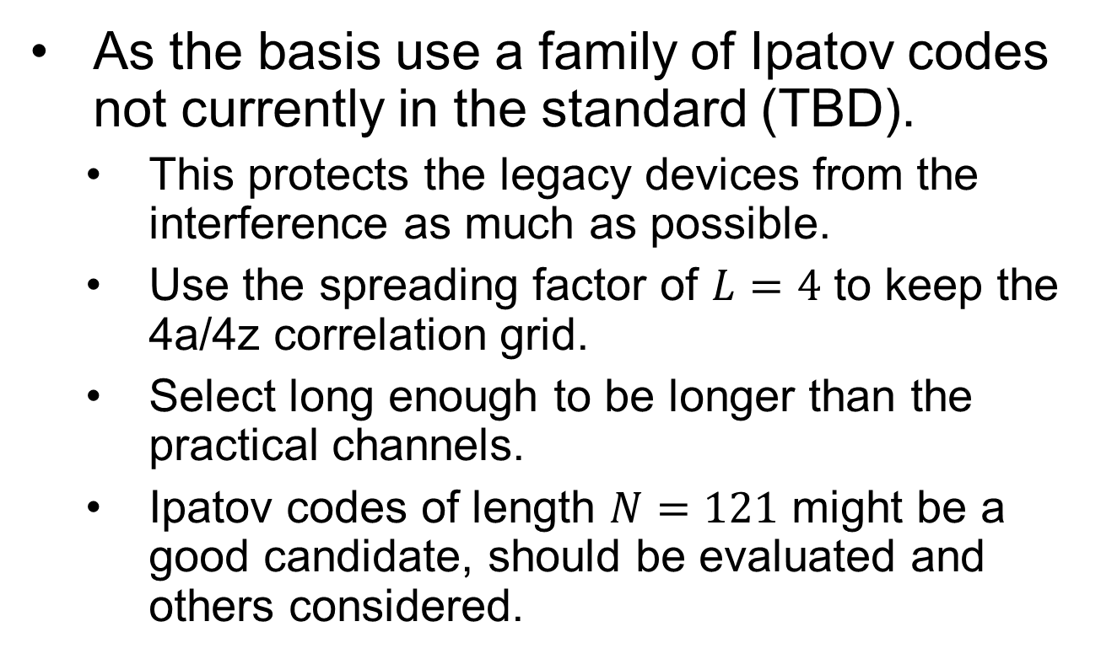
Proposed Solution (1/2)
As the basis use a family of Ipatov codes not currently in the standard (TBD).
  This protects the legacy devices from the interference as much as possible.
  Use the spreading factor of $L=4$ to keep the 4a/4z correlation grid.
  Select long enough to be longer than the practical channels.
  Ipatov codes of length $N=121$ might be a good candidate, should be evaluated and others considered.

Slide 6
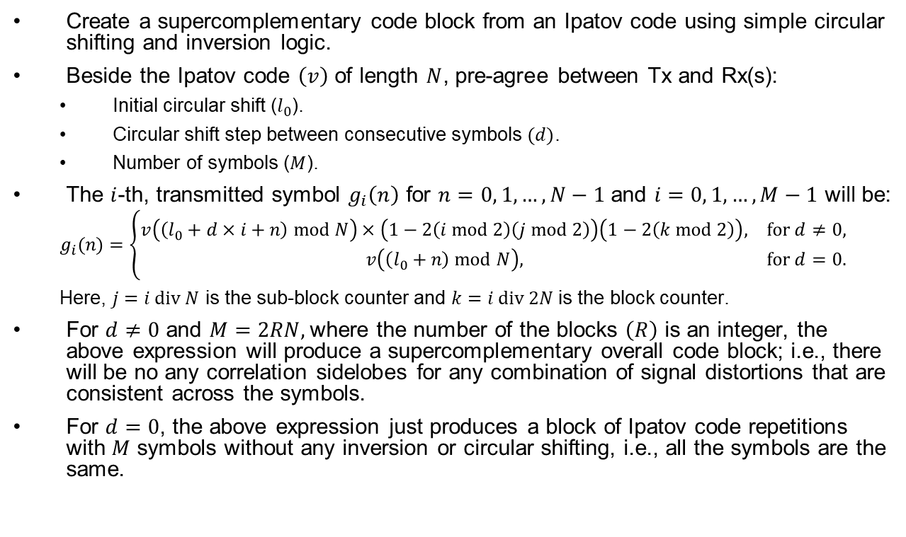
Proposed Solution (2/2)
Create a supercomplementary code block from an Ipatov code using simple circular shifting and inversion logic.
Beside the Ipatov code $\left(v\right)$ of length $N$, pre-agree between Tx and Rx(s):
  Initial circular shift ($l_{0}$).
  Circular shift step between consecutive symbols $(d)$.
  Number of symbols ($M$).
The $i$-th, transmitted symbol $g_{i}\left(n\right)$ for $n=0, 1,…,N−1$ and $i=0, 1,…,M−1$ will be:
  $$g_{i}(n)=\left\{\begin{matrix}v\left(\left(l_{0}+d×i+n\right) mod N\right)×\left(1−2\left(i mod 2\right)\left(j mod 2\right)\right)\left(1−2\left(k mod 2\right)\right), & \text{for} d≠0, \\ v\left(\left(l_{0}+n\right) mod N\right), & \text{for} d=0.\end{matrix}\right.$$
  Here, $j=i div N$ is the sub-block counter and $k=i div 2N$ is the block counter.
For $d≠0$ and $M=2RN,$where the number of the blocks $\left(R\right)$ is an integer, the above expression will produce a supercomplementary overall code block; i.e., there will be no any correlation sidelobes for any combination of signal distortions that are consistent across the symbols.
For $d=0$, the above expression just produces a block of Ipatov code repetitions with $M$ symbols without any inversion or circular shifting, i.e., all the symbols are the same.

Slide 7
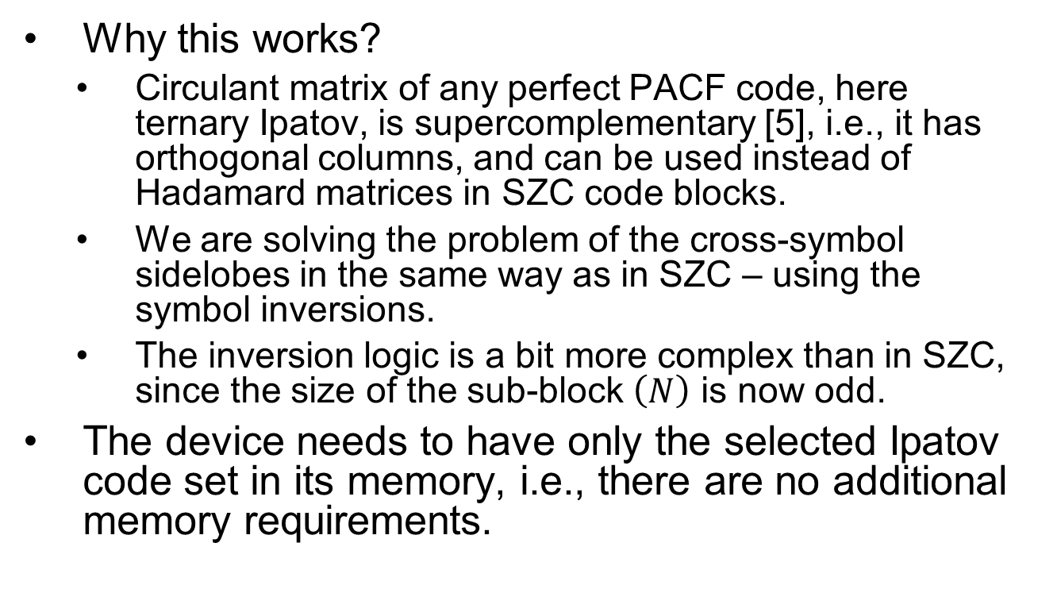
Conclusion
Why this works?
  Circulant matrix of any perfect PACF code, here ternary Ipatov, is supercomplementary [5], i.e., it has orthogonal columns, and can be used instead of Hadamard matrices in SZC code blocks.
  We are solving the problem of the cross-symbol sidelobes in the same way as in SZC – using the symbol inversions.
  The inversion logic is a bit more complex than in SZC, since the size of the sub-block $\left(N\right)$ is now odd.
The device needs to have only the selected Ipatov code set in its memory, i.e., there are no additional memory requirements.

Slide 8
References
[1] DCN 15-22-0175-00-04ab: “Sensing Device.”
[2] DCN 15-22-0592-00-04ab: “Pulse Burst Sensing - Phase Noise Proof Supercomplementary Set of Sequences.”
[3] DCN 15-22-0616-00-04ab: “Interference Analysis of Initial Synchronization Sequence.”
[4] DCN 15-22-0632-00-04ab: “SCZ Code Blocks: A Good Candidate for the Sensing Sequences in 4ab.”
[5] B. M. Popovic, “Complementary Sets Based on Sequences with Ideal Periodic Autocorrelation,” Electronics Letters, vol. 26, pp. 1428–1430, 1990.

