Slide 1
Project: IEEE P802.15 Working Group for Wireless Personal Area Networks (WPANs)
Submission Title: [Kaiser Pulse Shape Estimation using Test Equipment on 4z BPRF3 Packet]
Date Submitted: [17 Jan 2023]
Source: [Igor Dotlic, Carl Murray, Michael McLaughlin, Billy Verso, and Jarek Niewczas] Company [Qorvo]
Address [Adelaide Chambers, Peter Street, Dublin 8, Ireland]
E-Mail:[igor(dot)dotlic(at)qorvo(dot)com]
Re: [Study Group 4ab: UWB Next Generation.]
Abstract: [Get a feeling on measurement artefact that one can expect when certifying a packet against the currently proposed sensing pulse requirements and propose the change of the requirements.]
Purpose: [To further the sensing pulse shape discussion in TG 4ab.]
Notice: This document has been prepared to assist the IEEE P802.15. It is offered as a basis for discussion and is not binding on the contributing individual(s) or organization(s). The material in this document is subject to change in form and content after further study. The contributor(s) reserve(s) the right to add, amend or withdraw material contained herein.
Release: The contributor acknowledges and accepts that this contribution becomes the property of IEEE and may be made publicly available by P802.15.
Notes:
Jul 12, 2010
Page 1

Slide 2
Kaiser Pulse Shape Estimation using Test Equipment on 4z BPRF3 Packet

Slide 3
Introduction
Motivation
  Get a feeling on measurement artefact that one can expect when certifying a packet against the currently proposed sensing pulse requirements.
Using the currently proposed reference pulse to see how “an ideal implementation” would perform.
Using a high-end packet generator.
  Able to produce a packet with a required pulse shape easily.
  A part of the testing equipment.
  Minimize influence of packet non-idealities such as phase errors, timing errors, and amplitude errors on the pulse shape estimation.

Slide 4
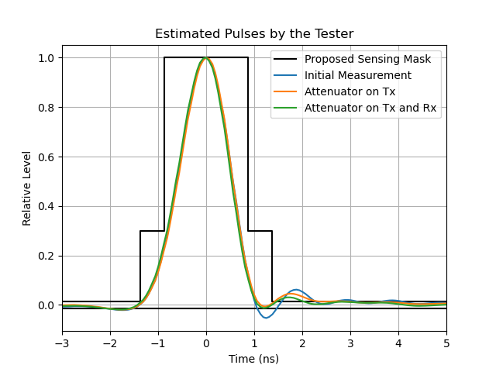
Results

Slide 5
Conclusions
Observations
  The main lobe is somewhat asymmetrical; almost enough to touch the mask.
  The level of the pre-cursor is at the mask edge and does not depend on the impedance matching.
  The level of post-cursors is always higher than the proposed margin and dependent on the impedance matching, i.e., reflections on the cable.
Suggestions
  Similar results from other parties are encouraged.
  Increase the margin for the post-cursors, both in time and cross-correlation domains.
  Consider increasing the margin for the pre-cursors.
  Loose the main lobe pinching point: C:(Tw₃ /2,y2).
  Higher pulse correlation requirement is generally acceptable, but the value should be carefully chosen.

