Slide 1
Project: IEEE P802.15 Working Group for Wireless Personal Area Networks (WPANs)
Submission Title: Ultra-Wideband Swarm Ranging Protocol for Dynamic and Dense Networks
Source: Feng Shan, Haodong Huo, Chunyi Li (Southeast University, China)
Address : [2 Sipailou, Nanjing, 210012 China]
E-Mail: [shanfeng@seu.edu.cn]
Re: 141st IEEE 802.15 WSN Meeting, WNG
Abstract: [UWB, swarm ranging, two way ranging]
Purpose:
Notice: This document has been prepared to assist the IEEE P802.15. It is offered as a basis for discussion and is not binding on the contributing individual(s) or organization(s). The material in this document is subject to change in form and content after further study. The contributor(s) reserve(s) the right to add, amend or withdraw material contained herein.
Release: The contributor acknowledges and accepts that this contribution becomes the property of IEEE and may be made publicly available by P802.15.

Slide 2
Ultra-Wideband Swarm Ranging Protocol for
Dynamic and Dense Networks
Feng Shan, Haodong Huo, Jiaxin Zeng, Zengbao Li, Weiwei Wu, and Junzhou Luo, “Ultra-Wideband Swarm Ranging Protocol for Dynamic and Dense Networks,” IEEE/ACM Transactions on Networking (ToN), vol. 30, no. 6 (2022): 2834-2848. (Open Access at DOI: 10.1109/TNET.2022.3186071)

Slide 3
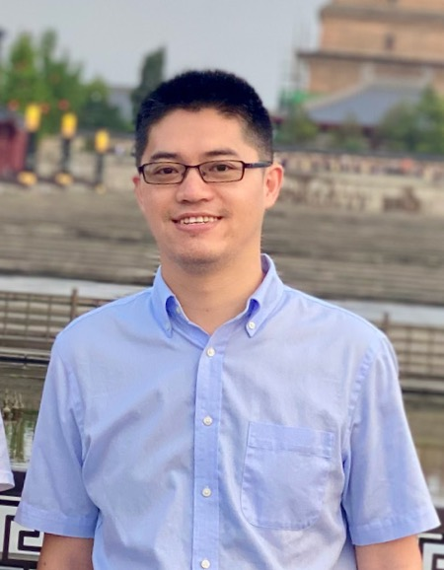
Who am I?
I am Feng SHAN, an Associate Professor at School of Computer Science and Engineering, Southeast University (SEU), Nanjing, China.
I received the Ph.D. degree in Computer Science from Southeast University in 2015, supervised by Professor Junzhou Luo.
I was a Visiting Scholar at the School of Computing and Engineering, University of Missouri-Kansas City, Kansas City, MO, USA, from 2010 to 2012.
My research interests are in the areas of wireless communication, unmanned system swarm cooperation, algorithm design and analysis.

Slide 4
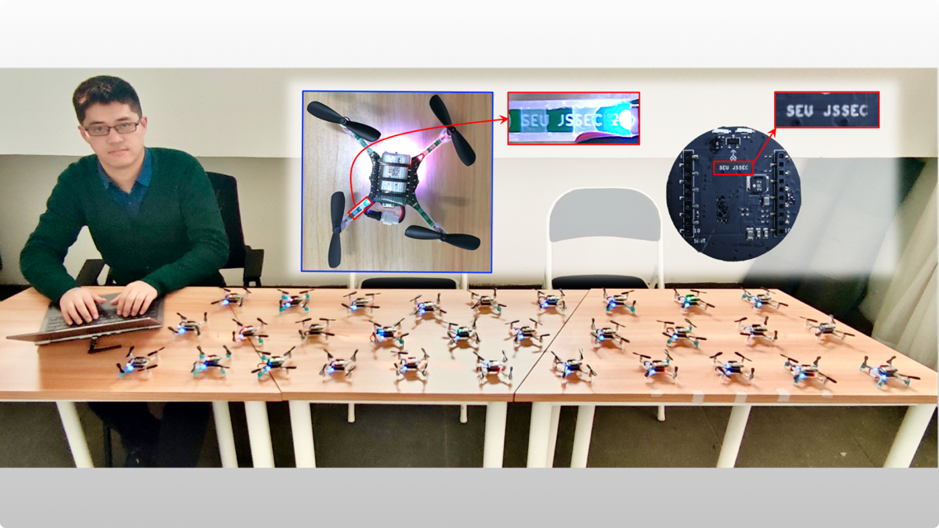
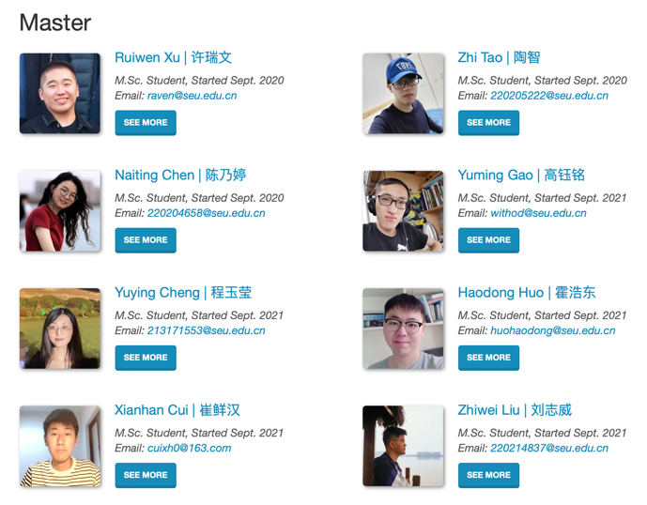
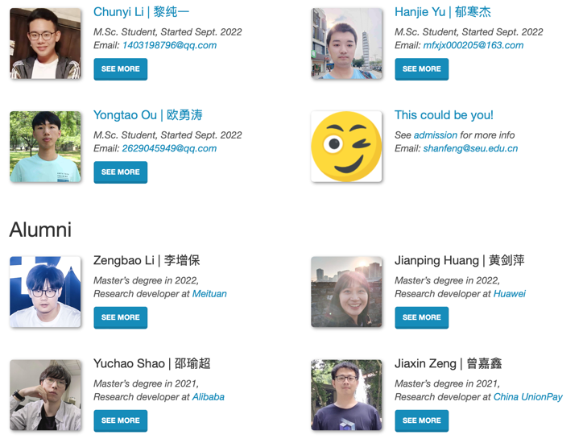
SEU-NetSI Research Group Introduction
NetSI group conducts research in the area of Internet of Things and Swarm Intelligence. More specially, the focus is on the wireless networking for a swarm of moving things and study how to coordinate their collaboration.
NetSI group research goal is to provide theoretically sound analysis as well as build practically working systems.

Slide 5
Outline
Introduction
Preliminary
Protocol Design
Experiment
Conclusion

Slide 6
Outline
Introduction
Preliminary
Protocol Design
Experiment
Conclusion

Slide 7
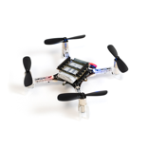
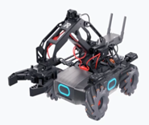

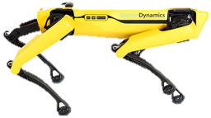
Swarm of robots and devices
Aerial / ground robots, wearable / portable devices are
becoming smaller, lighter, and cheaper.
Crazyflie 2.1
Robo Master EP
SPOT
Mobile phone
Hundreds of them may form a swarm to participate in
complicated cooperative tasks.
An army of legged robot dogs battle in a deep forest.
A team of drones search for given targets.
A swarm of small robots explore and map unknown environments.

Slide 8



Dynamic and dense swarm network
Dynamic and dense swarm
Requirements
Large number.
Real-time internal distance ranging
for localization.
High mobility.
Low latency ad hoc networking
and communication.
Short distance.

Slide 9


Ultra-wideband swarm ranging protocol
Ultra-wideband (UWB) wireless technology support simultaneously ranging and communication.
Our target is to design a UWB ranging protocol for a dynamic and dense networks of robots and devices.

Slide 10
Challenges to design such a ranging protocol
Design a simple yet efficient protocol
  A large number share the same UWB channel.
  Inappropriate cause conflicting and high computation cost.
Design a adaptive and robust protocol
  High mobility requires high frequency ranging.
  Ranging frequency should be reduced whenever necessary.
  Also cause wireless channel unstable and packet lose.
Design a scalable and compatible protocol
  Message has limitation space for dense neighbor.
  Support existing networking and localization protocols.

Slide 11
Outline
Introduction
Preliminary
Protocol Design
Experiment
Conclusion

Slide 12




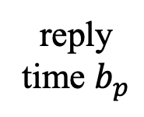


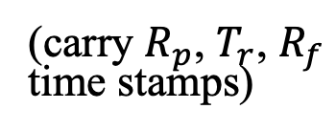



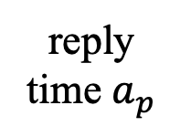
Double-sided two-way ranging (DS-TWR)
Double-sided two-way ranging (DS-TWR)
  An existing ranging protocol from IEEE Standard 802.15.4-2011 is later improved by industry giant Decawave.
Distance calculated after exchanging four messages
  poll, response, final, and report messages.
$$R_{p}$$
reply
time $b_{p}$
$$T_{r}$$
round
time $b_{d}$
$$R_{f}$$
B
time
poll
response
final
(carry $R_{p}$, $T_{r}$, $R_{f}$
time stamps)
report
round
time $a_{d}$
reply
time $a_{p}$
time
A
$$T_{p}$$
$$R_{r}$$
$$T_{f}$$

Slide 13

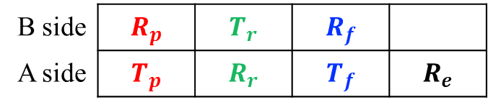
Double-sided two-way ranging (DS-TWR)
Recorded timestamps : $T_{p}, R_{p}, T_{r}, R_{r}, T_{f}, R_{f}$
Calculate the round and reply time:
  $$a_{d}=R_{r}−T_{p}, b_{p}=T_{r}−R_{p}, b_{d}=R_{f}−T_{r}, a_{p}=T_{f}−R_{r}$$
Time of flight: $t_{p}=\frac{a_{d}b_{d}−a_{p}b_{p}}{a_{d}+b_{d}+a_{p}+b_{p}}$
Conclusion: ranging if has
$$R_{p}$$
reply
time $b_{p}$
$$T_{r}$$
round
time $b_{d}$
$$R_{f}$$
B
time
poll
response
final
(carry $R_{p}$, $T_{r}$, $R_{f}$
time stamps)
report
round
time $a_{d}$
reply
time $a_{p}$
time
A
$$T_{p}$$
$$R_{r}$$
$$T_{f}$$
B side | $$R_{p}$$ | $$T_{r}$$ | $$R_{f}$$
A side | $$T_{p}$$ | $$R_{r}$$ | $$T_{f}$$ | $$R_{e}$$

Slide 14
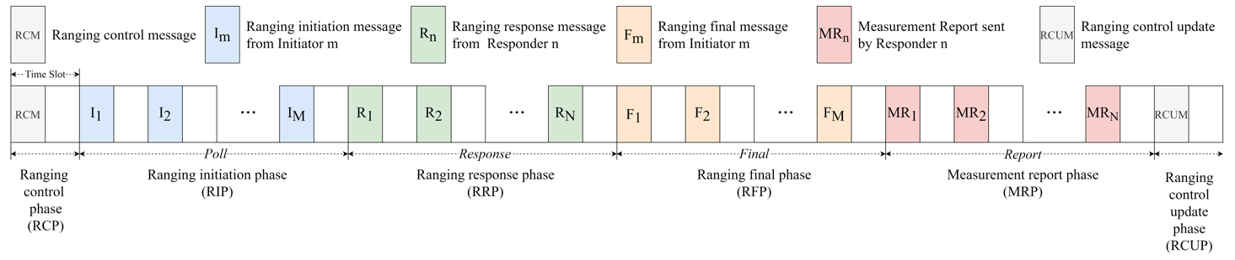
IEEE 802.15.4z-2020
Enhanced MAC and PHY layer to achieve higher ranging accuracy.
Detailed specification for many-to-many DS-TWR.
Pre-allocated time slots, unable to handle dynamic join and leave devices.
Too complicated to implement on low-end devices.
"IEEE Standard for Low-Rate Wireless Networks--Amendment 1: Enhanced Ultra Wideband (UWB) Physical Layers (PHYs) and Associated Ranging Techniques," in IEEE Std 802.15.4z-2020 (Amendment to IEEE Std 802.15.4-2020) , vol., no., pp.1-174, 25 Aug. 2020

Slide 15

A practical implementation – Token Ring
Maintain a global token to control the ranging process. Token owner initializes ranging process with all its neighbors, one by one. Then, pass the token to the next in the ring.
Token Ring method can avoid channel collision.
DS-TWR
Token
A
B
C
Broecker B, Tuyls K, Butterworth J. Distance-based multi-robot coordination on pocket drones[C]//2018 IEEE International Conference on Robotics and Automation (ICRA). IEEE, 2018: 6389-6394.

Slide 16
A practical implementation – Token Ring
Inefficient: messages heard by all neighbors, but are mostly ignored.
Unstable: when the global token is lost, the entire ranging process crashes.
DS-TWR
Token
A
B
C

Slide 17




The basic idea of swarm ranging
Define one single message named ranging message
Each side periodically broadcasts the ranging message
A
A
C
B
A
B
C
ranging message
B
Broadcast ranging message
C

Slide 18
The basic idea of swarm ranging
To deal with the challenges of the dynamic and dense swarm, the following questions must be answered.
  Q1: How to design the ranging message so that sufﬁcient timestamps are carried?
  Q2: Does the enlarged transmit period affect accuracy?
  Q3: How does high mobility affect the ranging accuracy?
  Q4: How often should the ranging message be broadcasted?
  Q5: What if message lost or ranging frequency mismatched?
  Q6: How to handle dense neighbors?
  Q7: Does the swarm ranging protocol supports or compatible with other higher level protocols?

Slide 19
Outline
Introduction
Preliminary
Protocol Design
Experiment
Conclusion

Slide 20
























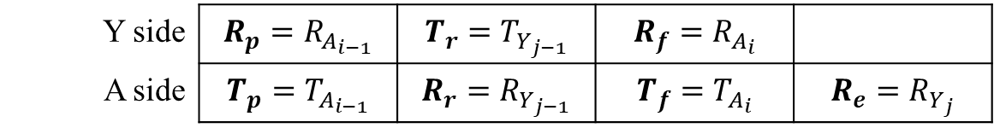
Ranging message and ranging table
Each ranging message includes
  The last transmit timestamp
  All receive timestamps since last transmit
Ranging table keeps only few timestamps
$$R_{A_{1}}$$
$$T_{Y_{1}}$$
$$R_{A_{2}}$$
$$T_{Y_{2}}$$
$$R_{A_{3}}$$
$$T_{Y_{3}}$$
$$R_{A_{4}}$$
$$T_{Y_{4}}$$
Y
$$A_{1}$$
$$Y_{1}$$
$$A_{2}$$
$$Y_{2}$$
$$A_{3}$$
$$Y_{3}$$
$$A_{4}$$
$$Y_{4}$$
A
$$T_{A_{1}}$$
$$R_{Y_{1}}$$
$$T_{A_{2}}$$
$$R_{Y_{2}}$$
$$T_{A_{3}}$$
$$R_{Y_{3}}$$
$$T_{A_{4}}$$
$$R_{Y_{4}}$$
Y side | $$R_{p}=R_{A_{i−1}}$$ | $$T_{r}=T_{Y_{j−1}}$$ | $$R_{f}=R_{A_{i}}$$
A side | $$T_{p}=T_{A_{i−1}}$$ | $$R_{r}=R_{Y_{j−1}}$$ | $$T_{f}=T_{A_{i}}$$ | $$R_{e}=R_{Y_{j}}$$

Slide 21
Ranging message and ranging table
Each ranging message includes
  The last transmit timestamp
  All receive timestamps since last transmit
Ranging table keeps only few timestamps
Q1 (ranging message design) is answered

Slide 22







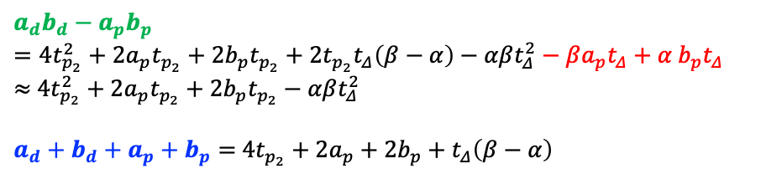






















How mobility affect ranging accuracy
Distance computed: $d_{2}$
$$vP$$
A
$$vP$$
Y
$$v$$
$$A_{i−1}$$
$$\left\{\begin{aligned}t_{p_{1}}=t_{p_{2}}+βt_{Δ} \\ t_{p_{3}}=t_{p_{2}}−αt_{Δ} \\ t_{p_{4}}=t_{p_{2}}−t_{Δ} \\ a_{d}=b_{p}+2t_{p_{2}}+βt_{Δ} \\ b_{d}=a_{p}+2t_{p_{2}}−αt_{Δ} \\ { a}_{d}≈b_{p},∵t_{Δ},t_{p_{2}}≪{a_{d},b}_{p} \\ { b}_{p}:a_{p}≈β:α \end{aligned}\right.$$
$$d_{1}$$
$$d_{2}$$
$$Y_{j−1}$$
$$d_{3}$$
$$A_{i}$$
$$Y_{j}$$
distance
$$d_{4}$$
$${βt}_{∆}c$$
$${αt}_{∆}c$$
$$t_{p_{3}}c$$
$$t_{∆}c$$
$$t_{p_{4}}c$$
$$t_{p_{1}}c$$
$$t_{p_{2}}c$$
$$b_{p}$$
$$b_{d}$$
Y
$$A_{i−1}$$
$$Y_{j−1}$$
$$A_{i}$$
$$Y_{j}$$
time
$$a_{d}$$
$$a_{p}$$
time
A
$$ToF=t_{p}^{computed}=\frac{a_{d}b_{d}−a_{p}b_{p}}{a_{d}+b_{d}+a_{p}+b_{p}}=t_{p_{2}}+\frac{t_{p_{2}}t_{Δ}\left(β−α\right)−αβt_{Δ}^{2}}{4t_{p_{2}}+2a_{p}+2b_{p}+t_{Δ}\left(β−α\right)}≈t_{p_{2}}$$
$$a_{d}b_{d}−a_{p}b_{p}=4t_{p_{2}}^{2}+2a_{p}t_{p_{2}}+2b_{p}t_{p_{2}}+2t_{p_{2}}t_{Δ}\left(β−α\right)−αβt_{Δ}^{2}−βa_{p}t_{Δ}+α{ b}_{p}t_{Δ}$$
$≈$ $4t_{p_{2}}^{2}+2a_{p}t_{p_{2}}+2b_{p}t_{p_{2}}−αβt_{Δ}^{2}$
$a_{d}+b_{d}+a_{p}+b_{p}=$ $4t_{p_{2}}+2a_{p}+2b_{p}+t_{Δ}\left(β−α\right)$

Slide 23











How mobility affect ranging accuracy
Distance computed: $d_{2}$
$$vP$$
A
$$vP$$
Y
$$v$$
$$A_{i−1}$$
$$\left\{\begin{aligned}t_{p_{1}}=t_{p_{2}}+βt_{Δ} \\ t_{p_{3}}=t_{p_{2}}−αt_{Δ} \\ t_{p_{4}}=t_{p_{2}}−t_{Δ} \\ a_{d}=b_{p}+2t_{p_{2}}+βt_{Δ} \\ b_{d}=a_{p}+2t_{p_{2}}−αt_{Δ} \\ { a}_{d}≈b_{p},∵t_{Δ},t_{p_{2}}≪{a_{d},b}_{p} \\ { b}_{p}:a_{p}≈β:α \end{aligned}\right.$$
$$d_{1}$$
$$d_{2}$$
$$Y_{j−1}$$
$$d_{3}$$
$$A_{i}$$
$$Y_{j}$$
distance
$$d_{4}$$
$${βt}_{∆}c$$
$${αt}_{∆}c$$
$$t_{p_{3}}c$$
$$t_{∆}c$$
$$t_{p_{4}}c$$
$$t_{p_{1}}c$$
$$t_{p_{2}}c$$
$$b_{p}$$
$$b_{d}$$
Y
$$A_{i−1}$$
$$Y_{j−1}$$
$$A_{i}$$
$$Y_{j}$$
time
$$a_{d}$$
$$a_{p}$$
time
A
$$ToF=t_{p}^{computed}=\frac{a_{d}b_{d}−a_{p}b_{p}}{a_{d}+b_{d}+a_{p}+b_{p}}=t_{p_{2}}+\frac{t_{p_{2}}t_{Δ}\left(β−α\right)−αβt_{Δ}^{2}}{4t_{p_{2}}+2a_{p}+2b_{p}+t_{Δ}\left(β−α\right)}≈t_{p_{2}}$$
Q3 (mobility affects accuracy) is answered

Slide 24
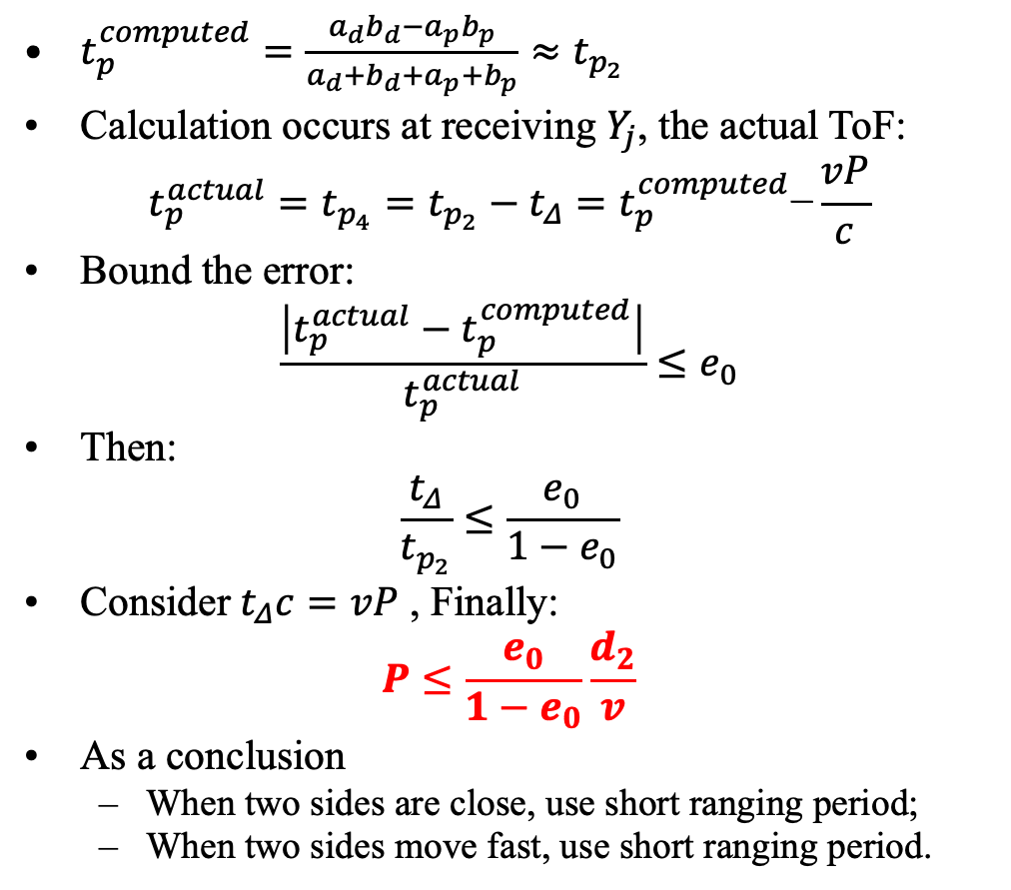
Design of adaptive ranging protocol
$t_{p}^{computed}=\frac{a_{d}b_{d}−a_{p}b_{p}}{a_{d}+b_{d}+a_{p}+b_{p}}≈t_{p_{2}}$
Calculation occurs at receiving $Y_{j}$, the actual ToF:
$$t_{p}^{actual}=t_{p_{4}}=t_{p_{2}}−t_{Δ}=t_{p}^{computed}\text{−}\frac{vP}{c}$$
Bound the error:
$$\frac{\left|t_{p}^{actual}−t_{p}^{computed}\right|}{t_{p}^{actual}}≤e_{0}$$
Then:
$$\frac{t_{Δ}}{t_{p_{2}}}≤\frac{e_{0}}{1−e_{0}}$$
Consider${ t}_{Δ}c=vP$ , Finally:
$$P≤\frac{e_{0}}{1−e_{0}}\frac{d_{2}}{v}$$
As a conclusion
  When two sides are close, use short ranging period;
  When two sides move fast, use short ranging period.
Q4 (broadcast frequency) is answered

Slide 25



















Packet loss and ranging period mismatch
We summary four cases.
  Case 1, $A$ side receives more than it transmits.
  Case 2, one message from $A$ side is lost.
  Case 3, $A$ side transmits more than it receives.
  Case 4, one message from $Y$ side is lost.
Y
Y
$$A_{i−1}$$
$$Y_{j−1}$$
$$Y_{j}$$
$$A_{i−1}$$
$$Y_{j−1}$$
$$A_{i}$$
$$Y_{j}$$
A
A
Case 1
Case 2
Y
Y
$$A_{i−1}$$
$$Y_{j−1}$$
$$A_{i}$$
$$A_{i+1}$$
$$Y_{j}$$
$$A_{i−1}$$
$$Y_{j−1}$$
$$A_{i}$$
$$Y_{j}$$
$$A_{i+1}$$
$$Y_{j+1}$$
A
A
Case 3
Case 4

Slide 26

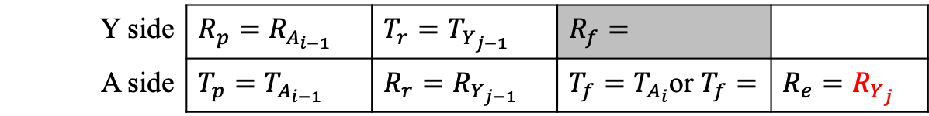




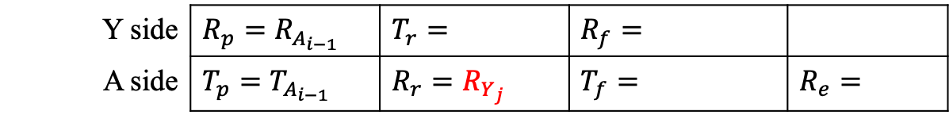
Handle mismatch and loss
Handle Case 1 and Case 2
Y
Y
$$A_{i−1}$$
$$Y_{j−1}$$
$$Y_{j}$$
$$A_{i−1}$$
$$Y_{j−1}$$
$$A_{i}$$
$$Y_{j}$$
A
A
Case 1
Case 2
Y side | $$R_{p}=R_{A_{i−1}}$$ | $$T_{r}=T_{Y_{j−1}}$$ | $$R_{f}=$$
A side | $$T_{p}=T_{A_{i−1}}$$ | $$R_{r}=R_{Y_{j−1}}$$ | $T_{f}=T_{A_{i}}$or $T_{f}=$ | $$R_{e}=R_{Y_{j}}$$
Y side | $$R_{p}=R_{A_{i−1}}$$ | $$T_{r}=$$ | $$R_{f}=$$
A side | $$T_{p}=T_{A_{i−1}}$$ | $$R_{r}=R_{Y_{j}}$$ | $$T_{f}=$$ | $$R_{e}=$$

Slide 27

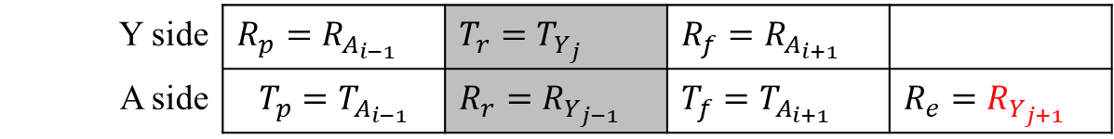



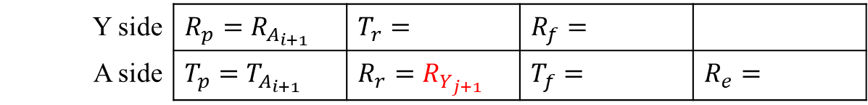
Handle mismatch and loss
Handle Case 4
Y
$$A_{i−1}$$
$$Y_{j−1}$$
$$A_{i}$$
$$Y_{j}$$
$$A_{i+1}$$
$$Y_{j+1}$$
A
Case 4
Y side | $$R_{p}=R_{A_{i−1}}$$ | $$T_{r}=T_{Y_{j}}$$ | $$R_{f}=R_{A_{i+1}}$$
A side | $$T_{p}=T_{A_{i−1}}$$ | $$R_{r}=R_{Y_{j−1}}$$ | $$T_{f}=T_{A_{i+1}}$$ | $$R_{e}=R_{Y_{j+1}}$$
Y side | $$R_{p}=R_{A_{i+1}}$$ | $$T_{r}=$$ | $$R_{f}=$$
A side | $$T_{p}=T_{A_{i+1}}$$ | $$R_{r}=R_{Y_{j+1}}$$ | $$T_{f}=$$ | $$R_{e}=$$
Q5 (packet loss and mismatched frequency) is answered

Slide 28
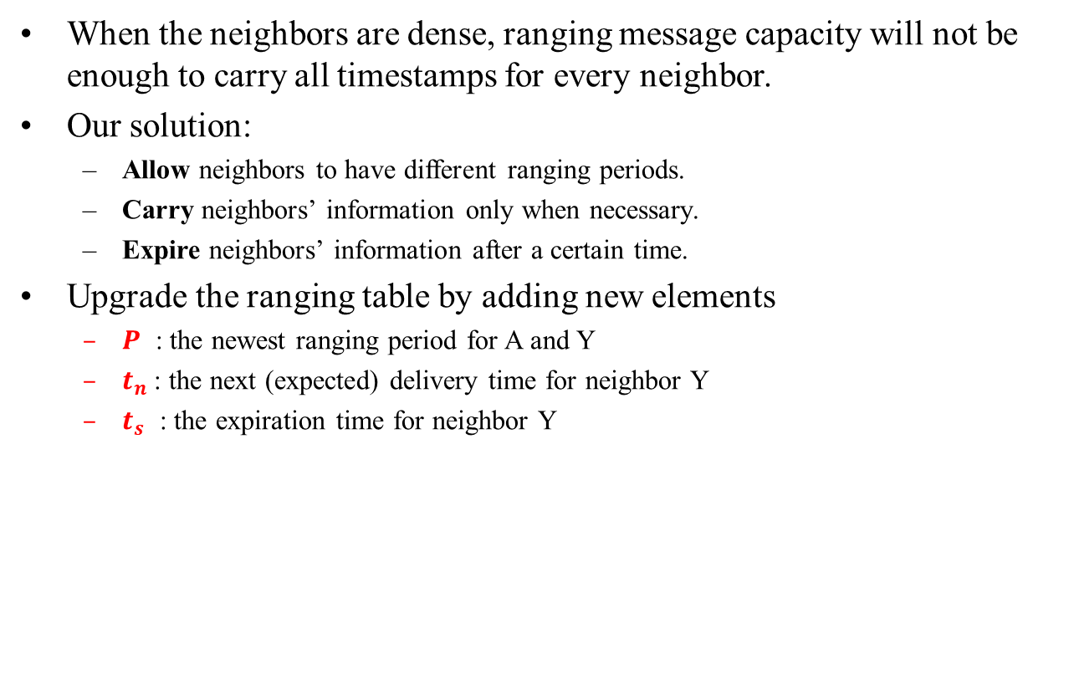
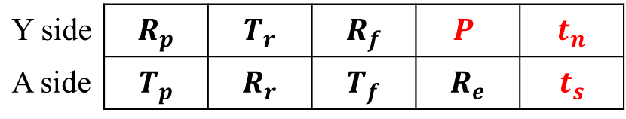
Handle dense neighbors
When the neighbors are dense, ranging message capacity will not be enough to carry all timestamps for every neighbor.
Our solution:
  Allow neighbors to have different ranging periods.
  Carry neighbors’ information only when necessary.
  Expire neighbors’ information after a certain time.
Upgrade the ranging table by adding new elements
  $P$ : the newest ranging period for A and Y
  $t_{n}$: the next (expected) delivery time for neighbor Y
  $t_{s}$ : the expiration time for neighbor Y
Y side | $$R_{p}$$ | $$T_{r}$$ | $$R_{f}$$ | $$P$$ | $$t_{n}$$
A side | $$T_{p}$$ | $$R_{r}$$ | $$T_{f}$$ | $$R_{e}$$ | $$t_{s}$$

Slide 29






















Handle dense neighbors
Selectively include known neighbors’ timestamp information in every ranging message M according to${ t}_{n}$until reach the maximum size limitation. Update each included neighbors’${ t}_{n}$to T (local clock time of A) + P.
T₁
T₂
T₃
T₄
Time Interval
$${ t}_{A1}$$
$${ t}_{B1}$$
$${ t}_{C1}$$
$${ t}_{D1}$$
$${ t}_{D2}$$
$${ t}_{A2}$$
$${ t}_{B2}$$
$${ t}_{E1}$$
$${ t}_{C2}$$
$${ t}_{D3}$$
$${ t}_{B3}$$
$${ t}_{A3}$$
$${ t}_{E2}$$
$${ t}_{C3}$$
$${ t}_{B4}$$
$${ t}_{D4}$$
$${ t}_{A4}$$
$${ t}_{E3}$$
$${ t}_{C4}$$
$${ t}_{B5}$$
$${ t}_{D5}$$
Time
M₁={A, B, C, D}
M₂={D, A, B, E}
M₃={C, D, B, A}
M₄={E, C, B, D}
Q6 (dense neighbor) is answered

Slide 30
Support higher level protocols/algorithms
Maintains neighbor list for higher level protocol, e. g., OLSR.
Support for localization by providing the fundamental distance information
Applications
Source Seeking
Exploration
Mapping
Battling
...
Fundamental
Technologies
Ad Hoc
Networking
Network
Localization
Swarm Ranging
...
Hardware
Drones
Robots
Mobile phones
Wearable devices
Q7 (support higher level protocols) is answered

Slide 31
Outline
Introduction
Preliminary
Protocol Design
Experiment
Conclusion

Slide 32

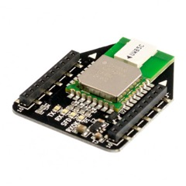
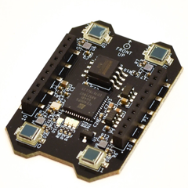
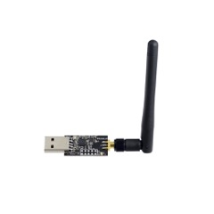
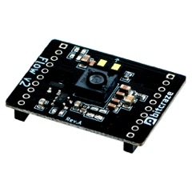
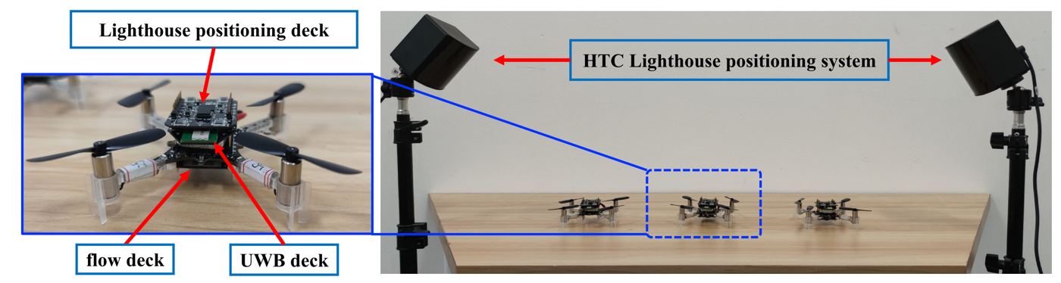
Hardware
Crazyflie 2.1
DW1000/3000
UWB deck
Lighthouse deck
Crazyradio PA
Flow deck
Slide 32

Slide 33
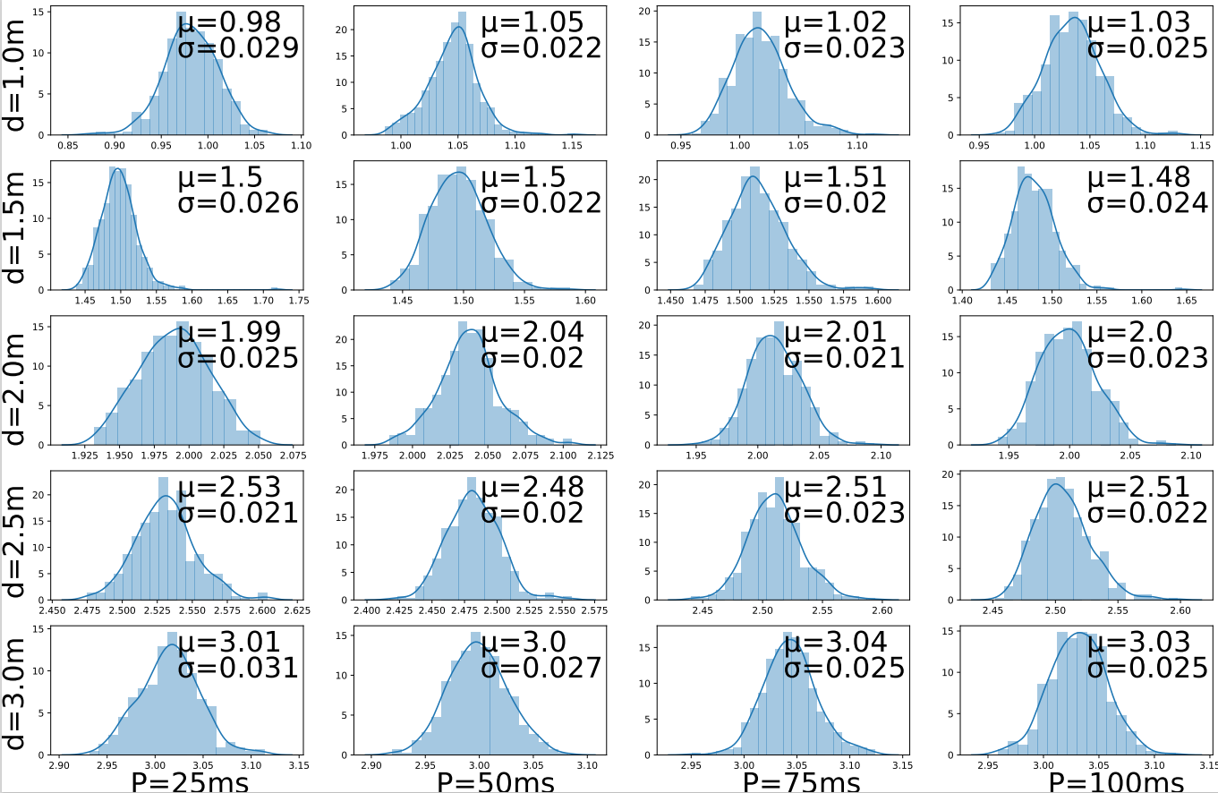
Ranging period and accuracy
The impact of ranging period on ranging accuracy
Slide 33

Slide 34
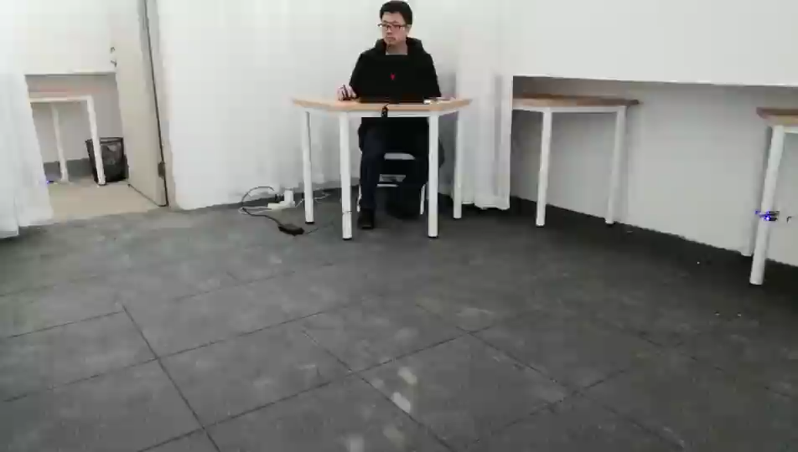
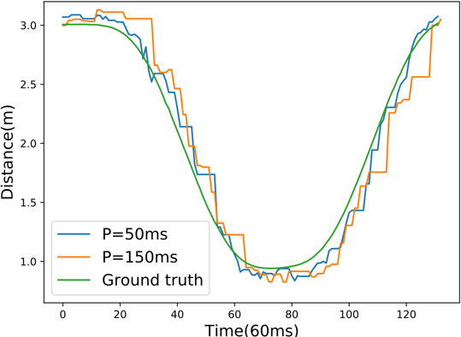
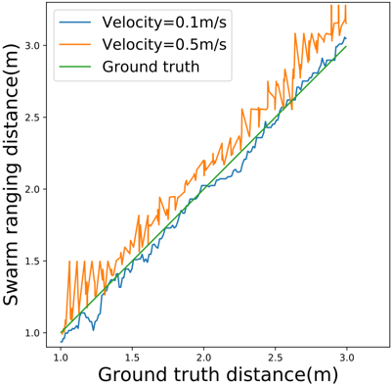
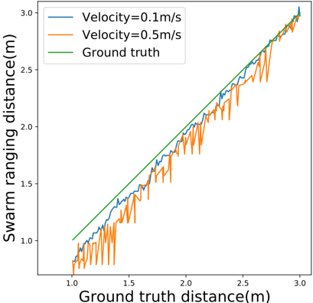
Velocity, ranging period and accuracy
The ranging results are delayed compare to the ground truth.
The larger P, the bigger delay.
Velocity also affects the delay .
Impact of ranging period
moving towards
moving away
Slide 34

Slide 35
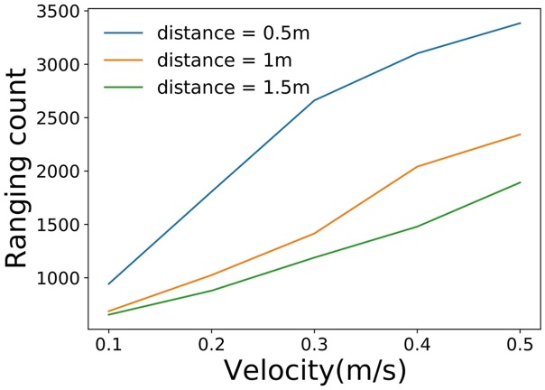
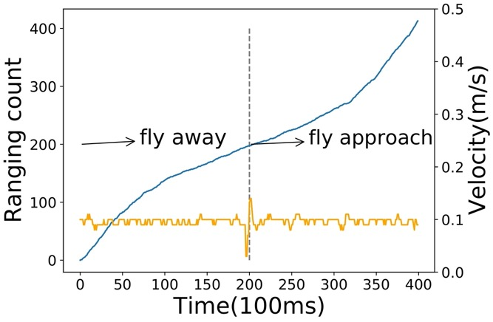

Adaptive ranging period
$$P≤\frac{e_{0}}{1−e_{0}}\frac{d_{2}}{v}$$
Adaptive to velocity
Adaptive to distance
Slide 35

Slide 36
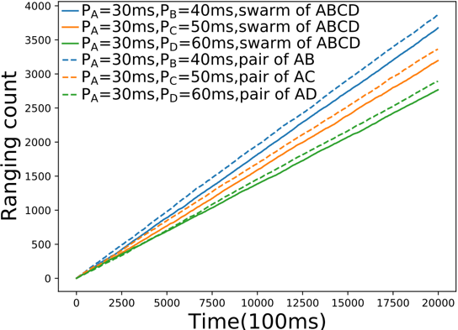
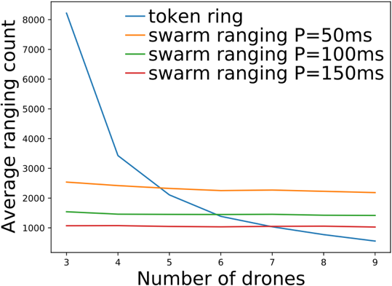
Protocol performance
Performance for mismatched ranging period
Comparison with ranging based on token ring.
Slide 36

Slide 37
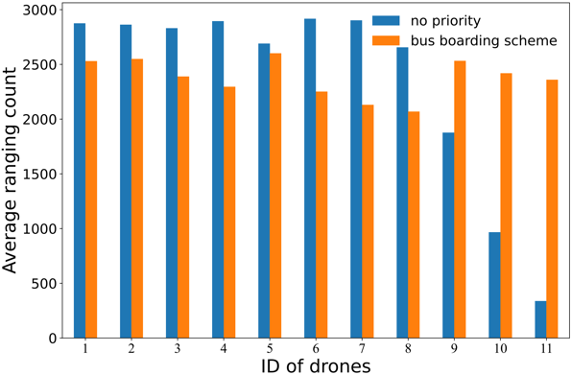
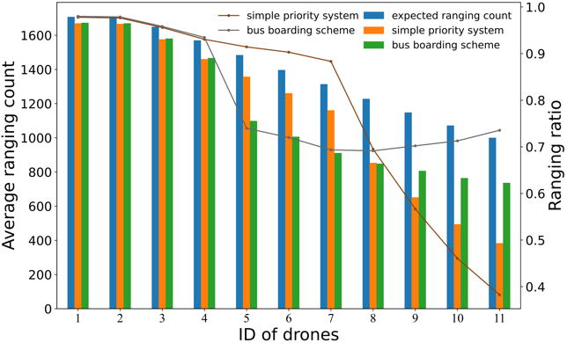
Handle dense neighbors
Balances the allocation of ranging resources.
Guarantees fair chances for each drone to ranging.
Slide 37

Slide 38
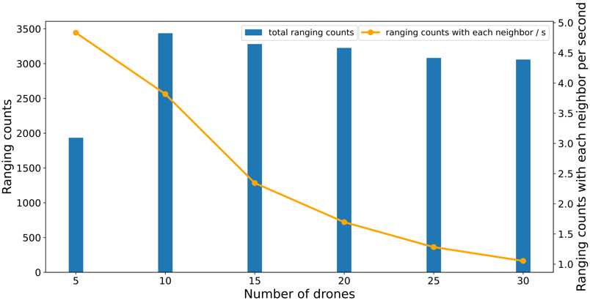
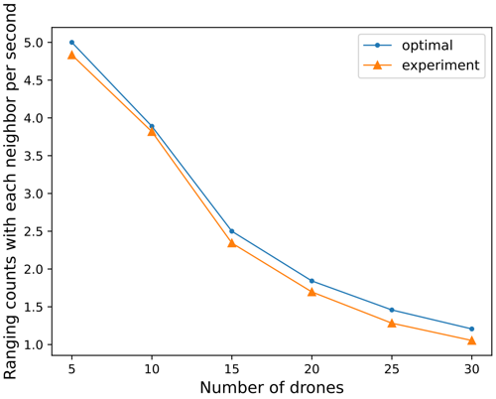
Scalability
Close to the optimal performance.
Even when there are 29 neighbors to respond to, our protocol can still guarantee that all the neighbors’ latest distances are measured every second.
Slide 38

Slide 39
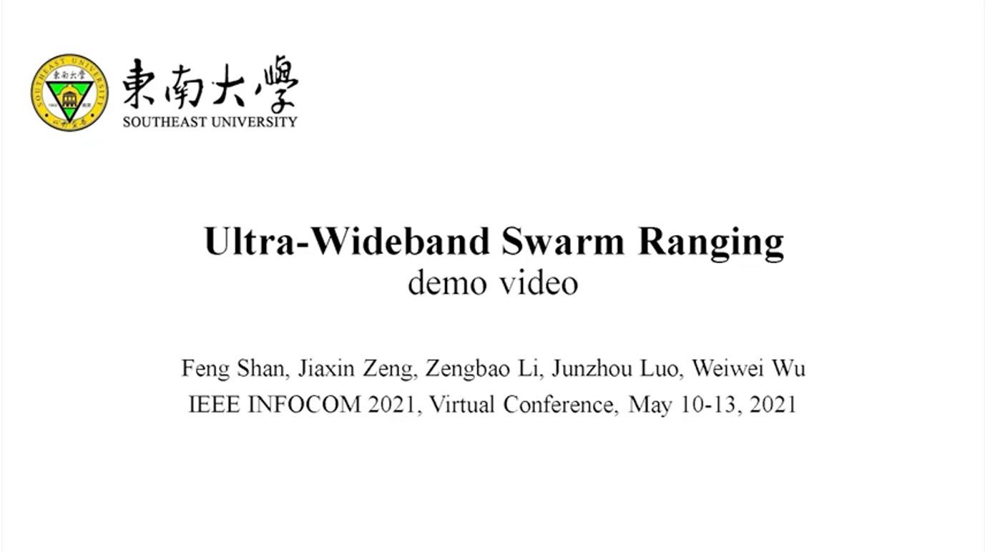
Demo Video
Slide 39

Slide 40
Outline
Introduction
Preliminary
Protocol Design
Experiment
Conclusion

Slide 41
Conclusion
We proposed a UWB swarm ranging protocol, designed specially for dynamic and dense networks.
It is simple yet efficient. All messages are unified in one, i.e., ranging message, which is broadcasted periodically.
It is adaptive and robust. The ranging period adapts to the ranging pair’s velocity and distance. Packet loss is handled appropriately.
It is scalable and compatible. A rotation scheme is designed to handle dense neighbors. Higher level networking and localization protocols and algorithms are supported.
Real-world experiment is conducted. The protocol is implemented on Crazyflie drones, that are powered by STM32 microcontrollers and have only 192KB memory.

Slide 42
Comparison
802.15.4z Many-to-Many DS-TWR
  Multiple roles and message types are involved.
  Pre-allocated time slots, not suitable for dynamic join and leave devices (time-scheduling mode).
  Contend control requires additional control information (contend mode).
  Require higher-level packet loss and ranging starvation handling.
  Suitable for application scenarios with low mobility and sparse devices.
Swarm Ranging Protocol
  Only one message type is involved (Ranging Message), easy to implement.
  No additional ranging control overhead (i.e. RCP and RCUP).
  Packet loss is carefully considered and handled.
  Alleviate ranging starvation by utilizing local information.
  Designed for dynamic and dense swarm applications.
Open source code: https://github.com/SEU-NetSI/crazyflie-firmware

Slide 43
Q&A

