Slide 1
Project: IEEE P802.15 Working Group for Wireless Specialty Networks (WSN)
Submission Title: Time-efficient one-to-many ranging using MMS-UWB
Source: Bin Qian, Chenchen Liu, Lei Huang, David Xun Yang (Huawei Technologies)
Address : [Huawei Bantian Base, Longgang District, Shenzhen, 518129 China]
E-Mail: [qianbin14@huawei.com]
Re: Task Group 4ab: UWB Next Generation for 802.15.4
Abstract: [UWB, one-to-many ranging]
Purpose:
Notice: This document has been prepared to assist the IEEE P802.15. It is offered as a basis for discussion and is not binding on the contributing individual(s) or organization(s). The material in this document is subject to change in form and content after further study. The contributor(s) reserve(s) the right to add, amend or withdraw material contained herein.
Release: The contributor acknowledges and accepts that this contribution becomes the property of IEEE and may be made publicly available by P802.15.
Notes:
Jul 12, 2010
Page 1

Slide 2
PAR Objective | Proposed Solution (how addressed)
Safeguards so that the high throughput data use cases will not cause significant disruption to low duty-cycle ranging use cases
Interference mitigation techniques to support higher density and higher traffic use cases
Other coexistence improvement
Backward compatibility with enhanced ranging capable devices (ERDEVs)
Improved link budget and/or reduced air-time
Additional channels and operating frequencies
Improvements to accuracy / precision / reliability and interoperability for high-integrity ranging
Reduced complexity and power consumption
Hybrid operation with narrowband signaling to assist UWB
Enhanced native discovery and connection setup mechanisms
Sensing capabilities to support presence detection and environment mapping
Low-power low-latency streaming
Higher data-rate streaming allowing at least 50 Mbit/s of throughput
Support for peer-to-peer, peer-to-multi-peer, and station-to-infrastructure protocols | Time-efficient one-to-many ranging using MMS-UWB
Infrastructure synchronization mechanisms

Slide 3
Previous contributions related to one-to-many ranging
[1] DCN 585r1 “One-to-many ranging using NBA-MMS”
[2] DCN 015r1 “one to many ranging using MMR technical framework proposal”

Slide 4
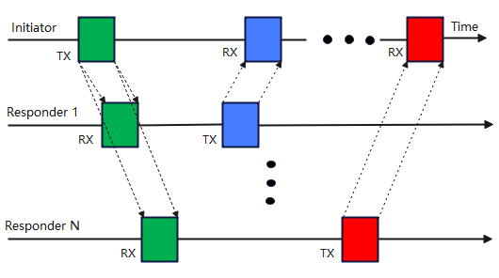
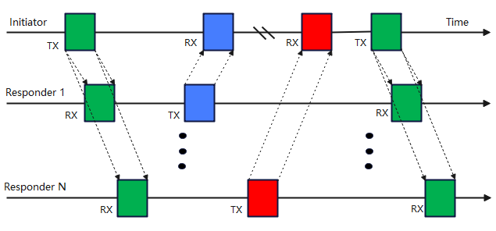
Recap of one-to-many ranging in 4z
SS-TWR
DS-TWR
The initiator broadcasts UWB ranging signals to all responders
Different responders reply to the UWB ranging signals in the different time slots

Slide 5
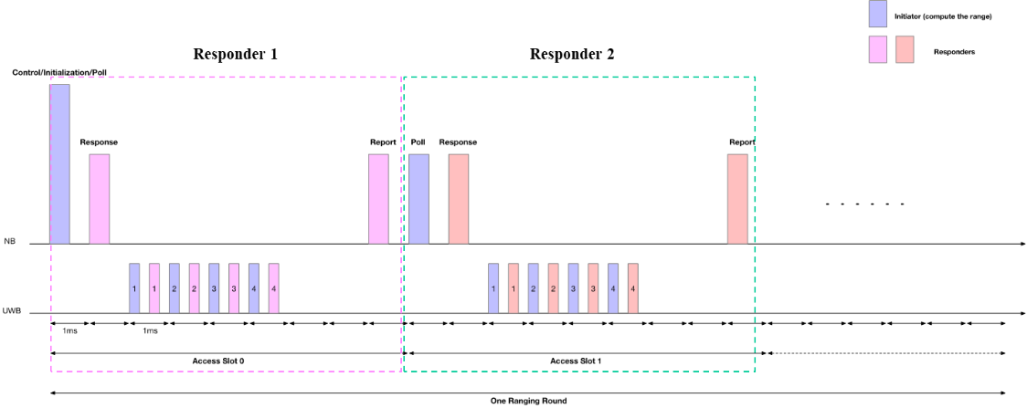
One-to-many ranging in MMS-UWB
In DCN585, an one-to-many ranging scheme is proposed, where multiple one-to-one ranging procedures are concatenated
Simple implementation
Low time-efficiency

Slide 6
Time sensitive application
VR/AR is one of important use cases for UWB
  As stated in DCN465r2, UWB ranging could be used for recognizing user motions and gestures
VR/AR is time sensitive application
  Time efficiency of ranging is critical especially as the number of devices supported increases
MMS-UWB could be used to tackle the problem of body block in the AR/VR related applications
It is useful to improve the time efficiency of one-to-many ranging of MMS-UWB

Slide 7
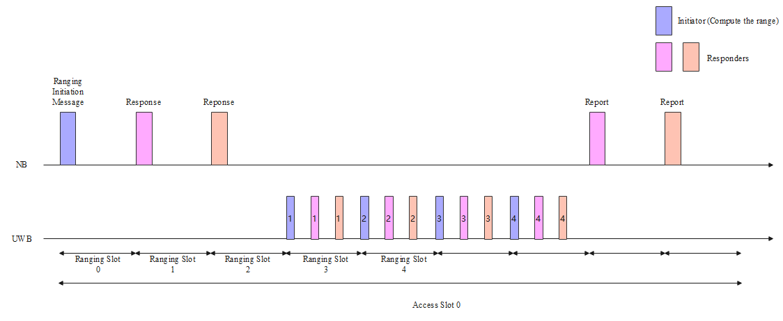
Time-efficient one-to-many ranging by time division multiplexing
The responders can send an UWB fragment one-by-one in their assigned time slots within one 1ms-duration
The overall air time is reduced since the number of UWB fragment transmitted by the initiator is reduced compared with the concatenation method in slides 4
It is a natural extension of one-to-many ranging in 4z

Slide 8
Implementation Remarks
The transmission order of the responders could be indicated by the ranging initiation message
  The responders shall be capable of a fixed reply time of sufficient precision
The initiator needs to accumulate multiple UWB fragments from different responders
  It is necessary to set a minimum spacing between two adjacent responders’ UWB fragments
  Additional memory is required at the initiator
The maximum number of responders involved in the time-efficient one-to-many ranging by time division multiplexing should be limited, e.g., 2 or 3.

Slide 9
Time-efficient one-to-many ranging by code division multiplexing
In DCN0015, another time-efficient one-to-many ranging is illustrated where different responders may send UWB fragments at the same time using different MMRS with sufficient cross-correlation suppression
  When utilizing an MMRS based on complementary sets
    The cross-correlation suppression performance could be guaranteed by setting different values of the gap
  When utilizing an Ipatov sequence for MMRS
    The cross-correlation suppression is computed in DCN 0616r0
    To improve the cross-correlation suppression, it is helpful to apply the cyclic shifted Ipatov sequence, which can have a zero cross-correlation zone
𝑪𝑹𝑷(𝒙,𝒚) (dB) | Seq25 | Seq26 | Seq27 | Seq28 | Seq29 | Seq30 | Seq31 | Seq32
Seq25 | 0 | -14.6 | -10.2 | -10.6 | -10.6 | -13.6 | -9.5 | -13.1
Seq26 | -14.6 | 0 | -10.6 | -13.6 | -10.2 | -10.6 | -10.6 | -10.9
Seq27 | -10.2 | -10.6 | 0 | -14.6 | -13.6 | -10.6 | -10.2 | -10.6
Seq28 | -10.6 | -13.6 | -14.6 | 0 | -10.6 | -10.2 | -12.1 | -9.5
Seq29 | -10.6 | -10.2 | -13.6 | -10.6 | 0 | -14.6 | -13.1 | -12.1
Seq30 | -13.6 | -10.6 | -10.6 | -10.2 | -14.6 | 0 | -10.9 | -10.2
Seq31 | -9.5 | -10.6 | -10.2 | -12.1 | -13.1 | -10.9 | 0 | -10.6
Seq32 | -13.1 | -10.9 | -10.6 | -9.5 | -12.1 | -10.2 | -10.6 | 0

Slide 10
Summary
The one-to-many ranging schemes in MMS-UWB is recommended to improve the time efficiency, especially for the time sensitive applications
The maximum number of responders involved in the time-efficient one-to-many ranging in MMS-UWB should be limited
In the code division multiplexing option, when utilizing an Ipatov sequence as MMRS, the cyclic shifted Ipatov sequence is recommended to guarantee the sufficient cross-correlation suppression

