Slide 1
Project: IEEE P802.15 Working Group for Wireless Personal Area Networks (WPANs)
Submission Title: [Bistatic Sensing and Phase Noise – Uniform HPRF vs. PBS]
Date Submitted: [16 Jan, 2023]
Source: [Håkon A. Hjortland, Nikolaj Andersen, Kristian Granhaug, Dries Neirynck, Jan Roar Pleym, Dag T. Wisland] Company [Novelda AS]
E-mail: [haakon.hjortland@novelda.com]
Re: [Working Group input]
Abstract: [Uniform high-PRF bistatic sensing suffers from sidelobe noise due to phase noise when the nodes are close to each other. Pulse burst sensing avoids this problem by ensuring that none of the sidelobes are located where the weak far-away targets are. Simulation results are presented.]
Purpose: []
Notice: This document has been prepared to assist the IEEE P802.15. It is offered as a basis for discussion and is not binding on the contributing individual(s) or organization(s). The material in this document is subject to change in form and content after further study. The contributor(s) reserve(s) the right to add, amend or withdraw material contained herein.
Release: The contributor acknowledges and accepts that this contribution becomes the property of IEEE and may be made publicly available by P802.15.

Slide 2
PAR Objective | Proposed Solution (how addressed)
Safeguards so that the high throughput data use cases will not cause significant disruption to low duty-cycle ranging use cases
Interference mitigation techniques to support higher density and higher traffic use cases
Other coexistence improvement
Backward compatibility with enhanced ranging capable devices (ERDEVs)
Improved link budget and/or reduced air-time | High mean PRF, reduced impact of phase noise
Additional channels and operating frequencies
Improvements to accuracy / precision / reliability and interoperability for high-integrity ranging
Reduced complexity and power consumption
Hybrid operation with narrowband signaling to assist UWB
Enhanced native discovery and connection setup mechanisms
Sensing capabilities to support presence detection and environment mapping | Good sensitivity at long ranges, channel diversity from combined monostatic and bistatic sensing
Low-power low-latency streaming
Higher data-rate streaming allowing at least 50 Mbit/s of throughput
Support for peer-to-peer, peer-to-multi-peer, and station-to-infrastructure protocols
Infrastructure synchronization mechanisms

Slide 3
Bistatic Sensing and Phase Noise Uniform HPRF vs. PBS

Slide 4
Related TG4ab Contributions
15-22-0308-00-04ab-air-time-efficiency-improvements
15-22-0335-00-04ab-air-time-efficiency-improvements-update
15-22-0592-00-04ab-pulse-burst-sensing-phase-noise-proof-supercomplementary-set-of-sequences
15-22-0602-00-04ab-sensing-sequence-metrics

Slide 5
Introduction
The phase noise issue discussed here concerns:
HPRF bistatic sensing
Nodes close to each other
Target far away
The simulations presented here show how phase noise impacts the bistatic sensing
Assumed system design goals:
Minimize air-time to reduce power consumption
So do not reduce the Tx pulse amplitude to try to mitigate the phase noise issue
System should preferably be thermal noise limited, not phase noise limited
The standard should have both HPRF and PBS, not PBS only
Sensing patterns: HPRF / PBS
Sensing sequences: We prefer Ipatov for both HPRF and PBS

Slide 6
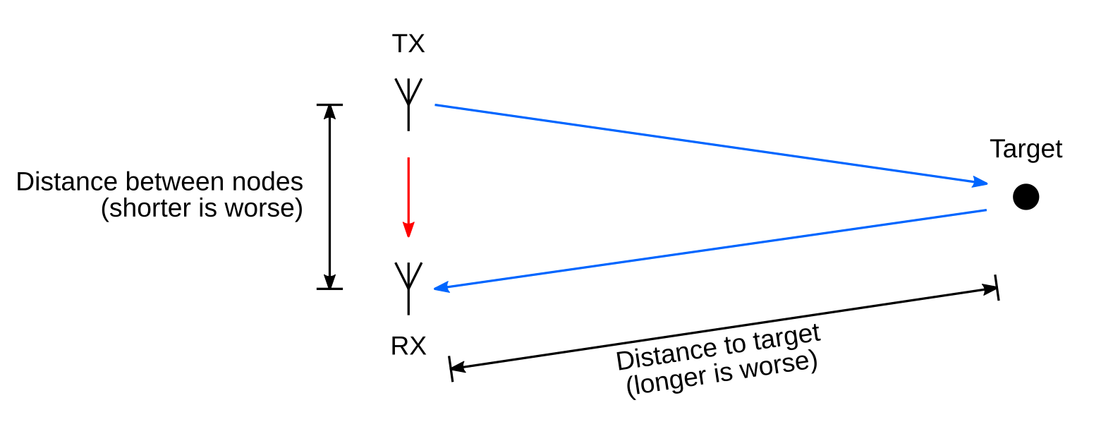
Bistatic Sensing Scenario

Slide 7
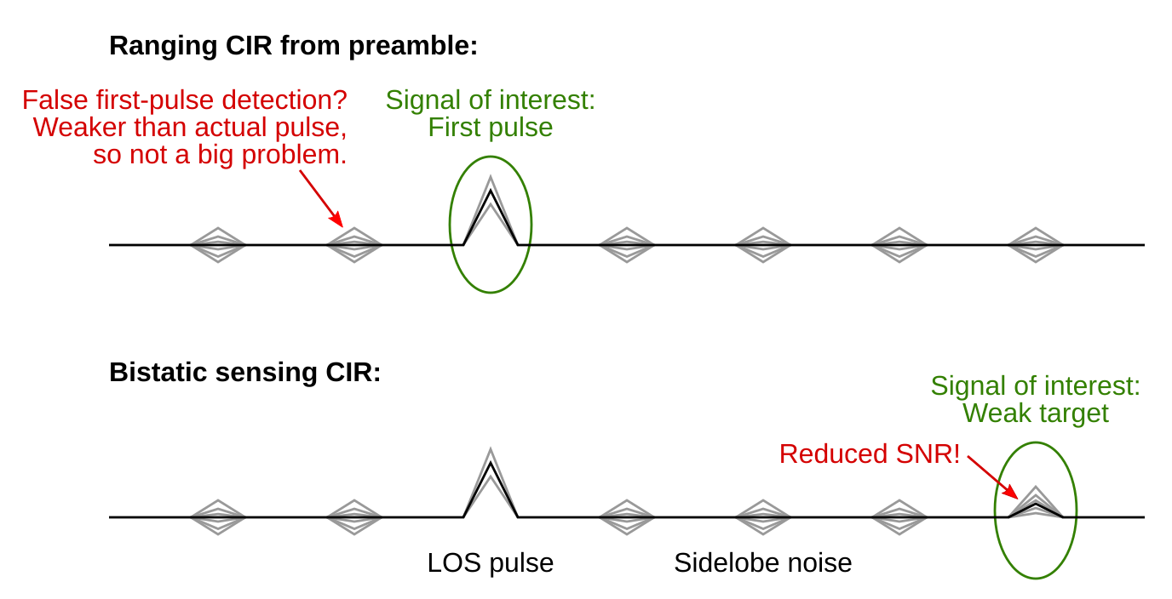
Sensing is More Sensitive to Phase Noise Than Ranging

Slide 8
Simulation Parameters
Tx pulse:
Gaussian shape, σ = 0.88 ns, 6 ns rectangular window
Amplitude: 0.5 V (R = 100 Ω)
Energy per pulse: 1.95 pJ
Center frequency: 8 GHz
Tx/Rx antenna gain: 0 dB
Transmissions are within FCC peak and mean power limits
Noise figure: 5 dB
Metric: Largest sidelobe noise due to phase noise in 0 ns to 66 ns range

Slide 9
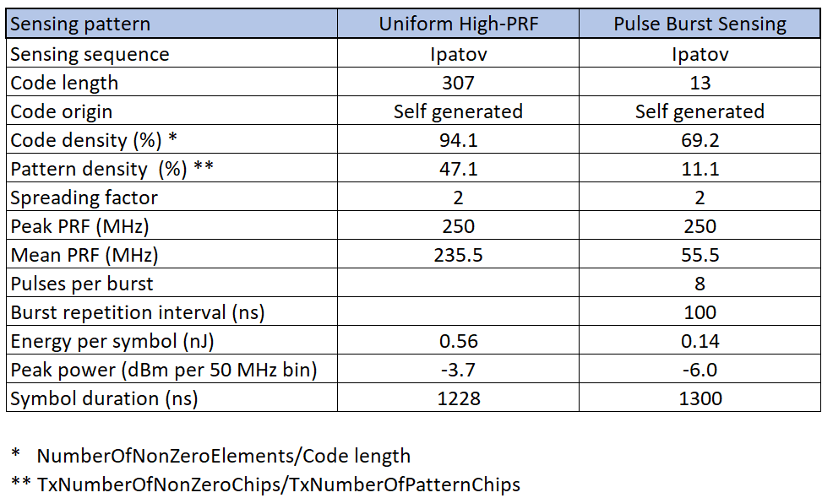
Simulation Parameters Sensing Patterns and Sequences Note: These are just examples, not proposed sequences. Using Ipatov with length 307 to allow 250 MHz PRF.

Slide 10
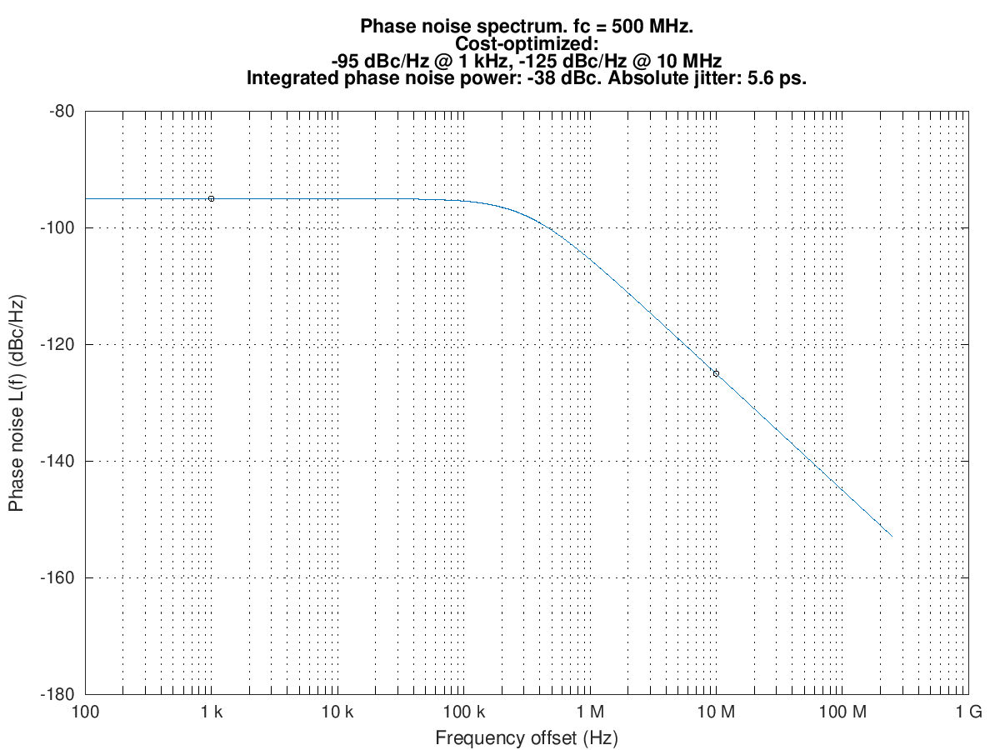
Simulation Parameters Phase Noise Spectrum of Example Cost-Optimized PLL
Based on measured performance of a real-world PLL
In the simulator, 3 dB is added to the spectrum below to reflect that there is phase noise in both TX and RX

Slide 11
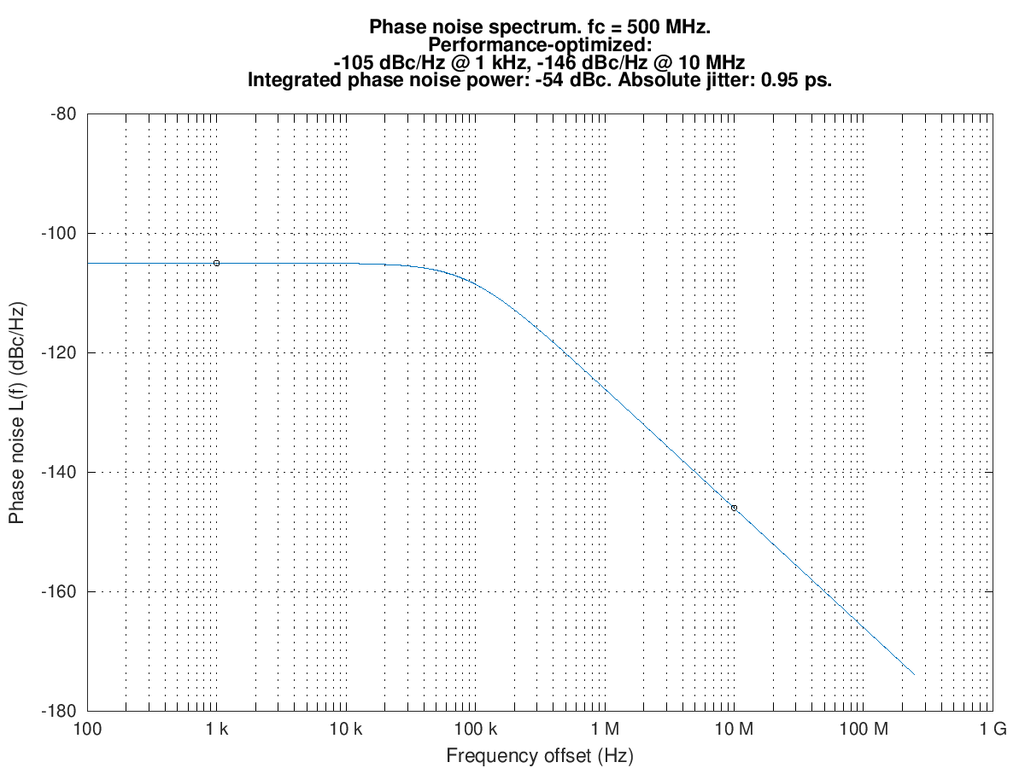
Simulation Parameters Phase Noise Spectrum of Example Performance-Optimized PLL
Based on a performance template provided to us
In the simulator, 3 dB is added to the spectrum below to reflect that there is phase noise in both TX and RX

Slide 12
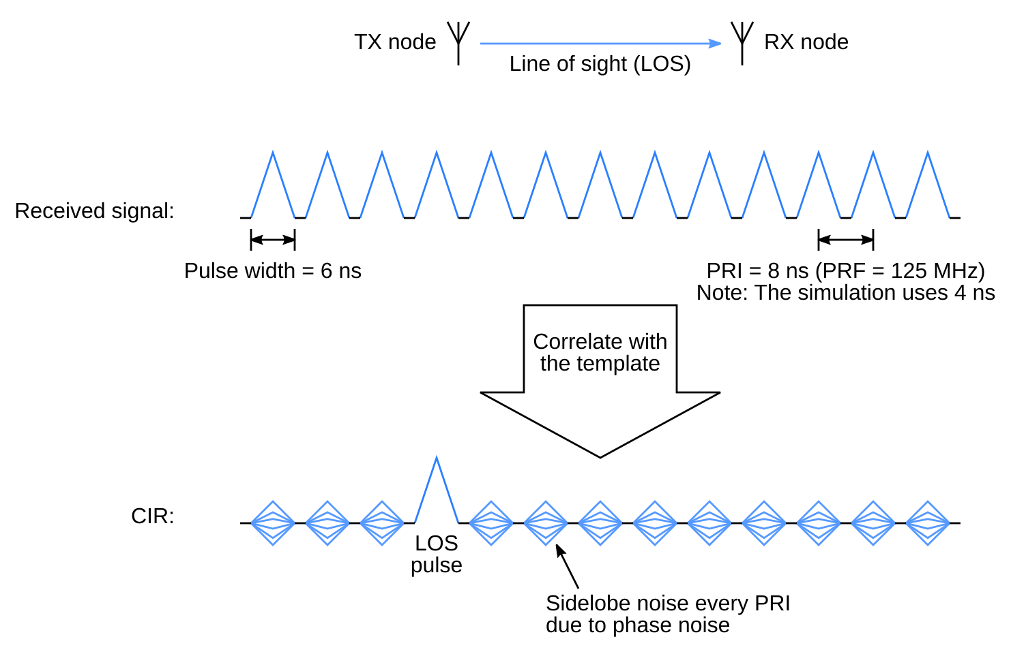
Uniform High-PRF Sensing Waveforms

Slide 13
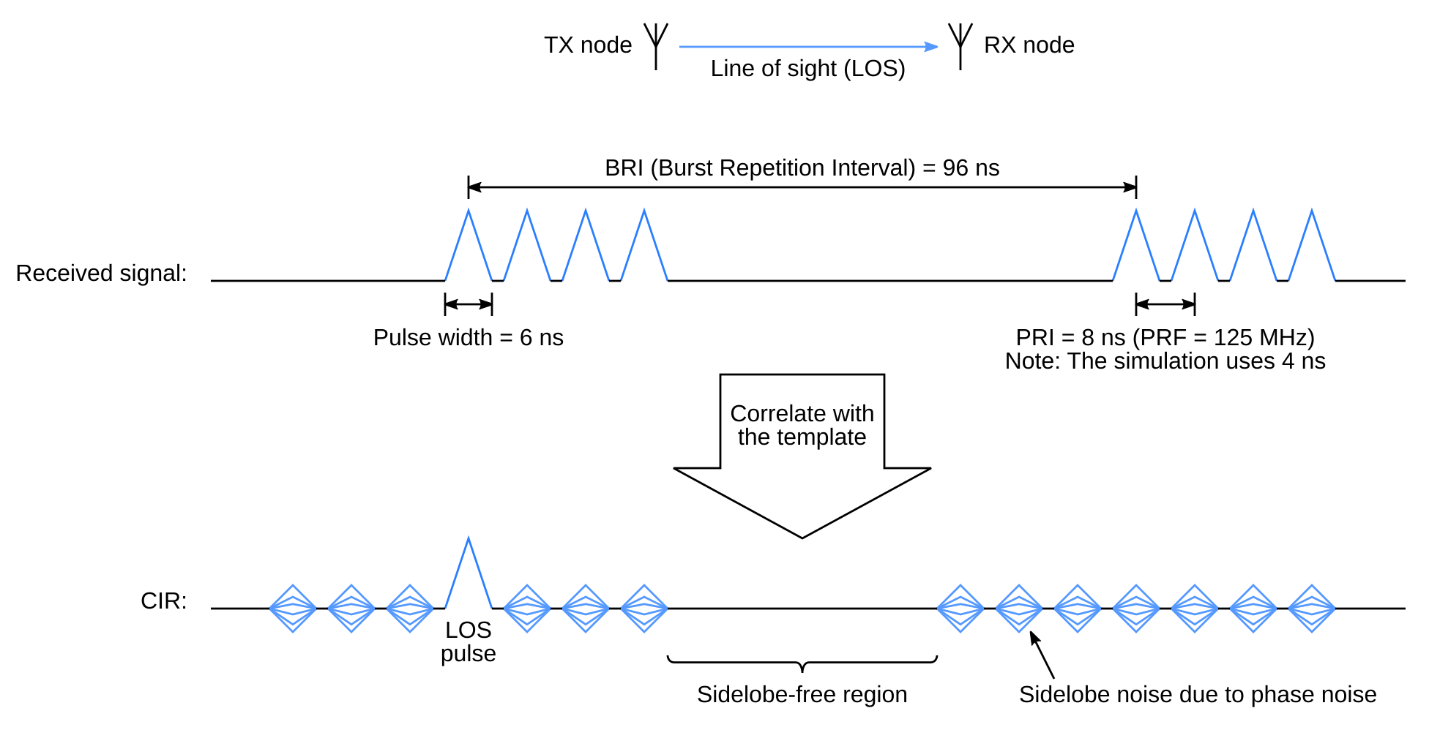
Pulse Burst Sensing Waveforms

Slide 14
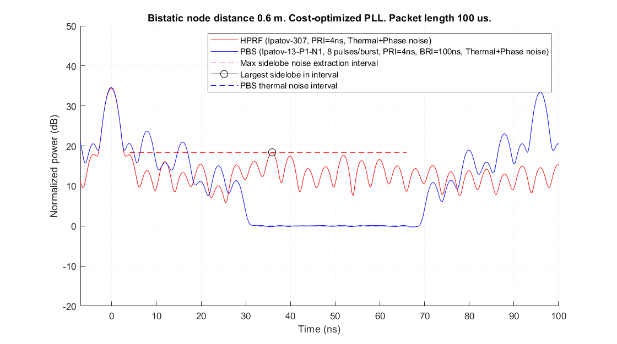
Simulation of Uniform HPRF and PBS With Thermal and Phase Noise

Slide 15
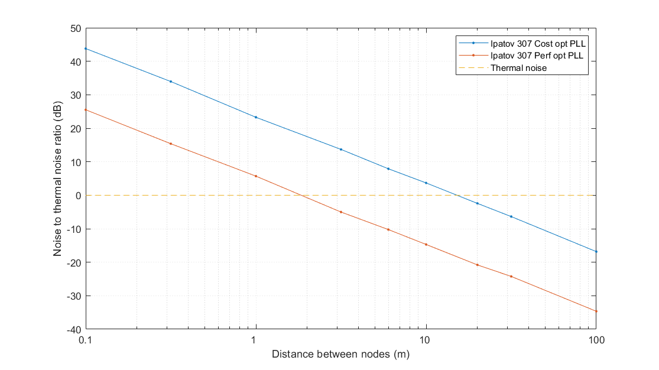
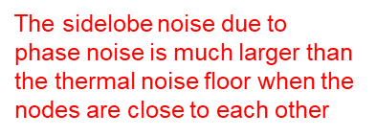
Sidelobe Noise vs. Distance Between Nodes Cost-Optimized vs. Performance-Optimized PLL

Slide 16
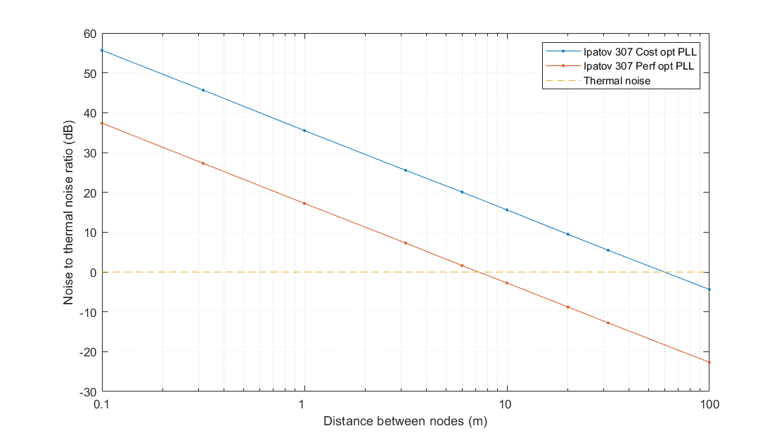
1 V Pulse Amplitude Instead of 0.5 V and Two Pulses Interfering Constructively

Slide 17
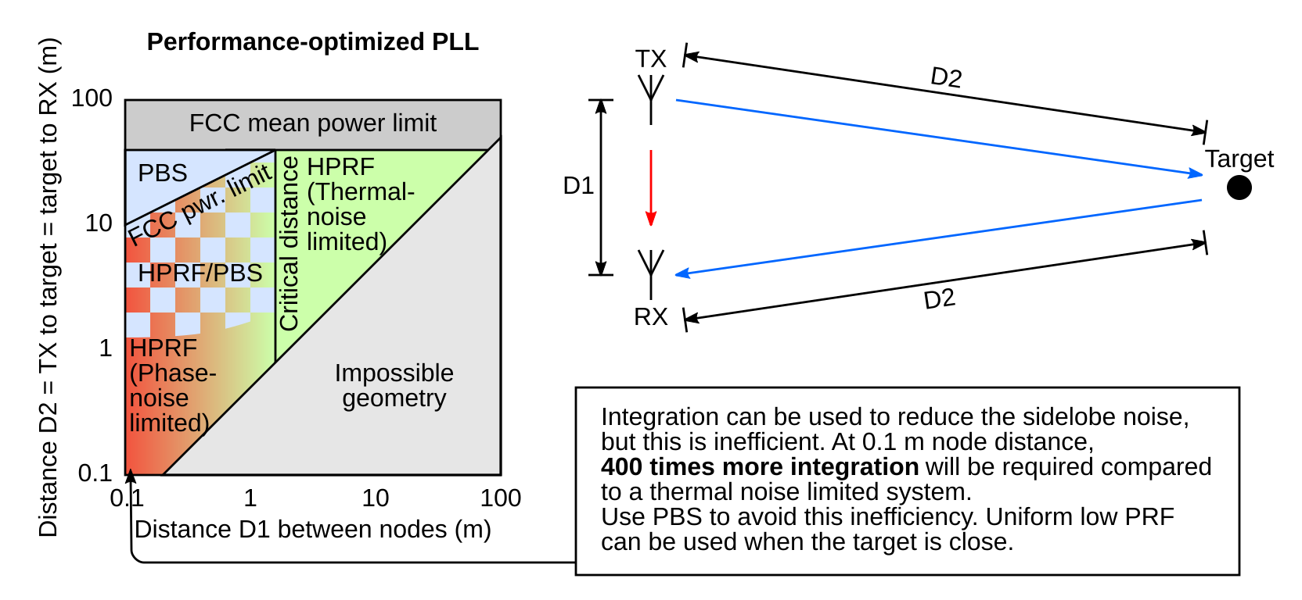
When to Use PBS and When to Use HPRF

Slide 18
Will the AGC Raise the Noise Floor so that Sidelobe Noise Becomes Irrelevant (EVM Limited System)?
Communication can use an ADC with few bits
Ranging can use an ADC with few bits since the first pulse probably is not that much weaker than the strongest pulse
Monostatic sensing might look at e.g. a breathing person next to a wall (a small signal on top of a strong signal), or a near-by and a far-away target at the same time, so a high dynamic range is needed
Bistatic sensing requires reception of both the strong reference pulse, e.g. a LOS pulse, to find time 0 of the CIR, and weak target pulses, so a high dynamic range is needed also here
Adding an ADC bit lowers the AGC-determined noise floor by 6 dB, which probably uses much less power than the alternative of just integrating four times longer
Therefore, a system designed for sensing will probably have an ADC with many bits, and the noise floor will therefore not be raised by an AGC. This means that sidelobe noise will still be the limiting factor in some cases, as explored in this presentation.

Slide 19
Implementation Requirements for Pulse Burst Sensing
Need a stored PBS sequence or a generation algorithm in firmware
Need the correlation template to be memory-based
No need for a full-duplex transceiver
Relaxed phase-noise requirements
To switch between HPRF and PBS:
Just change the sensing sequence
Uniform HPRF (Ipatov w/ length 307):
+0+0++-00-+-+-+-++----+++
-+---+++++--+++++++-+--++
+++-+-++-+-0-+----++--0+-
0-++-+++--++-+--+0+-----+
+0+-++++--+0--+++-+++++--
-++-+++++++++0-----+---++
+--0++--++++--+--++--+-+-
++---+-+-+++-++++++++-0--
++-+--+-+++--+-++---+--++
-+++-+-+-+0-+--+----+-+--
++-+-++--0+--+--+0-----+-
++-+-0-----+++--+0-++-+++
++-+---
PBS (based on Ipatov w/ length 13):
+0+0++0000000000000000000
0+0++00-00000000000000000
+0++00--00000000000000000
0++00--+00000000000000000
++00--++00000000000000000
+00--++-00000000000000000
00--++-+00000000000000000
0--++-+000000000000000000
--++-+0+00000000000000000
-++-+0+000000000000000000
++-+0+0+00000000000000000
+-+0+0++00000000000000000
-+0+0++000000000000000000

Slide 20
Summary
Bistatic sensing when the nodes are close to each other:
Uniform high-PRF sensing:
Sidelobe regrowth due to phase noise
System can become phase noise limited rather than thermal noise limited, which reduces performance
Pulse Burst Sensing:
No sidelobes where the weak far-away targets are
System is thermal noise limited, which gives good performance
Simple implementation: Only need to change the sensing sequence
The 4ab standard should include both uniform high-PRF sensing and Pulse Burst Sensing, not Pulse Burst Sensing only

