Slide 1
Project: IEEE P802.15 Working Group for Wireless Personal Area Networks (WPANs)
Submission Title: Summary of NB CCA For UWB channel Access
Date Submitted: January 2023
Source: Huan-Bang Li, Takeshi Matsumura (NICT, Japan).
Address: 3-4 Hikarino-oka, Yokosuka-shi, Kanagawa, 239-0847 Japan
E-Mail: {lee, matsumura}@nict.go.jp
Abstract: Summary on NB-assisted UWB channel access.
Purpose: To improve coexistence among UWB systems.
Notice: This document has been prepared to assist the IEEE P802.15. It is offered as a basis for discussion and is not binding on the authoring individual(s) or organization(s). The material in this document is subject to change in form and content after further study. The authors(s) reserve(s) the right to add, amend or withdraw material contained herein.

Slide 2
PAR Objective | Proposed Solution (how addressed)
Safeguards so that the high throughput data use cases will not cause significant disruption to low duty-cycle ranging use cases | Effective and efficient CCA reduce disruption between UWB devices
Interference mitigation techniques to support higher density and higher traffic use cases | Use NB radio to facilitate CCA so as to improve coexistence.
Other coexistence improvement | Use NB radio to improve coexistence among UWB devices.
Backward compatibility with enhanced ranging capable devices (ERDEVs)
Improved link budget and/or reduced air-time
Additional channels and operating frequencies
Improvements to accuracy / precision / reliability and interoperability for high-integrity ranging
Reduced complexity and power consumption
Hybrid operation with narrowband signaling to assist UWB | Exploiting NB PHY and concurrent operation with UWB to assist UWB channel access
Enhanced native discovery and connection setup mechanisms
Sensing capabilities to support presence detection and environment mapping
Low-power low-latency streaming
Higher data-rate streaming allowing at least 50 Mbit/s of throughput
Support for peer-to-peer, peer-to-multi-peer, and station-to-infrastructure protocols
Infrastructure synchronization mechanisms

Slide 3
Contents
Features of NB CCA
Concurrent operation of NB and UWB
Simulation results
Summary of NB CCA

Slide 4
Features of NB CCA
A pair of coupled NB PHY and UWB PHY are operated concurrently based on same timer. NB radio indicates UWB channel occupancy status.
CCA is performed at NB channel by NB PHY. The results of NB CCA are used for assisting UWB channel access.
Same NB CCA can be commonly applied no matter if UWB radio operated are of the same type or not.

Slide 5
Conceptual View of NB-CCA (not recommend)
UWB ch
UWB x UWB y UWB z
NB packet NB packet NB packet
NB Ch
Time
A simple way to do NB-CCA is let NB transmission be synchronized to UWB transmission. However, this is less of efficiency and not recommended.

Slide 6
Conceptual View of NB-CCA (recommend)
UWB ch
UWB x UWB y UWB z
NB pattern 1 NB pattern 2 NB pattern 3
NB Ch
Time
With the proposed NB CCA method, NB channel is dealt with as combination of sub-channels. Short NB packets are transmitted to reduce NB channel occupation time. UWB channel usage (length) are presented by different patterns of NB sub-channels.

Slide 7
Example of NB-UWB Mapping Using Patterns
#1 #2 #3 #4 #5
w/transmit
w/o transmit
#1 #2 #3 #4 #5
#1 #2 #3 #4 #5
#1 #2 #3 #4 #5
#1 #2 #3 #4 #5
UWB x UWB y UWB z … …
Control transmission of each sub-channel to get different patterns. Let each pattern correspond to a UWB task (length), a receiver can judge the UWB length according to the received NB sub-channel pattern.

Slide 8
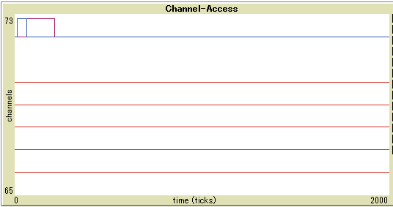
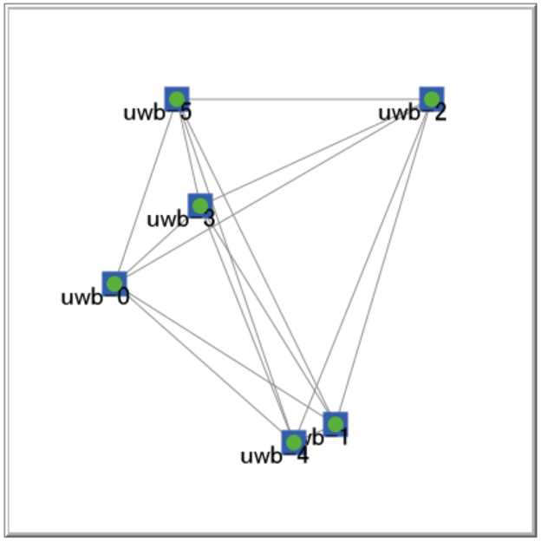
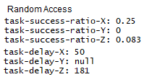
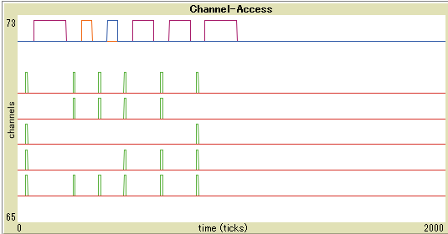
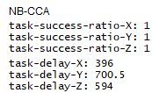
Simulation Results (1)
Five NB sub-ch UWB
ch
Six uniformly distributed UWB within communication ranges.
Each executes task X (50 ticks), Y (100 ticks), and Z (150 ticks).
Random access vs NB-CCA.
Five NB sub-ch UWB
ch

Slide 9
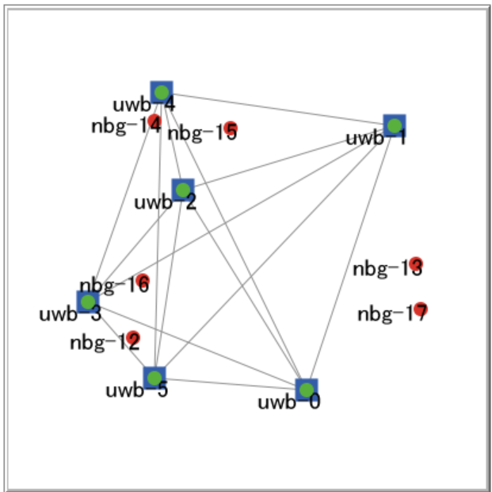
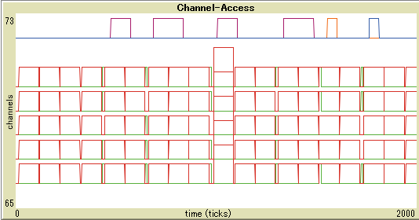
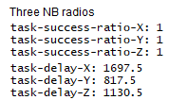
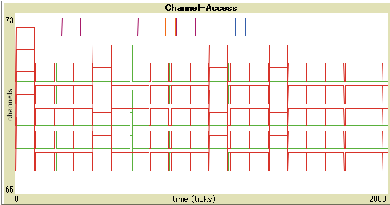
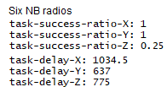
Simulation Results (2)
Five NB sub-ch UWB
ch
NB-CCA UWB and other NB radios co-exist. Each NB radio sends packets constantly that occupy all sub-ch.
Each NB radio transmits and stops alternatively every 100 ticks
Three vs. Six NB radios.
Five NB sub-ch UWB
ch

Slide 10
Summary of NB CCA
Add an optional CCA mode to 10.2.8 Clear channel assessment (CCA) of IEEE 802.15.4-2020 as follows (15-22-0275-00-04ab)
An HRP UWB PHY shall implement one CCA Mode 1 through CCA Mode 4 or one of the following methods:
CCA Mode 5: HRP UWB preamble sense based on the SHR of a frame. CCA shall report a busy medium upon detection of a preamble symbol as specified in 15.2.6. An idle channel shall be reported if no preamble symbol is detected up to a period not shorter than the maximum packet duration plus the maximum period for acknowledgment.
CCA Mode 6: HRP UWB preamble sense based on the packet with the multiplexed preamble as specified in 15.6. CCA shall report a busy medium upon detection of a preamble symbol as specified in 15.2.6.
CCA Mode 7: UWB medium access coupled with CCA of narrow-band assisted PHY (NBA-PHY) as specified in 15.x. Transmission or CCA conducted by the coupled NBA-PHY act as indications of the UWB-PHY medium access status. CCA shall report an idle or a busy UWB medium based on the NBA-PHY CCA results.
*Original texts are highlighted in yellow while the proposed add-on texts in blue.

Slide 11
Summary of NB CCA -- Continue
Add a subclause to IEEE 802.15.4-2020 as follows to define NB CCA (15-22-0275-00-04ab)
Subclause ## Narrow-band assisted CCA
A compliant device shall contain a UWB PHY and a coupled narrow-band assisted PHY (NBA-PHY). The UWB PHY that uses CCA mode 7 as defined in 10.2.8 shall be operated with the NBA-PHY in tightly coupled manner, at least, with synchronized clock or same MAC timer.
On one hand, a compliant device shall perform CCA using the NBA-PHY against narrow-band medium whenever it intends to access a UWB medium. On another hand, a compliant device that intends to execute a UWB task after receiving an idle medium report shall firstly transmit an NBA packet and then execute the UWB task.
A compliant device shall neither send NB packet nor start UWB task if the NB CCA gives a busy channel report.
A NB radio may terminate CCA procedure whenever it already successfully acquired channel occupancy information.
* The proposed add-on texts are highlighted in blue.

Slide 12
Conclusion Remarks
Length of NB packet should be of short time length to save resource of NB channel.
Proper NB radio TX power as well as NB CCA sensing level should be used, so that NB radio doesn’t unnecessarily reduce the utilization of UWB channel.
NB radio should be assigned with distinguished features compared to the other general NB radios so that the other general NB radio don’t shut up UWBs.

