Slide 1
        doc.: 15-23-0036-02-04ab
Project: IEEE P802.15 Working Group for Wireless Personal Area Networks (WPANs)
Submission Title: Updates for Multiple Transmission
Date Submitted: January 18, 2023
Source: [Taeyoung Ha, Mingyu Lee, Youngwan So, Aniruddh Rao Kabbinale, Ankur Bansal, Clint Chaplin] Company [Samsung Electronics]
E-Mail: ty1115.ha@samsung.com
Abstract: Introduce the Multiple RSF Transmissions in a Slot Scenario
Purpose: Increase air time efficiency by allowing the multiple MMRS transmission in a slot.
Notice: This document has been prepared to assist the IEEE P802.15. It is offered as a basis for discussion and is not binding on the contributing individual(s) or organization(s). The material in this document is subject to change in form and content after further study. The contributor(s) reserve(s) the right to add, amend or withdraw material contained herein.

Slide 2
PAR Objective | Proposed Solution (how addressed)
Safeguards so that the high throughput data use cases will not cause significant disruption to low duty-cycle ranging use cases
Interference mitigation techniques to support higher density and higher traffic use cases
Other coexistence improvement
Backward compatibility with enhanced ranging capable devices (ERDEVs)
Improved link budget and/or reduced air-time | Transmit RSF in a slot to reduce air-time
Additional channels and operating frequencies
Improvements to accuracy / precision / reliability and interoperability for high-integrity ranging
Reduced complexity and power consumption
Hybrid operation with narrowband signaling to assist UWB
Enhanced native discovery and connection setup mechanisms
Sensing capabilities to support presence detection and environment mapping
Low-power low-latency streaming
Higher data-rate streaming allowing at least 50 Mbit/s of throughput
Support for peer-to-peer, peer-to-multi-peer, and station-to-infrastructure protocols
Infrastructure synchronization mechanisms

Slide 3
Previous contributions
Multiple Transmission
DCN 179r0 (Mar. 2022) – “Multiple transmission in a ranging slot”
  Introduce the multiple transmission concept
DCN 356r0 (Jul. 2022) – “Multiple transmission in a ranging slot”
  Text proposal for the multiple transmission concept
DCN 465r2 (Sep. 2022) – “Usecase for the multiple transmissions in a ranging slot”
  Introduce the proper usecase for the multiple transmission scenario

Slide 4
Previous contributions
Multi-Millisecond Ranging (MMR)
DCN 570r0 (Nov. 2022) – “RSF and MMRS in Multi-Millisecond UWB”
  Propose the sequences for MMR
DCN 571r0 (Nov. 2022) – “NBA-UWB Technical Framework Proposal (2022-Nov)”
  Text proposal for NBA-UWB Framework
DCN 585r0 (Nov. 2022) – “one-to-many-ranging using NBA-MMS”
  Propose the procedures for the one to many ranging scenario when NBA-MMS is used

Slide 5
Previous contributions
Scheduling IE
DCN 501r0 (Sep. 2022) – “New Scheduling IE for 4ab applications”
  Propose the new scheduling IE for 4ab
DCN 568r1 (Nov. 2022) – “Improvements on scheduling IE design in 802.15.4ab”
  Propose the additional options for the scheduling IE

Slide 6
Updates for Multiple transmission
Multi-Millisecond Ranging Sequence (MMRS)
Composition of RSF (which was proposed at the DCN 570r0) in MMRS is same as the multiple transmission proposal (i.e., sequence only packet)
MMRS provides proper performances (i.e., cross-correlation performance between sequences) and the number of sequences (i.e., a number of sequence combinations can be made through 16 length-128 complementary set and 0~64 zero gaps)
→ RSF in MMRS is suitable for the Multiple transmission scenario

Slide 7
Updates for Multiple transmission
Scheduling IE
Ranging Device Management IE (RDM IE) was proposed to schedule multiple transmissions among devices in DCN 356r0
New scheduling IE was proposed in DCN 501r0 and DCN 568r1 to improve efficiency in existing RDM IE
→ Scheduling IE can be used for the Multiple transmission scenario
Octets: 1 | Variable | … | Variable
Control field | Scheduling List element # 1 | … | Scheduling List element # N
Bits: 0 | 1-6 | 7
Address Size | Scheduling List Length | Scheduling List Type
Bits: 0-6 | 7-10 | 11-15 | Octets: 2 or 8
Starting Slot Index | Scheduling Step | Scheduling Repetition | Address

Slide 8
Procedure of Multiple transmission
Both NBA-UWB devices and UWB only devices can support the multiple transmission scenario
Procedure of the Multiple transmission scenario can be divided into 4 steps
  Scheduling
    Schedule the transmission timing of each device by initiator
    Scheduling can be proceeded through scheduling IE or Control msg of NB or out-of-band (OOB) procedures
  Trigger
    (SYNC+SFD) packet of UWB or Poll msg of NB triggers multiple transmissions by initiator
  Multiple transmission
    Multiple RSF transmission occurs between the scheduled responders
  Ranging Report
    Initiator can deliver the ranging report to the responders

Slide 9
UWB Multiple transmission
Scheduling can be proceeded through Control packet (include scheduling IE) or out-of-band (OOB) procedures
(SYNC+SFD) packet triggers multiple RSF transmissions
Ranging report can be delivered through UWB

Slide 10
NBA Multiple transmission
Scheduling can be proceeded through Control msg of NB or out-of-band (OOB) procedures
Poll message of NB triggers multiple RSF transmissions
Ranging report can be delivered through NB or UWB

Slide 11
Scheduling IE for Multiple Transmission
Scheduling List Type: Represent the scheduling list type (0: bitmap based, 1: periodic scheduling, 2: Multiple transmission scheduling)
As multiple transmission usually occurs in periodic manner, Scheduling IE in DCN 568r1 is used
  Starting Slot Index field marks the first transmission slot in the recurring periodic transmission pattern, in unit of slots, similar to the role of the Ranging Slot Index field defined in RDM IE in legacy 4z
  Scheduling Step field represents the period of the transmission pattern, such as 4, 8, 16, 32, 64, in unit of slots
  Scheduling Repetition field represents the number of repetitions of the transmission pattern, such as 2, 4, 8, 16, 32, in unit of slots
Octets: 2 | Variable | … | Variable
Control field | Scheduling List element # 1 | … | Scheduling List element # N
Bits: 0 | 1-7 | 8 - 10 | 11-15
Address Size | Scheduling List Length | Scheduling List Type | RFU
Bits: 0-6 | 7-10 | 11-15 | Octets: 2 or 8 | Octets: 1 | Octets: 1 | Octets: 1
Starting Slot Index | Scheduling Step | Scheduling Repetition | Address | Sequence index | Number of gaps | Sequence Repetition

Slide 12
Scheduling IE for Multiple Transmission
To allocate the sequences of each device, several fields are added
  Sequence index field indicates the index of 16 length-128 complementary set or current ipatov preamble sequence
  Number of gaps field represents the size of zero gaps (G) (i.e., 0 ~ 64) [A, G, B, G]
  Sequence Repetition field represents the repetition number of MMRS
Scheduling IE is transmitted only when the scheduling among responders is needed
Octets: 2 | Variable | … | Variable
Control field | Scheduling List element # 1 | … | Scheduling List element # N
Bits: 0 | 1-7 | 8 - 10 | 11-15
Address Size | Scheduling List Length | Scheduling List Type | RFU
Bits: 0-6 | 7-10 | 11-15 | Octets: 2 or 8 | Octets: 1 | Octets: 1 | Octets: 1
Starting Slot Index | Scheduling Step | Scheduling Repetition | Address | Sequence index | Number of gaps | Sequence Repetition

Slide 13
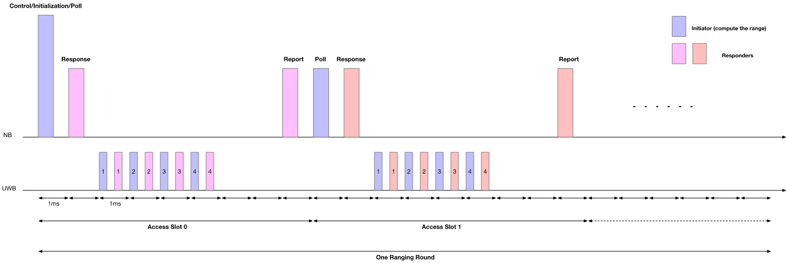
NBA Multiple transmission
One to many ranging scenario can be optimized by using the Multiple transmission scheme

Slide 14
Conclusion
MMRS is used for the Multiple transmission scenario
Procedure of the Multiple transmission scenario (Scheduling, Trigger, Multiple transmission, Ranging report) is proposed
New Scheduling IE for the Multiple transmission scenario is proposed
Multiple transmission scenario can be extended to the one to many using NBA-MMS scenario

