Slide 1
Project: IEEE P802.15 Working Group for Wireless Personal Area Networks (WPANs)
Submission Title: Configuration for MMS based ranging
Date Submitted: January 2023
Source: Kuan Wu, Lei Huang, Bin Qian, David Xun Yang (Huawei Technologies)
Email: wukuan2@huawei.com
Abstract: Introducing new IE design for configuration for MMS based ranging in 802.15.4ab applications
Purpose: To enable the configuration for MMS based ranging in 802.15.4ab applications
Notice: This document has been prepared to assist the IEEE P802.15. It is offered as a basis for discussion and is not binding on the contributing individual(s) or organization(s). The material in this document is subject to change in form and content after further study. The contributor(s) reserve(s) the right to add, amend or withdraw material contained herein.
Release: The contributor acknowledges and accepts that this contribution becomes the property of IEEE and may be made publicly available by P802.15.

Slide 2
PAR Objective | Proposed Solution (how addressed)
Safeguards so that the high throughput data use cases will not cause significant disruption to low duty-cycle ranging use cases
Interference mitigation techniques to support higher density and higher traffic use cases
Other coexistence improvement
Backward compatibility with enhanced ranging capable devices (ERDEVs)
Improved link budget and/or reduced air-time
Additional channels and operating frequencies
Improvements to accuracy / precision / reliability and interoperability for high-integrity ranging
Reduced complexity and power consumption
Hybrid operation with narrowband signaling to assist UWB | To introduce new IE which is able to support the configuration of MMS-based ranging
Enhanced native discovery and connection setup mechanisms
Sensing capabilities to support presence detection and environment mapping
Low-power low-latency streaming
Higher data-rate streaming allowing at least 50 Mbit/s of throughput
Support for peer-to-peer, peer-to-multi-peer, and station-to-infrastructure protocols
Infrastructure synchronization mechanisms

Slide 3
References
1. DCN 214r0 (April 2022) “Long-range Ranging”
DCN 571r0 (November 2022) “NBA-UWB Technical Framework Proposal”
DCN 266r0 (May 2022) “Discussion on NB Assisted UWB Message Sequence and Synchronization ”
4. DCN 470r1 (September 2022) “More on 4ab preambles: apEval results and recommendations”
5. DCN 570r0 (November 2022) “RSF and MMRS in Multi-Millisecond UWB”
6. IEEE Standard for Low-Rate Wireless Networks–Amendment 1: Enhanced Ultra Wideband (UWB) Physical Layers (PHYs) and Associated Ranging Techniques, IEEE Standard 802.15.4z-2020 (Amendment to IEEE Standard 802.15.4-2020)

Slide 4
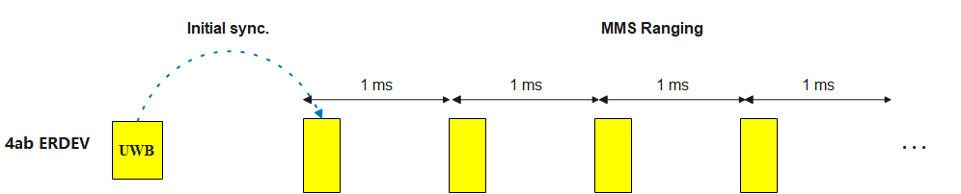
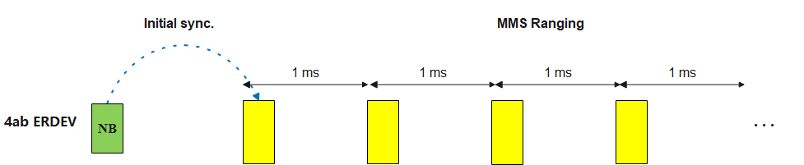
Recap: Ranging modes discussed in 4ab
Multiple ranging modes are discussed in 4ab
  Non-MMS based ranging
  MMS based ranging [1] →Initial packet acquisition is provided by UWB signal, a UWB only solution
  NBA-MMS based ranging [2] –[3]→Initial packet acquisition is provided by NB signal
Sequences for initial packet acquisition and MMS ranging necessitate different requirements
  Initial packet acquisition → requiring good cross-correlation over short accumulation [4]
  MMS combining → requiring good cross-correlation over long accumulation + a larger set of available sequences [5], i.e., multi-millisecond ranging sequences (MMRS) based on complementary sets or Ipatov sequences
(a) UWB-only solution for initial packet acquisition
(b) NB-assisted initial packet acquisition

Slide 5
Recap: RCPCS IE in 802.15.4z
In 802.15.4z, preamble sequences are configurated by Ranging Channel and Preamble Codes Selection IE (RCPCS IE) [6].
  Fields TX Preamble Code and RX Preamble Code are enabled to configure preamble codes based on Ipatov sequences
  RCPCS IE is commonly used in set-up activities prior to ranging exchanges →RCPCS IE is less frequently updated compared with IEs that are configured at round/block level (such as ARC IE [6])
Bits: 0 | 1 | 2 | 3-7 | Octets:0/4 | 0/3 | 0/1 | 0/1 | 0/2
CCI | DDP | PSP | Channel Number | CCI | DPS Duration | TX Preamble Code | RX Preamble Code | PSR
Format of RCPCS IE [6]
Observation & Motivation
  The legacy RCPCS IE is not able to support the configuration of MMS based ranging, i.e., the selection of MMRS and ranging integrity fragments (RIF) sequence. → To propose a new MMS-based Ranging Preamble Code Selection IE (MRPCS IE) which is able to support the configuration of MMS based ranging.

Slide 6
Proposal: MRPCS IE
Bits: 0-1 | 2 | 3 | 4 | 5-7 | Octets: 0/1 | 0/1 | 0/1 | 0/2 | 0/2 | 0/1 | 0/1 | 0/1 | 0/1
Ranging Mode | Initial Sync. sequence selection presence | MMRS selection presence | RIF sequence selection presence | TBD | Sequence Usage Type | TX MMRS Code | RX MMRS Code | PSR For MMRS | PSR For initial sync. (TBD) | TX Gap Sizes for MMRS | RX Gap Sizes for MMRS | TX Initial Sync. Code (TBD) | RX Initial Sync. Code (TBD)
DDP: DPS Duration Presence [6]
DPS: Dynamic channel and preamble code selection [6]
PSR: Preamble symbol repetitions [6]
Bits: 0-1 | 2-3 | 4 | 5-7
Initial sync. sequences type | MMRS type | RIF sequence type | Reserved
Ranging Mode field
  0: Non-MMS based ranging → only initial sync. sequence selection is needed
  1: MMS based ranging → both initial sync. sequence selection and MMRS selection are needed
  2: NBA-MMS based ranging → only MMRS selection is needed
  3: Reserved
Sequence Usage Type
  Initial Sync. Sequence Selection Presence field (only valid when Ranging Mode = 0 or 1)
  MMS Ranging Sequence Selection Presence field (only valid when Ranging Mode = 1 or 2)

Slide 7
Proposal: MRPCS IE (cont.)
Bits: 0-1 | 2 | 3 | 4 | 5-7 | Octets: 0/1 | 0/1 | 0/1 | 0/2 | 0/2 | 0/1 | 0/1 | 0/1 | 0/1
Ranging Mode | Initial Sync. sequence selection presence | MMRS selection presence | RIF sequence selection presence | TBD | Sequence Usage Type | TX MMRS Code | RX MMRS Code | PSR For MMRS | PSR For initial sync. (TBD) | TX Gap Sizes for MMRS | RX Gap Sizes for MMRS | TX Initial Sync. Code (TBD) | RX Initial Sync. Code (TBD)
DDP: DPS Duration Presence [6]
DPS: Dynamic channel and preamble code selection [6]
PSR: Preamble symbol repetitions [6]
Bits: 0-1 | 2-3 | 4 | 5-7
Initial sync. sequences type (TBD) | MMRS type | RIF sequence type (TBD) | Reserved
MMRS type field
  0: MMRS based on complementary sets → Fields TX MMRS Code, RX MMRS Code, PSR, TX Gap Sizes for MMRS, and RX Gap Sizes for MMRS are present
  1: MMRS based on Ipatov Sequences → Fields TX MMRS Code, RX MMRS Code, and PSR are present
  2: MMRS Sequences selection not present
  3: Reserved
RIF sequence type field → STS sequence may be used [5]. The exact format for this field is TBD

Slide 8
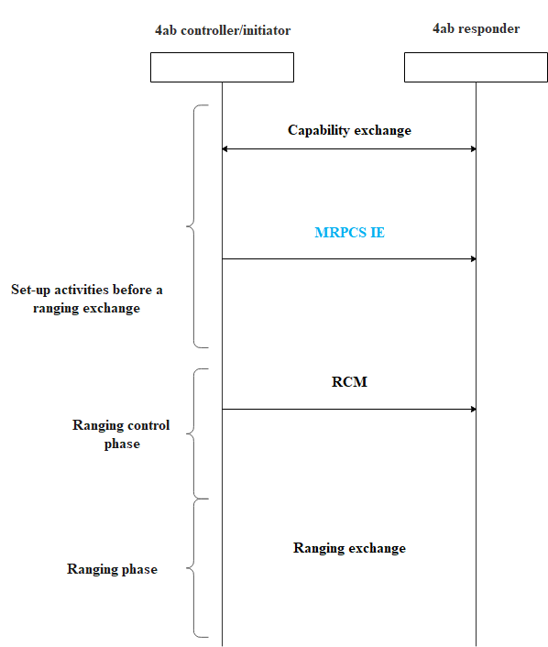
Proposal: MRPCS IE (cont.)
The exchange of MRPCS IE is completed during the set-up activities before a ranging exchange.
The MRPCS IE may be transmitted by an out-of-band (OOB) method
The configuration by MRPCS IE is performed at beacon interval level or block level → less frequently configured as compared with ranging control message (RCM).
The configuration of ranging channel is performed by 802.15.4z RCPCS IE [6].

Slide 9
Summary
  In this contribution, we introduce an MRPCS IE which is able to support the configuration of MMS-based ranging.

