Slide 1
Project: IEEE P802.15 Working Group for Wireless Specialty Networks (WSN)
Submission Title: China MIIT’s consultation on UWB
Source: Bin Qian, David Xun Yang, Lei Huang, Xiaohui Peng, Chenchen Liu (Huawei Technologies)
Address : [Huawei Bantian Base, Longgang District, Shenzhen, 518129 China]
E-Mail: [qianbin14@huawei.com]
Re: Task Group 4ab: UWB Next Generation for 802.15.4
Abstract: [MIIT’s consultation]
Purpose:
Notice: This document has been prepared to assist the IEEE P802.15. It is offered as a basis for discussion and is not binding on the contributing individual(s) or organization(s). The material in this document is subject to change in form and content after further study. The contributor(s) reserve(s) the right to add, amend or withdraw material contained herein.
Release: The contributor acknowledges and accepts that this contribution becomes the property of IEEE and may be made publicly available by P802.15.
Notes:
Jul 12, 2010
Page 1

Slide 2
Background
On Jan. 4th 2023, MIIT of China issued an “Ultra Wideband (UWB) Equipment Radio Management Regulations (Draft for Comments) ” to seek public opinions. Deadline for comments is Feb. 6th 2023.
The official purpose is to promote the development of the radio industry, improve the efficiency of spectrum use, and strengthen the management of radio transmission equipment.
More details can be found (in Chinese) https://www.miit.gov.cn/jgsj/wgj/gggs/art/2023/art_df8ec283689d4facba0b65c41c371bb1.html
In this contribution, we would like to provide some technical details of this draft regulation.

Slide 3
UWB Equipment RF Requirements
Operating frequency range: 7.235-8.750GHz
Bandwidth of transmitted signal (-10dB bandwidth): Not less than 500MHz
Effective isotropic radiated power (EIRP) spectral density limit: $≤$-41dBm/MHz
Out-of-band transmission power limit
Frequency Range | EIRP Limit
5.925-7.125GHz (including 7.125GHz) | -70dBm/MHz
7.125-7.235GHz | -51dBm/MHz
8.750-9GHz | -51dBm/MHz
9-10.6GHz (including 9GHz) | -70dBm/MHz

Slide 4
UWB Equipment RF Requirements (cont.)
Common frequency band spurious emission limits
The transmitter is in a state of maximum power transmission
The transmitter is in a state of standby or idle
Testing Frequency Band | Limit | Testing Bandwidth | Detection Method
30MHz-1GHz | -36dBm | 100kHz | RMS detection
1GHz-12.75GHz | -30dBm | 1MHz
Testing Frequency Band | Limit | Testing Bandwidth | Detection Method
30MHz-1GHz | -57dBm | 100kHz | RMS detection
1GHz-12.75GHz | -47dBm | 1MHz

Slide 5
UWB Equipment RF Requirements (cont.)
Special frequency band spurious emission limits
Testing Frequency Band | Limit | Testing Bandwidth | Detection Method
48.5-72.5MHz | -54dBm | 100kHz | RMS detection
76-108MHz
167-223MHz
470-702MHz
223-235MHz | -61dBm | 100kHz
806-821MHz | -61dBm | 100kHz
824-835MHz | -61dBm | 100kHz
851-866MHz | -57dBm | 100kHz
869-880MHz | -57dBm | 100kHz
885-915MHz | -61dBm | 100kHz
930-960MHz | -57dBm | 100kHz

Slide 6
UWB Equipment RF Requirements (cont.)
Testing Frequency Band | Limit | Testing Bandwidth | Detection Method
1447-1467MHz | -52dBm | 1MHz | RMS detection
1710-1785MHz | -49dBm | 1MHz
1785-1805MHz | -52dBm | 1MHz
1805-1880MHz | -58dBm | 1MHz
1880-1920MHz | -52dBm | 1MHz
1920-1980MHz | -49dBm | 1MHz
2010-2025MHz | -52dBm | 1MHz
2110-2170MHz | -52dBm | 1MHz
2300-2400MHz | -52dBm | 1MHz
2500-2690MHz | -52dBm | 1MHz
3400-3600MHz | -52dBm | 1MHz
4800-5000MHz | -52dBm | 1MHz

Slide 7
More Information
The use of UWB radio transmission equipment is prohibited within 1 km of radio astronomy sites.
The use of UWB radio transmission equipment is prohibited on aircraft.
The UWB radio transmission equipment which has been approved already can continue be sold and used until end of life
Once the new regulations take effect, the old regulations (released in 2008) will be abolished
Relevant testing methods for technical requirements of UWB radio transmission equipment will be formulated separately

Slide 8
RF Regulations Requirements released in 2008
Operating frequency range: 6 – 9GHz
Bandwidth of transmitted signal (-10dB bandwidth): Not less than 500MHz
Effective isotropic radiated power (EIRP) spectral density limit:
Frequency Range | EIRP Limit
Below 1.6GHz | -90dBm/MHz
1.6-3.6GHz | -85dBm/MHz
3.6-6.0GHz | -70dBm/MHz
6.0-9.0GHz | -41dBm/MHz
9.0-10.6GHz | -70dBm/MHz
Above 10.6GHz | -85dBm/MHz

Slide 9
RF Regulations Requirements released in 2008 (cont.)
Frequency band spurious emission limits
Transmitter State | 48.5-72.5MHz 76-108MHz 167-223MHz 470-798MHz (Testing bandwidth is 100KHz) | Other frequency bands in 30MHz-1GHz (Testing bandwidth is 100KHz) | 1-40GHz (Testing bandwidth is 1MHz)
Working | -54dBm | -36dBm | -30dBm
Standby | -57dBm | -57dBm | -47dBm

Slide 10
Comparison of the two releases
Item | Release 2008 |  | Release 2023
-10dB bandwidth | Not less than 500MHz
Operating frequency range | 6G-9GHz |  | 7.235-8.750GHz
EIRP spectral density limit | Frequency Band (GHz) | Limit (dBm/MHz) | Frequency Band (GHz) | Limit (dBm/MHz)
 | Below 1.6 | -90 | 7.235-8.750 | -41
 | 1.6-3.6 | -85
 | 3.6-6.0 | -70
 | 6.0-9.0 | -41
 | 9.0-10.6 | -70
 | Above 10.6 | -85
Out-of-band transmission power limit | / |  | Frequency Band (GHz) | Limit (dBm/MHz)
 |  |  | 5.925-7.125 (including 7.125) | -70
 |  |  | 7.125-7.235 | -51
 |  |  | 8.750-9 | -51
 |  |  | 9-10.6 (including 9) | -70

Slide 11
Item | Release 2008 |  |  |  | Release 2023
spurious emission limits | Frequency Band (MHz) | Testing Bandwidth | Limit (dBm) |  | Frequency Band (MHz) | Testing Bandwidth | Limit (dBm)
 |  |  | Working | Standby
 |  |  |  |  |  |  | Working | Standby
 | 30-1000 | 100KHz | -36 | -57 | 30-1000 | 100KHz | -36 | -57
 | 1000-40000 | 1MHz | -30 | -47 | 1000-40000 | 1MHz | -30 | -47
 | 48.5-72.5 | 100KHz | -54 | -57 | 48.5-72.5 | 100KHz | -54
 | 76-108 |  |  |  | 76-108
 | 167-223 |  |  |  | 167-223
 | 470-798 |  |  |  | 470-702
 | / |  |  |  | 223-235 | 100KHz | -61
 |  |  |  |  | 806-821 | 100KHz | -61
 |  |  |  |  | 824-835 | 100KHz | -61
 |  |  |  |  | 851-866 | 100KHz | -57
 |  |  |  |  | 869-880 | 100KHz | -57
 |  |  |  |  | 885-915 | 100KHz | -61
 |  |  |  |  | 930-960 | 100KHz | -57
 |  |  |  |  | 1447-1467 | 1MHz | -52
 |  |  |  |  | 1710-1785 | 1MHz | -49
 |  |  |  |  | 1785-1805 | 1MHz | -52
 |  |  |  |  | 1805-1880 | 1MHz | -58

Slide 12
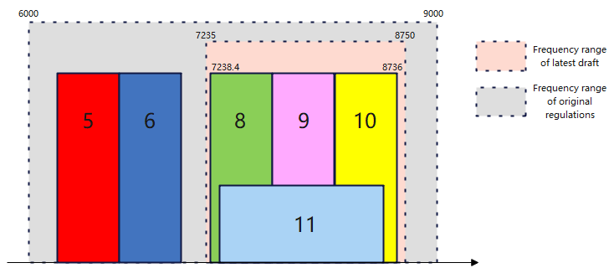
Comparison Summary of the two releases
Compared to the RF requirements released in 2008, the latest draft has a narrower operating frequency range
The latest draft has stricter restrictions on the EIRP spectral density limit, out-of-band transmission power limit and spurious emission limits

Slide 13
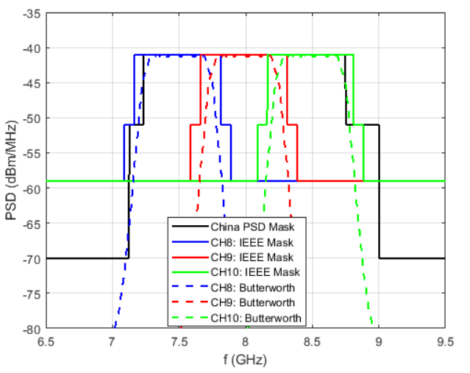
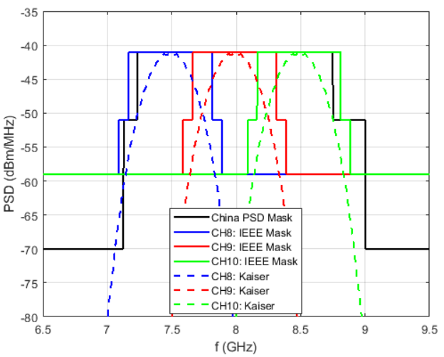
Impact on Pulse Shape
Two kinds of pulse shape are tested
Pulse Shape | -10dB BW (MHz) | CH8 |  | CH9 |  | CH10
8th order Butterworth | 590 | IEEE mask | China PSD mask | IEEE mask | China PSD mask | IEEE mask | China PSD mask
 |  |  | X |  |  |  | X
Kaiser | 530 | IEEE mask | China PSD mask | IEEE mask | China PSD mask | IEEE mask | China PSD mask
 |  |  | X |  |  |  | ?
$$√$$
$$√$$
$$√$$
$$√$$
$$√$$
$$√$$
$$√$$
$$√$$

