Slide 1
Project: IEEE P802.15 Working Group for Wireless Personal Area Networks (WPANs)
Submission Title: Propagation Simulations of UWB Communication Applications for HBAN and VBAN Use Cases
Date Submitted: March 13th, 2023
Source: Daisuke Anzai, Nagoya Institute of Technology
Address Gokiso-cho, Showa-ku, Nagoya, 466-8555, Japan
Voice: +81-52-735-5389, FAX: +81-52-735-5389, E-Mail: anzai@nitech.ac.jp
Re: In response to call for technical contributions
Abstract: This provides of propagation simulations in UWB communication applications for human passengers BAN (HBAN) and vehicle BAN (VAN) use cases.
Purpose: Material for discussion in P802.15.6a TG corresponding to comments in EC Meeting
Notice: This document has been prepared to assist the IEEE P802.15. It is offered as a basis for discussion and is not binding on the contributing individual(s) or organization(s). The material in this document is subject to change in form and content after further study. The contributor(s) reserve(s) the right to add, amend or withdraw material contained herein.
Release: The contributor acknowledges and accepts that this contribution becomes the property of IEEE and may be made publicly available by P802.15.

Slide 2
Propagation Simulations of UWB Communication Applications for HBAN and VBAN Use Cases
Daisuke Anzai, Sho Asano, Yutaro Aoki
Nagoya Institute of Technology

Slide 3
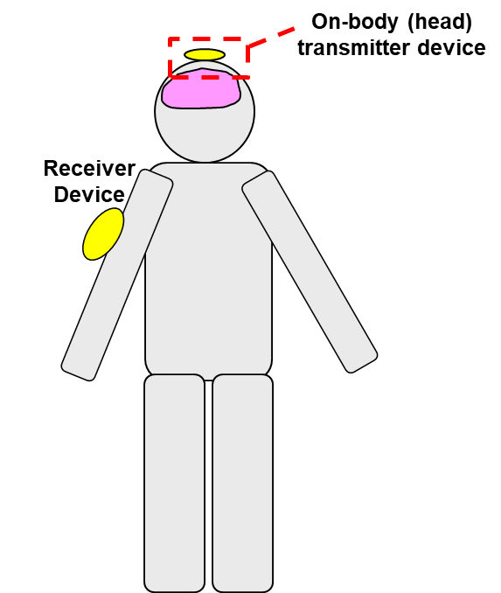
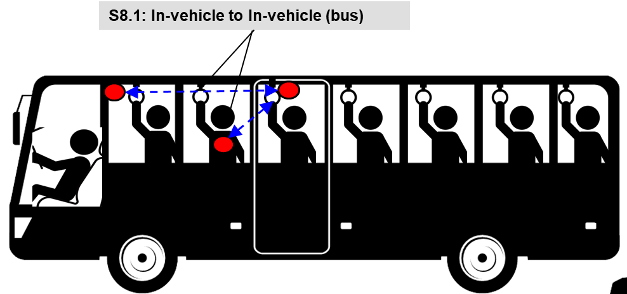
UWB communication applications
Vehicle BAN (VBAN)
Human BAN (HBAN)
Passengers bus model^{[1]}
Brain-computer interface (BCI) model^{[1]}
^{[1]}IEEE 802.15-22-0344-02-006a

Slide 4
Channel parameters for BCI/BMI cases
Antenna direction | Case | Receiving direction | Receiving antenna position
 |  |  | Whole head (d₀ = 10 mm) |  |  | Scalp (d₀ = 10 mm) |  |  | Arm (d₀ = 100 mm) |  |  | Torso (front) (d₀ = 100 mm) |  |  | Off-body (d₀ = 10 mm)
 |  |  | PL₀ [dB] | n | σ_{s} [dB] | PL₀ [dB] | n | σ_{s} [dB] | PL₀ [dB] | n | σ_{s} [dB] | PL₀ [dB] | n | σ_{s} [dB] | PL₀ [dB] | n | σ_{s} [dB]
Forward | BCI | X | 24.84 | 3.84 | 9.52 | 27.13 | 3.36 | 10.18 | 23.70 | 9.76 | 0.74 | 69.31 | 3.85 | 3.02 | 48.47 | 1.45 | 9.63
 |  | Y | 3.78 | 6.80 | 7.27 | 11.44 | 5.32 | 6.96 | 102.62 | 0.57 | 8.15 | 50.24 | 2.76 | 0.65 | 19.13 | 2.67 | 2.72
 |  | Z | 3.73 | 6.03 | 9.31 | 17.58 | 3.31 | 7.52 | 104.27 | 0.59 | 4.98 | 27.52 | 8.61 | 1.98 | 22.81 | 2.69 | 7.55
 | BMI | X | 32.21 | 2.55 | 12.94 | 33.07 | 2.40 | 14.17 | 60.60 | 2.01 | 1.10 | 70.72 | 5.04 | 2.69 | 40.26 | 1.65 | 6.19
 |  | Y | 10.72 | 5.63 | 8.02 | 14.08 | 4.89 | 7.88 | 90.00 | 0.66 | 10.08 | 59.62 | 3.02 | 0.61 | 23.09 | 2.25 | 3.85
 |  | Z | 13.00 | 4.62 | 8.86 | 18.04 | 3.52 | 8.75 | 87.49 | 0.45 | 5.35 | 32.56 | 9.25 | 1.61 | 22.12 | 2.66 | 5.81
Sideways | BCI | X | 20.37 | 3.80 | 7.47 | 10.97 | 5.63 | 6.89 | 51.42 | 3.14 | 1.13 | 16.68 | 10.59 | 2.42 | 0.05 | 4.95 | 2.66
 |  | Y | 19.60 | 4.96 | 7.59 | 25.39 | 3.86 | 7.31 | 80.65 | 1.99 | 11.42 | 67.02 | 3.72 | 1.80 | 34.94 | 2.74 | 5.65
 |  | Z | 13.36 | 4.54 | 7.09 | 19.77 | 3.34 | 7.03 | 76.35 | 1.85 | 5.12 | 62.07 | 6.87 | 2.61 | 44.11 | 0.56 | 5.84
 | BMI | X | 17.71 | 4.01 | 7.33 | 14.01 | 4.84 | 7.51 | 51.22 | 3.28 | 1.09 | 15.68 | 11.30 | 2.58 | -3.03 | 5.25 | 4.76
 |  | Y | 26.20 | 4.19 | 12.94 | 33.17 | 2.65 | 12.88 | 78.08 | 2.63 | 12.69 | 56.25 | 4.89 | 1.52 | 45.33 | 1.24 | 6.31
 |  | Z | 20.14 | 4.09 | 8.89 | 23.42 | 3.39 | 9.35 | 77.09 | 1.87 | 5.07 | 36.17 | 10.07 | 1.61 | 42.50 | 0.80 | 4.96

Slide 5
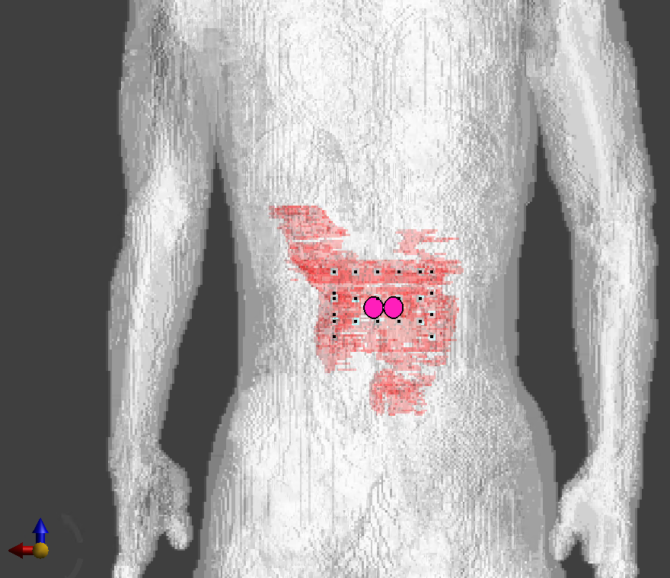
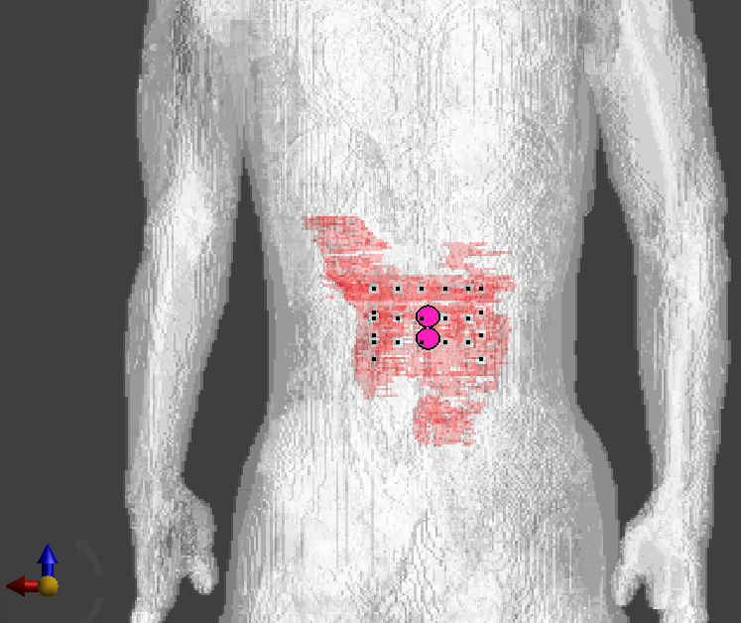

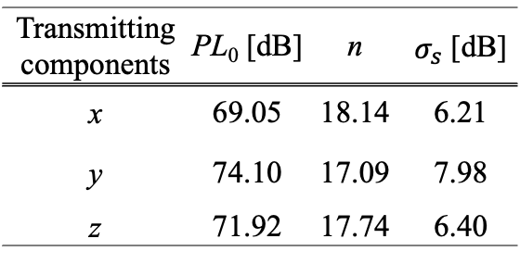
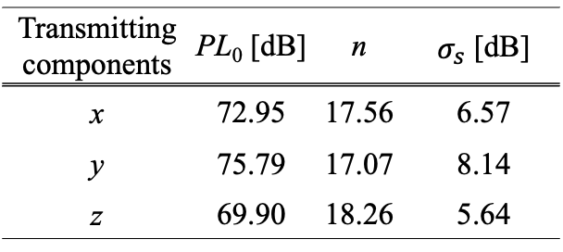
Channel parameters for implant (upper body) applications
Horizontal arrangement
Vertical arrangement
Transmitting components | PL₀ [dB] | n | $σ_{s}$ [dB]
x | 69.05 | 18.14 | 6.21
y | 74.10 | 17.09 | 7.98
z | 71.92 | 17.74 | 6.40
Transmitting components | PL₀ [dB] | n | $σ_{s}$ [dB]
x | 72.95 | 17.56 | 6.57
y | 75.79 | 17.07 | 8.14
z | 69.90 | 18.26 | 5.64
$d_{0}=10$ mm

Slide 6
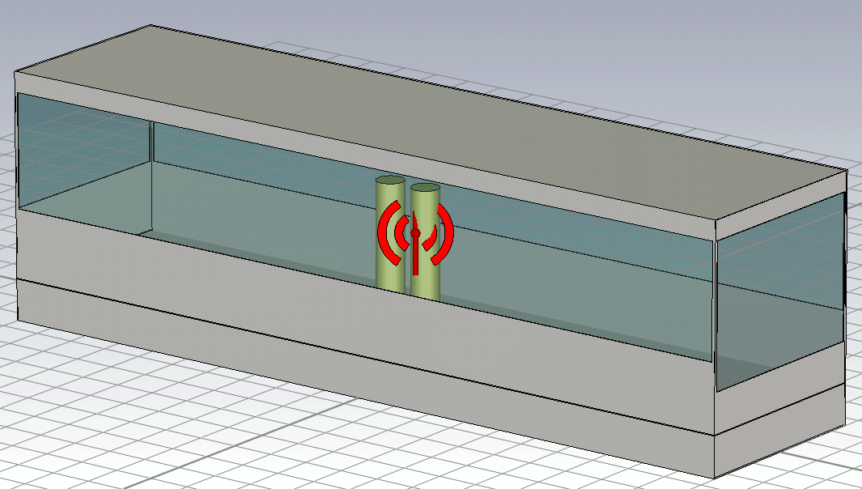
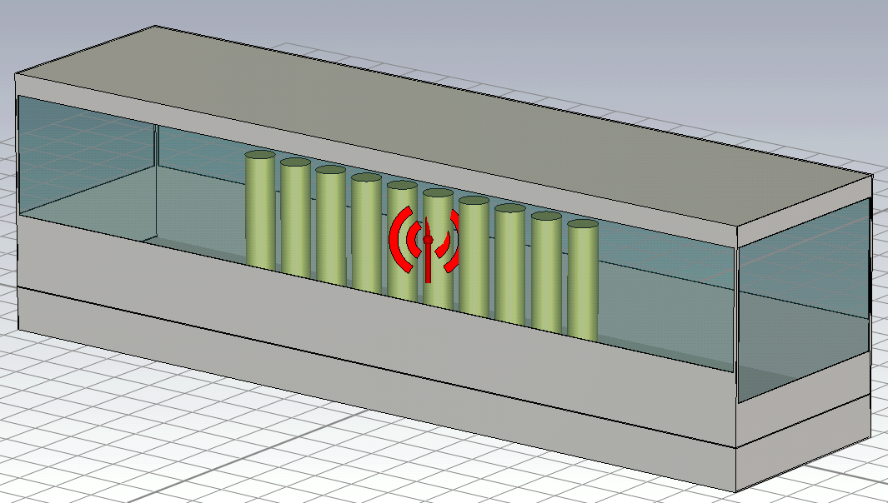
Channel parameters for passenger bus model
2 persons
10 persons
Rear
Center
Front
d₀=1000 (mm)
Tx | Center |  |  |  | Front |  | Rear
direction | Forward |  | Sideways |  | Forward | Sideways | Forward | Sideways
persons | 10 | 2 | 10 | 2 | 10 | 10 | 10 | 10
n | 1.31 | 1.96 | 0.33 | 1.48 | 1.01 | 0.70 | 1.22 | 2.07
PL₀ [dB] | 60.98 | 63.54 | 65.03 | 73.49 | 58.31 | 63.18 | 47.21 | 52.65

Slide 7

Channel parameters for sedan car cabin model
Tx | Driver | Rear seat
n | 1.28 | 1.73
PL₀ [dB] | 65.35 | 60.93
$$PL=PL_{0}+10n\log_{10}\left(\frac{d}{d_{0}}\right) (dB)$$

Slide 8
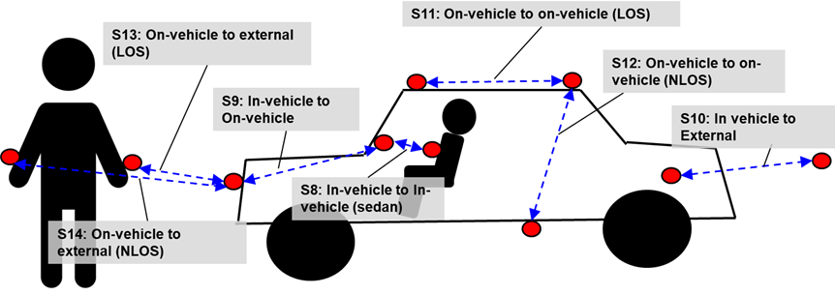
Channel parameters for VBAN use cases
 | Path loss (dB) | Distance (mm)
S09 | -74.75 | 2077
S10 | -86.45 | 3536
S11 | -69.04 | 1500
S12 | -102.08 | 1800
S13 | -70.19 | 1509
S14 | -92.79 | 1897

Slide 9
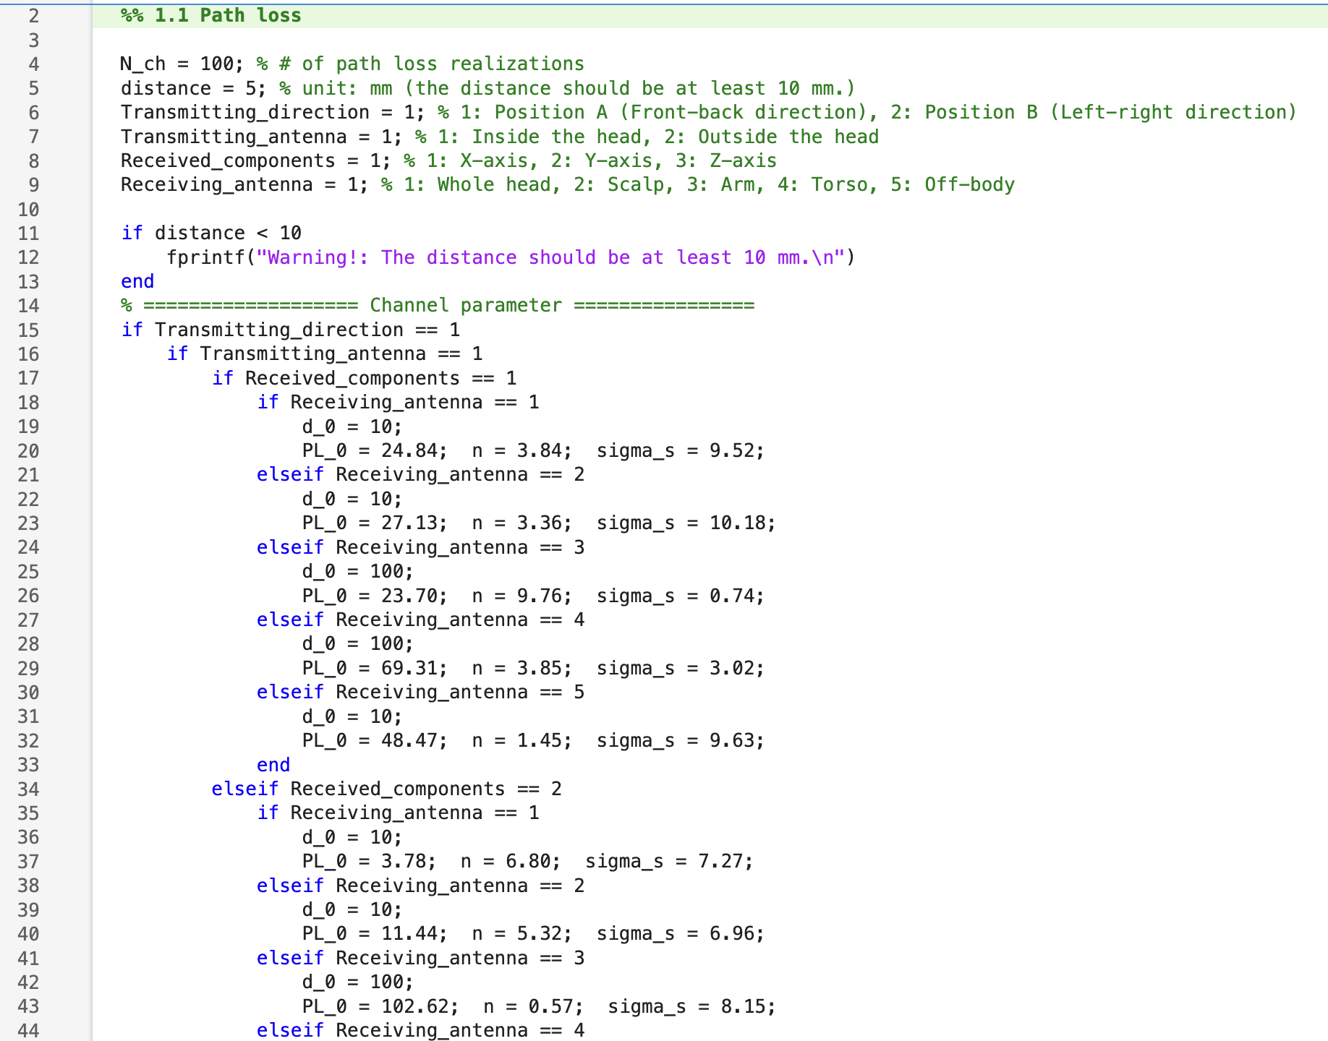
Propagation simulation

Slide 10
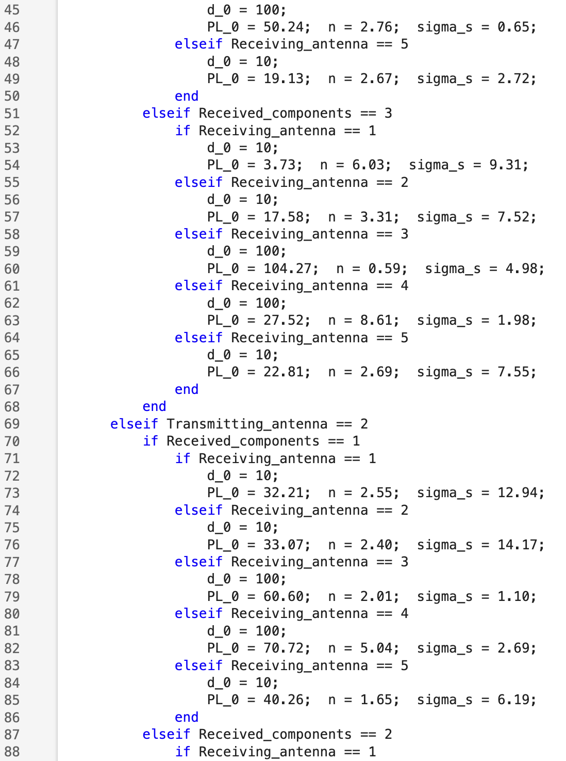
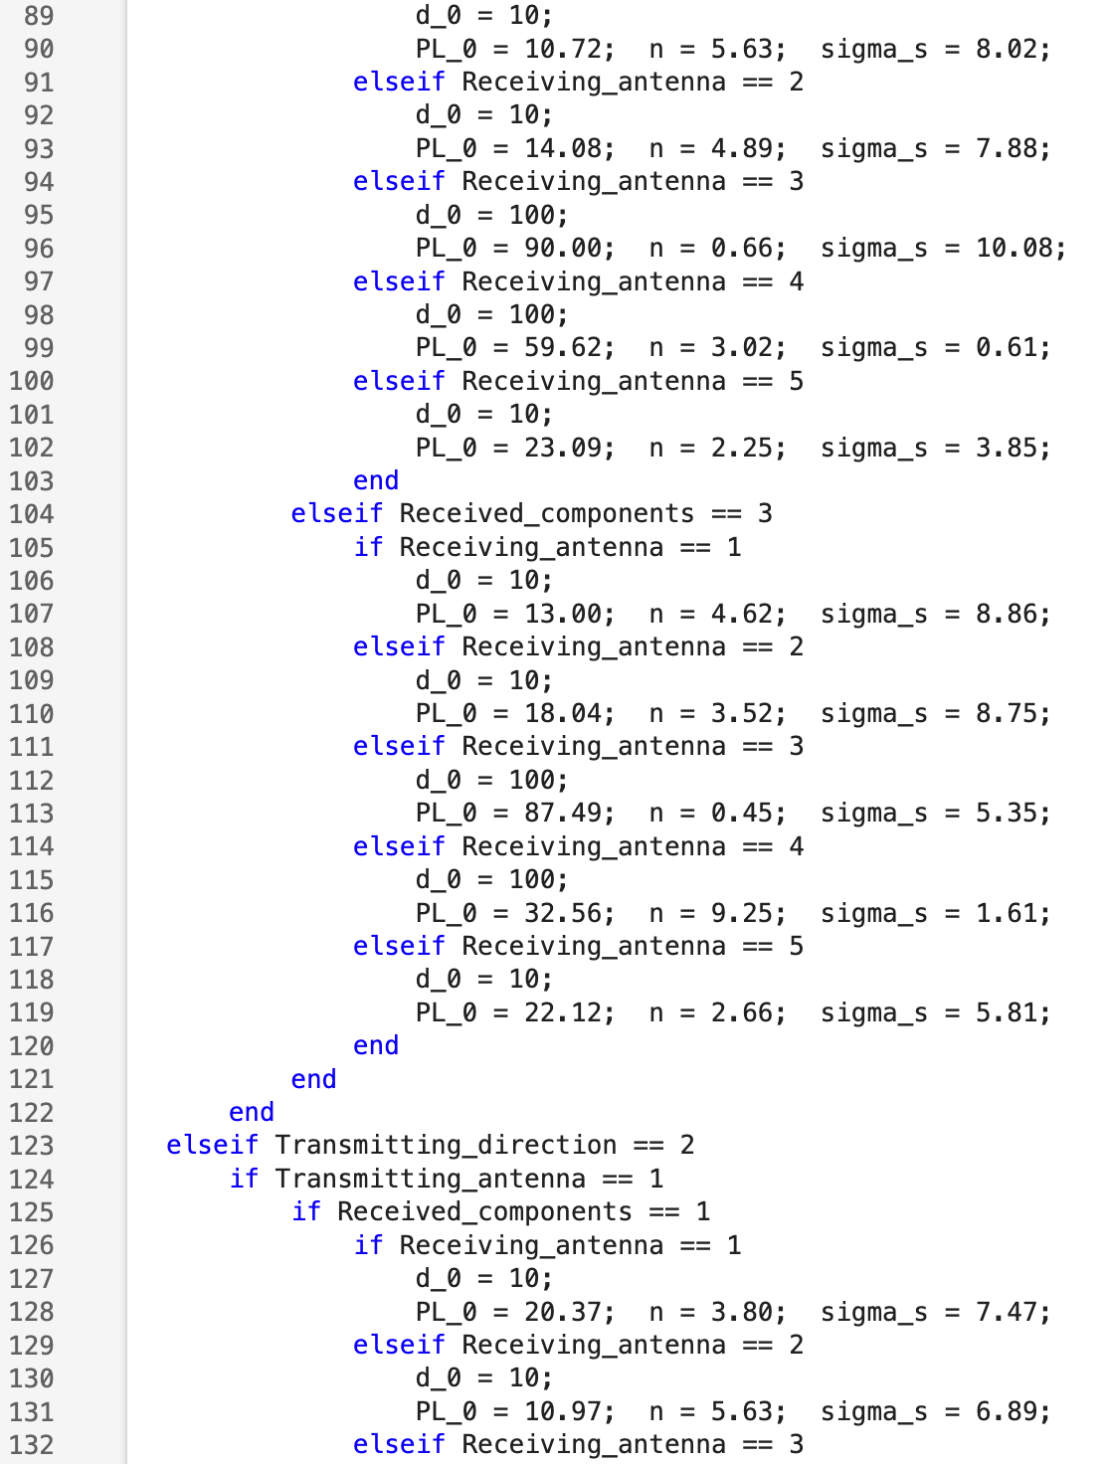
Propagation simulation (cont.)

Slide 11
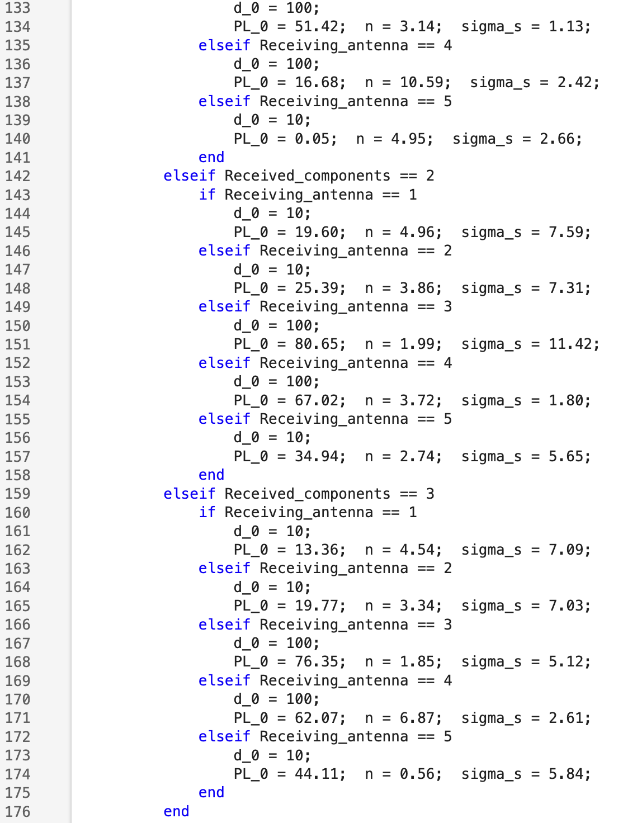
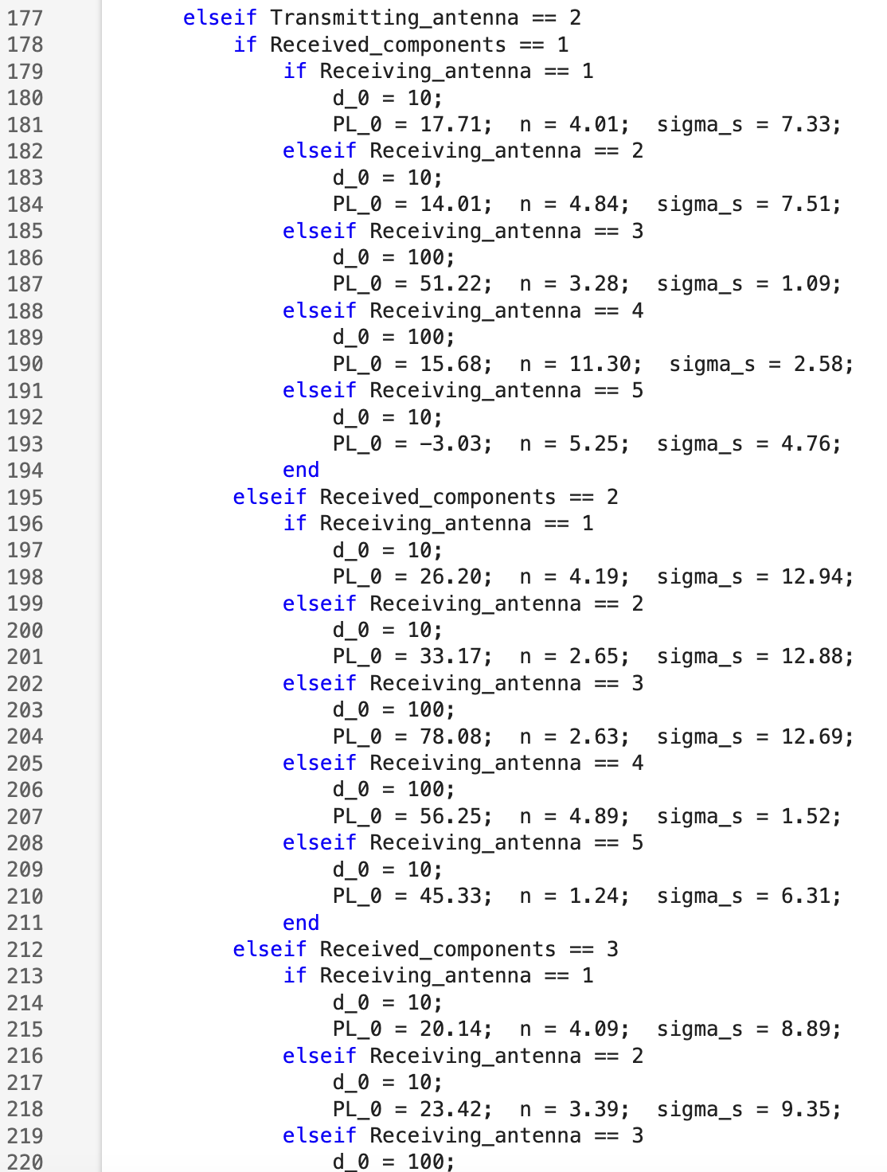
Propagation simulation (cont.)

Slide 12
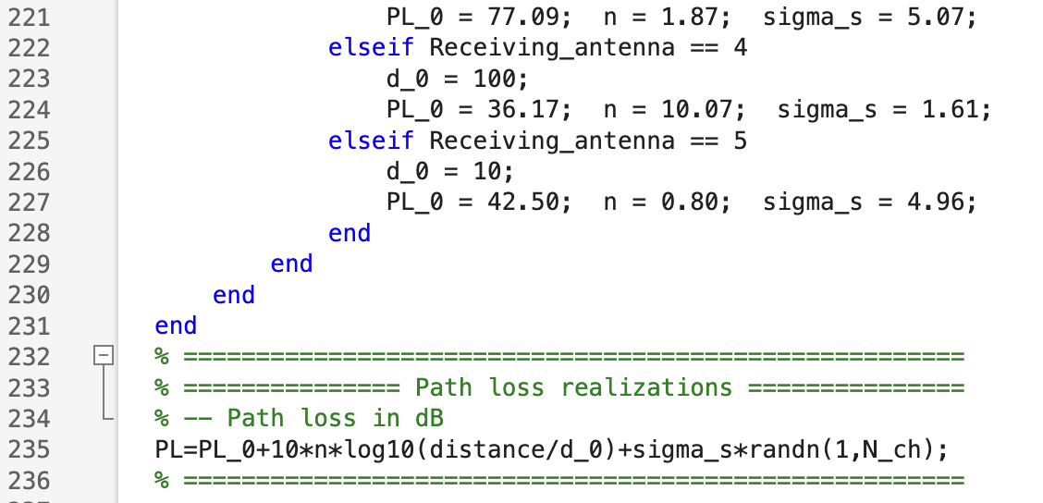
Propagation simulation (cont.)

Slide 13
References
D. Anzai, I. Balasingham, G. Fischer, J. Wang, “Reliable and High-Speed Implant Ultra-Wideband Communications with Transmit–Receive Diversity,” EAI/Springer Innovations in Communication and Computing, pp. 27-32, March 2020.
Y. Shimizu, D. Anzai, R. C-Santiago, P. A. Floor, I. Balasingham, and J. Wang, “Performance evaluation of an ultra-wideband transmit diversity in a living animal experiment” IEEE Trans. Microw. Theory Tech., vol. 65, no. 7, pp. 2596-2606, July 2017.
D. Anzai, K. Katsu, R. Chavez-Santiago, Q. Wang, D. Plettemeier, J. Wang, and I. Balasingham, “Experimental evaluation of implant UWB-IR transmission with living animal for body area networks,” IEEE Trans. Microw. Theory Tech., vol. 62, no. 1, pp. 183-192, Jan. 2014.
J. Shi, D. Anzai, and J. Wang, “Channel modeling and performance analysis of diversity reception for implant UWB wireless link,” IEICE Trans. Commun., no. E95-B, vol. 10, pp. 3197-3205, Oct. 2012.

