Slide 1
        doc.: 15-23-0017-01-04ab
Project: IEEE P802.15 Working Group for Wireless Personal Area Networks (WPANs)
Submission Title: MMRS Repetition Number in RSF
Date Submitted: January, 2023
Source: Xiliang Luo, Vinod Kristem, Moche Cohen (Apple)
Address: One Apple Park Way, Cupertino, CA 95104, USA
E-Mails: xiliang_luo@apple.com
Abstract: Clarify the number of MMRS symbols in each RSF.
Purpose: Provide more details on the MMS UWB.
Notice: This document has been prepared to assist the IEEE P802.15. It is offered as a basis for discussion and is not binding on the contributing individual(s) or organization(s). The material in this document is subject to change in form and content after further study. The contributor(s) reserve(s) the right to add, amend or withdraw material contained herein.
Release: The contributor acknowledges and accepts that this contribution becomes the property of IEEE and may be made publicly available by P802.15.

Slide 2
        doc.: 15-23-0017-01-04ab
PAR Objective | Proposed Solution (how addressed)
Safeguards so that the high throughput data use cases will not cause significant disruption to low duty-cycle ranging use cases
Interference mitigation techniques to support higher density and higher traffic use cases | Periodicity-Division Multiple Access
Other coexistence improvement
Backward compatibility with enhanced ranging capable devices (ERDEVs)
Improved link budget and/or reduced air-time | MMS
Additional channels and operating frequencies
Improvements to accuracy / precision / reliability and interoperability for high-integrity ranging | MMS for high-integrity ranging
Reduced complexity and power consumption
Hybrid operation with narrowband signaling to assist UWB | NBA-MMS
Enhanced native discovery and connection setup mechanisms
Sensing capabilities to support presence detection and environment mapping
Low-power low-latency streaming
Higher data-rate streaming allowing at least 50 Mbit/s of throughput
Support for peer-to-peer, peer-to-multi-peer, and station-to-infrastructure protocols
Infrastructure synchronization mechanisms

Slide 3
Illustration of MMS Packets
        doc.: 15-23-0017-01-04ab
NB
OR
1~2 ms
1ms
(X-2) ms
(1+Z) ms
1ms
(Y-2) ms
UWB
S
Y
N
C
S
FD
RSF
1
RSF
2
RSF
X
RIF
1
RIF
2
RIF
Y
Z = {0, 1}
MMRS
MMRS
MMRS
MMRS
STS
STS
Same sequences
Different STS sequences for integrity

Slide 4
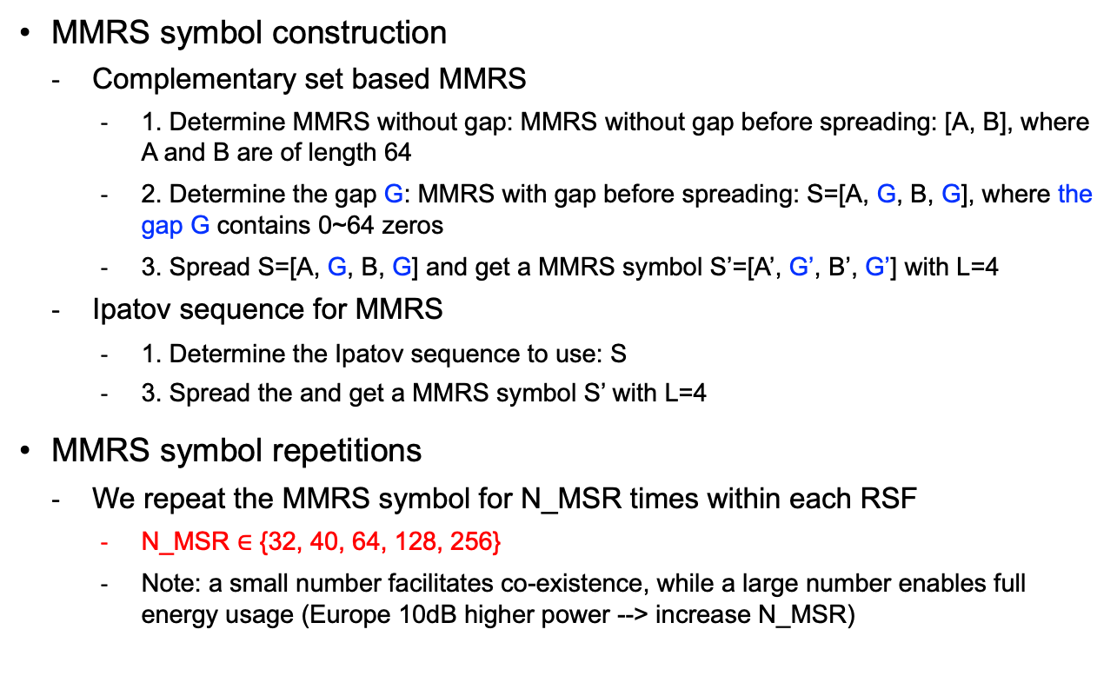
MMRS Symbol and Repetitions
        doc.: 15-23-0017-01-04ab
  MMRS symbol construction
    Complementary set based MMRS
      1. Determine MMRS without gap: MMRS without gap before spreading: [A, B], where A and B are of length 64
      2. Determine the gap G: MMRS with gap before spreading: S=[A, G, B, G], where the gap G contains 0~64 zeros
      3. Spread S=[A, G, B, G] and get a MMRS symbol S’=[A’, G’, B’, G’] with L=4
    Ipatov sequence for MMRS
      1. Determine the Ipatov sequence to use: S
      3. Spread the and get a MMRS symbol S’ with L=4
  MMRS symbol repetitions
    We repeat the MMRS symbol for N_MSR times within each RSF
      N_MSR $∈$ {32, 40, 64, 128, 256}
      Note: a small number facilitates co-existence, while a large number enables full energy usage (Europe 10dB higher power --> increase N_MSR)

Slide 5
MMRS Symbol and Repetitions
        doc.: 15-23-0017-01-04ab
RSF
MMRS
Symbol
MMRS
Symbol
MMRS
Symbol
N_MSR could be one from {32, 40, 64, 128, 256}

