Slide 1
Project: IEEE P802.15 Working Group for Wireless Specialty Networks (WSN)
Submission Title: More on PHR considerations
Source: Bin Qian, Rani Keren, Chenchen Liu, Lei Huang, Wei Lin, David Xun Yang (Huawei Technologies)
Address : [Huawei Bantian Base, Longgang District, Shenzhen, 518129 China]
E-Mail: [qianbin14@huawei.com]
Re: Task Group 4ab: UWB Next Generation for 802.15.4
Abstract: [UWB, PHR]
Purpose:
Notice: This document has been prepared to assist the IEEE P802.15. It is offered as a basis for discussion and is not binding on the contributing individual(s) or organization(s). The material in this document is subject to change in form and content after further study. The contributor(s) reserve(s) the right to add, amend or withdraw material contained herein.
Release: The contributor acknowledges and accepts that this contribution becomes the property of IEEE and may be made publicly available by P802.15.
Notes:
Jul 12, 2010
Page 1

Slide 2
PHR Proposals
Single PHR proposal in [1-2]
PHR data rate and preamble symbol repetition (PSR) are configured by OOB method
Do not support dynamic PHR data rate
4-bit PHR1 proposal in [3]
Support dynamic PHR data rate
2 PHR repetitions seems to be a good compromise
In DCN0691r0, a length-32 mapping based PHR1 scheme is proposed, which aims to match the performance of 4 PHR repetitions. In this contribution, the mapping based PHR1 scheme is updated to match the performance of 2 PHR repetitions.
[1] IEEE 15-22-0475-01-04ab-phr-content-and-rate
[2] IEEE 15-22-0546-01-04ab-legacy-4z-phr-for-several-new-data-rates
[3] IEEE 15-22-0653-00-04ab-an-updated-phy-header-proposal

Slide 3
Mapping Based PHR1
Criteria: (1) Minimize the imbalance between the performance of PHR1 and PHR2; (2) Minimize the air time to achieve more gating gain.
Updated scheme:
PHR1 is transmitted based on a length-18 mapping (potentially length-16 mapping) containing 12 sequences to indicate PHR2 data rate and PSDU data rate as well as whether LDPC is applied
The mapping sequence is transmitted at 1.95 Mbps

Slide 4
Data Rate Mapping
PHR1 mapping sequence values | PSDU data rate (Mbps)
1 1 1 1 1 1 1 0 0 0 0 0 0 0 0 0 0 0 | 1.95, w/ LDPC
0 0 0 0 0 0 0 1 0 1 0 0 0 1 1 1 0 1 | 1.95, w/o LDPC
0 0 0 0 0 0 0 1 1 0 1 0 0 0 1 1 1 0 | 7.8, w/ LDPC
0 0 0 0 0 0 0 0 1 1 0 1 0 0 0 1 1 1 | 7.8, w/o LDPC
0 0 0 0 0 0 0 1 0 1 1 0 1 0 0 0 1 1 | 31.2, w/ LDPC
0 0 0 0 0 0 0 1 1 0 1 1 0 1 0 0 0 1 | 31.2, w/o LDPC
0 0 0 0 0 0 0 1 1 1 0 1 1 0 1 0 0 0 | 62.4, w/ LDPC
0 0 0 0 0 0 0 0 1 1 1 0 1 1 0 1 0 0 | 62.4, w/o LDPC
0 0 0 0 0 0 0 0 0 1 1 1 0 1 1 0 1 0 | 124.8, w/ LDPC
0 0 0 0 0 0 0 0 0 0 1 1 1 0 1 1 0 1 | 124.8, w/o LDPC
0 0 0 0 0 0 0 1 0 0 0 1 1 1 0 1 1 0 | Reserved
0 0 0 0 0 0 0 0 1 0 0 0 1 1 1 0 1 1 | Reserved
PHR2 data rate determination
When LDPC is applied, the PHR2 date rate is half of the PSDU data rate; when BCC is applied, the PHR2 data rate is the same as the PSDU date rate

Slide 5
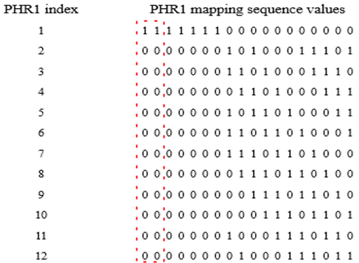
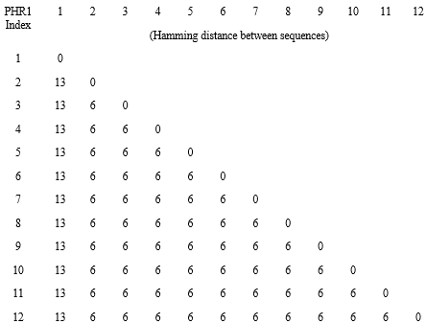
PHR1 Mapping
The length of mapping sequence is 18
Index #1 is applied to support 1.95Mbps PSDU with LDPC
Index #2 to #12 have the same Hamming distance distribution and same PER performance
10 sequences are used to indicate current PSDU data rate and whether to use LDPC
2 additional sequences are reserved for future use
1% PER SNR points are as follows
Besides, the first two columns of the mapping could be removed to form a length-16 mapping. For Index # 1, the Hamming distance is 11 and 1% PER SNR point is -1.0dB, while for Index #2 - #12, the Hamming distance is 6 and 1% PER SNR point is 1.8dB.
PHR1 index | 1% PER SNR Point (dB)
#1 | -1.8
#2 - #12 | 1.8

Slide 6
Recommendation
We prefer the mapping based PHR1 at 1.95 Mbps since this option achieves better tradeoff between the performance balance and the PHR airtime.

