Slide 1

140th Session of Meetings of the
IEEE 802.15 Working Group for Wireless Specialty Networks (WSN)
Closing Report
Nov. 14-17, 2022
Held in Bangkok & Hybrid via Webex

Slide 2
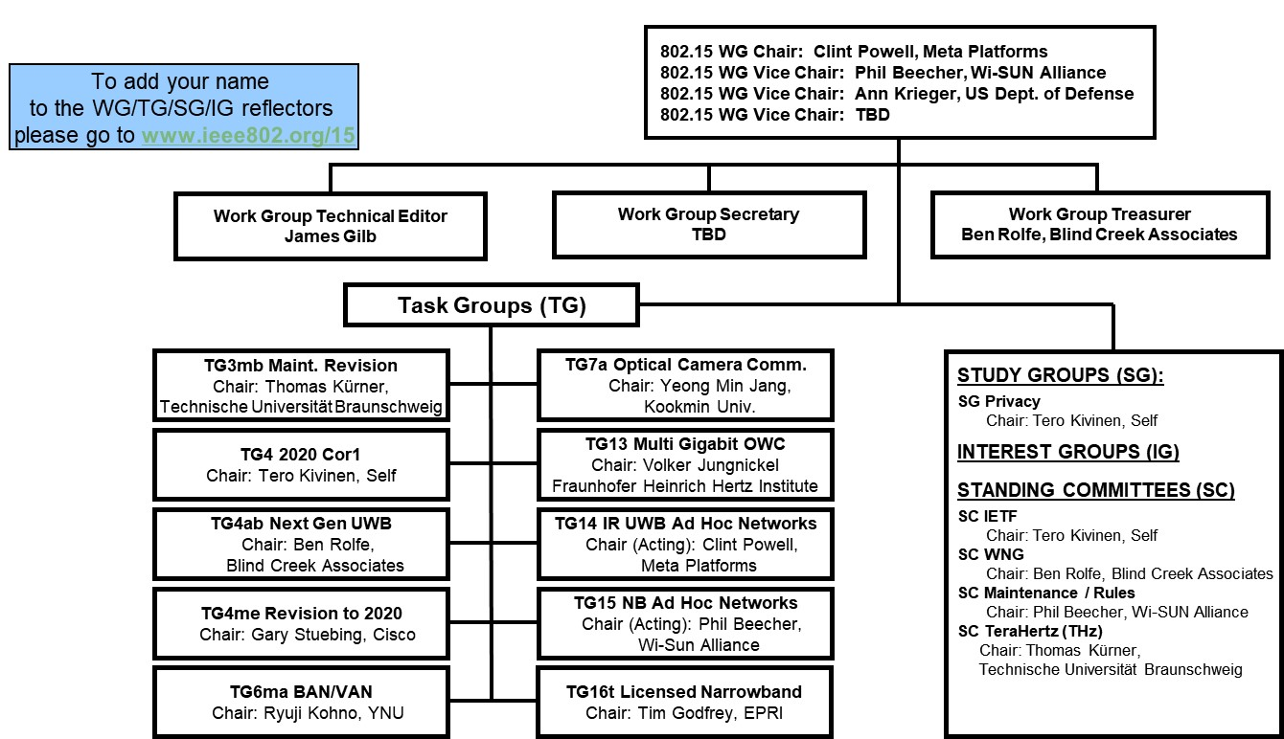
802.15 WG Org. Chart

Slide 3
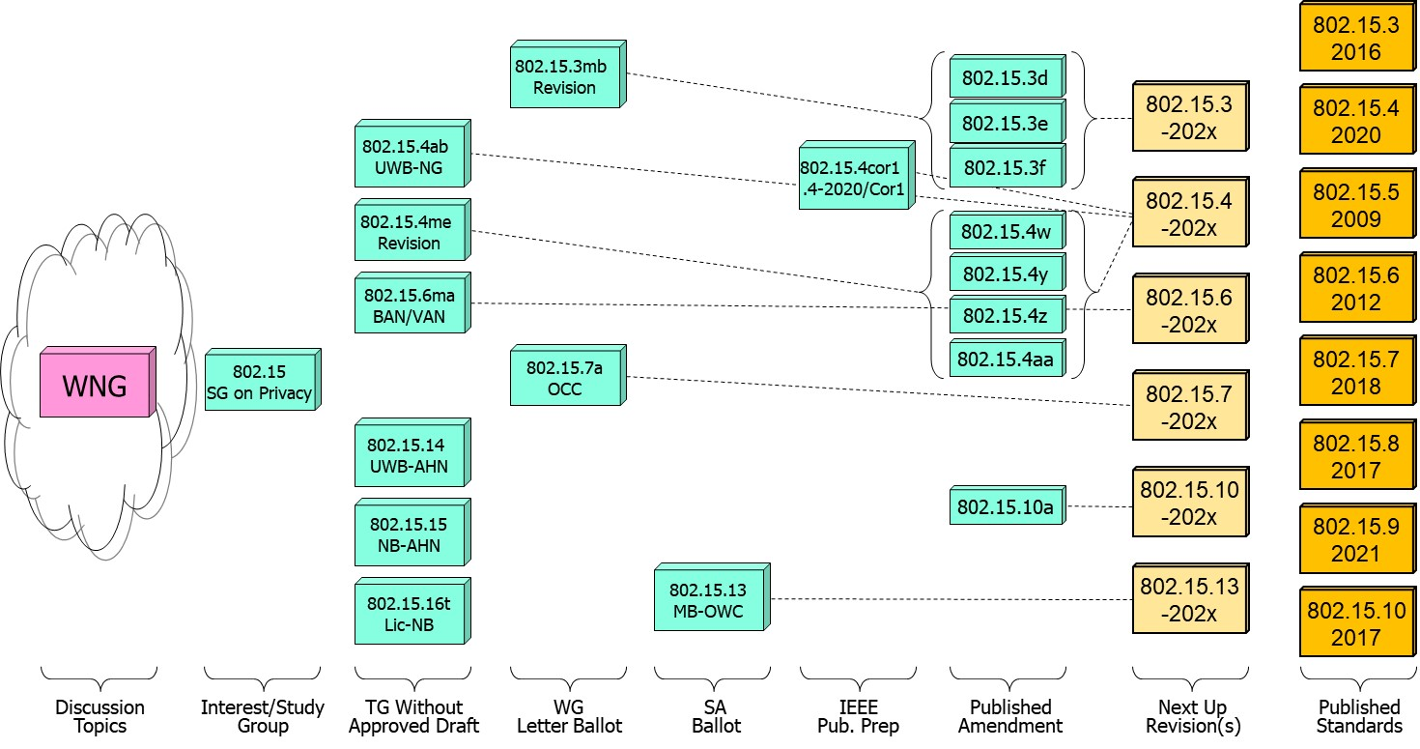
802.15 WG Standards Pipeline

Slide 4
802.15 WG Administrative
Voting members: 136
Nearly voting members: 9
Aspirant voting member: 26
802.15 WG Officer elections held in March 2022
Clint Powell elected WG Chair
Phil Beecher elected WG Vice-Chair
802.15 WG Vice-Chair election held in Nov. 2022
Ann Krieger elected WG Vice-Chair
Still seeking a WG Sec & 1 WG Vice-Chair
  If interested contact WG15 Chair

Slide 5
802.15 WG Subgroups/Objectives
TG 3mb – Revision b, Maintenance (mb)
Objective: revision for 802.15.3, extension of the frequency range to 300 GHz and review the 802.1D references and replace them with 802.1Q as appropriate
TG 4/Cor1 – 802.15.4-2020 Corrigenda
Objective: correction of errors, inconsistencies, and ambiguities
TG 4ab – Next Generation Ultra WideBand (UWB-NG) amendment
Objective: enhancements to 802.15.4 Ultra Wideband (UWB) physical layers (PHYs) media access control (MAC), and associated ranging techniques while retaining backward compatibility with enhanced ranging capable devices (ERDEVs)
TG 4me – Revision e, Maintenance (mb)
Objective: revision to 802.15.4-2020, rolling up amendments 802.15.4w, 802.15.4y, 802.15.4z, and 802.15.4aa and work on errors, omissions, updates, etc.

Slide 6
802.15 WG Subgroups/Objectives
TG 6ma – Revision a, Maintenance (ma)
Objective: enhancements to the BAN Ultra Wideband (UWB) physical layer (PHY) and media access control (MAC) to support enhanced dependability to a human BAN (HBAN) and adds support for vehicle body area networks (VBAN), a coordinator in a vehicle with devices around the vehicular cabin
TG 7a – Optical Camera Communication (OCC)
Objective: high-rate OCC Physical Layer (PHY) using light wavelengths from 10,000 nm to 190 nm delivering data rates up to 100 Mb/s for point-to-point and point-to-multipoint communication

Slide 7
802.15 WG Subgroups/Objectives
TG 13 – Multi-Gigabit/sec Optical Wireless Communication (MG-OWC)
Objective: define OWC specifications to enable high data rate transfer among end points with up to multi-Gigabit throughput and ranges up to 200 m unrestricted line of site targeting support for ceiling-mounted infrastructure serving stationary and mobile devices as well as point-to-point links
TG 14 – Impulse Radio Ultra Wideband Wireless Ad Hoc Networks (UWB-AHN) ---IN HIBERNATION---
Objective: focused on impulse radio (IR) Ultra Wideband (UWB) PHY and MAC providing precision ranging capability that is accurate to the centimeter level by including (via. referencing) the 802.15.4 IR UWB functionality into a simple focused specification
TG 15 – Narrow Band Wireless Ad Hoc Networks (NB-AHN)
---IN HIBERNATION---
Objective: focused on narrow band ad hoc network PHY and MAC by including (via referencing) functionality and features of 802.15.4 into a simple focused specification

Slide 8
802.15 WG Subgroups/Objectives
TG 16t – Licensed Narrowband (Lic-NB)
Objective: specify new PHY in licensed spectrum with channel bandwidths greater than or equal to 5 kHz and less than 100 kHz focusing on spectrum less than 2 GHz.
IG Privacy
Objective: determine interest of topic “privacy of addresses” and if SG should be formed to develop PAR and CSD

Slide 9
802.15 WG Subgroups/Objectives
SC Maintenance/Rules
Objective: review errors noted in published standards providing a response/proposal to the 802.15 WG; review the 802.15 WG operations manual and suggest changes to 802.15 WG; review PARs submitted by other WGs
SC IETF – Internet Engineering Task Force standing committee
Objective: provides an 802.15 liaison to IETF for projects associated with 802.15 standards
SC THz – TeraHertz (THz)
Objective: follow the developments of THz communications, providing input to the regulatory framework for THz comms. in close cooperation IEEE 802.18 TAG; trigger the start of projects to amend existing and develop new standards for THz comms.
SC WNG – Wireless Next Generation (WNG)
Objective: provides an opportunity to individuals to make technical presentations to the 802.15 WG on new technologies and/or proposals for new projects

Slide 10
Meeting Slots for 802.15 WG Nov. Plenary

Slide 11
Session Objectives Nov. 14-17, 2022
TG 3mb (Revision) (4 meeting slots)
  Comment resolution on initial Letter Ballot
  Seek WG approval to start Letter Ballot Recirc
TG 4/Cor1 (0 meeting slots)
  In IEEE editing phase
TG 4ab (UWB-NG) (8 meeting slots)
  Continue to hear and discuss PHY & MAC presentations
  Identify elements to start pulling together baseline draft
TG 4me (Revision) (4 meeting slots)
  Hear presentations on errors, omissions, updates, etc.
  Hear status update of merged baseline draft
TG 6ma (Revision) (3 meeting slots)
  Hear and discuss presentations
  Continue harmonization with TG 4ab

Slide 12
Session Objectives Nov. 14-17, 2022
TG 7a (OCC) (3 meeting slots)
  Comment resolution on initial Letter Ballot
  Seek WG approval to start Letter Ballot Recirc
TG 13 (MG-OWC) (2 meeting slots)
  Comment resolution for latest SA Ballot recirc
  Discuss timeline of future recircs and submission to RevCom
TG 14 (UWB-AHN) (0 meeting slots)
TG 15 (NB-AHN) (0 meeting slots)
TG 16t (Lic-NB) (3 meeting slots)
  Continue draft development
Joint 802.1/802.15 (1 meeting slot)
  Presentation on additional elements of 802.15.4 arch. overview
  Next steps for moving ahead

Slide 13
Session Objectives Nov. 14-17, 2022
IG PRIVACY (2 meeting slots)
  Discuss and formulate objectives w.r.t. address privacy
  Seek approval to form SG
SC MAINTENANCE (2 meeting slots)
  Review any change requests for the Operations Manual
  Work on any templates
  Review other WG PAR submissions
SC IETF (1 meeting slot)
  Discuss IETF activities
SC THz (0 meeting slots)
SC WNG (1 meeting slot)
  Hearing presentations

Slide 14
TG3mb Nov. 2022
Closing Report

Slide 15
Project: IEEE P802.15 Working Group for Wireless Speciality Networks (WSN)
Submission Title: TG 3mb November 2022 Closing Plenary Slides
Date Submitted: 17 November 2022
Source: Thomas Kürner TU Braunschweig
Address Schleinitzstr. 22, D-38092 Braunschweig, Germany
Voice:+495313912416, FAX: +495313915192, E-Mail: t.kuerner@tu-bs.de
Re: n/a
Abstract: TG 3mb November 2022 Closing Plenary Slides
Purpose: Closing report to WG 15 closing plenary
Notice: This document has been prepared to assist the IEEE P802.15. It is offered as a basis for discussion and is not binding on the contributing individual(s) or organization(s). The material in this document is subject to change in form and content after further study. The contributor(s) reserve(s) the right to add, amend or withdraw material contained herein.
Release: The contributor acknowledges and accepts that this contribution becomes the property of IEEE and may be made publicly available by P802.15.

Slide 16
Starting Point of the week:
Results of LB191
  VOTERS 139
  VOTED 88
  YES 73
  ABSTAIN 12
  NO 3
  % VOTERS 63,31%
  % YES 96,05%
  % ABSTAIN 13,64%
  Comments received:
  6 sets of comments (Sand, Verso, Kivinen, Shellhammer, Brown, Kürner)
    Total 351 comments
      Thereof:
        6 must be satisfied
        11 technical
        340 editorial

Slide 17
Meetings/Contributions
4 meetings on Tue AM1, Tue PM2, Wed AM1 and Wed AM2
Resolving Comments of LB191:
TG3mb - Opening Report (22/0579)
Comments resolution (22/0559r4)
Proposal for revised tables on EVM and Rx Sensitivity Levels in Chapter 15 in 802.15.3RevB (22/0581)
Proposal for restructuring Chapter 4 in 802.15.3RevB (22/0580)
Proposal for revising headlines in 802.15.3RevB (22/0595)
Coexiseance Assessment Document (22/0462r4)

Slide 18
Meetings/Contributions
4 meetings on Tue AM1, Tue PM2, Wed AM1 and Wed AM2
Resolving Comments of LB191:
TG3mb - Opening Report (22/0579)
Comments resolution (22/0559r4)
Proposal for revised tables on EVM and Rx Sensitivity Levels in Chapter 15 in 802.15.3RevB (22/0581)
Proposal for restructuring Chapter 4 in 802.15.3RevB (22/0580)
Proposal for revising headlines in 802.15.3RevB (22/0595)
Coexiseance Assessment Document (22/0462r4)

Slide 19
Review of Time Line for TG3ma
  January 2022 Kick-Off; Issuing Call for Proposals
  March 2022 Roll-up available ; start reviewing the roll-up version; Listening proposals;
  Webcons AprilMay Roll-up available; start reviewing roll-up
  May 2022 Start drafting D0
  July 2022 Starting TG Review /WG Editor Review
  September 2022 Starting LB
  November 2022 LB Comment Resolution
  January 2023 Starting SB
  March 2023 SB Comment Resolution
  May 2023 Submission to RevCom

Slide 20
TG Motion
Move that TG 3mb formally request that the 802.15 WG start a WG Letter Ballot requesting approval of CA document 15-22-0462-04-03ma-coexistence-assurance.doc and document P802-15-3-Rev B-D2.pdf (as edited in accordance with the instructions in document 15-22-0559-04-03ma-lb191-consolidated-comments.xlsx) and to forward document P802-15-3-Rev B-D2.pdf, as edited in accordance with the instructions in document 15-22-0559-04-03ma-lb191-consolidated-comments.xlsx, and CA document 15-22-0462-04-03ma-coexistence-assurance.doc to Standards Association ballot pending the completion and inclusion of the edits in the draft.
Moved By: Iwao Hosako
Seconded By: Monique Brown
No objection and abstain, the motion carries with unanimous consent

Slide 21
WG Motion
Move that 802.15 WG start a WG Letter Ballot requesting approval of CA document 15-22-0462-04-03ma-coexistence-assurance.doc and document P802-15-3-Rev B-D2.pdf (as edited in accordance with the instructions in document 15-22-0559-04-03ma-lb191-consolidated-comments.xlsx) and to forward document P802-15-3-Rev B-D2.pdf, as edited in accordance with the instructions in document 15-22-0559-03-03ma-lb191-consolidated-comments.xlsx, and CA document 15-22-0559-04-03ma-lb191-consolidated-comments.xlsx to Standards Association ballot pending the completion and inclusion of the edits in the draft.
Moved By: Thomas Kürner
Seconded By: Phil Beecher

Slide 22
TG Motion
Move that 802.15.3mb TG approve the formation of a Comment Resolution Group (CRG) for the WG balloting of the P802.15.3-RevB-D2 with the following membership: Thomas Kürner (Chair), Iwao Hosako, Shoichi Kitazawa and Jörg Robert. The 802.15.3mb CRG is authorized to approve comment resolutions and to approve the start of recirculation ballots of the revised draft on behalf of the 802.15 WG. Comment resolution on recirculation ballots between sessions will be conducted via reflector email and via teleconferences announced to the reflector as per the LMSC 802 WG P&P
Moved By: Iwao Hosako
Seconded By: Monique Brown
No objection and abstain, the motion carries with unanimous consent

Slide 23
WG Motion
Move that 802.15 WG approve the formation of a Comment Resolution Group (CRG) for the WG balloting of the P802.15.3-RevB-D2 with the following membership: Thomas Kürner (Chair), Iwao Hosako, Shoichi Kitazawa and Jörg Robert. The 802.15.3mb CRG is authorized to approve comment resolutions and to approve the start of recirculation ballots of the revised draft on behalf of the 802.15 WG. Comment resolution on recirculation ballots between sessions will be conducted via reflector email and via teleconferences announced to the reflector as per the LMSC 802 WG P&P
Moved By: Thomas Kürner
Seconded By: Phil Beecher

Slide 24
Next Meetings
  Requested January meeting slots for TG3mb
    1 time slot
  CRG calls scheduled
Friday 9 December 2022, 2pm CET
Tuesday 13 December 2022, 3pm CET
Wednesday 14 December 2022, 2pm CET
Wednesday 21 December 2022, 3pm CET
Thursday 5 January 2023, 3pm CET

Slide 25
TG4me Nov. 2022
Closing Report

Slide 26
Project: IEEE P802.15 Working Group for Wireless Personal Area Networks (WPANs)
Submission Title: November, 2022 IEEE 802.15.4me Plenary Agenda and Closing
Date Submitted: November 17, 2022
Source: Gary Stuebing Company: Cisco Systems
Address 5310 N Ocean Blvd, Unit 9A, North Myrtle Beach, SC
Voice 803 230-3027 E-Mail: gstuebin@cisco.com
Re: DCN 15-22-0672-00-04me Abstract: November, 2022 IEEE 802.15.4me Plenary Agenda and Closing
Purpose: Agenda and Closing Report for Task Group
Notice: This document has been prepared to assist the IEEE P802.15. It is offered as a basis for discussion and is not binding on the contributing individual(s) or organization(s). The material in this document is subject to change in form and content after further study. The contributor(s) reserve(s) the right to add, amend or withdraw material contained herein.
Release: The contributor acknowledges and accepts that this contribution becomes the property of IEEE and may be made publicly available by P802.15.

Slide 27
15.4me Sessions this Week
 | Monday | Tuesday | Wednesday | Thursday
AM 1 | Opening Plenary |  | 15.4me Cancelled
AM 2 |  | 15.4me | Midweek Plenary
PM 1 |  |  | 15.4me
PM 2 | 15.4me |  |  | 15.4me
6:30p |  |  |  | Closing Plenary

Slide 28
Agenda
  Call for Patents
  Review Submissions
  Next Steps
  Draft Timeline
  Next meetings
  Minutes posted: https://mentor.ieee.org/802.15/dcn/22/15-22-0671-00-04me-tg4me-november-2022-minutes.doc

Slide 29
Draft Timeline
December 15ish/22 – First version of Features/Merge/Layout to Amend Editors to ensure correct.
January/23 Meeting – Consolidate comments from Amendment Editors and any submissions from Call for Submissions. Agreement on List of Separate Features – Result: 2nd Version with modifications for March
March/23 – Review 1st Pass of reformatted/reorganized Document
May/23 – 1st Letter Ballot
Jul/23 – Review of Comments (Form CRG)
Sep/23 – Comment Resolution and Recirc
(CRG)
Nov/23 – Conditional Sponsor Ballot and CRG
Jan/24 – Sponsor Recirc (CRG)
Mar/24 – Submit to REVCOM

Slide 30
TG6ma Nov. 2022
Closing Report

Slide 31
Project: IEEE P802.15 Working Group for Wireless Personal Area Networks (WPANs)
Submission Title: [TG15.6ma Closing Report for November 2022]
Date Submitted: [17th November 2022]
Source: [Ryuji Kohno1,2,] [1;Yokohama National University, 2;YRP International Alliance Institute(YRP-IAI)]
Address [1; 79-5 Tokiwadai, Hodogaya-ku, Yokohama, 240-8501 Japan
2; YRP1 Blg., 3-4 HikarinoOka, Yokosuka-City, Kanagawa, 239-0847 Japan]
Voice:[1; +81-90-5408-0611], FAX: [+81-45-383-5528],
Email:[1: kohno@ynu.ac.jp, 2: kohno@yrp-iai.jp] Re: []
Abstract: [This document contains closing report for TG15.6ma for Revision of P802.15.6-2012 with Enhanced Dependability November 2022.]
Purpose: [information]
Notice: This document has been prepared to assist the IEEE P802.15. It is offered as a basis for discussion and is not binding on the contributing individual(s) or organization(s). The material in this document is subject to change in form and content after further study. The contributor(s) reserve(s) the right to add, amend or withdraw material contained herein.
Release: The contributor acknowledges and accepts that this contribution becomes the property of IEEE and may be made publicly available by P802.15.

Slide 32
Objectives of TG 6ma – Enhanced Dependability Body Area Network (ED-BAN)
Objective: Enhancements to the BAN Ultra Wideband (UWB) physical layer (PHY) and media access control (MAC) to support enhanced dependability to a human BAN (HBAN) and adds support for vehicle body area networks (VBAN), a coordinator in a vehicle with devices around the vehicular cabin.
Action:
Submission of Draft Proposals Corresponding Call for Proposals
Update of Channel and Coexisting Models
Discussion on Feasibility and satisfaction in market of the TRD
Discussion on Feasibility of TSN of 802.1 in MAC and interference mitigation in PHY and MAC
Joint Meeting with other groups for harmonization to resolve common problems
Next Things to Do：
Accept Proposals to Satisfy Technical Requirements

Slide 33
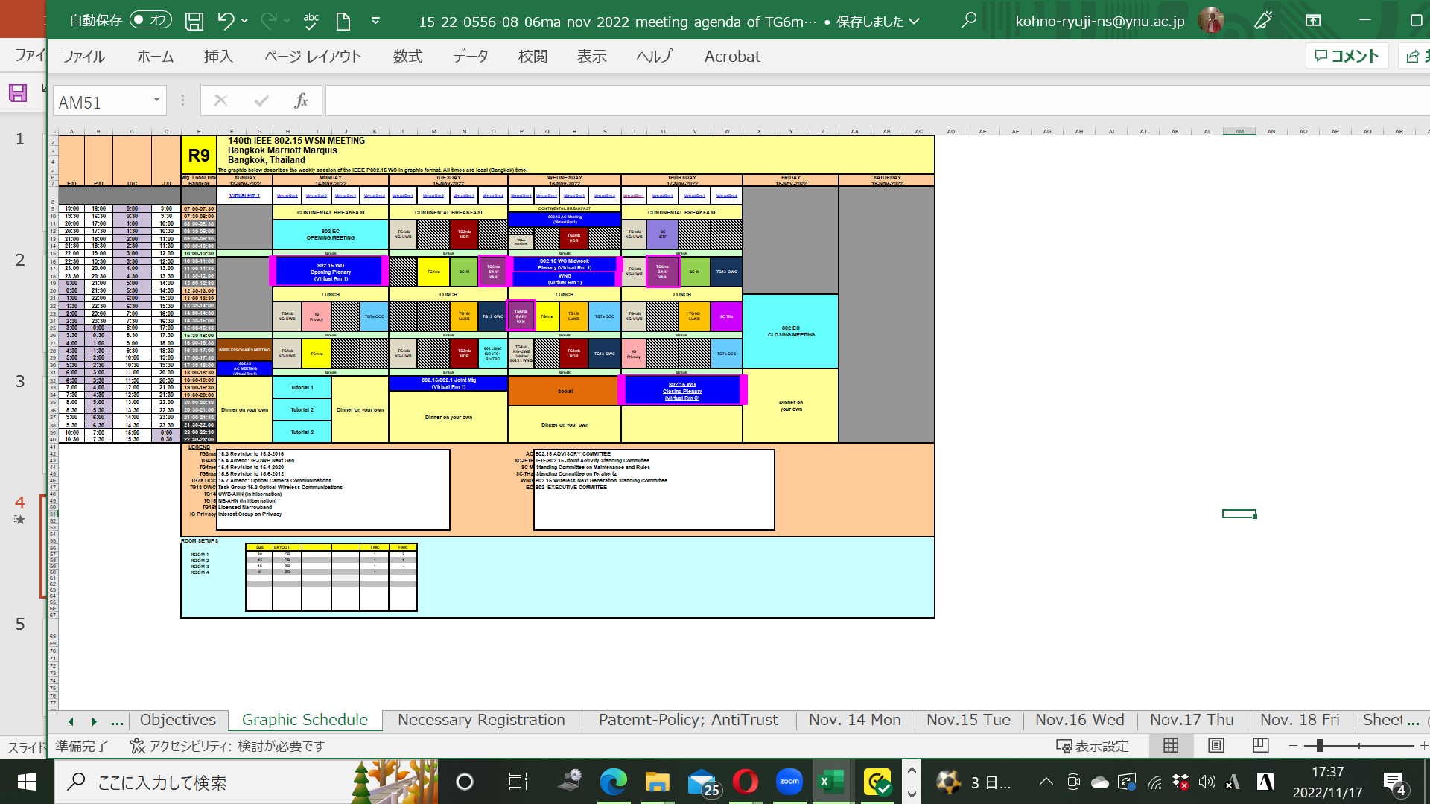
TG15.6ma Plenary Session Schedule for 13-17th, November 2022
TG15.6ma has three own sessions such as
Session1(Virtual RM#4) AM2 10:30-12:30 in local time 22:30-01:30 +1day EDT, Nov.15(TUE), 12:30-14:30 JST
Session2(Virtual RM#1) PM1 15:30-17:30 in local time 1:30-3:30 EDT, Nov. 16(WED), 15:30-17:30 JST
Session3(Virtual RM#2) AM2 10:30-12:30 in local time 22:30-01:30 +1day EDT, Nov.17(THU), 12:30-14:30 JST

Slide 34
TG15.6ma Plenary Session Schedule for 13-17th, November 2022
TG15.6ma has three own sessions such as
Session1(Virtual RM#4) AM2 10:30-12:30 in local time 22:30-01:30 +1day EDT, Nov.15(TUE), 12:30-14:30 JST
Session2(Virtual RM#1) PM1 15:30-17:30 in local time 1:30-3:30 EDT, Nov. 16(WED), 15:30-17:30 JST
Session3(Virtual RM#2) AM2 10:30-12:30 in local time 22:30-01:30 +1day EDT, Nov.17(THU), 12:30-14:30 JST
1.Session1(Virtual RM#4) AM2 10:30-12:30 in local time 22:30-01:30
+1day EDT, Nov.15(TUE), 12:30-14:30 JST
https://ieeesa.webex.com/ieeesa/j.php?MTID=mb884a0f3d7d2d4ef463797a991898c12
Meeting number: 2338 389 2474 Password: 80215mtgrm4
2. Session2(Virtual RM#1) PM1 15:30-17:30 in local time 1:30-3:30
EDT, Nov. 16(WED), 15:30-17:30 JST
https://ieeesa.webex.com/ieeesa/j.php?MTID=m5dff7eac804a555afce33031902f8b9e
Meeting number: 2332 311 7560 Password: 80215mtgrm1
3. Session3(Virtual RM#2) AM2 10:30-12:30 in local time 22:30-01:30
+1day EDT, Nov.17(THU), 12:30-14:30 JST
https://ieeesa.webex.com/ieeesa/j.php?MTID=m95604532074fae572029cf2fd8c9f2e3
Meeting number: 2336 549 8412 Password: 80215mtgrm2

Slide 35
Agenda items for the week
TG15.6ma meeting call to order
Call for essential patents and policies & procedures reminder
Approve last meeting minutes: TG 15.6ma Meeting Minutes for Nov. 2022 doc.#15-22-0556-02-06ma
Agenda of TG15.6ma September Meeting doc.#15-22-0557-08-06ma
Review and Summary
  IG DEP, SG & TG15.6a Activity for Amendment of IEEE802.15.6 Wireless BAN with Enhanced Dependability 339-02
  2. Summary of Channel and Environment Models doc.#15-22-0269-02-06ma
  3 Technical Requirement Document of TG15.6ma doc.#15-21-0577-06-006a
  Call for Proposals doc.#15-22-0488-01-06ma
  Presentation
  QoS-aware Hybrid ARQ Scheme Utilizing Decomposable Error Correcting Codes for Wireless Body Area Networks
  doc.#15-22-0561-00-06ma
  2.. Evaluation of IEEE 802.15.6 Ultra-wideband Physical Layer Utilizing Super Orthogonal Convolutional Code
  doc.#15-22-0562-00-06ma
  3. Harmonization with 4ab: data rates & FEC doc.#15-22-0zzz-00-06ma
  Propagation Characteristics of UWB Communication Applications for BCI Use Case doc.#15-22-0583-00-06ma
  Propagation Characteristics of UWB Communication Applications for Passengers Bus Use Case 0584-00-06ma
  Definition of Coexistence Levels and How to Support Higher Levels doc.#15-22-0631-00-06ma
  MAC Protocol Proposal for Multiple BAN environment(Level 1) doc.#15-22-0ddd-00-06ma
  MAC Protocol Using Negotiation among Coordinators in Coexistence of Multiple Wireless BANs 0633-00-o6ma
  Coordinator-to-Coordinator(C2C) Negociation among Coexisting BANs doc.#15-22-0388-00-06ma
  MAC proposal for coexisting dependable BANs doc.#15-22-0594-00-06ma
  MAC Preliminary harmonization with 4ab: MAC operation doc.#15-22-0634-00-06ma
  MAC Bridging for Time-Sensitive Networking of 802.15.6ma doc.#15-22-0024-00-06a
  Interference reduction technique under Coexistence with other wireless and EMI for HBAN and VBAN on UWB using code and pulse orthogonality doc.#15-22-06575-00-06ma
  Soft Spectrum Adaptation(SSA) Based on Pulse Shaping for Interference Mitigation between UWB radio and Other Coexisting Radio doc.#15-22-0652-00-06ma
  Summary of Channel and Environmental Modeling Activities for BANs on TG15.6a doc.#15-22-0658-00-06ma
Discussion
1. . Remained Issues for PHY and MAC Specification doc.#15-22-0663-00-06ma
2. Revision of Call for Proposals doc.#15-22-0488-03-06ma
3. Timeline 0of TG15.6ma doc.#15-22-0522-01-06ma

Slide 36
Task Group Motion
Motion to approve the TG6ma Call for Proposals, Document 15-22-0488-01, to be postpone until March 10th, 2023.
  Move: Marco Hernandez Second: Seong Soon Joo
Unanimous consent. Motion carries..

Slide 37
Task Group Motion
Motion to approve the addition of Daisuke Anzai of Nagoya Institute of Technology as secretary of 15.6ma.
  Move: Marco Hernandez Second: Seong Soon Joo
Unanimous consent. Motion carries.

Slide 38
TG 6ma Timeline
Tech Req Doc July 2022
Chan Mod Doc. Call Proposals Sept 2022
Harmon Proposals March 2023
Specification Framework Doc January 2023
1st Draft Doc March 2023
WG Letter Ballot May 2023
Comment Resolution Sept 2023
Sponsor Ballot Nov 2023
Comment Resolution Mar 2024
Revcom May 2024
All dates indicate deadlines

Slide 39
Timeline details.
Note: the deadlines are subject to change.

Slide 40
Contributions
・TG15.6ma opening report for November 2022 meeting 15-22-0557-02-06ma
・TG15.6ma Agenda of November Meeting in 2022 15-22-0556-08-06ma
・Overview of IG-DEP, SG6a, TG6a, and TG15.6ma for Revision of IEEE802.15.6-2012 Wireless BAN with Enhanced Dependability 15-22-0389-02-06ma
・Summary of Channel Model Documents for TG6ma 15-22-0658-00-06ma
・Overview of MAC proposals for 15.6ma 15-22-0656-00-06ma
・Overview of FEC proposals for 15.6ma 15-22-0611-00-06ma
・Propagation Characteristics of UWB Communication Applications for Passengers Bus Use Case 584-02
・Soft Spectrum Adaptation(SSA) Based on Pulse Shaping for Interference Mitigation between UWB radio and Other Coexisting Radio 15-22-0652-00-06ma
・Definition of Coexistence Levels and How to Support Higher Levels 15-22-0631-01-06ma
・Hybrid ARQ Scheme Utilizing Decomposable Error Correcting Code for Dependable WBAN 15-22-0375-00
・Propagation characteristics of UWB communication applications including medical implants, BCI and Passenger Bus 15-22-0469-01-06ma
・Propagation Characteristics of UWB Communication Applications for BCI Use Case 15-22-0583-01-06ma
・Preliminary harmonization with 4ab: MAC operation 15-22-0634-00-06ma
・ Harmonization with 4ab: data rates & FEC 15-22-0610-00-06ma
・MAC proposal for coexisting dependable BANs 15-22-0594-00-06ma
・Interference reduction technique under coexistence with other wireless and EMI for HBAN and VBAN on UWB using code and pulse orthogonality 15-22-0575-00-06ma
TG6ma Call for Proposals 15-22-0488-00-06ma
・Evaluation of IEEE 802.15.6ma Ultra-wideband Physical Layer Utilizing Super Orthogonal Convolutional Code 15-22-0562-00-06ma
・QoS-aware Hybrid ARQ Scheme Utilizing Decomposable Error Correcting Codes for Wireless Body Area Networks 15-22-0561-00-06ma
・TG6ma Call for Proposals 15-22-0488-03-06ma
・TTG 15.6ma timeline 15-22-0423-03-06ma
・ TG15.6ma Meeting Minutes for November 2022 15-22-0668-00-06ma
・ TG15.6ma Closing Report for November 2022 15-22-0670-00-06ma

Slide 41
Contacts and Conference call
Chair; Ryuji Kohno, YNU/YRP-IAI
kohno@ynu.ac.jp, kohno@yrp-iai.jp
Vice-Chair; Marco Hernandez, YRP-IAI/CWC
Marco.Hernandez@ieee.org
Secretary; Daisuke Anzai, NIT
anzai@nitech.ac.jp
Takumi Kobayashi, YNU/TCU
kobayashi-takumi-ch@ynu.ac.jp
Technical Editor; Minsoo Kim, YRP-IAI
minsoo@minsookim.com

Slide 42
TG7a Nov. 2022
Closing Report

Slide 43
Project: IEEE P802.15 Working Group for Wireless Personal Area Networks (WPANs)
Submission Title: 15.7a Higher Rate, Longer Range OCC TG Closing Report (November 2022)
Date Submitted: November 17, 2022
Source: Yeong Min Jang, Kookmin University
Address
Voice: +82-2-910-5068 E-Mail: yjang@kookmin.ac.kr
Re:
Abstract: IEEE 802.15.7a Higher Rate, Longer Range OCC TG Closing Report for November 2022
Purpose: [Report progress to WG]
Notice: This document has been prepared to assist the IEEE P802.15. It is offered as a basis for discussion and is not binding on the contributing individual(s) or organization(s). The material in this document is subject to change in form and content after further study. The contributor(s) reserve(s) the right to add, amend or withdraw material contained herein.
Release: The contributor acknowledges and accepts that this contribution becomes the property of IEEE and may be made publicly available by P802.15.

Slide 44
Accomplishment for the meeting
    Letter Ballot #192, the initial letter ballot for the P802.15.7-RevA-D2 draft concluded on Nov. 10th, with the following results:
    The ballot meets quorum and passes. Total 445 comments (Editorial comments: 270 and Technical comments: 175) were submitted and received on the draft.
    Thank you for your valuable comments.
VOTERS | 139
VOTED | 88
YES | 68
ABSTAIN | 15
NO | 5
% VOTERS | 63.31%
% YES | 93.15%
% ABSTAIN | 17.05%

Slide 45
Accomplishment for the meeting
3 Slots (on Mon., Wed., and Thur.)
1st Slot:
  Meeting Objectives and Agenda Approval (603-01)
  Advantages of Rolling Shutter OFDM scheme in Draft D2 document (549-00)
  Advantages of MIMO C-OOK scheme in Draft D2 document (550-00)
  Advantages of Hybrid S2PSK-OFDM (HS2PSK-OFDM)scheme in Draft D2 document(551-00)
  Advantages of HOOK-OFDM scheme in Draft D2 document (552-00)
  Advantages of MIMO-OOK scheme in Draft D2 document (553-00)
  Discussion on the Issues of Draft D2 comment from Fraunhofer HHI (554-00)
  Discussion on the Issues of Draft D2 comment from Intel Corporation (555-00)

Slide 46
Accomplishment for the meeting
2nd Slot:
  Meeting Objectives and Agenda Approval (603-01)
  Response to comments from Tero Kivinen on the Draft D2 document- Part 1 (617-00)
  Response to comments from Tero Kivinen on the Draft D2 document- Part 2 (618-00)
  Response to comments from Tero Kivinen on the Draft D2 document- Part 3 (619-00)
  Response to comments from Tero Kivinen on the Draft D2 document- Part 4 (620-00)
  Discussion on comments from German Aerospace Center (DLR) for Draft D2 document (621-00)
  Discussion and response on comments of Draft D2 document from SKG Waves (622-00)

Slide 47
Accomplishment for the meeting
3rd Slot:
  Meeting Objectives and Agenda Approval (603-01)
  Kookmin responses to LB192 combined comments (644-01)
  Response to ETRI’ comments on the Draft D2 document -Part 1 (623-00)
  Response to ETRI’ comments on the Draft D2 document -Part 2 (624-00)
  Response to ETRI’ comments on the Draft D2 document -Part 3 (625-00)
  Discussion on the Issues of Draft D2 document from Qorvo (626-00)
  Discussion and response on the Issues of Draft D2 document from Qualcomm (627-00)
  Prepared the Motion to create CRG and TG/WG Motion for LB2

Slide 48
TG Motion
Motions to Approve Formation of CRG
Move that 802.15.7a TG approve the formation of a Comment Resolution Group (CRG) for the WG balloting of the P802.15.7a/D2 with the following membership: Yeong Min Jang, Sang-Kyu Lim, Ryuji Kohno, Phil Beecher, and Seongsoon Joo. The 802.15.7a CRG is authorized to approve comment resolutions, edit the draft according to the comment resolutions, and to approve the start of recirculation ballots of the revised draft on behalf of the 802.15.7a TG. Comment resolution on recirculation ballots between sessions will be conducted via reflector email and via teleconferences announced to the reflector as per the LMSC 802 WG P&P.
Moved By: Yeong Min Jang
Seconded By: Sang-Kyu Lim
Approved by unanimous consent

Slide 49
WG Motion
Motions to Approve Formation of CRG
Move that 802.15 WG approve the formation of a Comment Resolution Group (CRG) for the WG balloting of the P802.15.7a/D2 with the following membership: Yeong Min Jang, Sang-Kyu Lim, Ryuji Kohno, Phil Beecher, and Seongsoon Joo. The 802.15.7a CRG is authorized to approve comment resolutions, edit the draft according to the comment resolutions, and to approve the start of recirculation ballots of the revised draft on behalf of the 802.15 WG. Comment resolution on recirculation ballots between sessions will be conducted via reflector email and via teleconferences announced to the reflector as per the LMSC 802 WG P&P.
Moved By: Yeong Min Jang
Seconded By: Phil Beecher

Slide 50
Plan for November and December
2 conference calls (Nov. 30 and Dec. 7 at 5:00 am (EST))
Complete LB192 comment resolution.

Slide 51
Plan for January Meeting
3 slots (8AM on Tue., Wed., and Thur.).
Create Draft D3.
Start the 1st recirculation for D3.

Slide 52
TG13 Nov. 2022
Closing Report

Slide 53
IEEE 802.15 TG13
Multi-Gbit/s Optical Wireless Communication
November 2022 Closing Report
Date: 2022-11-17
Author:

Slide 54
Abstract
This presentation contains the IEEE 802.15 TG13 Multi- Gbit/s Optical Wireless Communication Closing Report for the November 2022 hybrid meeting in Bangkok.

Slide 55
TG13 plan for November
Agenda in doc. 15-22/0590r3
    resolved all comments against D9.0
    approved comment resolutions
    requested ITU-T to reserve frame type for TG13
    Motion for conditional approval to start recirculation
    prepared EC package for submitting draft to RevCom
    discuss timeline
3 slots this week
    TUE Nov-15 PM1
    WED Nov-16 PM2
    THUR Nov-17 AM2

Slide 56
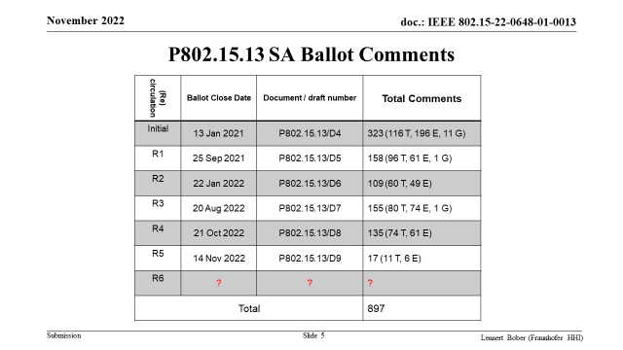

Slide 57
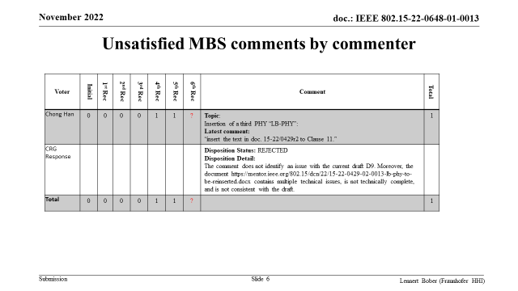

Slide 58
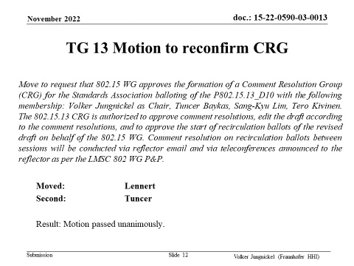

Slide 59
WG Motion to reconfirm CRG
Move that 802.15 WG approves the formation of a Comment Resolution Group (CRG) for the Standards Association balloting of the P802.15.13_D10 with the following membership: Volker Jungnickel as Chair, Tuncer Baykas, Sang-Kyu Lim, Tero Kivinen. The 802.15.13 CRG is authorized to approve comment resolutions, edit the draft according to the comment resolutions, and to approve the start of recirculation ballots of the revised draft on behalf of the 802.15 WG. Comment resolution on recirculation ballots between sessions will be conducted via reflector email and via teleconferences announced to the reflector as per the LMSC 802 WG P&P.
  Moved: Volker Jungnickel
  Second:
  Result: Motion passed unanimously.

Slide 60
Plan for CRG Telcos
TG13 CRG Telco dates
  28 Nov. 2022, 11:00-12.30 CET (5:00-6:30 ET, 18:00-19:30 KT)
  5 Dec. 2022, 11:00-12.30 CET (5:00-6:30 ET, 18:00-19:30 KT)
  12 Dec. 2022, 11:00-12.30 CET (5:00-6:30 ET, 18:00-19:30 KT)
  19 Dec. 2022, 11:00-12.30 CET (5:00-6:30 ET, 18:00-19:30 KT)
  9 Jan 2023, 11:00-12.30 CET (5:00-6:30 ET, 18:00-19:30 KT)
  meetings to be cancelled if not needed

Slide 61
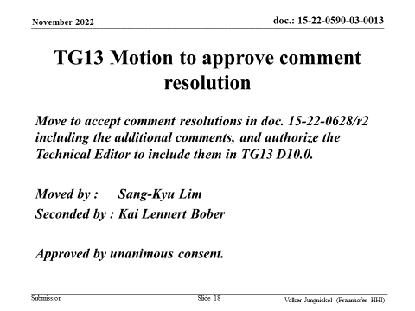

Slide 62
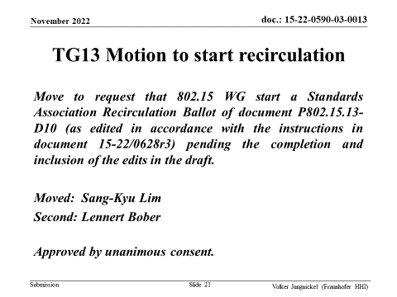

Slide 63
WG15 Motion to start recirculation
Move that 802.15 WG starts a Standards Association Recirculation Ballot of document P802.15.13-D10 (as edited in accordance with the instructions in document 15-22/0628r3) pending the completion and inclusion of the edits in the draft.
Moved: Volker Jungnickel
Second:
Approved by …

Slide 64
WG15 Motion to submit D10 to RevCom
Motion: that 802.15 WG has reviewed and affirms the CSD https://mentor.ieee.org/802-ec/dcn/21/ec-21-0199-00-ACSD-p802-15-13.pdf and requests conditional approval from the LMSC to submit P802.15.13-D10 (or current revision) to RevCom.
Moved: Volker Jungnickel
Second:
Approved by unanimous consent.

Slide 65
TG13 Next steps
D10 goes to recirculation out of November
  prepare D10 until 30 Nov.
  Aim to get at RevCom agenda for January
  Two meeting slots for January
  Final presentation of 802.15.13 in IEEE 802

Slide 66
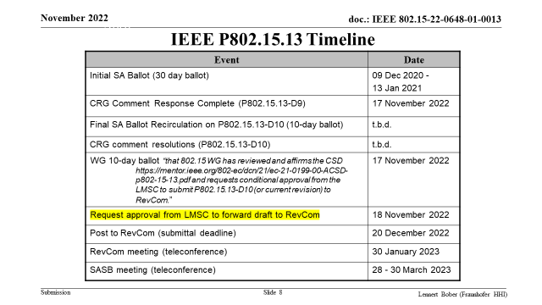

Slide 67
Thanks to WG15 for hosting this project
The Optical Wireless Communication Task Group thanks WG15 for hosting this project.
  We had a slow start in 2015, due to the legacy of 802.15.7-2011
  After around 2018, it really took off
  Main success factors
    Decicion to implement handover/interference management as distributed MIMO
    Hiring a new Technical Editor (Lennert Bober) who was knowledgeable about MAC
    Spring Cleaning: Move all legacy stuff to the appendix, accept new contents only after careful consideration to be complete and integrable into the draft
  Great Support from the working group
    Improve the draft during SA ballot (Tero Kivinen)
    From WG Chairs and Vice Chairs over the whole time
    Numerous contributions from industry and academia
    Some long-term contributors/officers: Sang-Kyu Lim, Tuncer Baykas, Lennert Bober, Chong Han, Tero Kivinen, Volker Jungnickel

Slide 68
TG16t Nov. 2022
Closing Report

Slide 69
Project: IEEE P802.15 Working Group for Wireless Specialty Networks (WSN)
Submission Title: Licensed Narrowband Amendment TG16t November Closing Report
Date Submitted: 2022-11-17
Source: Tim Godfrey, EPRI
Abstract: Meeting Agenda and Presentation
Purpose: Chair’s presentation for task group meeting
Notice: This document has been prepared to assist the IEEE P802.15. It is offered as a basis for discussion and is not binding on the contributing individual(s) or organization(s). The material in this document is subject to change in form and content after further study. The contributor(s) reserve(s) the right to add, amend or withdraw material contained herein.
Release: The contributor acknowledges and accepts that this contribution becomes the property of IEEE and may be made publicly available by P802.15.

Slide 70
TG16t November Plenary Agenda
Meeting Slots – Tuesday, Wednesday, Thursday PM1
Introductions, Secretary, Review and Approve Agenda
Policy Review
Presentation and Review of Draft and Contributions for Draft
Adjourn

Slide 71
Document Status
SRD Status
Approved clean version with 2022 number is 802.15-22-0033r3
SDD Status
Approved clean version with 2022 number is 802.15-22-0084r2
Released Call for Contributions for Draft – 802.15-22-0112r0

Slide 72
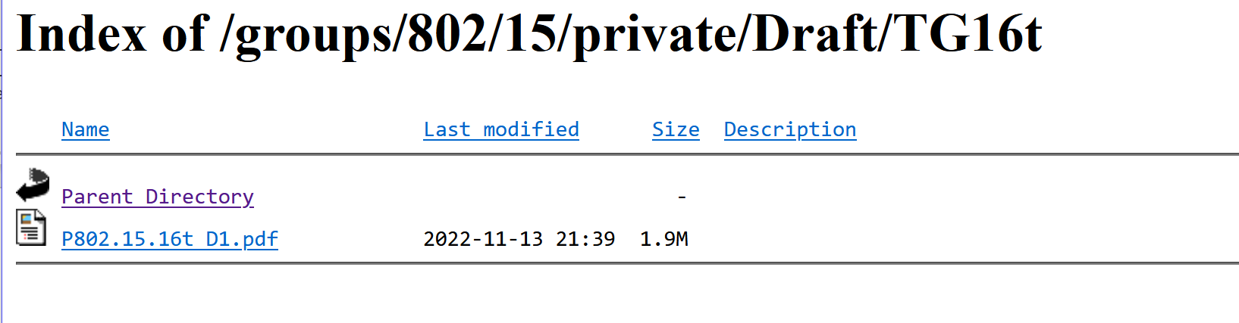
Contributions for November Plenary
Draft D0.1 for review
in 802.15 private area
Date | Document | Title | Author
14-Nov-2022 ET | 615r0 | ieee802.16t MAC Layer | Menashe Shahar (Ondas)
14-Nov-2022 ET | 630r0 | Filtering result with fixed point math | Juha Juntunen (MCC)
15-Nov-2022 ET | 512r0 | Air Interface Protocol - PHY Layer | Menashe Shahar (Ondas)
16-Nov-2022 ET | 643r0 | Direct Peer to Peer | Vishal Kalkundrikar (Ondas)
17-Nov-2022 ET | 665r0 | Air Interface Protocol MAC Layer | Vishal Kalkundrikar (Ondas)
17-Nov-2022 ET | 664r0 | Air Interface Protocol - PHY Layer | Menashe Shahar (Ondas)

Slide 73
Next Steps
Update to PHY Air Interface to be posted as 664r1
Update to MAC to be posted as 665r1
Update to DPP to be posted to 643r1
Consider what might go into Annex R – informative material. Move BSC into the informative material.
From those updates, Harry will update draft to 0.2
Review D0.2 on Teleconference

Slide 74
Teleconference planning
Monday 19 December, 8am PST, 11am EST, 9:30pm India

Slide 75
Project Timeline
Milestone | Date
Task Group Start | Jan 2020
SRD Approval | April 2021
SDD Approval | Jan 2022
Draft Development
Informal TG review of draft | Jan 2023
Working Group Letter Ballot | May 2023
Working Group Recirculation Letter Ballot | Sep 2023
SA Ballot | Nov 2023
Forward to RevCom | Mar 2024
PAR Expiration Date: 31 Dec 2024
If needed, request PAR extension July 2024

Slide 76
SG Privacy Nov. 2022
Closing Report
Slide 76

Slide 77
Project: IEEE P802.15 Working Group for Wireless Personal Area Networks (WPANs)
Submission Title: IG Privacy Opening Report, Agenda and Closing report for November Meeting
Date Submitted: 14^{h} November, 2022
Source: Tero Kivinen Company -
E-Mail: kivinen@iki.fi
Re: IG Privacy Meeting in Bangkok
Abstract:
Opening Report, Agenda and Closing report for IG Privacy November Meeting.
Purpose: Provide information which kind of changes are needed to the standard.
Notice: This document has been prepared to assist the IEEE P802.15. It is offered as a basis for discussion and is not binding on the contributing individual(s) or organization(s). The material in this document is subject to change in form and content after further study. The contributor(s) reserve(s) the right to add, amend or withdraw material contained herein.
Release: The contributor acknowledges and accepts that this contribution becomes the property of IEEE and may be made publicly available by P802.15.

Slide 78
Agenda for November
Start working on the PAR for the task group

Slide 79
Detailed Agenda for November
Monday 14th of November 1330-1530
    Opening slides, discuss on the par
Thursday 17th of November 1330-1530
    Go through closing report

Slide 80
Scope of work
Provide privacy for 802.15.4, especially for the addressing for mobile devices.
No point of doing work on the fixed IoT infrastructure.
Scope:
    Address issues in 802.15.4 MAC related to privacy.

Slide 81
Known issues
Address are static and we need mechanism to change it, and inform the other peers about the change.
  After the change, we do want to copy security context from previous MAC address to it to new MAC address. The frame counter needs to reset to 0 also.
Sleeping node should change its address BEFORE going to sleep, so when it wakes up, it already has new address set up, and the pending addresses in the beacon refer to that new address.
Addresses are stored in the security tables, in the 802.15.10, TSCH link, and SRM.

Slide 82
PAR items
5.2.b: This amendment specifies modifications to the IEEE Std 802.15.4 medium access control (MAC) specification to specify new mechanisms that address and improve user privacy.
5.5: Users and regulatory agencies are concerned about protecting personal information such as locations, movements, contacts and activities, etc. Devices incorporating IEEE Std 802.15.4 are increasingly integrated in personal mobile devices carried with people current IEEE Std 802.15.4 does not sufficiently protect users from user tracking and user profiling attacks. To ensure continued growth and support for IEEE Std 802.15.4, this project standardizes user privacy solutions applicable to IEEE Std 802.15.4 for mobile devices.

Slide 83
More information
See Wng presentation 15-22-0477-00.

Slide 84
SC IETF Nov. 2022
Closing Report

Slide 85
Project: IEEE P802.15 Working Group for Wireless Personal Area Networks (WPANs)
Submission Title: SC IETF November Slides
Date Submitted: 16^{h} November, 2022
Source: Tero Kivinen Company -
E-Mail: kivinen@iki.fi
Re: SC IETF November Slides
Abstract:
Opening Report and slides for SC IETF November Meeting.
Purpose: Provide information which kind of changes are needed to the standard.
Notice: This document has been prepared to assist the IEEE P802.15. It is offered as a basis for discussion and is not binding on the contributing individual(s) or organization(s). The material in this document is subject to change in form and content after further study. The contributor(s) reserve(s) the right to add, amend or withdraw material contained herein.
Release: The contributor acknowledges and accepts that this contribution becomes the property of IEEE and may be made publicly available by P802.15.

Slide 86
Agenda for November
Discuss what happened in IETF 115 in London (November 5 – 11, 2022)

Slide 87
IETF 115
IETF 115 was held between Saturday 5th of November and Friday 11th of November in London.
The proceedings are available:
  https://datatracker.ietf.org/meeting/115/proceedings

Slide 88
IETF 116
IETF 116 will be held in Yokohama, Japan between 25th of March and 31st of March, 2023

Slide 89
Work Groups/Strems to Cover
Raw – Reliable and Available Wireless
6lo – IPv6 over Networks of Resource-constrained Nodes
Lpwan – IPv6 over Low Power Wide-Area Networks
Lake – Lightweight Authenticated Key Exchange
Suit – Software Updates for Internet of Things

Slide 90
Work Groups/Strems to Cover
BoFs in IETF 115
Computer Aware Networking (can)
More Instant Messaging Interoperability (mimi)
Secure Asset Transfer Protocol (satp)
Time Variant Routing (tvr)
RADIUS Extensions Reanimated (radextra)

Slide 91
SC MAIN/RULES Nov. 2022
Closing Report

Slide 92
Project: IEEE P802.15 Working Group for Wireless Personal Area Networks (WPANs)
Submission Title: [SC Maintenance Opening / Closing Report for November 2022 Plenary Session]
Date Submitted: [15 November 2022]
Source: [Phil Beecher] Company [Wi-SUN Alliance]
Address [Hove Actually, SE England]
Voice:[+44-1273-422275], E-Mail:[pbeecher@wi-sun.org]
Re: [SCM Report for November 2022 Session.]
Abstract: [Report for the November 2022 Session]
Purpose: [Contribution for SC Maintenance]
Notice: This document has been prepared to assist the IEEE P802.15. It is offered as a basis for discussion and is not binding on the contributing individual(s) or organization(s). The material in this document is subject to change in form and content after further study. The contributor(s) reserve(s) the right to add, amend or withdraw material contained herein.
Release: The contributor acknowledges and accepts that this contribution becomes the property of IEEE and may be made publicly available by P802.15.

Slide 94
SC Meeting Objectives – Agenda
    November 15, 2022
    Policy and Procedure
    Approve Agenda
    Review 802 PAR Requests
    Recess
    November 17, 2022
    Review any change requests for Operations Manual
    A.o.B.
    Adjourn
Notes:
December 22
Page 94

Slide 95
PAR Review SCM
PARs to be considered November Plenary - Comments due November 15th 18:00
Nov 13-18, 2022 Bangkok, Thailand
802.3df - Amendment: Media Access Control Parameters for 800 Gb/s and Physical Layers and Management Parameters for 400 Gb/s and 800 Gb/s Operation, PAR Modification and CSD
802.3dj - Amendment: Media Access Control Parameters for 1.6 Tb/s and Physical Layers and Management Parameters for 200 Gb/s, 400 Gb/s, 800 Gb/s, and 1.6 Tb/s Operation, PAR and CSD
802.3dk - Amendment: Greater than 50 Gb/s Bidirectional Optical Access PHYs, PAR and CSD
802.11bk - Amendment: 320 MHz Positioning, PAR and CSD
Feedback to be reviewed on Thursday 17th November

Slide 96
SC Meeting Achievements
    Reviewed PARs from 802.3 / 802/11
    Reviewed updates to Operations Manual - diff posted as: https://mentor.ieee.org/802.15/dcn/22/15-22-0662-00-0mag-802-15-operations-manual-work-in-progress.docx
802.15 WG Approval of Operations Manual
802.15 WG approves to adopt Operations Manual, (doc #15-10-0235-32-0000-802-15-operations-manual) at 08:00 Eastern Time on Monday 21 November 2022.
Moved: Phil Beecher
Second: Gary Stuebing
Notes:
December 22
Page 96

Slide 97
SC THz Nov. 2022
Closing Report

Slide 98
Project: IEEE P802.15 Working Group for Wireless Speciality Networks (WSN)
Submission Title: SC THz November 2022 Closing Plenary Slides
Date Submitted: 17 November 2022
Source: Thomas Kürner TU Braunschweig
Address: Schleinitzstr. 22, D-38092 Braunschweig, Germany
Voice:+495313912416, FAX: +495313915192, E-Mail: t.kuerner@tu-bs.de
Re: n/a
Abstract: SC THz November 2022 Closing Plenary Slides
Purpose: Closing report to WG 15 closing plenary
Notice: This document has been prepared to assist the IEEE P802.15. It is offered as a basis for discussion and is not binding on the contributing individual(s) or organization(s). The material in this document is subject to change in form and content after further study. The contributor(s) reserve(s) the right to add, amend or withdraw material contained herein.
Release: The contributor acknowledges and accepts that this contribution becomes the property of IEEE and may be made publicly available by P802.15.

Slide 99
Meeting Agenda
Meeting Objectives, Call for Contributions and Agenda Approval (22/0576r2)
Minutes Approval (22/0350)
Measurement and Characterization of 300 GHz Channel in a Conference Room (22/0567)
Challenges in Short-Range and Middle-Range Wireless Communications using the 300GHz-Band (22/0587r1)
Study on interference induced by THz wave scattering from slightly rough surfaces (22/0569r5)
Adjourn

Slide 100
SC WNG Nov. 2022
Closing Report

Slide 101
Project: IEEE P802.15 Working Group for Wireless Personal Area Networks (WPANs)
Submission Title: Wireless Next Generation
Date Submitted: November 16, 2022
Source: Benjamin A. Rolfe (Blind Creek Associates)
Contact:
Voice: +1 408 395 7207, E-Mail: ben.rolfe @ ieee.org
Re: Wireless Next Generation
Abstract: Agenda and Meeting Slides.
Purpose: Support the illusion of organization
Notice: This document has been prepared to assist the IEEE P802.15. It is offered as a basis for discussion and is not binding on the contributing individual(s) or organization(s). The material in this document is subject to change in form and content after further study. The contributor(s) reserve(s) the right to add, amend or withdraw material contained herein.
Release: The contributor acknowledges and accepts that this contribution becomes the property of IEEE and may be made publicly available by P802.15.
Notes:
Jul 12, 2010
Page 101

Slide 102

Hybrid Meeting
Registration is required
Please remember to enter your attendance in IMAT
Reminder:
This is a non-PAR activity
All the rules of conduct apply https://grouper.ieee.org/groups/802/sapolicies.shtml

Slide 103
Agenda 16 November 2022
Opening and Meeting Reminders
Presentations and discussion
  New UWB regulation in Europe
  Harmonization between scientific and commercial usage
Any other business
Adjourn

Slide 104

The usual question
What do you propose the Working Group do next?

Slide 105
Links
https://mentor.ieee.org/802.18/dcn/22/18-22-0141-00-0000-new-uwb-regulation-in-europe.pptx

Slide 106
140th Session of meetings of the IEEE 802.15 Working Group for Wireless Specialty Networks
WG 15 Adjourned

