Slide 1
Project: IEEE P802.15 Working Group for Wireless Personal Area Networks (WPANs)
Submission Title: [Code Length Selection of 11n Based LDPC Codes for 15.4ab]
Date Submitted: [17th Nov. 2022]
Source: [Wei Lin, Lei Huang, Xun Yang, Bin Qian, Chenchen Liu, Rani Keren, Shimi Shilo] Company [Huawei]
Address [Huawei base, Shenzhen, CHINA & Huawei Israel & Huawei Singapore]
E-Mail:[lin.linwei@huawei.com]
Re: [Study Group 4ab: UWB Next Generation]
Abstract: [Code Length Selection of 11n Based LDPC Codes for 15.4ab]
Purpose: []
Notice: This document has been prepared to assist the IEEE P802.15. It is offered as a basis for discussion and is not binding on the contributing individual(s) or organization(s). The material in this document is subject to change in form and content after further study. The contributor(s) reserve(s) the right to add, amend or withdraw material contained herein.
Release: The contributor acknowledges and accepts that this contribution becomes the property of IEEE and may be made publicly available by P802.15.

Slide 2
Technical Guidance
PAR Objective | Proposed Solution (how addressed)
Safeguards so that the high throughput data use cases will not cause significant disruption to low duty-cycle ranging use cases.
Interference mitigation techniques to support higher density and higher traffic use cases
Other coexistence improvement
Backward compatibility with enhanced ranging capable devices (ERDEVs).
Improved link budget and/or reduced air-time | New Channel Coding Schemes can provide improved link budgets and reduced air time
Additional channels and operating frequencies
Improvements to accuracy / precision / reliability and interoperability for high-integrity ranging;
Reduce complexity and power consumption;
Hybrid operation with narrowband signaling to assist UWB;
Enhanced native discovery and connection setup mechanisms;
Sensing capabilities to support presence detection and environment mapping;
Low-power low-latency streaming
higher data-rate streaming allowing at least 50 Mbit/s of throughput. | New Channel Coding Schemes with higher rates can support high data rate
Support for peer-to-peer, peer-to-multi-peer, and station-to-infrastructure protocols;
Infrastructure synchronization mechanisms.

Slide 3
Related Submissions
[1] 15-22-0517-00-04ab-new-data-rates-and-coding, Carlos Aldana, et al

Slide 4
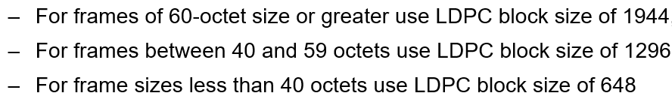
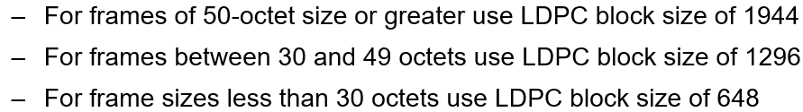
Discussions on LDPC Code Length Selection
It has been agreed that LDPC code (rate-1/2) is the optional advanced coding scheme
  Primary candidate is the 802.11n/11n-based LDPC code with block lengths {648,1296,1944}
  LDPC transmission with full parity bits has been agreed
LDPC code length selection have been addressed during the recent PHR discussions
  One of the possible solution is to define two boundaries (TBD1 and TBD2) according to the PSDU rate
  The two boundaries can also be found by matching the performance of data payloads and PHR
Range of N_{pld} | LDPC Codeword length L_{LDPC} (bits) | Number of LDPC codewords (N_{CW)}
972< N_{pld} | 1944 | Ceil(N_{pld} /972)
TBD1(PSDU_RATE) < N_{pld} <=972 | 1944 | 1
TBD2(PSDU_RATE)< N_{pld} <= TBD1(PSDU_RATE) | 1296 | 1
N_{pld} <= TBD2(PSDU_RATE) | 648 | 1
Example 1:
Example 2:

Slide 5
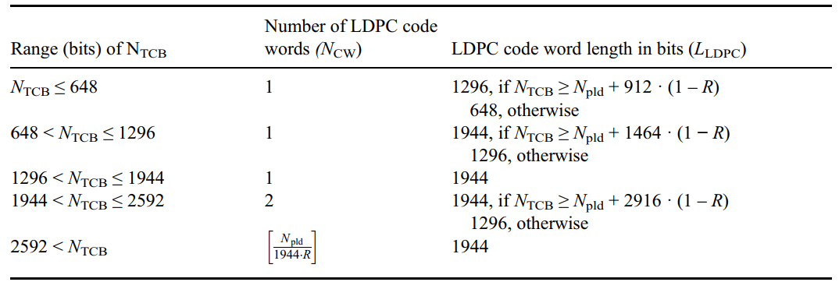
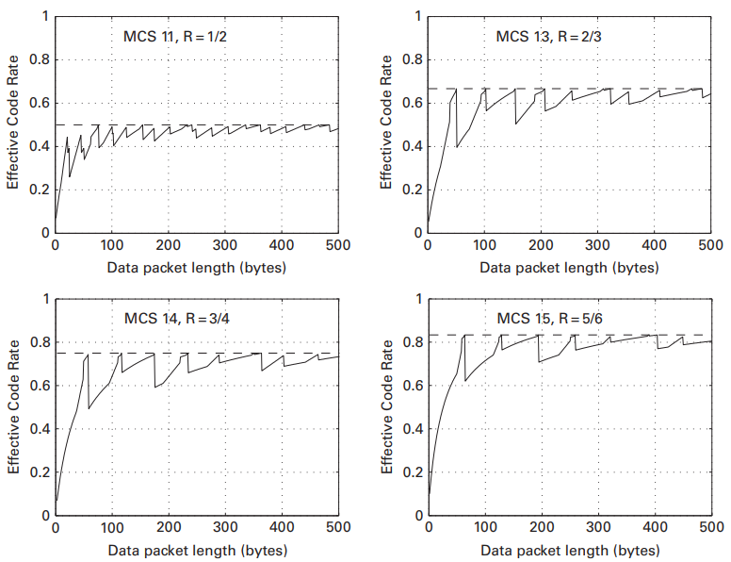

Revisit the LDPC Length Selection in 11n/ac
In 802.11n/ac, the LDPC code length selections have to consider the OFDM symbol boundaries, and balance the performance and efficiency (effective code rates)
  Long code always provides better performance, while short code always provides better efficiency
  The 11n LDPC length selection balances the performance (1944 LDPC always selected for N_{TCB} > 2592 (2x1296)) and effective code rate (there are cases that code fall back to shorter code for 2 codewords)
  For medium payloads, falling back to a shorter code are performed to keep the effective code rates not too low (less efficient) with sufficient performance
  For long payloads, the effective code rates always converge to the defined rate → long code wouldn’t decrease the efficiency
Effective code rate for LDPC for 20 MHz mode
Ref: E. Perahia and R. Stacey, Next Generation Wireless LANs 802.11n and 802.11ac, 2Ed, 2013.

Slide 6
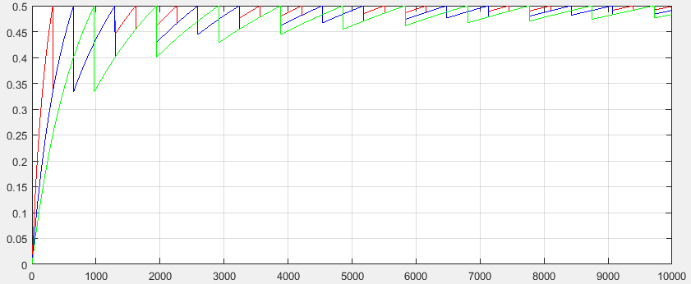
Effective LDPC Code Rates for 15.4ab
In 15.4ab, the LDPC code length selections don’t have to consider the OFDM boundaries (less complex), and also should balance the performance and efficiency (effective code rates)
  Long code always provides better performance, while short code always provides better efficiency
  648 LDPC: Red
  1296 LDPC: Blue
  1944 LDPC: Green
Effective code rates of 3 LDPC Lengths for 15.4ab

Slide 7
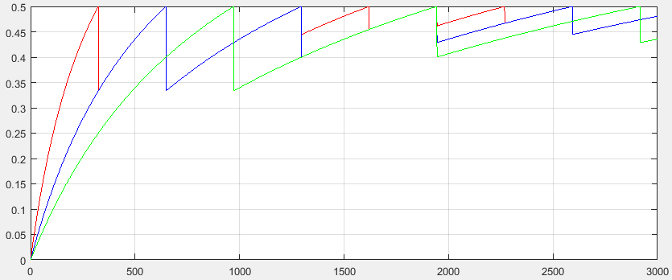
LDPC Length Selection for 15.4ab → Example 1 & 2
Example 1 & 2 tried to match the performance of data payloads and PHR
Effective code rates of Example 1
Effective code rates of Example 2
Example 1:
Example 2:

Slide 8
Enhancements of Efficiency
In 11n/ac, for short/medium payloads, falling back to a shorter code (with sufficient performance) are performed to keep the effective code rates not too low (less efficient)
  Case 0： For payload of 121 bytes (968 bits), with 1944 LDPC, coded bits are 1940 bits (1 codeword), R_{E} = 0.5
  Case A： For payload of 122 bytes (976 bits), with 1944 LDPC, coded bits are 976+972x2 = 2920 bits (2 codewords), R_{E} = 0.33
  Case B (11n)： For payload of 122 bytes (976 bits), with 1296 LDPC, coded bits are 976+648x2 = 2272 bits (2 codewords), R_{E} = 0.42
968 Bits
R_{E} = 0.5
Case 0
968 Bits
972 Bits
Single 1944 LDPC codeword
Case A
976 Bits
R_{E} = 0.33
Case B (11n)
976 Bits
R_{E} = 0.42
488 Bits
972 Bits
488 Bits
972 Bits
488 Bits
648 Bits
488 Bits
648 Bits
1944 LDPC after removing the padding bits
1296 LDPC after removing the padding bits

Slide 9
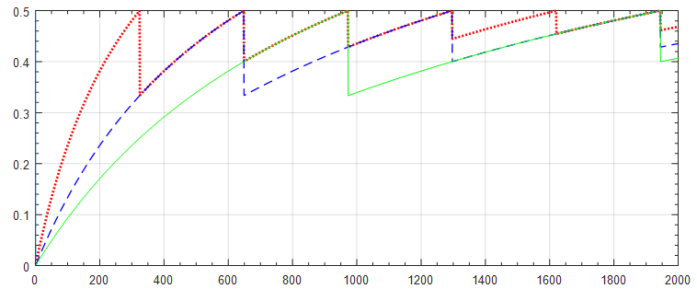
Enhancements of Efficiency
In 11n/ac, for short/medium payloads, falling back to a shorter code (with sufficient performance) are performed to keep the effective code rates not too low (less efficient)
  Case 0： For payload of 121 bytes (968 bits), with 1944 LDPC, coded bits are 1940 bits (1 codeword), R_{E} = 0.5
  Case A： For payload of 122 bytes (976 bits), with 1944 LDPC, coded bits are 976+972x2 = 2920 bits (2 codewords), R_{E} = 0.33
  Case B (11n)： For payload of 122 bytes (976 bits), with 1296 LDPC, coded bits are 976+648x2 = 2272 bits (2 codewords), R_{E} = 0.42
  The performances of both Case A and Case B better than Case 0, and spectral efficiency of Case B is better (0.42 > 0.33)
  Compared with Case A, 648 bits can be saved in Case B (11n)
  To better balance the performance and effective code rate, suggest to follow the length selecting logic of 11n/ac → employ the 1296 LDPC for payload length of [122, 162] bytes
  For data payload larger than 162 bytes, the 1944 LDPC shall always selected → in line with 11n/ac, and the effective code rate always larger than 0.4
Case B: 11n
Case A
TBD1
TBD2
976 Bits
1296 Bits

Slide 10
Performance & Efficiency
  Simulation results of payload length of 121 bytes (1 codeword of 1944 LDPC), 122 bytes (2 codewords of with 1296 and 1944 LDPC), 142 bytes (2 codewords of with 1296 and 1944 LDPC), 162 bytes (2 codewords of with 1296 and 1944 LDPC)
In terms of Eb/N0, all results are clustered around 1.5dB at FER = 10⁻², while 1296 LDPC have better efficiency (around 77% time of 1944 LDPC at payload length of 122 bytes)
121
Case B: 11n
Case A
162
122
142
TBD1
TBD2
976 Bits
1296 Bits

Slide 11
Conclusions
  To better balance the performance and effective code rate, suggest to follow the length selecting logic of 11n/ac → employ the 1296 LDPC for payload length of [122, 162] Bytes

Slide 12
Thank You

Slide 13
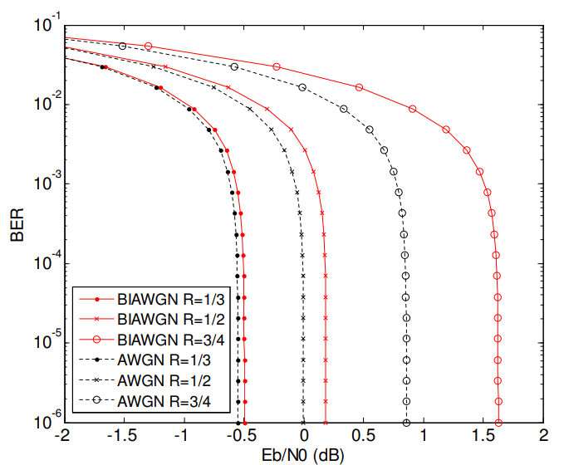
Appendix: Capacities of Different Code Rates

