Slide 1
Project: IEEE P802.15 Working Group for Wireless Personal Area Networks (WPANs)
Submission Title: [UWB In-band Discovery]
Date Submitted: [16 November, 2022]
Source: [Kangjin Yoon, Chunyu Hu, Carlos Aldana, Claudio Da Silva] Company [Meta Platforms, Inc.]
Address [1 Hacker Way, Menlo Park, CA 94025]
E-Mail:[{kyoon, chunyuhu, caldana, claudiodasilva}@fb.com]
Re: [Input to TG4ab]
Abstract: [UWB in-band discovery protocol has been proposed.]
Purpose: [To have the UWB in-band discovery protocol.]
Notice: This document has been prepared to assist the IEEE P802.15. It is offered as a basis for discussion and is not binding on the contributing individual(s) or organization(s). The material in this document is subject to change in form and content after further study. The contributor(s) reserve(s) the right to add, amend or withdraw material contained herein.
Release: The contributor acknowledges and accepts that this contribution becomes the property of IEEE and may be made publicly available by P802.15.

Slide 2
PAR Objective | Proposed Solution (how addressed)
Safeguards so that the high throughput data use cases will not cause significant disruption to low duty-cycle ranging use cases
Interference mitigation techniques to support higher density and higher traffic use cases
Other coexistence improvement
Backward compatibility with enhanced ranging capable devices (ERDEVs)
Improved link budget and/or reduced air-time
Additional channels and operating frequencies
Improvements to accuracy / precision / reliability and interoperability for high-integrity ranging
Reduced complexity and power consumption
Hybrid operation with narrowband signaling to assist UWB
Enhanced native discovery and connection setup mechanisms | Utilize Control Message and empty slots for discovery and connection setup
Sensing capabilities to support presence detection and environment mapping
Low-power low-latency streaming
Higher data-rate streaming allowing at least 50 Mbit/s of throughput
Support for peer-to-peer, peer-to-multi-peer, and station-to-infrastructure protocols
Infrastructure synchronization mechanisms

Slide 3
Previous Contributions Related To
Discovery
[1] DCN 456r0 (September 2022) “UWB Channel Usage Coordination for better UWB Coexistence”
[2] DCN 557r1 (November 2021) “UWB Wake-up Signaling”

Slide 4
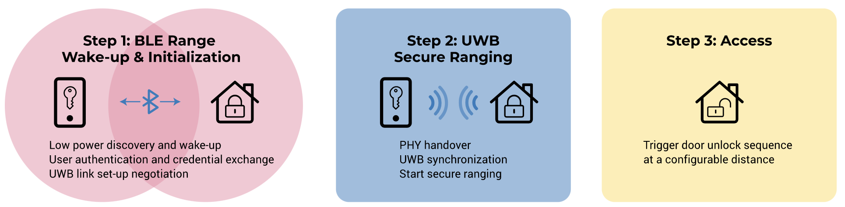
Background
Off-the-shelf 802.15.4z devices are relying on BLE for discovery and association
  UWB session starts when the device discovered each other via BLE
  Pros: Scanning/Beaconing via BLE is more power efficient than UWB
  Cons: Device should have BLE module, delay for transition from BLE to UWB
  For most use-cases so far, power efficiency was critical, because they require the automatic service initiation (e.g., passive car/door-lock access should happen without any user intervention)
Reference: https://www.firaconsortium.org/discover/use-cases

Slide 5
Background
However, other UWB services may involve active user participation
(e.g., user will pick-up their hand controller and wear head-mount display device before using VR service)
For these services;
  No need to constantly scan the device
  Other input (e.g., button press, motion detection) can trigger UWB discovery protocol
  Low implementation cost and/or low initial latency may be more critical than high power efficiency during discovery (scanning)

Slide 6
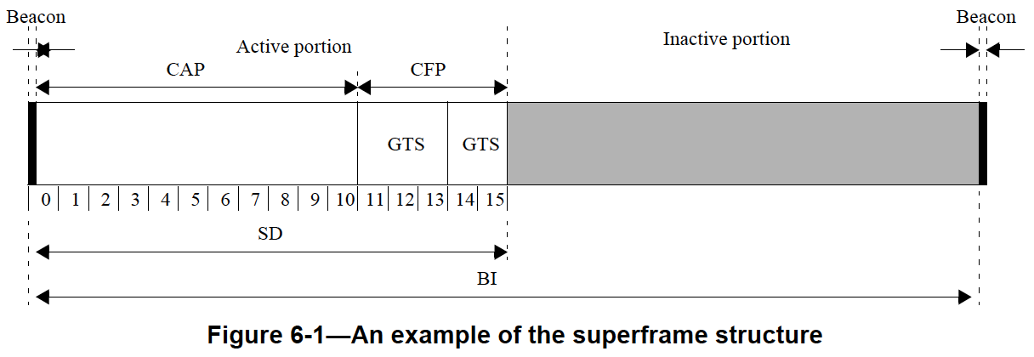
Background
Legacy in-band discovery protocol in 802.15.4
  Based on the superframe structure, which is not compatible with block-based mode
  Beacon frames could be additional overhead
  Capability information in the Association Request frame does not reflect UWB capabilities
CAP: Contention Access Period, CFP: Contention-Free Period, GTS: Guaranteed Time Slot, SD: Superframe Duration,
BI: Beacon Interval

Slide 7
Proposal
Core idea: Utilize existing Control Message instead of additional beacon frame and utilize empty slots to receive Association Request frames controlees not yet discovered
  Advantage #1: Keep block structure (no superframe structure)
  Advantage #2: Less overhead (no additional beacon frames)
  Advantage #3: Minimal impact on controlees already associated
Empty slots
Control
Data
Data
Data
Data
Association Request
Block N

Slide 8
Proposal
Controller sends Application Control IE in Control Message
Propose to have ‘Association Availability’ field in Application Control IE
  0: No further association is available (e.g., when resources are not enough)
  1: Further association is available
Bits: 0 | 1 | 2 | 3 | 4 | 5 | 6 | 7 | 8 | 9 | 10-15
SIP | RBDP | RRDP | RSDP | Scheduling Mode | Association Availability | RCP | DCP | SCP | TCP | Reserved
Content Control field of the Application Control IE
When ‘Association Availability’ field is set to 1, the controller shall be awake during the remaining slots in the round to receive possible Association Request frame from controlees
Controller may choose to temporarily hold (or limit) the ongoing service to increase the number of empty slots for discovery

Slide 9
Proposal
Controlee shall choose random timing within empty slots to send Association Request frame (to avoid collision)
No need to restrict controlees to send Association Request frame only at the beginning of slots (to maximize capacity)
After receiving Association Request frame, the controller can schedule a slot in the next block for the transmission of Association Response frame
5 empty slots
Scheduling via Control Message
4 empty slots
Control
Data
Data
Data
Data
Association Request
Control
Data
Data
Data
Data
Association Response
Block N
Block N+1

Slide 10
Proposal
Association Request frame format
  Only ‘Capability Information’ field is needed to be updated
Octets: Variable | 1 | 2 | 2/4
MAC Header | Command ID = 0x01 | Capability Information | FCS
Bits: 0 | 1 | 2-3 | 4 | 5 | 6 | 7 | 8-15
Allocate Address | LDPC | Data rates | MMS ranging | Sensing | DL TDoA | UL TDoA | Reserved
4ab capabilities can be added in ‘Capability Information’ field
  Examples: LDPC, Data rates, MMS ranging, Sensing, DL TDoA, UL TDoA

Slide 11
Proposal
Association Response frame format
  Only ‘Association Status’ field is needed to be updated
Octets: Variable | 1 | 2 | 1 | 2/4
MAC Header | Command ID = 0x02 | Short Address | Association Status | FCS
Association status | Description
0x00 | Association successful
0x01 | UWB session at capacity
0x02 | Association denied
0x03-0xff | Reserved

Slide 12
How to Find UWB Channel/Preamble
For scanning, controlees need to know UWB channel and preamble code the controller is using
We can utilize out-of-band (e.g., BLE or NB) and/or UWB mirroring channel [1]

Slide 13
Summary
UWB in-band discovery and association protocol is desirable for some UWB use-cases which can utilize user input as a trigger
The legacy in-band discovery and association protocol in 802.15.4 does not fit well
Proposed discovery and association protocol exploits existing Control Message and empty slots for discovery purpose → Minimal overhead increase
We proposed minimal changes to Association Request frame and Association Response frame to reflect UWB capabilities
UWB channel and preamble information for scanning can be transferred via out-of-band or UWB mirroring channel

Slide 14
Thank You

Slide 15
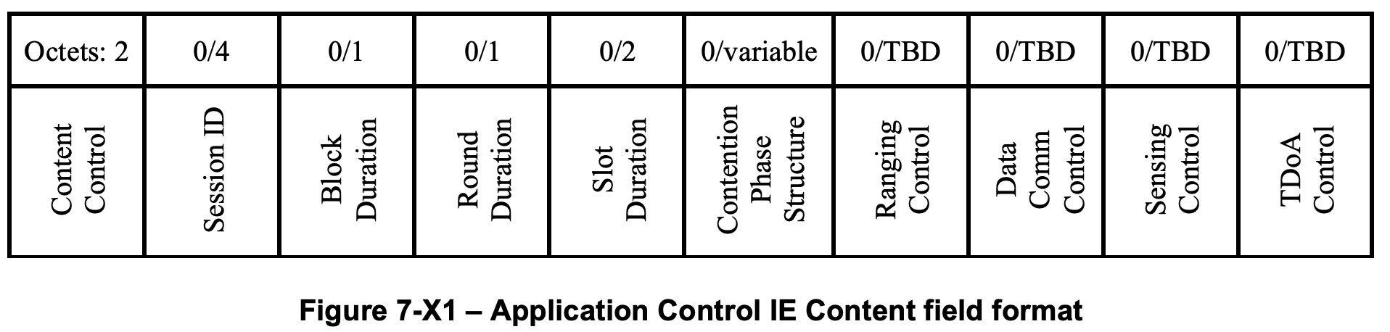
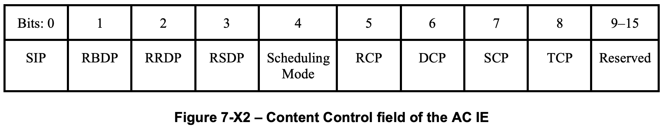
Application Control IE under Discussion

Slide 16
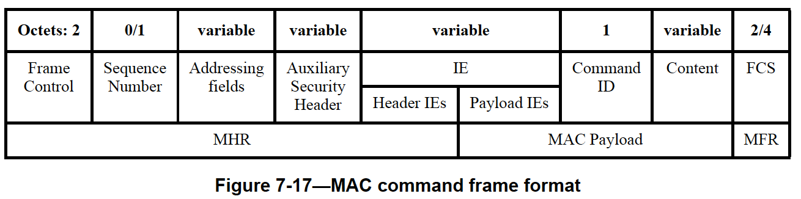
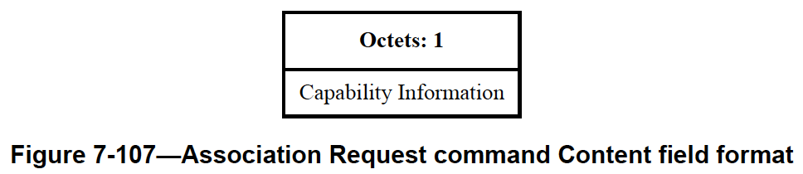
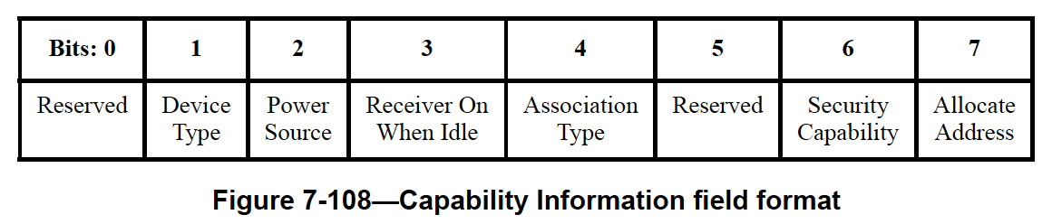
Association Request frame format in 802.15.4

Slide 17
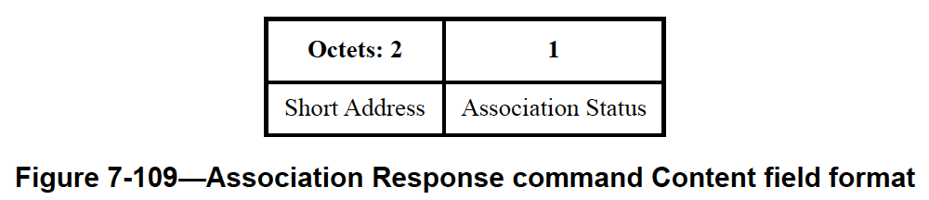
Association Response frame format in 802.15.4

