Slide 1
Project: P802.15 Working Group for Wireless Specialty Networks
Submission Title: Preliminary harmonization with 4ab: MAC operation
Date Submitted: November 16th, 2022
Source: Marco Hernandez, Ryuji Kohno, Takumi Kobayashi, Minsoo Kim
Company: YRP-AIA, YNU, Japan
Address: 3-4 Hikarino-oka, Yokosuka, 239-0847, Japan
Voice: +81 46-847-5439 Fax: +81 46-847-5431 E-Mail:
Re: In response to the call for technical contributions
Abstract:
Purpose: In response to the call for technical contributions
Notice: This document has been prepared to assist P802.15.6ma. It is offered as a basis for discussion and is not binding on the contributing individual(s) or organization(s). The material in this document is subject to change in form and content after further study. The contributor(s) reserve(s) the right to add, amend or withdraw material contained herein.
Release: The contributor acknowledges and accepts that this contribution becomes the property of IEEE and may be made publicly available by P802.15.6ma.

Slide 2
Harmonization
Initial steps towards coexistence with 15.4:
Adopt the 4ab UWB symbol modulation and FEC
  15.6ma devices would be able to detect 15.4ab beacons and consequently awareness of 4ab transmissions in the vicinity.
  It may trigger a mechanism at the MAC for contention [free] access to reduce collisions and/or reduce interference.
6ma makes contributions to
  Interference mitigation at the PHY level.
  Collision avoidance at the MAC level.
  Simulation with intra-interference are in progress

Slide 3
MAC protocol
TG6ma MAC proposal introduces a slotted structure for the MAC
  CFP (TDMA) and CFP (slotted Aloha under evaluation)
  Compatibility with 15.4z and 15.4ab
However, TG6ma does not use a NB aided channel.
  The proposed TG6ma control channel works in another UWB frequency band (management for coordinators)
Also, TG6ma uses HARQ (intersection of PHY and MAC) under evaluation

Slide 4
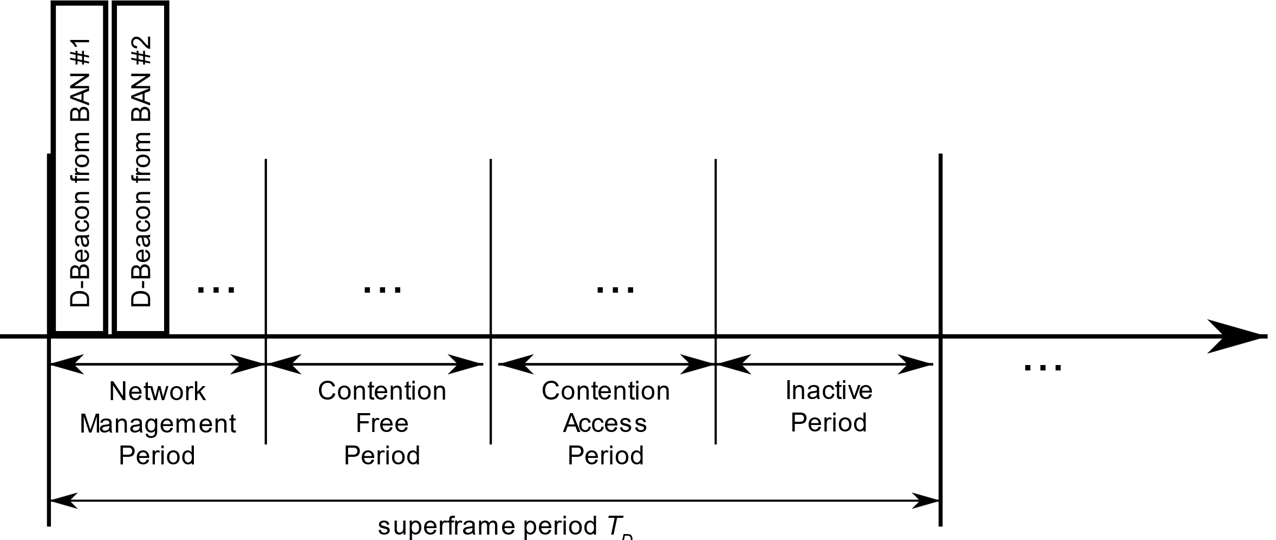
HBAN or VBAN standalone operation
Proposed MAC structure like 15.4
We need to work out the detail of CFP, CAP and IP duration with 4ab and 15.6-2012

