Slide 1
Project: P802.15 Working Group for Wireless Specialty Networks
Submission Title: Preliminary harmonization with 4ab: MAC operation
Date Submitted: November 16th, 2022
Source: Marco Hernandez, Ryuji Kohno, Takumi Kobayashi, Minsoo Kim
Company: YRP-AIA, YNU, Japan
Address: 3-4 Hikarino-oka, Yokosuka, 239-0847, Japan
Voice: +81 46-847-5439 Fax: +81 46-847-5431 E-Mail:
Re: In response to the call for technical contributions
Abstract:
Purpose: In response to the call for technical contributions
Notice: This document has been prepared to assist P802.15.6ma. It is offered as a basis for discussion and is not binding on the contributing individual(s) or organization(s). The material in this document is subject to change in form and content after further study. The contributor(s) reserve(s) the right to add, amend or withdraw material contained herein.
Release: The contributor acknowledges and accepts that this contribution becomes the property of IEEE and may be made publicly available by P802.15.6ma.

Slide 2
15.4ab MAC enhancements
There are few MAC proposals for the 4ab amendment compared to PHY proposals.
Most presentations are for supporting the new NB-assisted ranging and sensing.
Two presentations associated with data communication:
  [1] 15-22-0047-01-04ab-mac-layer-considerations-for-uwb-data-streaming.
  [2] 15-22-0172-00-04ab-mac-considerations-for-data-communication.

Slide 3
15.4ab MAC enhancements
[1] proposes to use CCA mode 1 (energy detection) with variable sensing duration and threshold.
  No results. We do not know how it works.
[2] summarizes the access methods in 15.4 and 15.4z
  Slotted structure vs. unslotted structure
  Contention-based vs. scheduling-based (contention-free)
  15.4z introduced a slotted structure for enhanced ranging.

Slide 4
15.4ab MAC enhancements
[2] proposes to use a slotted structure for 15.4ab as well for compatibility with 4z and the rest of 4ab PHY proposals.
  [2] proposes the same slotted structure for data communication.
  No results. We do not know how it performs.
And that is all for 15.4ab MAC proposals related to data communications.

Slide 5
Control channel
[15-22-0180-00-04ab-recap-of-narrowband-uwb-coupling-mac] proposes to use a control channel (mirroring channel) to assist UWB channel usage for ranging and collision avoidance.
  Information about the start time of ranging rounds, length of ranging block, number of ranging rounds, etc.
The same concept of Minsoo’s control channel, but for ranging. Although, it is a narrowband channel.
No results. We do not know how it performs.

Slide 6
Caveat
4ab is still working on the [MAC] proposals to be included in the amendment Std.
  As far as I know, there is no agreement on such MAC proposals.
  If 4ab will adopt a control channel or if the energy detection would have a variable threshold and duration.

Slide 7
Harmonization
Initial steps towards coexistence with 15.4:
Adopt the 4ab agreed UW B modulation.
  15.6ma devices would be able to detect 15.4ab beacons and consequently awareness of 4ab transmissions in the vicinity.
  It may trigger a mechanism at the MAC for contention [free] access to reduce collisions and/or reduce interference.
6ma makes contributions to
  Interference mitigation at the PHY level.
  Collision avoidance at the MAC level.
  Still a work in progress.

Slide 8
Harmonization
The YRP-IAI & Nagoya I.T. MAC proposal supports 8 levels of QoS depending on the environment of operation:
  HBAN or VBAN standalone operation (Level 0)
    Same FEC as 4ab
  HBAN or VBAN coexisting with other UWB systems (Level 1)
    Maybe additional concatenated external FEC
  HBAN and VBAN coexisting with other HBAN and VBAN networks (coordinators cooperation) (Level 2)
    Use of HARQ
  HBAN and VBAN coexisting with other HBAN and VBAN networks and with other UWB systems (4ab, 4z) (Level 3)
    Use of HARQ
  Details are TBD.

Slide 9
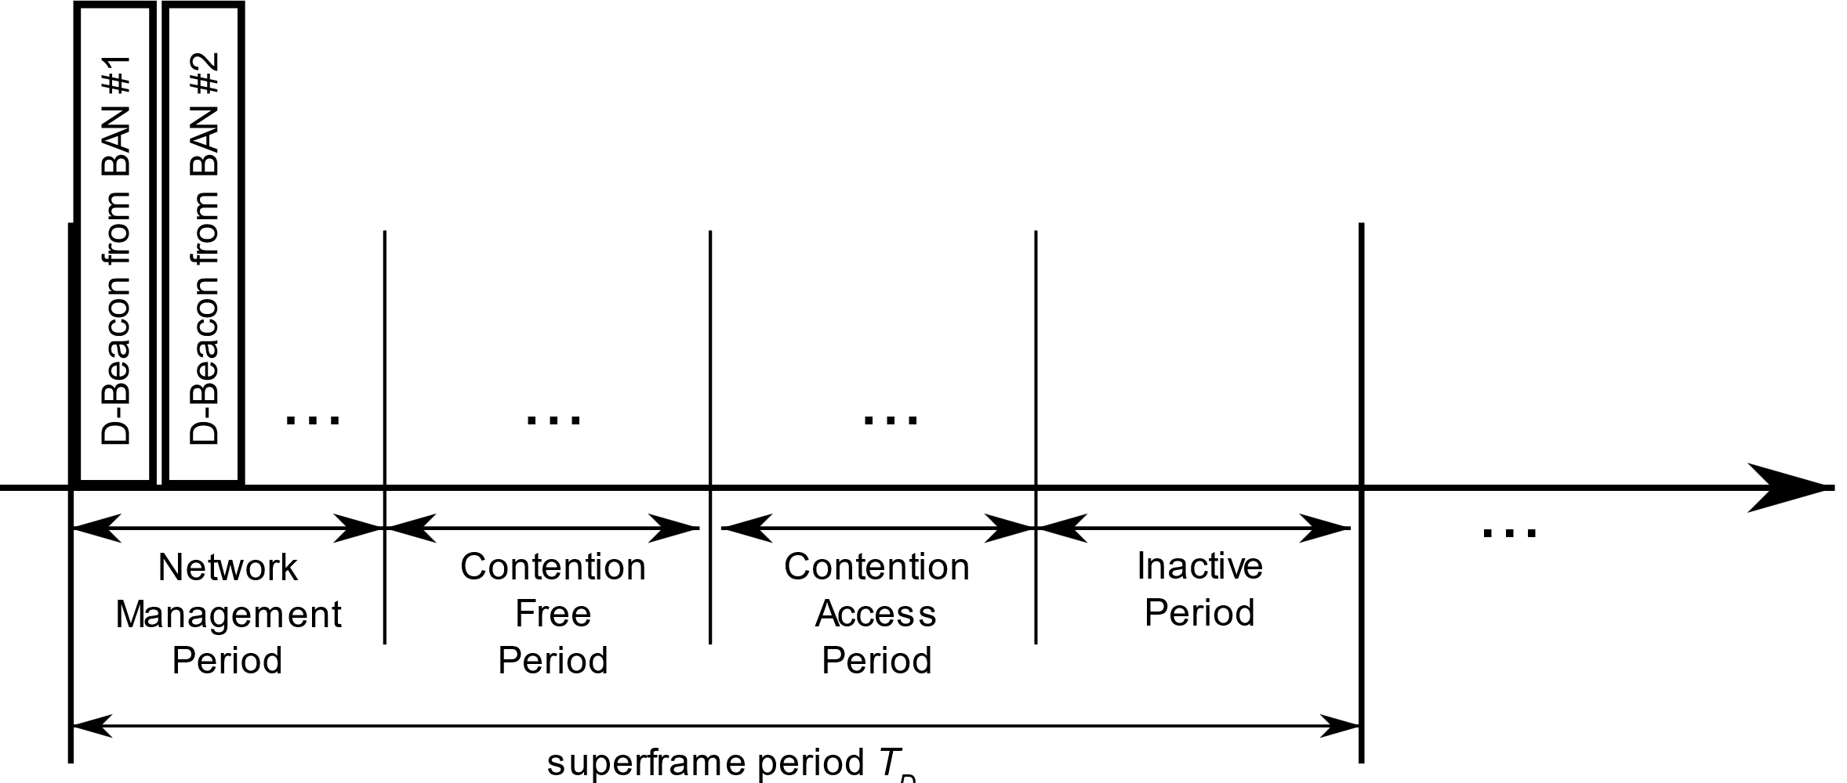
HBAN or VBAN standalone operation
Proposed MAC structure like 15.4
We need to work out the detail of CFP, CAP and IP duration with 4ab and 15.6-2012

Slide 10
HBAN or VBAN coexisting with other UWB systems (4ab, 4z)
6ma devices are aware of 4ab transmissions and vice-versa
We need to work out the details of interference avoidance.

Slide 11
HBAN and VBAN coexisting with other HBAN and VBAN networks and with other UWB systems (4ab, 4z)
  Same situation: 6ma devices are aware of 4ab transmissions and vice-versa
  We need to work out the details of interference mitigation and interference avoidance with 4ab and other wireless systems operating in the same frequency band

