Slide 1
Project: IEEE P802.15 Working Group for Wireless Personal Area Networks (WPANs)
Submission Title: [SCZ Code Blocks: A Good Candidate for the Sensing Sequences in 4ab]
Date Submitted: [15 Nov 2022]
Source: [Igor Dotlic, Carl Murray, Michael McLaughlin, Billy Verso, and Jarek Niewczas] Company [Qorvo]
Address [Adelaide Chambers, Peter Street, Dublin 8, Ireland]
E-Mail:[igor(dot)dotlic(at)qorvo(dot)com]
Re: [Study Group 4ab: UWB Next Generation.]
Abstract: [The document compares performances of the SZC code blocks and Ipatov codes under conditions of ADC clipping. The peak cross-correlation performance is also compared.]
Purpose: [To promote usage of the SZC code blocks in IEEE 802.15.4ab standard.]
Notice: This document has been prepared to assist the IEEE P802.15. It is offered as a basis for discussion and is not binding on the contributing individual(s) or organization(s). The material in this document is subject to change in form and content after further study. The contributor(s) reserve(s) the right to add, amend or withdraw material contained herein.
Release: The contributor acknowledges and accepts that this contribution becomes the property of IEEE and may be made publicly available by P802.15.
Notes:
Jul 12, 2010
Page 1

Slide 2
SCZ Code Blocks: A Good Candidate for the Sensing Sequences in 4ab
Comparison with Ipatov-91 Codes under ADC Clipping Conditions
and Codes Cross-correlation.

Slide 3
Recap on SZC Code Blocks
SZC code blocks are deterministic and non-repeating.
The main mathematical property is supercomplementarity - a perfect complementary correlation function.
Resilient to distortions common to all symbols
  CFO (bistatic case), Tx blanking the Rx sequence (monostatic) are good examples.
  Cannot be exactly applied in quantization.

Slide 4
Quantization Performance Analysis
Tx pulse convolved with the Rx filter response represented by the minimum phase version of the 4a RRC pulse.
Looking at the baseband complex signal sampled at 1 GHz.
Two considered strategies for ADC quantization level positioning:
  ADC LSB at the noise variance level.
  Capture the full dynamic range of the baseband complex signal.
A two-path channel was used with the first (direct) path being 26 dB above the second, 64 ns delayed, path.

Slide 5
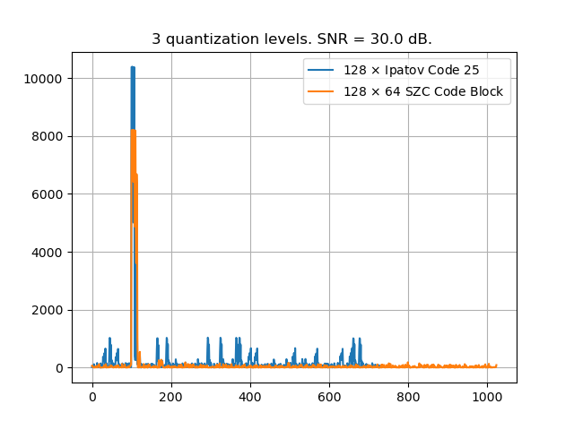
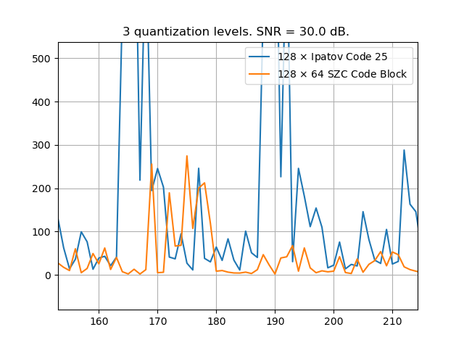
  CIR Estimates for ADC LSB at the Noise Variance – 3 quant. levels
SZC is showing considerable benefit.

Slide 6
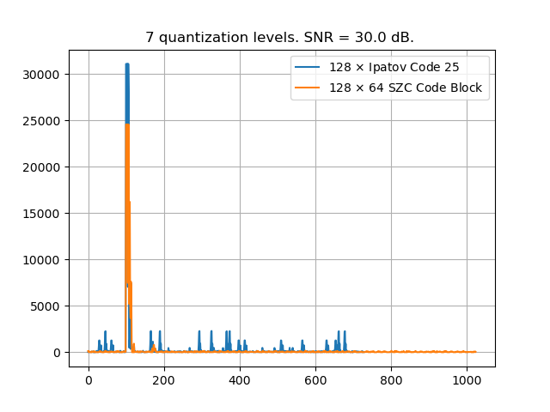
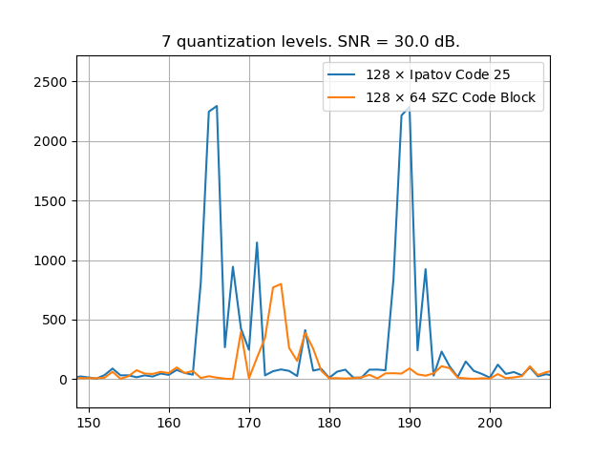
  CIR Estimates for ADC LSB at the Noise Variance – 7 quant. levels
SZC is again showing considerable benefit.

Slide 7
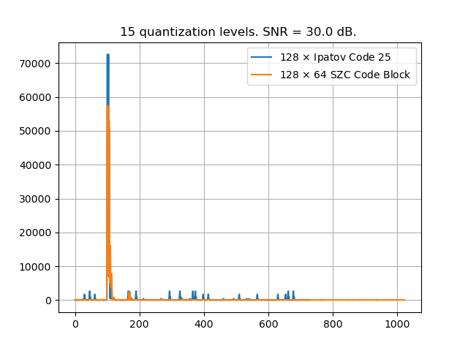
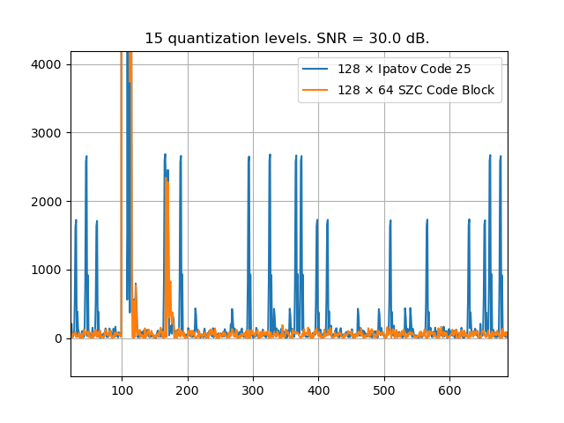
  CIR Estimates for ADC LSB at the Noise Variance – 15 quant. levels
SZC is still showing considerable benefit.

Slide 8
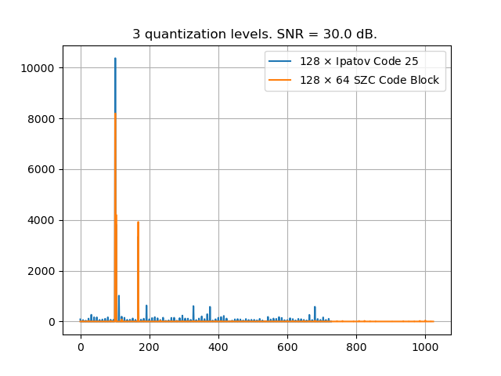
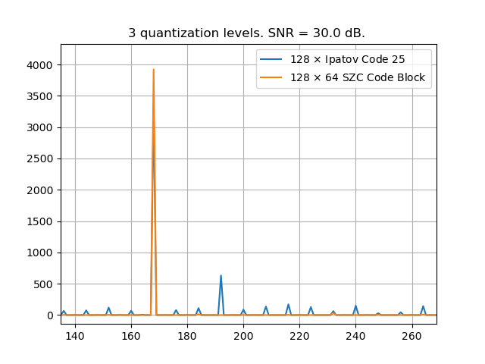
  CIR Estimates for the Full Dynamic Range – 3 quant. levels
SZC is showing considerable benefit.

Slide 9
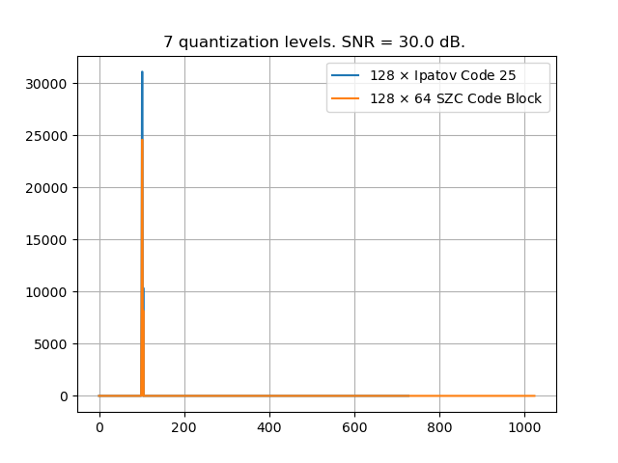
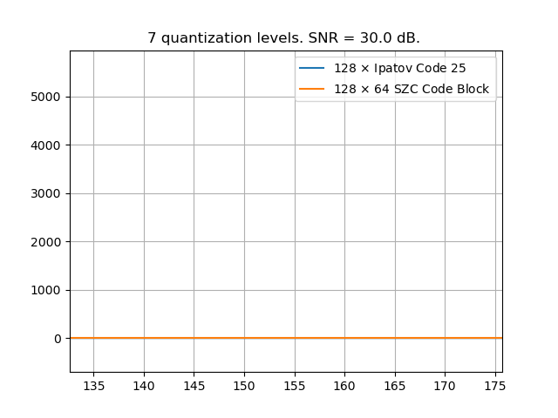
  CIR Estimates for the Full Dynamic Range – 7 quant. levels
LSB threshold is above the level of the second path; neither code in detecting the target.

Slide 10
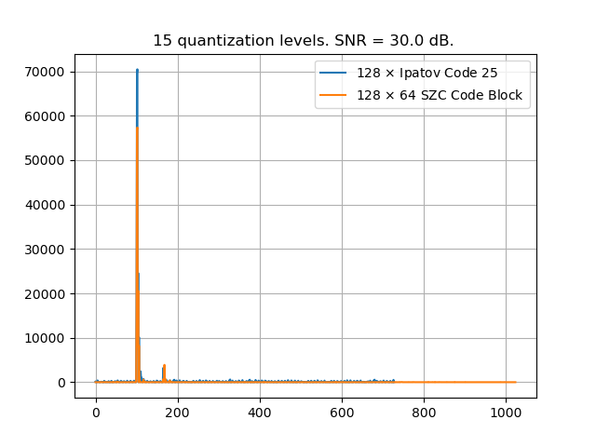
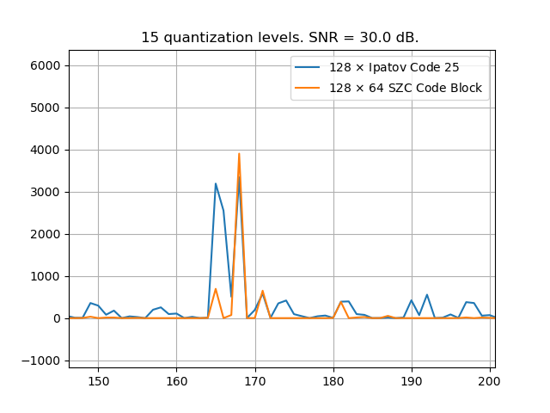
  CIR Estimates for the Full Dynamic Range – 15 quant. levels
Little ADC clipping present, so the difference between the two codes is less, but the SZC is still showing the benefit.

Slide 11
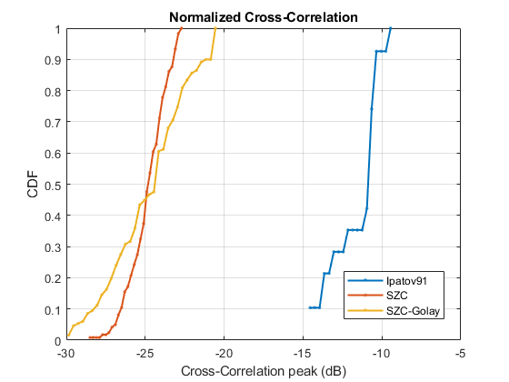
Cross-correlation Performance
Sixteen chosen SZC code blocks perform considerably better than the eight 4z Ipatov-91 codes.

Slide 12
Conclusions
SZC code blocks proved to be very resilient to ADC clipping; not true for the Ipatov-91 codes.
SZC code block SYNC field structure is compatible with the current 4z STS field structure.
  Ease of implementation.
The cross-correlation performance of SZC code blocks is much better than that of Ipatov-91 codes.
  Mitigates the interference to legacy 4z HPRF devices.

