Slide 1
Project: IEEE P802.15 Working Group for Wireless Personal Area Networks (WPANs)
Submission Title: Discussion on the Issues of Draft D2 document from Qorvo
Date Submitted: November 2022
Source: Huy Nguyen, Yeong Min Jang [Kookmin University].
Contact: +82-2-910-5068 E-Mail: yjang@kookmin.ac.kr
Re:
Abstract: Response to the Issues of Draft D2 comment from Tero Kivinen
Purpose: Response to the Issues of Draft D2 comment from Tero Kivinen
Notice: This document has been prepared to assist the IEEE P802.15. It is offered as a basis for discussion and is not binding on the contributing individual(s) or organization(s). The material in this document is subject to change in form and content after further study. The contributor(s) reserve(s) the right to add, amend or withdraw material contained herein.
Release: The contributor acknowledges and accepts that this contribution becomes the property of IEEE and may be made publicly available by P802.15.

Slide 2
Discussion on the Issues of Draft D2 document from Qorvo

Slide 3
Issue #1: Decorate in Draft D2 document
sub-clause 5.2 looks to be a hanging paragraph, which goes against the IEEE SA Standards Style Manual guidelines, Correct hanging paragraphs by creating new subclauses to hold the hanging text. Ref: section 13.1 of Style Manual: https://mentor.ieee.org/myproject/Public/mytools/draft/styleman.pdf
extra dot after clause number 5.2.1 -- Not sure of style required but in 15.4 the dot only appears after main clause numbers and not after any subclause numbers. In this 7a amendment there is a mix of styles where some subclause numbers have trailing dot and some do not. Delete tralling "." -- Note there are quite a lot of these to correct.
typo: "as follow“change to "as follows" -- Note there are 17 instances of this to fix!

Slide 4
Issue #2: Decorate in Draft D2 document
Seems new clause heading "5.2.1.4.6 PHY VIII" with no text. Add body or remove heading and amend the editing instruction to add it.
no closing "." at end of paragraph. (And similar in following 4 paragraphs"). Insert "." at end of paragraph, and check/fix where missing elsewhere in the doc.

Slide 5
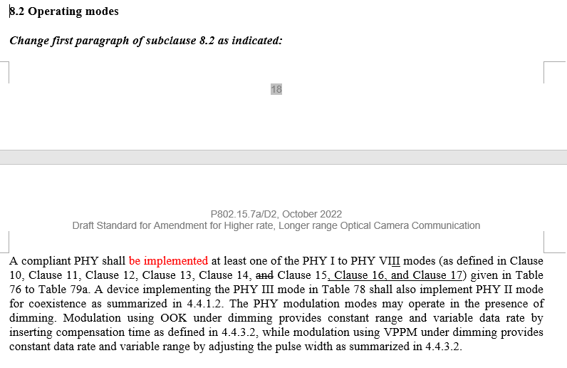
Issue #3: Decorate in Draft D2 document
"PHY VII and PHY VIII modes shall implement with a high frame rate camera (up to 50 kf/s)" makes one think there is something missing after "implement" to say what is implemented. Suggest reword as "PHY VII and PHY VIII modes shall support a high frame rate camera (up to 50 kf/s)“
"amplitude of LED" -- a diode does not have an amplitude.

Slide 6
Issue #4: Technical issue
"envelop" wrong word. change to "envelope"

