Slide 1
Project: IEEE P802.15 Working Group for Wireless Personal Area Networks (WPANs)
Submission Title: Response to ETRI’ comments on the Draft D2 document -Part 3
Date Submitted: November 2022
Source: Huy Nguyen, Yeong Min Jang [Kookmin University].
Contact: +82-2-910-5068 E-Mail: yjang@kookmin.ac.kr
Re:
Abstract: Response to the Issues of Draft D2 comment from Tero Kivinen
Purpose: Response to the Issues of Draft D2 comment from Tero Kivinen
Notice: This document has been prepared to assist the IEEE P802.15. It is offered as a basis for discussion and is not binding on the contributing individual(s) or organization(s). The material in this document is subject to change in form and content after further study. The contributor(s) reserve(s) the right to add, amend or withdraw material contained herein.
Release: The contributor acknowledges and accepts that this contribution becomes the property of IEEE and may be made publicly available by P802.15.

Slide 2
Response to for ETRI’ comments on the Draft D2 document -Part 3

Slide 3
Issue #1: Technical issue
In regard to "phyMimoOokLedId" in Table 115 on this page, it looks like that this attribute is related to 16.4.4 on page #23 in this draft. By the way, the description in 16.4.4 does not provide full information depending on the values of this attribute.
"phyHs2pskOfdmQam" in HOOK-OFDM mode in Table 115 on page #17

Slide 4
Issue #2: Technical issue
Keep the technical consistency on this issue between Table 79a, Table 115
Table 79a shown one example of mode with data rate. In Table 115, we shown some modes of modulation schemes depending on the type and range of PIB attributes. Then some modes did not show in table 79a.
Example:

Slide 5
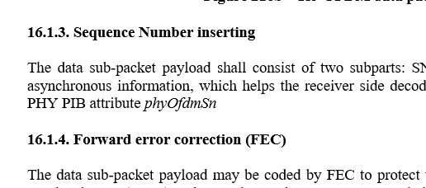
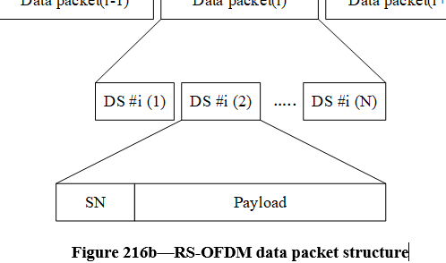
Issue #3: Decorate D2 document
No line space between the Figure and the Figure caption in Figure 216a
No line space between the Figure caption and the sub-clause title
No line space between the Figure and the Figure caption in Figure 216b
Font style in the title of 16.1.3

Slide 6
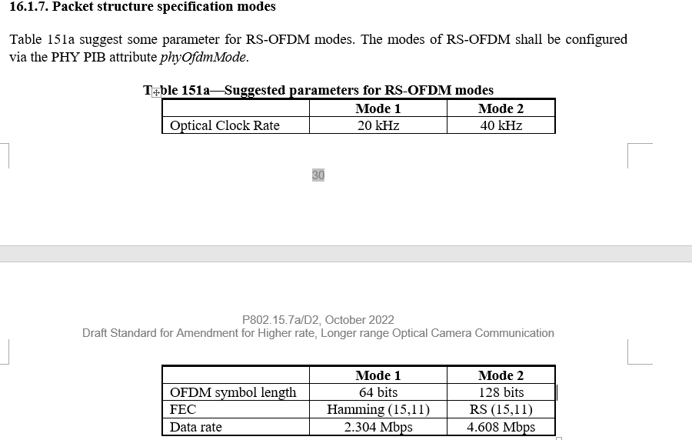
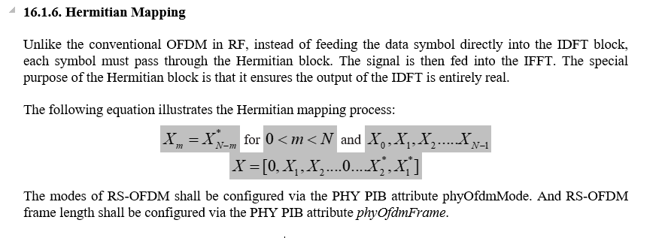
Issue #4: Technical issue
In regard to "phyOfdmFEC", it is shown as "phyOfdmFec" in Table 115 on page #14.
In regard to the last two sentences, "The modes of RS-OFDM ~ ~. And the length of RS-OFDM ~ ~.", I can't understand why the sentences are in 16.1.6 because this sub-clause is for Hermitian mapping.
In regard to "suggest" in the first sentence, I think the standard is not a document to suggest something to somewhere. ➔ we just suggest some mode for standard. We can design with new mode with reserved values in table 115. Please check IEEE 802.15.7-2018
In respect to "high frame rate camera (50 kf/s)" in the first sentence, this is saying about an implementation issue. So, this should be deleted. ➔ accepted

Slide 7
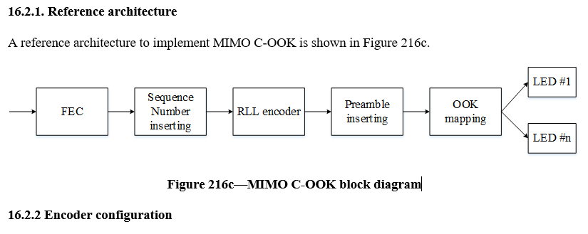
Issue #5: Technical issue
There are two sentences in this sub-clause. However, the sentences do not make sense. According to my understanding, PHY VII has four operating modes which are RS-OFDM mode, MIMO C-OOK mode, O-NOMA mode, and MIMO-OOK mode. In other words, MIMO C-OOK mode is one of them. Please read the sentences again.
The first sentence describes the PHY VII. I can't understand why this sentence is here.

Slide 8
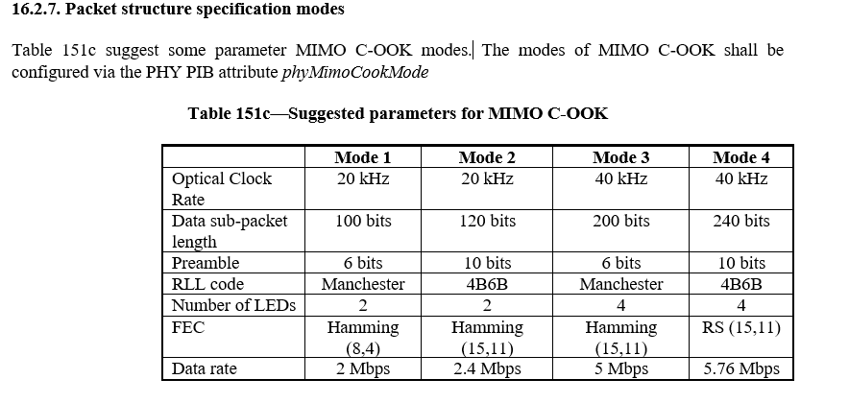
Issue #6: Technical issue
Keep the technical consistency on this issue between Table 79a, Table 115, Table 151c and here.
There is no PHY PIB attribute showing "phyMimoCookPreambleSymbol" in Table 115. ➔ it is “phyMimoCookPreamble”
In regard to "phyMimoCookFEC", it is shown as "phyMimoCookFec" in Table 115 on page #15. ➔ accepted

Slide 9
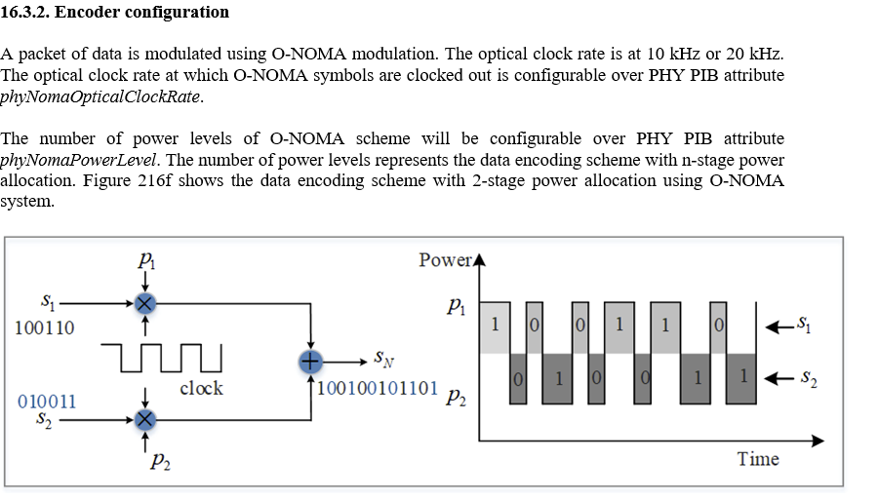
Issue #7: Technical issue
The title of 16.3.2 is "Encoder configuration", but the text in 16.3.2 is saying other thing.
For editorial consistency with the title of 16.3, it would be better to change "NOMA-OCC" to "O-NOMA".

Slide 10
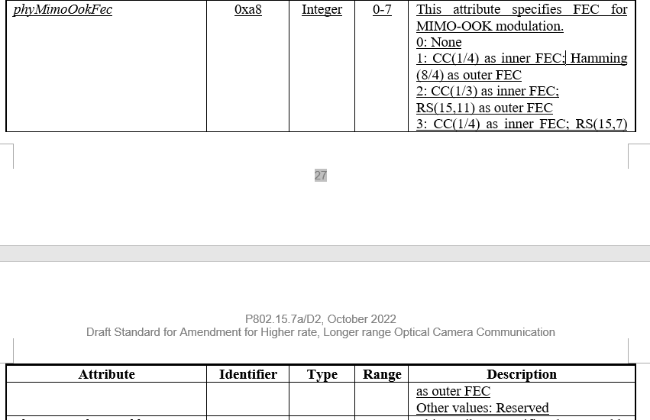
Issue #8: Technical issue
When the inner and outer FECs are configured by the PHY PIB attribute "phyMimoOokFec", how can the inner and outer FECs be distinguished ?
In regard to "phyMimoOokFEC", it is shown as "phyMimoOokFec" in Table 115 on page #16.
"Manchester code and 4B6B code“. Change it "Manchester code or 4B6B code".

Slide 11
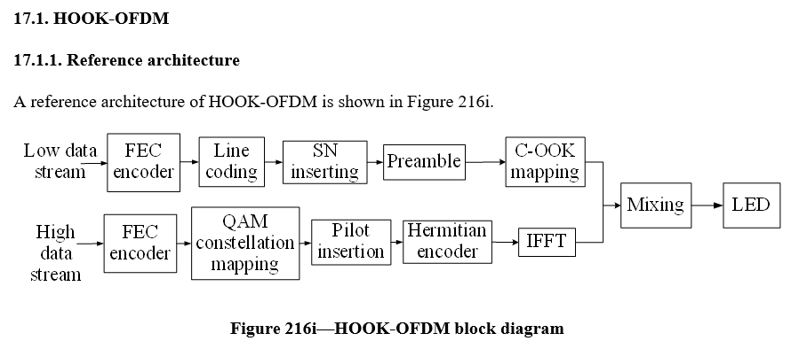
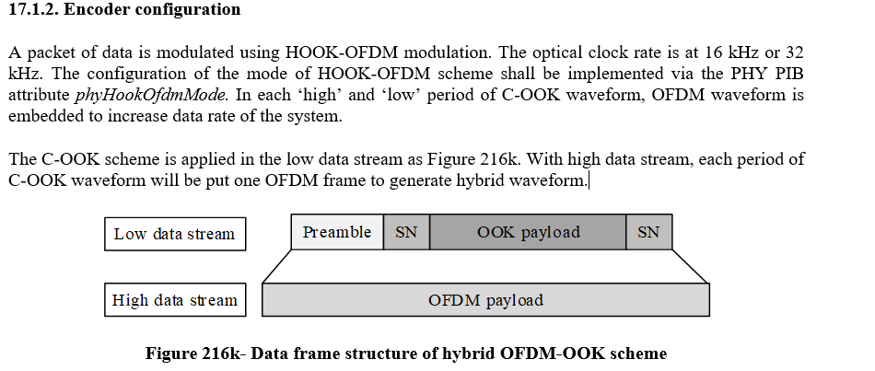
Issue #9: Technical issue
The sentence in 17.1 does not make sense. According to my understanding, PHY VIII has three operating modes which are HOOK-OFDM mode, HS2PSK mode, and BPPM mode. In other words, HOOK-OFDM mode is one of them. Please read the sentences again.
"Low-rate" and "High-rate" are shown in Figure 216k. By the way, what do they indicate ? Do they mean "data rate" ? If so, what is the specific guideline between "Low-rate" and "High-rate" ?

Slide 12
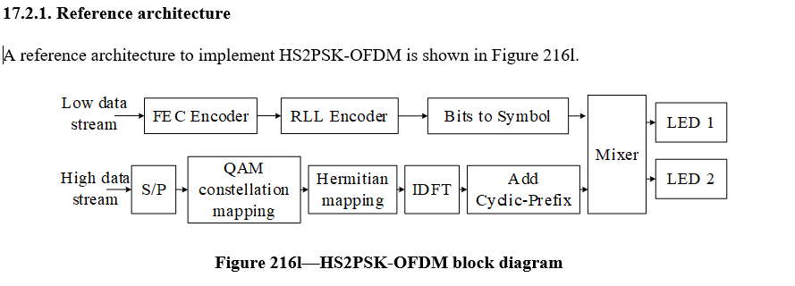
Issue #20: Technical issue
The first sentence in 17.2 does not make sense. According to my understanding, PHY VIII has three operating modes which are HOOK-OFDM mode, HS2PSK mode, and BPPM mode. In other words, HS2PSK mode is one of them. Please read the sentences again.
No line space between the Figure and the Figure caption in Figure 216l
No line space between the Figure caption and the title of sub-clause

Slide 13
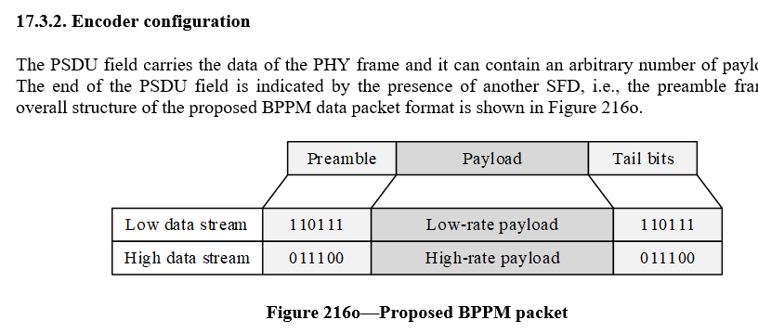
Issue #11: Technical issue
The first sentence in 17.3 does not make sense. According to my understanding, PHY VIII has three operating modes which are HOOK-OFDM mode, HS2PSK mode, and BPPM mode. In other words, BPPM mode is one of them. Please read the sentences again.
"Low-rate" and "High-rate" are shown in Figure 216n. By the way, what do they indicate ? Do they mean "data rate" ? If so, what is the specific guideline between "Low-rate" and "High-rate" ?
No line space between the Figure and the Figure caption in Figure 216n

