Slide 1
Project: IEEE P802.15 Working Group for Wireless Personal Area Networks (WPANs)
Submission Title: Response to ETRI’ comments on the Draft D2 document -Part 1
Date Submitted: November 2022
Source: Huy Nguyen, Yeong Min Jang [Kookmin University].
Contact: +82-2-910-5068 E-Mail: yjang@kookmin.ac.kr
Re:
Abstract: Response to the Issues of Draft D2 comment from Tero Kivinen
Purpose: Response to the Issues of Draft D2 comment from Tero Kivinen
Notice: This document has been prepared to assist the IEEE P802.15. It is offered as a basis for discussion and is not binding on the contributing individual(s) or organization(s). The material in this document is subject to change in form and content after further study. The contributor(s) reserve(s) the right to add, amend or withdraw material contained herein.
Release: The contributor acknowledges and accepts that this contribution becomes the property of IEEE and may be made publicly available by P802.15.

Slide 2
Response to ETRI’ comments on the Draft D2 document -Part 1

Slide 3
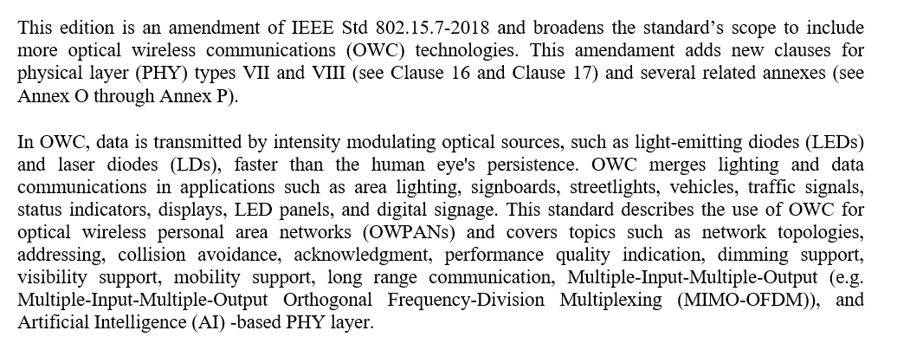
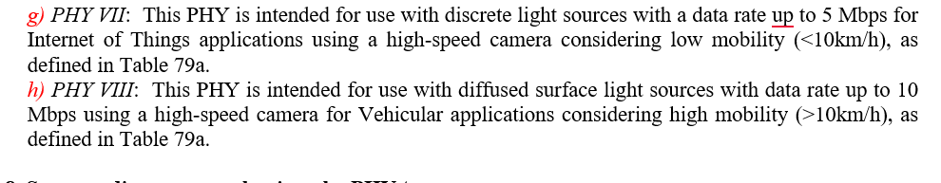
Issue #1: Decorate Draft D2 document
The editorial correction seems to be need on this line (Introduction part )
Change "g." to "g)" for the editorial consistency with IEEE 802.15.7-2018 style.
Numbering style for "h.". See 4.4.1 in IEEE 802.15.7-2018.
Change "Mb/s" to "Mbps" for the editorial consistency with IEEE 802.15.7-2018 style.
➔ We updated it

Slide 4
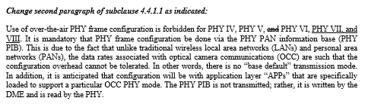
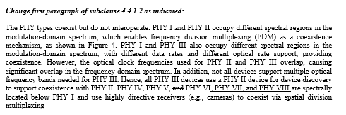
Issue #2: Technical issue in Draft D2 document
The second paragraph of 4.4.1.1 of IEEE 802.15.7-2018 should be modified because there are some descriptions on each PHY. By the way, the modified text for 4.4.1.1 is not found in this draft.
The paragraph of 4.4.1.2 of IEEE 802.15.7-2018 should be modified because there are some descriptions on each PHY. By the way, the modified text for 4.4.1.2 is not found in this draft.
Figure 4 in 4.4.1.2 of IEEE 802.15.7-2018 should be changed because PHY VII and VIII were added to this draft. By the way, the modified figure for Figure 4 is not found in this draft.
The last paragraph of 4.4.2 of IEEE 802.15.7-2018 should be modified because there are some descriptions on each PHY. By the way, the modified text for 4.4.2 is not found in this draft.

Slide 5
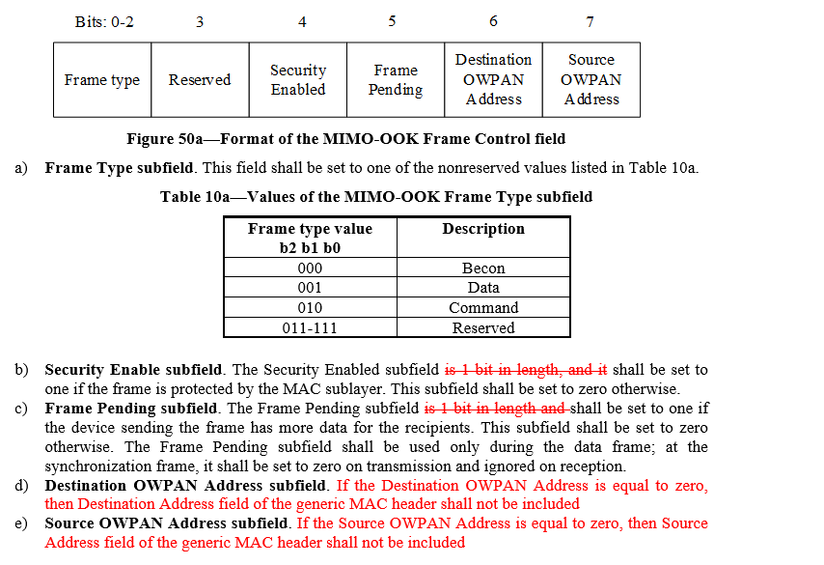
Issue #3: Decorate Draft D2 document
No line space between the figure and its figure caption in Figure 50a
Numbering style for "a.". See 5.2.1.1.1 to 5.2.1.1.4 in IEEE 802.15.7-2018.
Font style of the subfield name "Frame Type subfield". See 5.2.1.1.1 to 5.2.1.1.4 in IEEE 802.15.7-2018.
No line space between the sentence on line #12 and Table caption
No line space between the table and Table caption in Table 10a

Slide 6
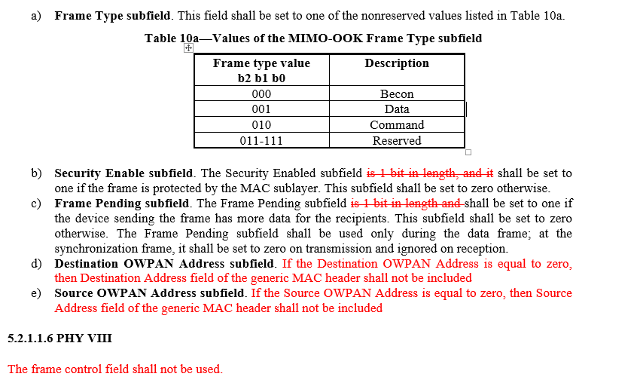
Issue #4: Technical issue in Draft D2 document
Change "Destination Addressing Mode" to "Destination OWPAN Address" in order to synchronize with 5.2.1.1.5
Change "Source PAN Address" to "Source OWPAN Address" in order to synchronize with 5.2.1.1.5 Change "Source Addressing Mode" to "Source OWPAN Address" in order to synchronize with 5.2.1.1.5
There is no text for 5.2.1.4.6 on page 6.

Slide 7
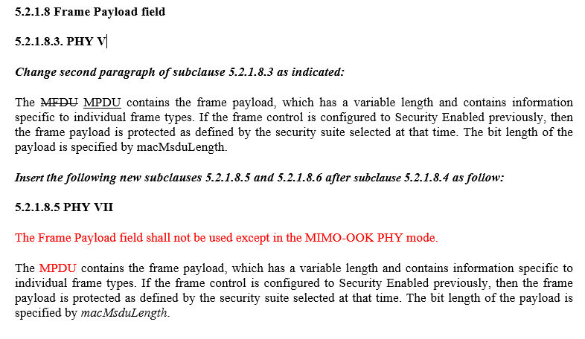
Issue #5: Technical issue in Draft D2 document
"What is ""MFDU"" on this line ? Does it indicate ""MPDU"" ?Actually, ""MFDU"" is shown in 5.2.1.8.3 of IEEE 802.15.7-2018 only once, but there is no information on what it indicates even in 3.2 Acronyms and abbreviations.“

Slide 8
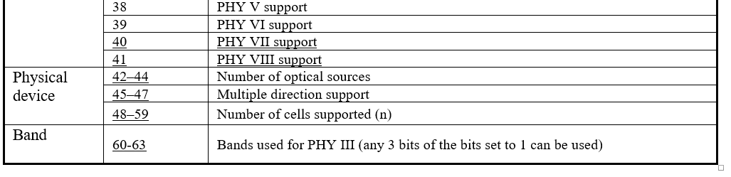
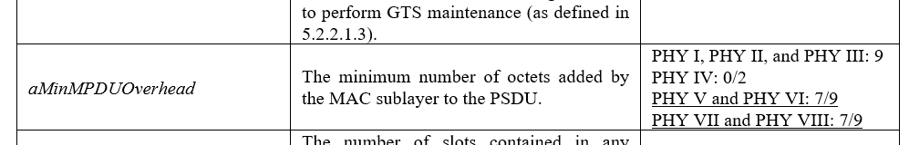
Issue #6: Technical issue in Draft D2 document
Table 18 on page 119 in IEEE 802.15.7-2018 should be modified because there are capabilities on each PHY type. ➔ updated table 18
Table 61 on page 187 in IEEE 802.15.7-2018 shows MAC sublayer constants, and the values for each PHY type are assigned for "aMinMPDUOverhead". So, the values for PHY VII and VIII should be assigned in this part. ➔ updated table 61

Slide 9
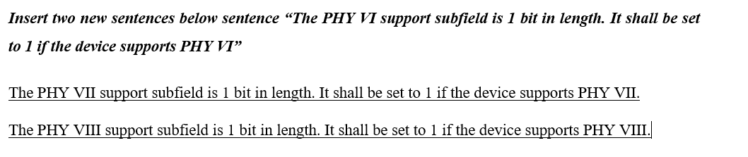

Issue #7: Technical issue in Draft D2 document
The descriptions for each PHY type are shown on pages 120 to 121 in IEEE 802.15.7-2018. So, The descriptions for PHY VII and VIII should be added to this part.
In "the amplitude of LED“. Change it to "the amplitue of signal to the light sources" for better understanding.

Slide 10
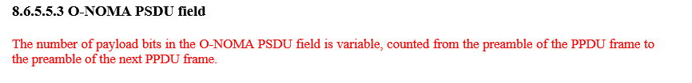
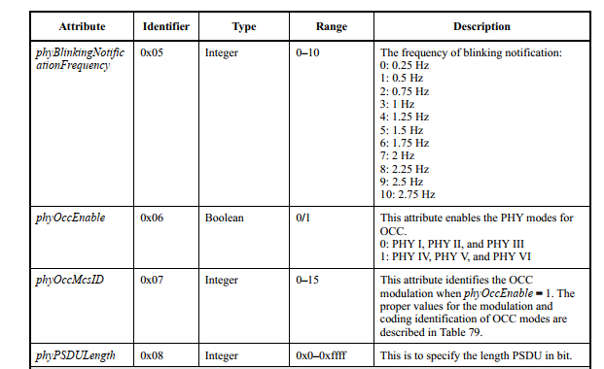
Issue #8: Decorate Draft D2 document
In regard to "The O-NOMA PPDU consists of the PSDU field only.", I don't know what it means. This sub-clause is for PSDU field. Add some text for O-NOMA PSDU field to this sub-clause.
In regard to "PHY PIB attribute phyPsduLength", it is not found in Table 115 on page 16. "phyPSDULength" is shown on Part A: PHY I, PHY II, and PHY III PHY attributes in Table 115 of IEEE 802.15.7-2018.
In Part A, we have some PHY PIB attributes,
which used for all PHY mode in standard

Slide 11
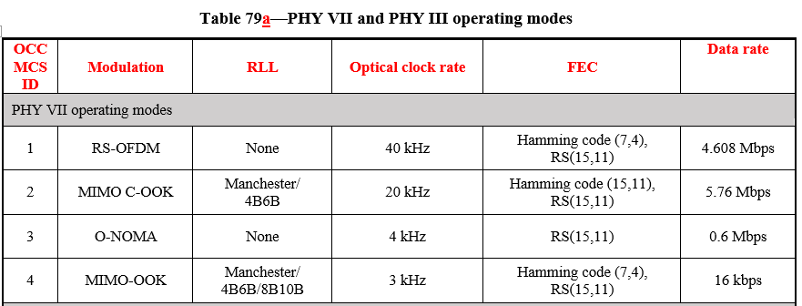
Issue #9: Decorate Draft D2 document
Title of Table 79a: PHY VII and PHY III operating modes
Font style in the title of Table 79a
No line space between the table and its table caption in Table 79a
Writing style for "Optical Clock Rate" in Table 79a
Font style of the sub-title for each column in Table 79a. See Table 79 in IEEE 802.15.7-2018.
Font style for "PHY VII operating mode" in Table 79a. See Table 79 in IEEE 802.15.7-2018.
Font style for "PHY VIII operating mode" in Table 79a. See Table 79 in IEEE 802.15.7-2018.
Unit notation for data rate. "kbps" and "bps" are shown in Table 79 of IEEE 802.15.7-2018.

Slide 12
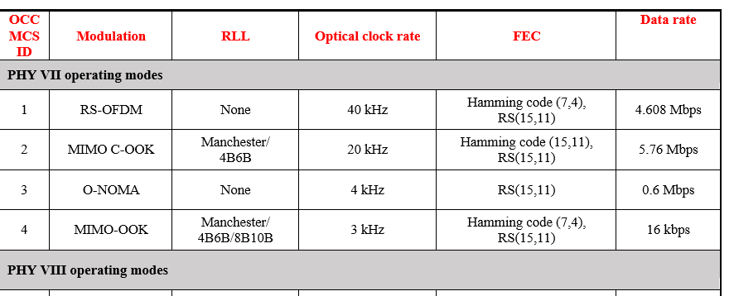
Issue #10: Decorate Draft D2 document
At the bottom of Table 79 in IEEE 802.15.7-2018, the acronyms and their full names used in Table 79 are shown. So, it would be better if the acronyms and their full names used in Table 79a should be added to this part.
No line space between the table and its table caption in Table 81
Font style of the sub-title for each column in Table 81. See Table 81 in IEEE 802.15.7-2018.
Font style for "macMinLIFSPeriod", "macMinSIFSPeriod", and "macMinRIFSPeriod" in Table 81. See Table 81 in IEEE 802.15.7-2018.
Font style of the sub-title for each column in Table 81. See Table 81 in IEEE 802.15.7-2018.
Font style for "PHY VII operating mode" in Table 83. See Table 83 in IEEE 802.15.7-2018.
Font style for "PHY VIII operating mode" in Table 83. See Table 83 in IEEE 802.15.7-2018.

Slide 13
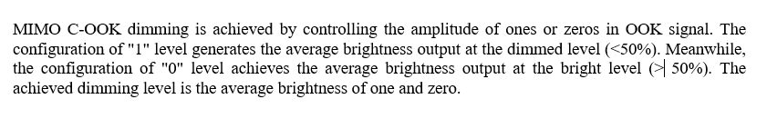
Issue #11: Technical issue in Draft D2 document
In respect to "10kHz or 20kHz", according to Table 79a, the optical clock rate for MIMO C-OOK mode is 20kHz. So, you need to keep the technical consistency. ➔ in Table 79a, we just put example about clock rate. In this standard, we applied with 10kHz and 20kHz.
In respect to "at the dimmed level (>50%)", I think the dimmed level for "1" level shoud be (<50%). And also, in 8.5.2.5.2 C-OOK dimming in IEEE 802.15.7-2018, the dimmed level for "1" level is (<50%). I think there is no reason that the dimmed level should be changed in MIMO C-OOK.
In respect to "at the dimmed level (<50%)", I think the dimmed level for "0" level shoud be (>50%). And also, in 8.5.2.5.2 C-OOK dimming in IEEE 802.15.7-2018, the dimmed level for "0" level is (>50%). I think there is no reason that the dimmed level should be changed in MIMO C-OOK.

