Slide 1
Project: IEEE P802.15 Working Group for Wireless Personal Area Networks (WPANs)
Submission Title: Discussion and response on comments of Draft D2 document from SKG Waves
Date Submitted: November 2022
Source: Huy Nguyen, Yeong Min Jang [Kookmin University].
Contact: +82-2-910-5068 E-Mail: yjang@kookmin.ac.kr
Re:
Abstract: Response to the Issues of Draft D2 comment from German Aerospace Center (DLR)
Purpose: Response to the Issues of Draft D2 comment from German Aerospace Center (DLR)
Notice: This document has been prepared to assist the IEEE P802.15. It is offered as a basis for discussion and is not binding on the contributing individual(s) or organization(s). The material in this document is subject to change in form and content after further study. The contributor(s) reserve(s) the right to add, amend or withdraw material contained herein.
Release: The contributor acknowledges and accepts that this contribution becomes the property of IEEE and may be made publicly available by P802.15.

Slide 2
Discussion and response on comments of Draft D2 document from SKG Waves

Slide 3
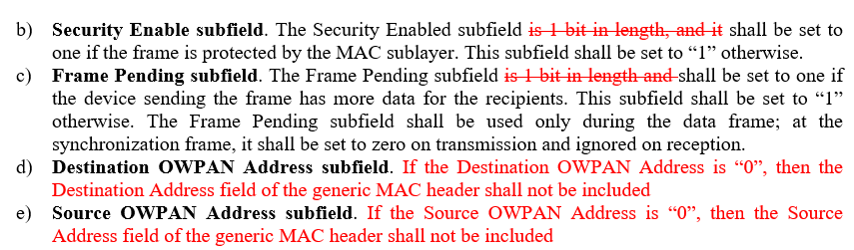
Issue #1: Decorate in D2 document
The Security Enabled subfield is 1 bit in length, and it shall be set to one if the frame is protected by the MAC sublayer. This subfield shall be set to zero otherwise. For readability purposes I think that the numbers "one" and "zero" should be represented differently from the symbols "1" and "0".
The Frame Pending subfield is 1 bit in length and shall be set to one if the device sending the frame has more data for the recipients. This subfield shall be set to zero otherwise. The Frame Pending subfield shall be used only during the data frame; at the synchronization frame, it shall be set to zero on transmission and ignored on reception.
If the Destination OWPAN Address is equal to zero, then .. <<If the Source OWPAN Address is "0", then...>>

Slide 4
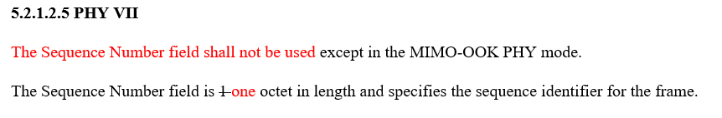
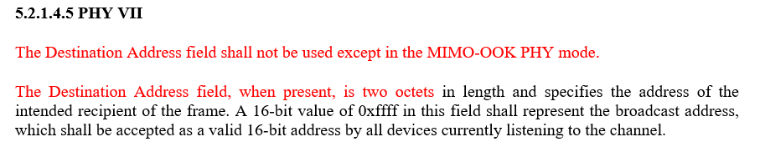
Issue #2: Decorate in D2 document
Sequence Number field is 1 octet in length ...As a variant of the previous comment, the counting meaning should be spelled out.
OWPAN Address, when present, is 2 octets in length... Same rationale as in previous comment. There may be other instances of the same situation in the document, (for example page 7, line 27), I will not comment further on those.“
"Docuemnt says: <<...and PHY VIII modes shall implement with a high frame rate camera...>>The reading of the sentence is confusing.“"Document should say:<<...PHY VIII modes shall be implemented with a high frame rate camera...>>“

Slide 5
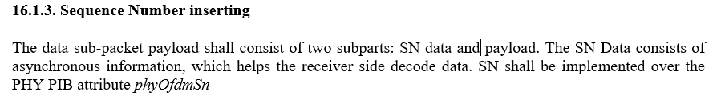
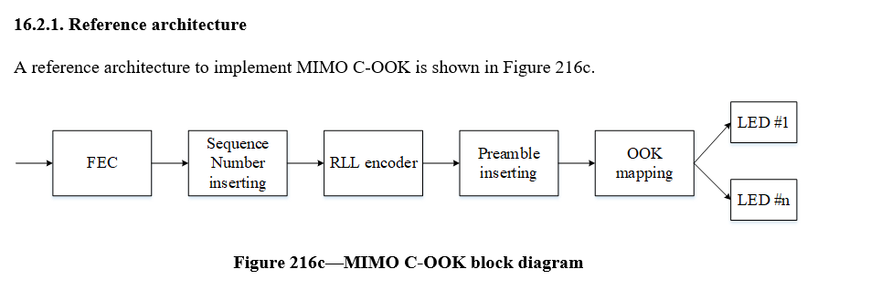
Issue #3: Decorate in D2 document
Document says: <<The data sub-packet payload shall consist of two subparts: SN data, payload.>>The reading of the sentence could be improved. Document should say:<<The data sub-packet payload shall consist of two parts: SN data and payload>>
"Document says:<<...with supported data rates and operating conditions is shown in Table 79a with high-speed OCC system uses the PHY VII.>>The sentence is difficult to read.“"Document should say:<<...with supported data rates and operating conditions is shown in Table 79a.The high-speed OCC system uses the PHY VII.>>, or similar modification for readability."

Slide 6
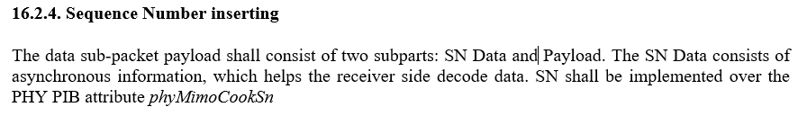
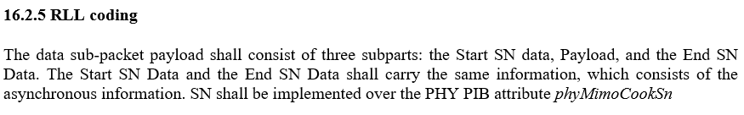
Issue #4: Decorate in D2 document
"Document says: <<The data sub-packet payload shall consist of two subparts: SN data, payload.>>Similar to comment in page 18, line 18, the reading of the sentence could be improved.“"Document should say:<<The data sub-packet payload shall consist of two parts: SN data and payload>>"
"Document says:<<...three subparts: the Start SN data, Payload, and the End SN...>>Reading and writing can be improved.“"Document should say:<<...three subparts: the Start SN data, the Payload and the End SN...>>"

Slide 7
Issue #5: Technical issue in Draft D2 document
"Document says:<<The data sub-packet format of...>>There is no reference to a sub-packet in the Figure 216h. Something missing?“"If nothing is missing, document should say:<<The data packet format of...>>Otherwise, add missing information on sub-packets."

Slide 8
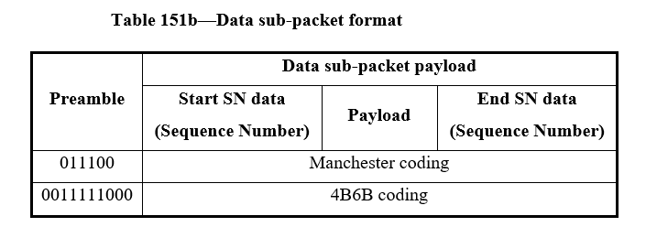
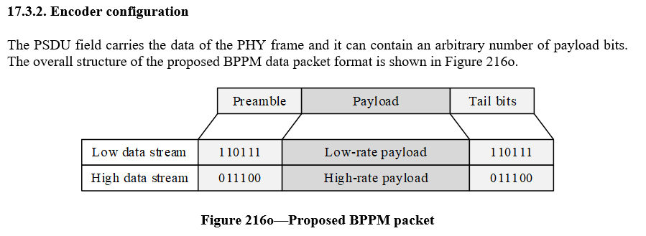
Issue #6: Technical issue in Draft D2 document
"Document says:<<Table 151e—Data Sub-Packet format>>Inconsistency with Figure 216h?“"Document should say:<<Table 151e—Data Packet format>>The structure presented in this table is the same as in the figure 216h, but here is called ""sub-packet"" and there is called ""packet"""
"Document says:<<The end of the PSDU field is indicated by the presence of another SFD, i.e., the preamble frame.>>From this sentence and the representation in Figure 216o, I conclude that it is possible that the payload may contain the preamble sequence being used, so how it is resolved such situation? I didn't find in the text a resolution for this event.“If the authors confirm that this situation is indeed possible special text must be aded for handling and resolving the event.

