Slide 1
Project: IEEE P802.15 Working Group for Wireless Personal Area Networks (WPANs)
Submission Title: Response to comments from Tero Kivinen on the Draft D2 document- Part 4
Date Submitted: November 2022
Source: Huy Nguyen, Yeong Min Jang [Kookmin University].
Contact: +82-2-910-5068 E-Mail: yjang@kookmin.ac.kr
Re:
Abstract: Response to the Issues of Draft D2 comment from Tero Kivinen
Purpose: Response to the Issues of Draft D2 comment from Tero Kivinen
Notice: This document has been prepared to assist the IEEE P802.15. It is offered as a basis for discussion and is not binding on the contributing individual(s) or organization(s). The material in this document is subject to change in form and content after further study. The contributor(s) reserve(s) the right to add, amend or withdraw material contained herein.
Release: The contributor acknowledges and accepts that this contribution becomes the property of IEEE and may be made publicly available by P802.15.

Slide 2
Response to comments from Tero Kivinen on the Draft D2 document- Part 4

Slide 3
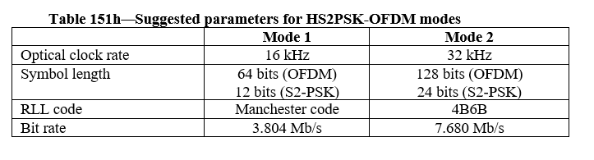
Issue #1: Decorate Draft D2 document
The column and row headings should be in bold. Change “Mode 1”, and “Mode 2” to be bold. Change also first column to be bold, as they are also headings.

Slide 4
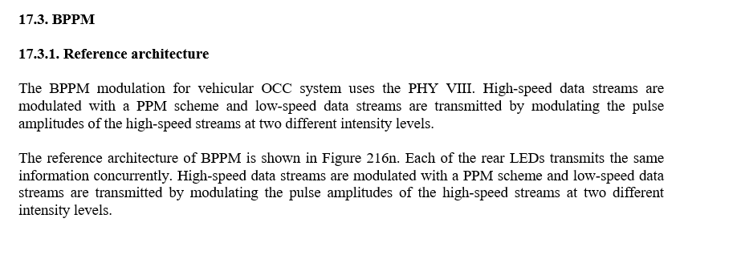
Issue #2: Technical issue in Draft D2 document
Orphan paragraph. Remove orphan paragraph, i.e., if you have both text and subsections inside the same heading the text before the first subsection is orphan paragraph, and must be removed. Easiest way to remove it is to add x.y.1 General or similar and move text there.

Slide 5
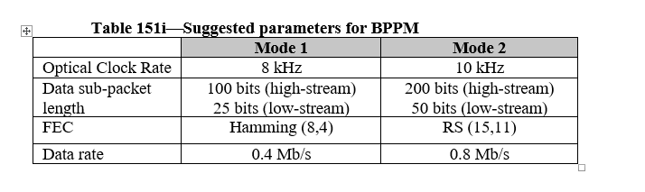
Issue #3: Decorate Draft D2 document
The column and row headings should be in bold. Change “Mode 1”, and “Mode 2” to be bold. Change also first column to be bold, as they are also headings.

Slide 6
Issue #4: Decorate Draft D2 document
Font size in figure 216b gets quite small, consider scaling it up bit.
Font size in figure 216d gets quite small, consider scaling it up bit.
➔ We increased font size

Slide 7
Issue #5: Decorate Draft D2 document
Font size in figure 216h gets quite small, consider scaling it up bit.
Font size in figure O.2 gets quite small, consider scaling it up bit.
➔ We increased font size

Slide 8
Issue #6: Decorate Draft D2 document
Font size in figure O.3 gets quite small, consider scaling it up bit.

Slide 9
Issue #7: Decorate Draft D2 document
Font size in figure O.7 gets quite small, but it might already be as large as can fit on page.

Slide 10
Issue #8: Decorate Draft D2 document
Figure O.11 seems to be bitmap, convert it vector graphics. Also the figure heading is split on different page than the figure itself, make sure the styles are set so that figures and their headings are kept together.

Slide 11
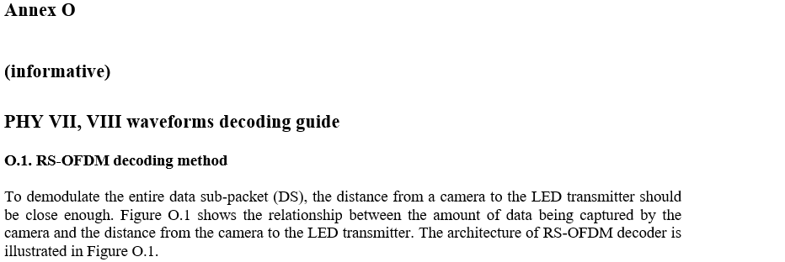
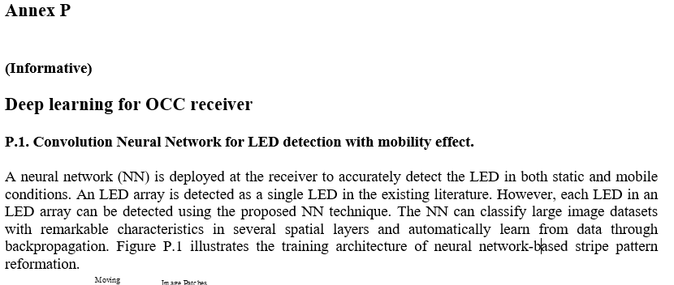
Issue #9: Decorate Draft D2 document
The annex title should be larger and bold. Change “Deep learning for OCC receiver” to be heading

