Slide 1
Project: IEEE P802.15 Working Group for Wireless Personal Area Networks (WPANs)
Submission Title: Response to comments from Tero Kivinen on the Draft D2 document- Part 3
Date Submitted: November 2022
Source: Huy Nguyen, Yeong Min Jang [Kookmin University].
Contact: +82-2-910-5068 E-Mail: yjang@kookmin.ac.kr
Re:
Abstract: Response to the Issues of Draft D2 comment from Tero Kivinen
Purpose: Response to the Issues of Draft D2 comment from Tero Kivinen
Notice: This document has been prepared to assist the IEEE P802.15. It is offered as a basis for discussion and is not binding on the contributing individual(s) or organization(s). The material in this document is subject to change in form and content after further study. The contributor(s) reserve(s) the right to add, amend or withdraw material contained herein.
Release: The contributor acknowledges and accepts that this contribution becomes the property of IEEE and may be made publicly available by P802.15.

Slide 2
Response to comments from Tero Kivinen on the Draft D2 document- Part 3

Slide 3
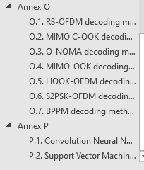
Issue #1: Decorate Draft D2 document
The column headings should be in bold.
Why is the Part N followed by Part P, not Part O?
➔ We follow alphabet table, after N is O and P.

Slide 4
Issue #2: Decorate Draft D2 document
Attribute “PhyOfdmFec” is not used anywhere in the standard.
Attribute “phyMimoCookRLLCode” is not used anywhere in the standard.
Attribute “phyMimoCookFec” is not used anywhere in the standard.
Attribute “phyNomaFec” is not used anywhere in the standard.
Attribute “phyMimoOokFec” is not used anywhere in the standard.
Attribute “phyHookOfdmFec” is not used anywehere in the standard.
➔ These attributes were mentioned in Clauses 16 and 17.

Slide 5
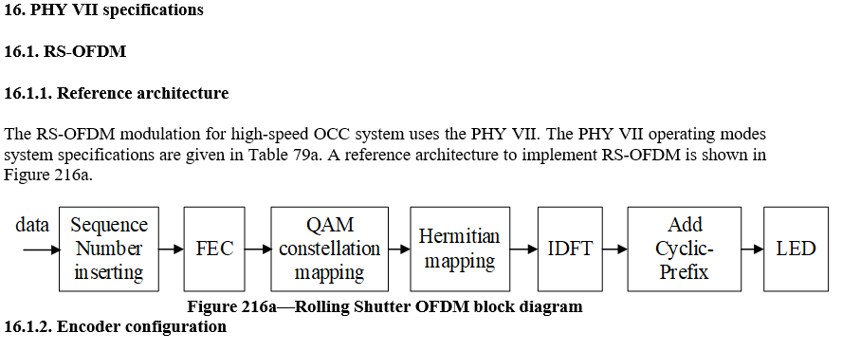
Issue #3: Decorate Draft D2 document
Orphan paragraph. Remove orphan paragraph, i.e., if you have both text and subsections inside the same heading the text before the first subsection is orphan paragraph, and must be removed. Easiest way to remove it is to add x.y.1 General or similar and move text there.

Slide 6
Issue #4: Decorate Draft D2 document
There is some strikeout text on section 16.2.6. This is new text to be added, so there cannot be any editing instructions here.

Slide 7
Issue #5: Decorate D2 document
The column and row headings should be in bold.
I have no idea what is supposed to be heading or what in the table 151b? ➔ this table shows the format of data sub-packet. How to design the sub-packet

Slide 8
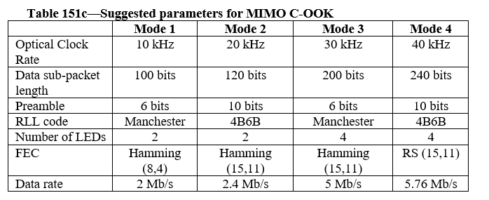
Issue #6: Decorate Draft D2 Version
The column and row headings should be in bold. Change “Mode 1”, to “Mode 4” to be bold. Change also first column to be bold, as they are also headings.

Slide 9
Issue #7: Decorate Draft D2 Version
Figure 216f seems to be bitmap. This makes text in figure to be unsearchable.
➔ We converted to .jpg format

Slide 10
Issue #8: Decorate Draft D2 Version
The column and row headings should be in bold. Change “Mode 1”, and “Mode 2” to be bold. Change also first column to be bold, as they are also headings.

Slide 11
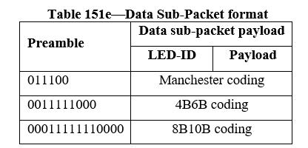
Issue #9: Decorate Draft D2 Version
I have no idea what is supposed to be heading or what in the table 151e? Clarify the table 151e. Is that really a table, or should it be figure instead? What are the 011100 and 00111111000 etc in the first column meaning?
➔this table shows the format of data sub-packet. How to design the sub-packet with preamble, LED-ID, and payload parts considering different RLL codes (Manchester code, 4B6B, 8B10B)

Slide 12
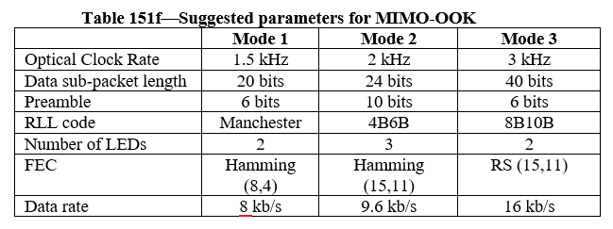
Issue #10: Decorate Draft D2 Version
The column and row headings should be in bold. Change “Mode 1”, to “Mode 3” to be bold. Change also first column to be bold, as they are also headings.

Slide 13
Issue #11: Decorate Draft D2 document
The column and row headings should be in bold. Change “Mode 1”, and “Mode 2” to be bold. Change also first column to be bold, as they are also headings.

Slide 14
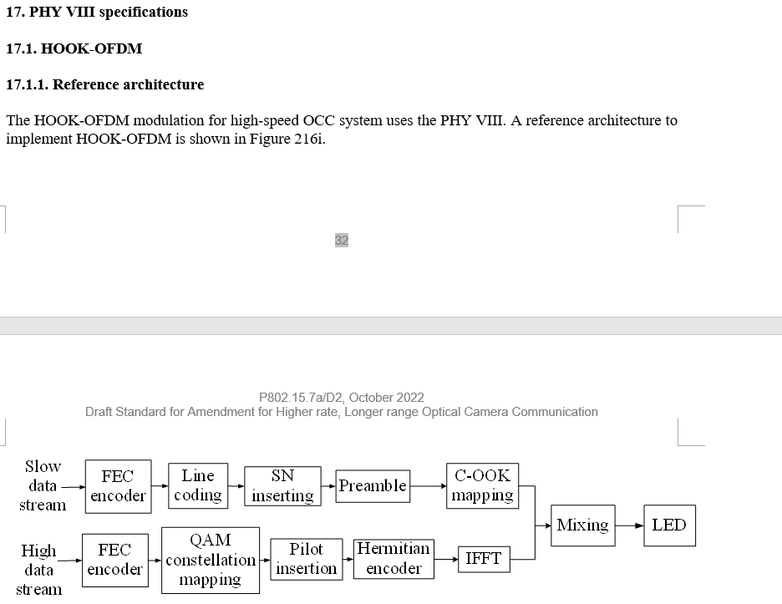
Issue #12: Technical issue in Draft D2 document
Orphan paragraph. Remove orphan paragraph, i.e., if you have both text and subsections inside the same heading the text before the first subsection is orphan paragraph, and must be removed. Easiest way to remove it is to add x.y.1 General or similar and move text there.

Slide 15
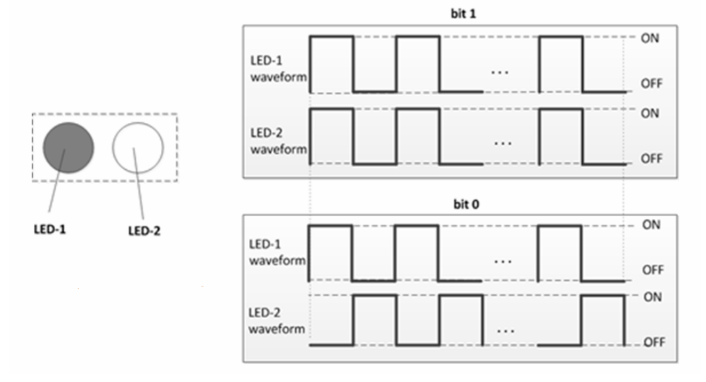
Issue #13: Decorate Draft D2 document
Consider converting figure 216m to vector graphics
➔ We converted to .jpg file

