Slide 1
Project: IEEE P802.15 Working Group for Wireless Personal Area Networks (WPANs)
Submission Title: Response to comments from Tero Kivinen on the Draft D2 document- Part 2
Date Submitted: November 2022
Source: Huy Nguyen, Yeong Min Jang [Kookmin University].
Contact: +82-2-910-5068 E-Mail: yjang@kookmin.ac.kr
Re:
Abstract: Response to the Issues of Draft D2 comment from Tero Kivinen
Purpose: Response to the Issues of Draft D2 comment from Tero Kivinen
Notice: This document has been prepared to assist the IEEE P802.15. It is offered as a basis for discussion and is not binding on the contributing individual(s) or organization(s). The material in this document is subject to change in form and content after further study. The contributor(s) reserve(s) the right to add, amend or withdraw material contained herein.
Release: The contributor acknowledges and accepts that this contribution becomes the property of IEEE and may be made publicly available by P802.15.

Slide 2
Response to comments from Tero Kivinen on the Draft D2 document- Part 2

Slide 3
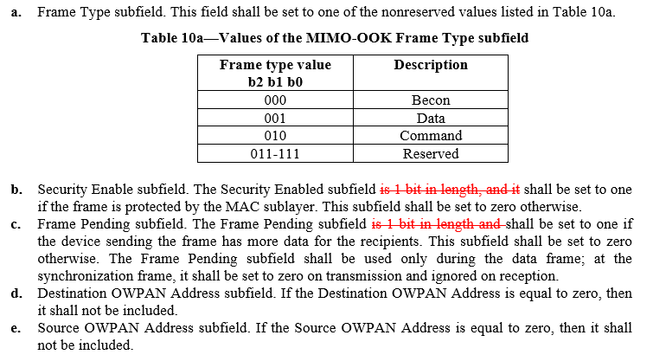
Issue #1: Decorate Draft D2 document
The column headings should be in bold.
Small numbers should be written out, so the “1 bit” should be written out. On the other hand there is no point of telling the length of field as the normative figure 50a already specifies it to be 1 bit in size. Remove “is 1 bit in length, and it”

Slide 4
Issue #2: Technical issue in Draft D2 document
The text is confusing. First of all if “Destination OWPAN Adress” in “If the xxx” is meaning this subfield, it should add word “subfield” after it. Also it is not clear where the “it” in “then it shall not be included” is refering to. It seems to point to the “Destination OWPAN Address” subfield which would not make any sense, as how you can have a bit set to zero, mean that it is not included... I assume it is supposed to say that the “Destination Address field” of the Generic MAC head is not included.

Slide 5
Issue #3: Technical issue in Draft D2 document
The text is confusing. First of all if “Source OWPAN Adress” in “If the xxx” is meaning this subfield, it should add word “subfield” after it. Also it is not clear where the “it” in “then it shall not be included” is refering to. It seems to point to the “Source OWPAN Address” subfield which would not make any sense, as how you can have a bit set to zero, mean that it is not included... I assume it is supposed to say that the “Source Address field” of the Generic MAC head is not included.

Slide 6
Issue #4: Technical issue in Draft D2 document
As the Destination OWPAN Identifier field is not used in PHY IV, V, VI, VII, or VIII, it would be better to combine all them together.
➔ We think it is not necessary. We separated to make clear in document.

Slide 7
Issue #5: Technical issue in Draft D2 document
I think the content of the 5.2.1.4.6 is missing.
As the Source OWPAN Identifier field is not used in PHY IV, V, VI, VII, or VIII, it would be better to combine all them together.
➔ We think it is not necessary. We separated to make clear in document.

Slide 8
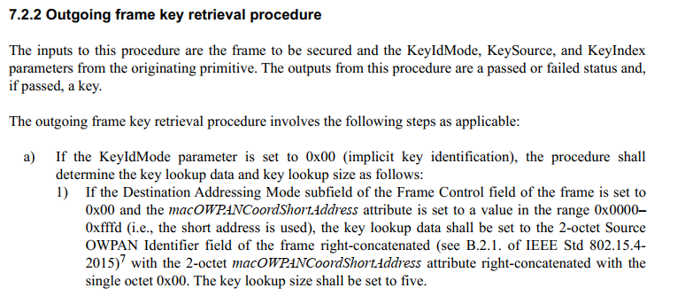
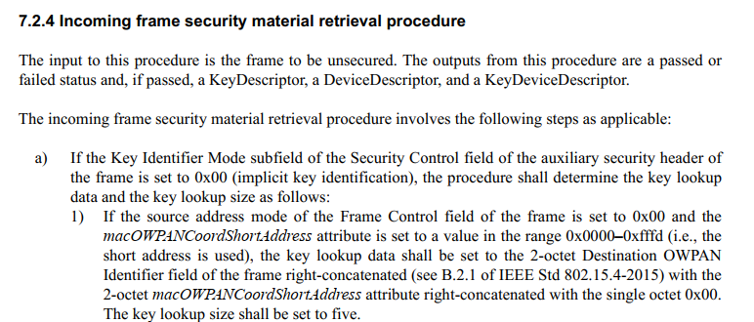
Issue #6: Technical issue in Draft D2 document
There is no “Destination Address Mode subfield” for the PHY VII, there is Destination OWPAN Address subfield.
There is no “Source Address Mode subfield” for the PHY VII, there is Source OWPAN Address subfield.
➔ Please check IEEE 802.15.7-2018 (5.3.1.1 MHR fields)

Slide 9
Issue #7: Technical issue in Draft D2 document
The “Destination OWPAN Address” is one bit field inside the frame control field, so there is no way to put 2 octets there. I think this is supposed to refer to the “Destination Address” field in the General MAC header. Also the “2 octets” should be spelled out.

Slide 10
Issue #8: Technical issue
The “Source PAN Address” field does not exists. I think this is supposed to refer to the “Source Address” field in the General MAC header. Also the “2 octets” should be spelled out.
As the Auxiliary Security Header field is not used in PHY IV, V, VI, VII, or VIII, it would be better to combine all them together.
➔ We think it is not necessary. We separated to make clear in document.

Slide 11
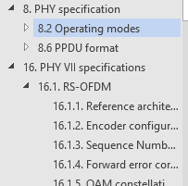
Issue #9: Decorate Draft D2 document
Spell out “1 octet”
Section header 8 missing
“a” should be underlined in the “Table 79a”.
The column headings should be in bold.

Slide 12
Issue #10: Decorate Draft D2 document
What is the meaning of the first “#” column? Is it supposed to be MCS ID or something else. If it is not MCS ID, then I assume there is no meaning for it, and it should be remove.

Slide 13
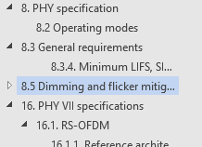
Issue #11: Decorate Draft D2 document
Add “8.3 General requirements” section header.
Add “8.5 Dimming and flicker mitigation” section header.

Slide 14
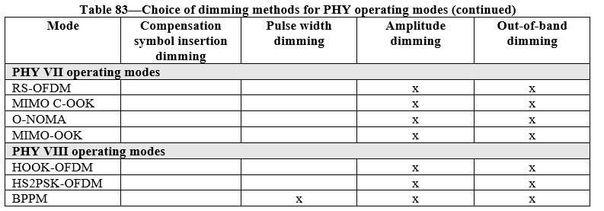
Issue #12: Decorate Draft D2 document
The column headings should be in bold. Change “PHY” and “Units” to bold. Change “macMinLIFSPeriod”, “macMinSIFSPeriod”, and “macMinRIFSPeriod” to bold italic.
The subtable headings are bold in base standard. Change “PHY VII operating modes” and “PHY VIII operating modes” to bold.

Slide 15
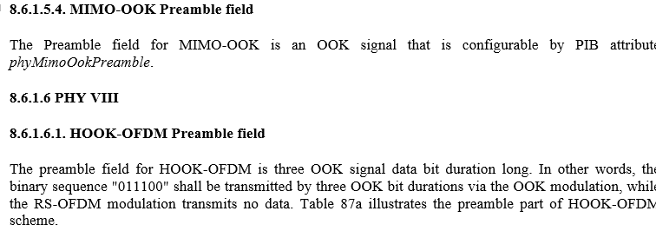
Issue #13: Decorate Draft D2 document
The column or row headings should be in bold.
The column headings should be in bold.

Slide 16
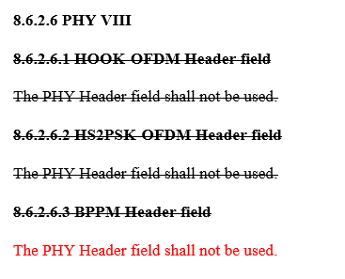
Issue #14: Technical issue in Draft D2 document
If none of the modes inside PHY VIII use this, they should be combined.

Slide 17
Issue #15: Technical issue in Draft D2 document
Section header 9 is missing
Section header 9.5 is missing.

