Slide 1
Project: IEEE P802.15 Working Group for Wireless Personal Area Networks (WPANs)
Submission Title: Response to comments from Tero Kivinen on the Draft D2 document- Part 1
Date Submitted: November 2022
Source: Huy Nguyen, Yeong Min Jang [Kookmin University].
Contact: +82-2-910-5068 E-Mail: yjang@kookmin.ac.kr
Re:
Abstract: Response to the Issues of Draft D2 comment from Tero Kivinen
Purpose: Response to the Issues of Draft D2 comment from Tero Kivinen
Notice: This document has been prepared to assist the IEEE P802.15. It is offered as a basis for discussion and is not binding on the contributing individual(s) or organization(s). The material in this document is subject to change in form and content after further study. The contributor(s) reserve(s) the right to add, amend or withdraw material contained herein.
Release: The contributor acknowledges and accepts that this contribution becomes the property of IEEE and may be made publicly available by P802.15.

Slide 2
Response to comments from Tero Kivinen on the Draft D2 document- Part 1

Slide 3
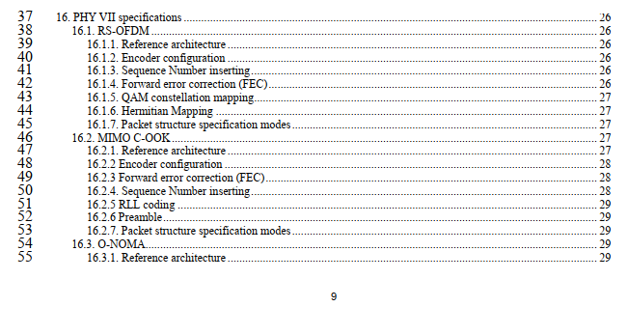
Issue #1: Decorate Draft D2 document
PDF Index is missing
PDF page numbers and document page numbers do not match.
Pages ii – vi are missing page numbers from the bottom of the page.

Slide 4
Issue #2: Abstract part
There is extra < and > around the abstract.
There is extra < and > around the keywords.
Amendment is not a good keyword

Slide 5
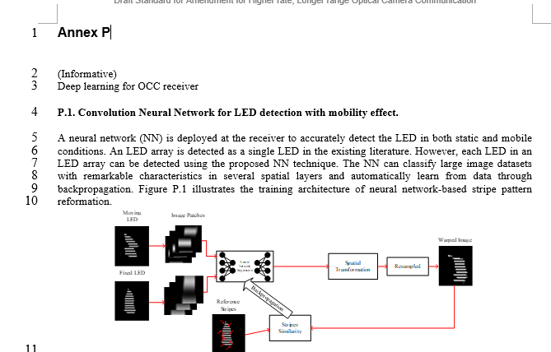
Issue #3: Annex Q
This annex is marked as being Annex Q, but it should be Annex P, and the sub-headers inside are P.1 etc.

Slide 6
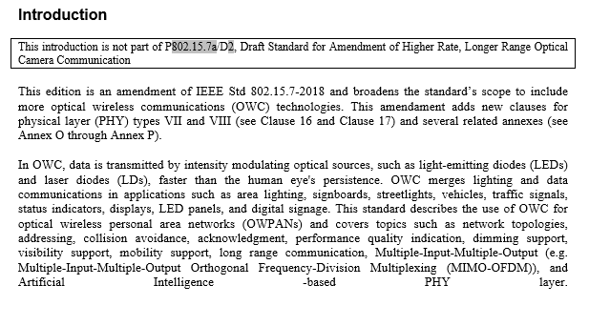
Issue #4: Introduction part
The editing instructions are missing from the beginning of the document.
➔ We rewrite introduction part based on 7a TG

Slide 7
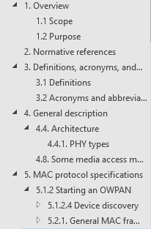
Issue #5: Decorate Draft D2 document
There is no changes in the section 1.1, remove it
There is no changes in the section 2, remove it.
There is no changes in the section 3.1, remove it.
➔ We want to make the hierarchy between sections

Slide 8
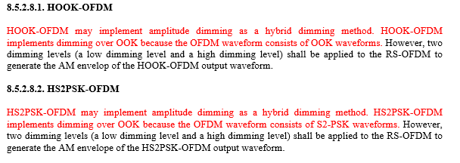
Issue #6: Decorate Draft D2 document
This is not first use of HOOK-OFDM, do not expand it here.
The first use of the HS2PSK-OFDM is on line 11, not on line 12.

Slide 9
Issue #7: Decorate Draft D2 document
The base draft uses “a)”, “b)” etc, this one uses “g.”, “h.” etc.
The font size of for “4.4” is smaller than “3.2” etc.
The font size of for “4.4.1” is smaller than “3.2” etc.
The font sizes for all headers.

Slide 10
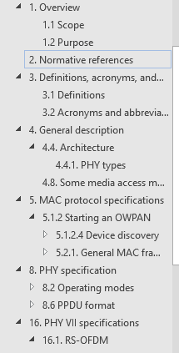
Issue #8: Decorate Draft D2 document
Section header 5 is missing
Section header 5.1 is missing

Slide 11
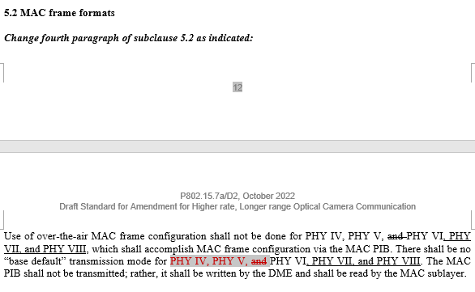
Issue #9: Decorate Draft D2 document
Underlining is incorrect in the amendment. The “for PHY IV, PHY V” and “PHY VI”, are already in the draft so those should not be underlined, on the other hand the “, and” is moved forward, so it should be strike-outed and then added later with underlining.

Slide 12
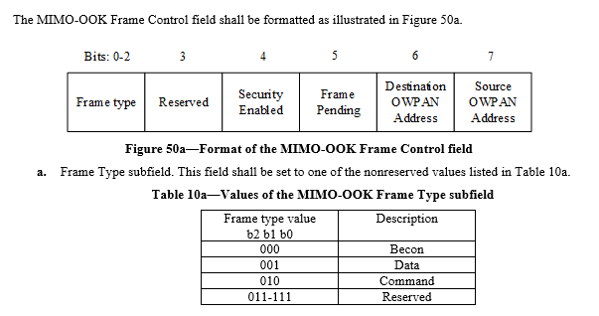
Issue #10: Decorate Draft D2 document
Figures and Tables has their heading too close to the actual figure or table. There should be bit space between them.
➔ We updated with a bit space between tables, figure and heading

Slide 13
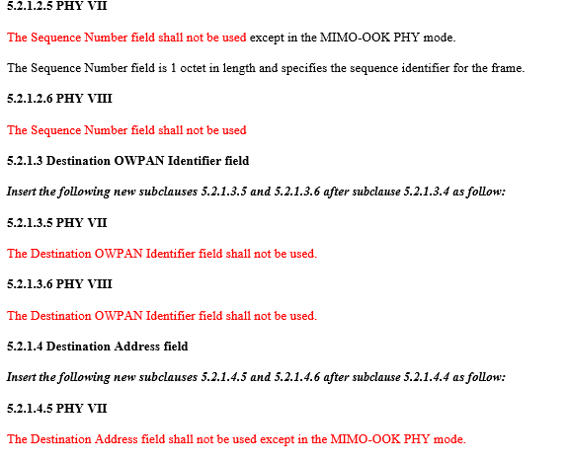
Issue #11: Decorate Draft D2 document
The base standard uses “a)”, “b)” etc instead of “a.”, “b.”
➔ We follow format in IEEE 802.15.7-2018
The base standard uses boldface for the field names for these lists. Change “Frame Type subfield”, “Security Enable subfield”, “Frame Pending subfield”, “Destination OWPAN Address subfield”, and “Source OWPAN Address subfield” to be in bold.
➔ We updated it.

