Slide 1
Project: IEEE P802.15 Working Group for Wireless Personal Area Networks (WPANs)
Submission Title: [Interference analysis of initial synchronization sequence]
Date Submitted: [Nov, 2022]
Source: [Chenchen Liu, Bin Qian, Lei Huang, David Xun Yang] Company [Huawei Technologies]
Address [Huawei Bantian Base, Longgang District, Shenzhen, 518129 China]
E-Mail:[liuchenchen1@Huawei.com]
Re: [Task Group 4ab: UWB Next Generation]
Abstract: [Analysis the interference of initial synchronization sequence]
Purpose: [ ]
Notice: This document has been prepared to assist the IEEE P802.15. It is offered as a basis for discussion and is not binding on the contributing individual(s) or organization(s). The material in this document is subject to change in form and content after further study. The contributor(s) reserve(s) the right to add, amend or withdraw material contained herein.
Release: The contributor acknowledges and accepts that this contribution becomes the property of IEEE and may be made publicly available by P802.15.

Slide 2
Related Submissions
15-22-0243-00-04ab-golay-complementary-sequences-preamble-construction-for-uwb-ranging-beyond-4z-ipatov (Xiliang)
15-22-0449-01-04ab-supercomplementary-zero-sum-cross-correlation-szc-code-blocks-generation(Igor Dotlic)
15-22-0507-00-04ab-simulation-evaluation-of-preamble-sequences-for-4ab(Chenchen Liu)

Slide 3
Background
Ipatov sequence of length 31, 91 and 127 have been used for initial synchronization in 4z standard because of their perfect periodic autocorrelation properties (31 with spreading factor 16 or 64; 91 with spreading factor 4; 127 with spreading factor 4)[4]
Some sequences of new length have been proposed for 4ab[2][3]
There are also proposal to reuse the legacy Ipatov sequence for 4ab, which may cause some interferences.
The drawbacks of reusing the legacy sequences and the advantages of Ipatov sequence with new length will be shown in this contribution

Slide 4
Drawbacks of reusing legacy sequence
If the legacy Ipatov sequences are used for initial synchronization, ranging or sensing scenario, there would be a strong interference between the 4ab device and legacy device, which can cause the following problems:
The false alarm problem
The error of CIR estimation results could be larger which leads to packet decoding error
The sensing results may contain multiple ghost targets
The ranging results may not be accurate

Slide 5
The False Alarm Problem
Reusing the legacy Ipatov sequences would cause false alarm problem for both legacy device and the 4ab device
For the legacy device, it can always detect the preamble but not able to correctly decode the packet
For the 4ab device, it can not distinguish the 4ab packet and the legacy packet based on the preamble field
The false alarm will also mislead the rate adaptation of 4ab

Slide 6
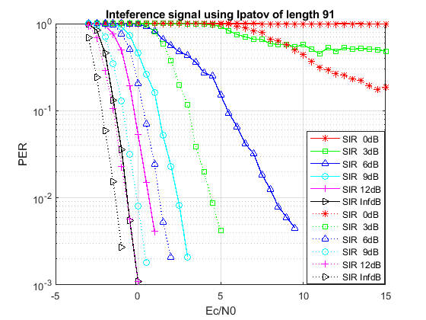
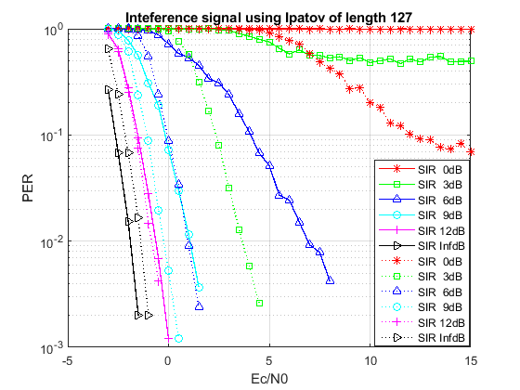
PER Simulations with Interferences of Legacy Ipatov Sequence
The legacy preamble sequence interference may become the bottleneck of system performance, especially for higher date rate
For date rate 124.8M, the PER results with 4z interference (at 31.2M) in AWGN(solid legacy, dotted:121 new seq[A])

Slide 7
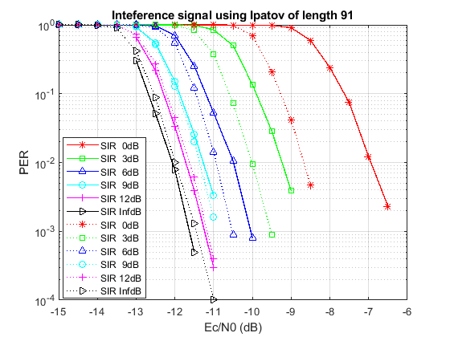
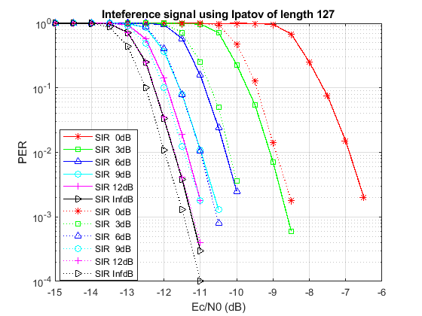
PER Simulations with Interferences of Legacy Ipatov Sequence
Even for 1.95M rate, the PER will also degrade if the interference caused by legacy preamble sequence exists

Slide 8
Correlation Simulation
The sensing and ranging performances heavily depend on the correlation of the sequence
So the correlation property of the legacy sequences with CFO as large as 40ppm are shown.
The center frequency is assumed to be 8GHz. The spreading fact is 4 for all sequences.

Slide 9
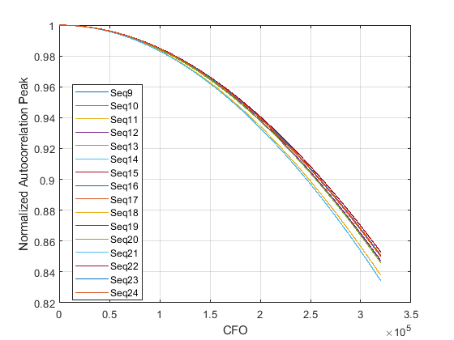
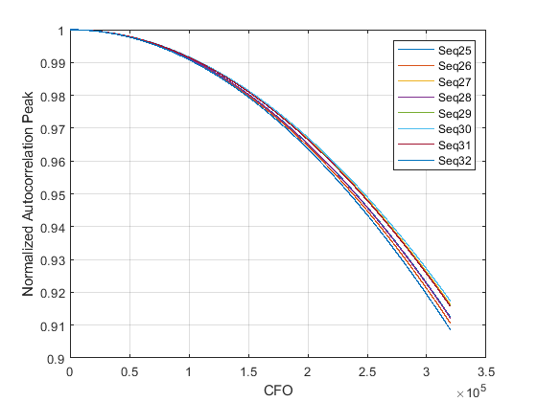
Normalized Auto Correlation of Legacy Sequence
Normalized Auto Correlation Peak=$\frac{{AC}_{x}(0,f)}{{AC}_{x}(0,0)}$, where
$${AC}_{x}(τ,f)=\sum_{n=0}^{N−1}{x\left(n\right){x(n+τ)}_{N}e^{−j2πf∆tn}}$$

Slide 10
Cross Correlation of Ipatov sequences
The cross correlation peak is calculated as follows：
$$CRP\left(x,y\right)=\frac{\max_{τ}{\sum_{n=0}^{N_{y}−1}{{x\left(n+τ\right)}_{N_{x}}y(n) }}}{\sum_{n=0}^{N_{y}−1}{y(n)y(n)}}$$
The cross correlation peak of length 91 Ipatov sequence
𝑪𝑹𝑷(𝒙,𝒚) (dB) | Seq25 | Seq26 | Seq27 | Seq28 | Seq29 | Seq30 | Seq31 | Seq32
Seq25 | 0 | -14.6 | -10.2 | -10.6 | -10.6 | -13.6 | -9.5 | -13.1
Seq26 | -14.6 | 0 | -10.6 | -13.6 | -10.2 | -10.6 | -10.6 | -10.9
Seq27 | -10.2 | -10.6 | 0 | -14.6 | -13.6 | -10.6 | -10.2 | -10.6
Seq28 | -10.6 | -13.6 | -14.6 | 0 | -10.6 | -10.2 | -12.1 | -9.5
Seq29 | -10.6 | -10.2 | -13.6 | -10.6 | 0 | -14.6 | -13.1 | -12.1
Seq30 | -13.6 | -10.6 | -10.6 | -10.2 | -14.6 | 0 | -10.9 | -10.2
Seq31 | -9.5 | -10.6 | -10.2 | -12.1 | -13.1 | -10.9 | 0 | -10.6
Seq32 | -13.1 | -10.9 | -10.6 | -9.5 | -12.1 | -10.2 | -10.6 | 0

Slide 11
Cross Correlation of Ipatov sequences
The cross correlation peak of length 127 Ipatov sequence
𝑪𝑹𝑷(𝒙,𝒚) (dB) | Seq9 | Seq10 | Seq11 | Seq12 | Seq13 | Seq14 | Seq15 | Seq16 | Seq17 | Seq18 | Seq19 | Seq20 | Seq21 | Seq22 | Seq23 | Seq24
Seq9 | 0 | -18.1 | -18.1 | -18.1 | -14.5 | -14.5 | -14.5 | -12 | -7.5 | -10.1 | -14.5 | -10.1 | -14.5 | -14.5 | -10.1 | -18.1
Seq10 | -18.1 | 0 | -18.1 | -18.1 | -14.5 | -14.5 | -14.5 | -14.5 | -10.1 | -13.2 | -10.1 | -9.3 | -10.1 | -12 | -14.5 | -10.1
Seq11 | -18.1 | -18.1 | 0 | -18.1 | -14.5 | -14.5 | -18.1 | -14.5 | -14.5 | -10.1 | -13.2 | -16.1 | -10.1 | -18.1 | -14.5 | -10.1
Seq12 | -18.1 | -18.1 | -18.1 | 0 | -14.5 | -14.5 | -14.5 | -14.5 | -10.1 | -9.3 | -16.1 | -16.1 | -18.1 | -10.1 | -9.3 | -12
Seq13 | -14.5 | -14.5 | -14.5 | -14.5 | 0 | -14.5 | -18.1 | -18.1 | -14.5 | -10.1 | -10.1 | -18.1 | -13.2 | -14.5 | -9.3 | -10.1
Seq14 | -14.5 | -14.5 | -14.5 | -14.5 | -14.5 | 0 | -14.5 | -18.1 | -14.5 | -12 | -18.1 | -10.1 | -14.5 | -16.1 | -14.5 | -16.1
Seq15 | -14.5 | -14.5 | -18.1 | -14.5 | -18.1 | -14.5 | 0 | -13.2 | -10.1 | -14.5 | -14.5 | -9.3 | -9.3 | -14.5 | -7.5 | -18.1
Seq16 | -12 | -14.5 | -14.5 | -14.5 | -18.1 | -18.1 | -13.2 | 0 | -18.1 | -10.1 | -10.1 | -12 | -10.1 | -16.1 | -18.1 | -13.2
Seq17 | -7.5 | -10.1 | -14.5 | -10.1 | -14.5 | -14.5 | -10.1 | -18.1 | 0 | -18.1 | -18.1 | -18.1 | -14.5 | -14.5 | -14.5 | -12
Seq18 | -10.1 | -13.2 | -10.1 | -9.3 | -10.1 | -12 | -14.5 | -10.1 | -18.1 | 0 | -18.1 | -18.1 | -14.5 | -14.5 | -14.5 | -14.5
Seq19 | -14.5 | -10.1 | -13.2 | -16.1 | -10.1 | -18.1 | -14.5 | -10.1 | -18.1 | -18.1 | 0 | -18.1 | -14.5 | -14.5 | -18.1 | -14.5
Seq20 | -10.1 | -9.3 | -16.1 | -16.1 | -18.1 | -10.1 | -9.3 | -12 | -18.1 | -18.1 | -18.1 | 0 | -14.5 | -14.5 | -14.5 | -14.5
Seq21 | -14.5 | -10.1 | -10.1 | -18.1 | -13.2 | -14.5 | -9.3 | -10.1 | -14.5 | -14.5 | -14.5 | -14.5 | 0 | -14.5 | -18.1 | -18.1
Seq22 | -14.5 | -12 | -18.1 | -10.1 | -14.5 | -16.1 | -14.5 | -16.1 | -14.5 | -14.5 | -14.5 | -14.5 | -14.5 | 0 | -14.5 | -18.1
Seq23 | -10.1 | -14.5 | -14.5 | -9.3 | -9.3 | -14.5 | -7.5 | -18.1 | -14.5 | -14.5 | -18.1 | -14.5 | -18.1 | -14.5 | 0 | -13.2
Seq24 | -18.1 | -10.1 | -10.1 | -12 | -10.1 | -16.1 | -18.1 | -13.2 | -12 | -14.5 | -14.5 | -14.5 | -18.1 | -18.1 | -13.2 | 0

Slide 12
Cross Correlation of length 121 Ipatov sequences in appendix
(dB) | s1 | s2 | s3 | s4 | s5 | s6 | s7 | s8 | s9 | s10 | s11 | s12 | s13 | s14 | s15 | s16 | s17 | s18 | s19 | s20 | s21 | s22
s1 | 0 | -19.1 | -14.6 | -19.1 | -13.1 | -13.1 | -14.6 | -19.1 | -11.7 | -11.7 | -13.1 | -13.1 | -11.7 | -13.1 | -13.1 | -19.1 | -19.1 | -11.7 | -19.1 | -11.7 | -14.6 | -11.7
s2 | -19.1 | 0 | -19.1 | -14.6 | -13.1 | -13.1 | -11.7 | -11.7 | -19.1 | -19.1 | -11.7 | -13.1 | -14.6 | -19.1 | -13.1 | -11.7 | -11.7 | -13.1 | -13.1 | -19.1 | -11.7 | -14.6
s3 | -14.6 | -19.1 | 0 | -19.1 | -13.1 | -13.1 | -19.1 | -14.6 | -11.7 | -11.7 | -13.1 | -13.1 | -13.1 | -11.7 | -11.7 | -19.1 | -19.1 | -13.1 | -14.6 | -11.7 | -19.1 | -11.7
s4 | -19.1 | -14.6 | -19.1 | 0 | -13.1 | -13.1 | -11.7 | -11.7 | -19.1 | -19.1 | -13.1 | -11.7 | -19.1 | -14.6 | -13.1 | -11.7 | -11.7 | -13.1 | -11.7 | -14.6 | -13.1 | -19.1
s5 | -13.1 | -13.1 | -13.1 | -13.1 | 0 | -14.6 | -19.1 | -14.6 | -13.1 | -11.7 | -19.1 | -19.1 | -11.7 | -11.7 | -19.1 | -11.7 | -13.1 | -19.1 | -11.7 | -19.1 | -11.7 | -14.6
s6 | -13.1 | -13.1 | -13.1 | -13.1 | -14.6 | 0 | -14.6 | -19.1 | -11.7 | -13.1 | -19.1 | -19.1 | -11.7 | -11.7 | -19.1 | -13.1 | -11.7 | -19.1 | -11.7 | -14.6 | -11.7 | -19.1
s7 | -14.6 | -11.7 | -19.1 | -11.7 | -19.1 | -14.6 | 0 | -14.6 | -19.1 | -19.1 | -11.7 | -11.7 | -19.1 | -19.1 | -11.7 | -11.7 | -13.1 | -13.1 | -13.1 | -13.1 | -13.1 | -13.1
s8 | -19.1 | -11.7 | -14.6 | -11.7 | -14.6 | -19.1 | -14.6 | 0 | -19.1 | -19.1 | -11.7 | -11.7 | -19.1 | -19.1 | -13.1 | -13.1 | -11.7 | -11.7 | -13.1 | -13.1 | -13.1 | -13.1
s9 | -11.7 | -19.1 | -11.7 | -19.1 | -13.1 | -11.7 | -19.1 | -19.1 | 0 | -14.6 | -14.6 | -19.1 | -11.7 | -11.7 | -13.1 | -14.6 | -19.1 | -13.1 | -13.1 | -13.1 | -13.1 | -11.7
s10 | -11.7 | -19.1 | -11.7 | -19.1 | -11.7 | -13.1 | -19.1 | -19.1 | -14.6 | 0 | -19.1 | -14.6 | -11.7 | -11.7 | -13.1 | -19.1 | -14.6 | -13.1 | -13.1 | -11.7 | -13.1 | -13.1
s11 | -13.1 | -11.7 | -13.1 | -13.1 | -19.1 | -19.1 | -11.7 | -11.7 | -14.6 | -19.1 | 0 | -14.6 | -19.1 | -19.1 | -11.7 | -13.1 | -13.1 | -11.7 | -14.6 | -11.7 | -19.1 | -13.1
s12 | -13.1 | -13.1 | -13.1 | -11.7 | -19.1 | -19.1 | -11.7 | -11.7 | -19.1 | -14.6 | -14.6 | 0 | -19.1 | -19.1 | -11.7 | -13.1 | -13.1 | -11.7 | -19.1 | -13.1 | -14.6 | -11.7
s13 | -11.7 | -14.6 | -13.1 | -19.1 | -11.7 | -11.7 | -19.1 | -19.1 | -11.7 | -11.7 | -19.1 | -19.1 | 0 | -14.6 | -14.6 | -13.1 | -13.1 | -19.1 | -11.7 | -13.1 | -13.1 | -13.1
s14 | -13.1 | -19.1 | -11.7 | -14.6 | -11.7 | -11.7 | -19.1 | -19.1 | -11.7 | -11.7 | -19.1 | -19.1 | -14.6 | 0 | -19.1 | -13.1 | -13.1 | -14.6 | -13.1 | -13.1 | -11.7 | -13.1
s15 | -13.1 | -13.1 | -11.7 | -13.1 | -19.1 | -19.1 | -11.7 | -13.1 | -13.1 | -13.1 | -11.7 | -11.7 | -14.6 | -19.1 | 0 | -19.1 | -14.6 | -14.6 | -19.1 | -11.7 | -19.1 | -11.7
s16 | -19.1 | -11.7 | -19.1 | -11.7 | -11.7 | -13.1 | -11.7 | -13.1 | -14.6 | -19.1 | -13.1 | -13.1 | -13.1 | -13.1 | -19.1 | 0 | -14.6 | -14.6 | -11.7 | -19.1 | -11.7 | -19.1
s17 | -19.1 | -11.7 | -19.1 | -11.7 | -13.1 | -11.7 | -13.1 | -11.7 | -19.1 | -14.6 | -13.1 | -13.1 | -13.1 | -13.1 | -14.6 | -14.6 | 0 | -19.1 | -11.7 | -19.1 | -11.7 | -19.1
s18 | -11.7 | -13.1 | -13.1 | -13.1 | -19.1 | -19.1 | -13.1 | -11.7 | -13.1 | -13.1 | -11.7 | -11.7 | -19.1 | -14.6 | -14.6 | -14.6 | -19.1 | 0 | -19.1 | -11.7 | -19.1 | -11.7
s19 | -19.1 | -13.1 | -14.6 | -11.7 | -11.7 | -11.7 | -13.1 | -13.1 | -13.1 | -13.1 | -14.6 | -19.1 | -11.7 | -13.1 | -19.1 | -11.7 | -11.7 | -19.1 | 0 | -19.1 | -14.6 | -19.1
s20 | -11.7 | -19.1 | -11.7 | -14.6 | -19.1 | -14.6 | -13.1 | -13.1 | -13.1 | -11.7 | -11.7 | -13.1 | -13.1 | -13.1 | -11.7 | -19.1 | -19.1 | -11.7 | -19.1 | 0 | -19.1 | -14.6
s21 | -14.6 | -11.7 | -19.1 | -13.1 | -11.7 | -11.7 | -13.1 | -13.1 | -13.1 | -13.1 | -19.1 | -14.6 | -13.1 | -11.7 | -19.1 | -11.7 | -11.7 | -19.1 | -14.6 | -19.1 | 0 | -19.1
s22 | -11.7 | -14.6 | -11.7 | -19.1 | -14.6 | -19.1 | -13.1 | -13.1 | -11.7 | -13.1 | -13.1 | -11.7 | -13.1 | -13.1 | -11.7 | -19.1 | -19.1 | -11.7 | -19.1 | -14.6 | -19.1 | 0

Slide 13
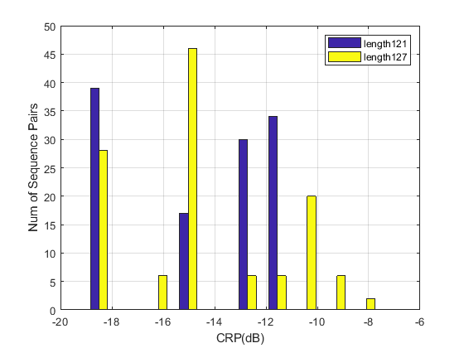
Cross Correlation of Ipatov sequences
The histogram of cross correlation peak of different length Ipatov sequence

Slide 14
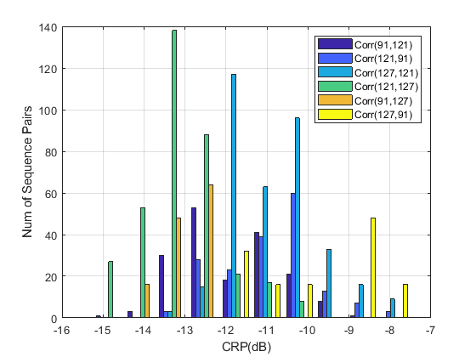
Cross Correlation of Ipatov sequences
The histogram of cross correlation peak among different length Ipatov sequence set

Slide 15
More reasons to adopt new length Ipatov
With increasing number of UWB devices, we need more preamble sequence, but the number of 91 Ipatov sequence is only 8, which may not be enough.
There are too many zeros in the 127 Ipatov sequence, and their correlation property are not good enough.

Slide 16
Conclusions
Ipatov sequences have been used in the 4a and 4z standard because of their perfect autocorrelation property. There are also preferred for the 4ab standard.
Reusing legacy Ipatov sequences would cause big interference problem for data transmission, ranging and sensing as shown in the simulation.
New length Ipatov sequences can greatly reduce the preamble interference problem, especially when accumulated across multiple symbols.
Ipatov sequences of length 121 can be a good candidate since they have perfect autocorrelation, different length, and a large cardinality of sequence set with low cross correlation

Slide 17
References
[1] 15-22-0243-00-04ab-golay-complementary-sequences-preamble-construction-for-uwb-ranging-beyond-4z-ipatov (Xiliang)
[2] 15-22-0449-01-04ab-supercomplementary-zero-sum-cross-correlation-szc-code-blocks-generation(Igor Dotlic)
[3] 15-22-0507-00-04ab-simulation-evaluation-of-preamble-sequences-for-4ab(Chenchen Liu)
[4] P802.15.4z, Draft Standard for Low-Rate Wireless Networks

Slide 18
Appendix Ipatov sequences of length 121
Sequence | Code sequence
s1 | 1 0 0 0 -1 1 0 0 -1 0 1 0 -1 -1 1 1 -1 1 0 -1 0 0 1 -1 -1 0 1 0 1 -1 1 1 1 0 0 -1 -1 1 0 -1 1 0 1 -1 0 1 1 0 -1 1 -1 1 -1 0 0 0 0 -1 0 0 0 -1 -1 0 0 -1 1 -1 0 -1 0 0 -1 -1 -1 0 -1 1 1 -1 -1 0 -1 0 1 -1 -1 -1 1 0 1 1 0 1 1 -1 1 1 -1 0 0 -1 0 -1 0 -1 -1 -1 -1 -1 1 1 1 1 0 -1 -1 -1 1 -1 1
s2 | 1 -1 1 -1 -1 -1 0 1 1 1 1 -1 -1 -1 -1 -1 0 -1 0 -1 0 0 -1 1 1 -1 1 1 0 1 1 0 1 -1 -1 -1 1 0 -1 0 -1 -1 1 1 -1 0 -1 -1 -1 0 0 -1 0 -1 1 -1 0 0 -1 -1 0 0 0 -1 0 0 0 0 -1 1 -1 1 -1 0 1 1 0 -1 1 0 1 -1 0 1 -1 -1 0 0 1 1 1 -1 1 0 1 0 -1 -1 1 0 0 -1 0 1 -1 1 1 -1 -1 0 1 0 -1 0 0 1 -1 0 0 0 1
s3 | 1 -1 1 -1 -1 -1 0 1 1 1 1 -1 -1 -1 -1 -1 0 -1 0 -1 0 0 -1 1 1 -1 1 1 0 1 1 0 1 -1 -1 -1 1 0 -1 0 -1 -1 1 1 -1 0 -1 -1 -1 0 0 -1 0 -1 1 -1 0 0 -1 -1 0 0 0 -1 0 0 0 0 -1 1 -1 1 -1 0 1 1 0 -1 1 0 1 -1 0 1 -1 -1 0 0 1 1 1 -1 1 0 1 0 -1 -1 1 0 0 -1 0 1 -1 1 1 -1 -1 0 1 0 -1 0 0 1 -1 0 0 0 1
s4 | -1 -1 -1 1 1 -1 -1 -1 -1 -1 0 1 -1 1 1 0 -1 -1 0 0 -1 1 0 -1 0 -1 -1 -1 0 -1 0 -1 0 0 1 1 0 1 -1 0 -1 1 -1 0 1 -1 0 0 -1 0 -1 1 1 -1 0 0 0 1 0 0 1 1 -1 0 1 1 -1 -1 0 0 0 -1 1 1 0 1 1 -1 1 -1 -1 1 -1 -1 -1 0 0 1 0 -1 0 0 0 0 -1 -1 -1 1 0 1 1 0 -1 0 1 1 1 1 -1 1 0 0 -1 1 -1 1 -1 0 -1 0 1
s5 | 1 -1 0 -1 -1 -1 0 -1 1 -1 -1 1 -1 1 -1 -1 -1 0 0 -1 1 -1 0 -1 1 1 1 -1 -1 -1 -1 -1 0 1 0 0 -1 -1 -1 1 0 0 -1 1 1 -1 0 1 -1 1 -1 0 0 -1 0 1 1 -1 -1 1 1 0 0 -1 0 0 0 0 -1 -1 1 0 1 0 0 1 1 0 1 1 0 -1 -1 -1 -1 1 -1 -1 0 1 -1 -1 0 -1 0 1 0 1 0 1 -1 0 0 0 1 0 1 1 -1 1 0 -1 0 1 -1 0 1 1 0 0 0

Slide 19
Appendix Ipatov sequences of length 121
Sequence | Code sequence
s6 | 0 0 0 1 1 0 -1 1 0 -1 0 1 -1 1 1 0 1 0 0 0 -1 1 0 1 0 1 0 -1 0 -1 -1 1 0 -1 -1 1 -1 -1 -1 -1 0 1 1 0 1 1 0 0 1 0 1 -1 -1 0 0 0 0 -1 0 0 1 1 -1 -1 1 1 0 -1 0 0 -1 1 -1 1 0 -1 1 1 -1 0 0 1 -1 -1 -1 0 0 1 0 -1 -1 -1 -1 -1 1 1 1 -1 0 -1 1 -1 0 0 -1 -1 -1 1 -1 1 -1 -1 1 -1 0 -1 -1 -1 0 -1 1
s7 | 1 -1 -1 -1 1 1 -1 0 0 -1 -1 1 1 0 1 1 0 1 -1 1 -1 0 0 0 0 -1 -1 -1 -1 1 -1 0 1 1 1 0 1 0 -1 0 1 -1 1 0 1 1 1 -1 0 -1 1 1 0 -1 -1 1 -1 1 -1 -1 -1 -1 -1 0 1 -1 0 -1 0 0 -1 1 0 0 -1 -1 0 0 -1 0 -1 -1 1 0 -1 0 0 1 0 -1 -1 0 1 0 1 0 1 -1 0 1 -1 -1 1 -1 -1 0 0 0 1 0 0 0 1 -1 -1 -1 0 0 1 -1 1
s8 | 1 -1 1 0 0 -1 -1 -1 1 0 0 0 1 0 0 0 -1 -1 1 -1 -1 1 0 -1 1 0 1 0 1 0 -1 -1 0 1 0 0 -1 0 1 -1 -1 0 -1 0 0 -1 -1 0 0 1 -1 0 0 -1 0 -1 1 0 -1 -1 -1 -1 -1 1 -1 1 -1 -1 0 1 1 -1 0 -1 1 1 1 0 1 -1 1 0 -1 0 1 0 1 1 1 0 -1 1 -1 -1 -1 -1 0 0 0 0 -1 1 -1 1 0 1 1 0 1 1 -1 -1 0 0 -1 1 1 -1 -1 -1 1'
s9 | 1 -1 -1 -1 -1 0 -1 1 1 -1 1 0 -1 -1 0 0 0 0 -1 -1 -1 1 1 0 1 0 0 -1 1 -1 1 0 0 0 1 -1 -1 0 1 -1 -1 -1 0 1 0 0 0 -1 0 0 -1 0 -1 1 -1 0 -1 -1 1 -1 -1 0 0 1 1 0 1 1 1 0 0 1 1 -1 0 0 -1 1 0 -1 1 -1 -1 1 1 -1 0 -1 1 0 1 0 1 0 -1 1 0 0 -1 0 1 0 1 1 0 -1 -1 -1 -1 -1 1 0 -1 0 1 1 -1 -1 -1 1 -1
s10 | -1 1 -1 -1 -1 1 1 0 -1 0 1 -1 -1 -1 -1 -1 0 1 1 0 1 0 -1 0 0 1 -1 0 1 0 1 0 1 -1 0 -1 1 1 -1 -1 1 -1 0 1 -1 0 0 -1 1 1 0 0 1 1 1 0 1 1 0 0 -1 -1 1 -1 -1 0 -1 1 -1 0 -1 0 0 -1 0 0 0 1 0 -1 -1 -1 1 0 -1 -1 1 0 0 0 1 -1 1 -1 0 0 1 0 1 1 -1 -1 -1 0 0 0 0 -1 -1 0 1 -1 1 1 -1 0 -1 -1 -1 -1 1

Slide 20
Appendix Ipatov sequences of length 121
Sequence | Code sequence
s11 | 1 1 0 1 0 -1 0 -1 1 1 1 1 0 0 -1 -1 1 0 0 0 -1 -1 0 1 1 -1 -1 1 1 0 1 -1 0 1 1 1 0 -1 0 0 0 0 -1 1 1 -1 0 -1 1 -1 0 0 1 0 0 1 -1 0 0 -1 -1 -1 -1 -1 1 -1 0 -1 -1 1 -1 1 1 1 -1 -1 -1 0 -1 -1 -1 1 0 -1 1 0 1 0 0 -1 1 -1 1 -1 0 1 0 -1 1 1 0 -1 1 -1 -1 1 -1 -1 0 0 0 -1 0 -1 0 -1 -1 0 0 -1 0
s12 | 0 -1 0 0 -1 -1 0 -1 0 -1 0 0 0 -1 -1 1 -1 -1 1 -1 0 1 1 -1 0 1 0 -1 1 -1 1 -1 0 0 1 0 1 -1 0 1 -1 -1 -1 0 -1 -1 -1 1 1 1 -1 1 -1 -1 0 -1 1 -1 -1 -1 -1 -1 0 0 -1 1 0 0 1 0 0 -1 1 -1 0 -1 1 1 -1 0 0 0 0 -1 0 1 1 1 0 -1 1 0 1 1 -1 -1 1 1 0 -1 -1 0 0 0 1 -1 -1 0 0 1 1 1 1 -1 0 -1 0 1 0 1 1
s13 | 1 -1 1 -1 0 -1 1 1 0 -1 -1 0 0 -1 -1 -1 1 1 1 -1 1 1 1 1 0 1 0 -1 -1 -1 -1 -1 1 0 0 -1 0 -1 0 -1 -1 1 -1 0 0 -1 1 1 1 0 -1 1 -1 0 1 0 1 -1 0 1 1 -1 -1 1 0 -1 1 0 1 1 1 0 0 -1 -1 1 0 1 0 0 0 -1 0 1 -1 -1 1 -1 1 1 -1 -1 0 -1 -1 0 1 0 -1 0 0 -1 0 0 1 -1 0 0 0 -1 1 -1 -1 0 0 0 0 -1 -1 0 -1
s14 | -1 0 -1 -1 0 0 0 0 -1 -1 1 -1 0 0 0 -1 1 0 0 -1 0 0 -1 0 1 0 -1 -1 0 -1 -1 1 1 -1 1 -1 -1 1 0 -1 0 0 0 1 0 1 -1 -1 0 0 1 1 1 0 1 -1 0 1 -1 -1 1 1 0 -1 1 0 1 0 -1 1 -1 0 1 1 1 -1 0 0 -1 1 -1 -1 0 -1 0 -1 0 0 1 -1 -1 -1 -1 -1 0 1 0 1 1 1 1 -1 1 1 1 -1 -1 -1 0 0 -1 -1 0 1 1 -1 0 -1 1 -1 1
s15 | 1 0 1 0 1 -1 1 1 0 0 0 1 1 1 -1 -1 1 -1 1 -1 -1 1 0 1 0 0 -1 0 0 -1 0 1 -1 1 -1 0 1 1 -1 1 0 1 -1 0 1 -1 -1 -1 1 -1 -1 -1 0 -1 1 1 -1 -1 -1 -1 -1 0 0 1 -1 0 0 -1 1 1 0 -1 0 0 0 0 -1 0 -1 -1 -1 0 1 1 0 1 1 -1 0 0 0 1 -1 1 0 0 -1 -1 0 1 -1 0 -1 -1 0 0 -1 -1 1 1 0 1 0 -1 -1 -1 -1 1 0 -1 0

Slide 21
Appendix Ipatov sequences of length 121
Sequence | Code sequence
s16 | -1 0 -1 0 0 0 0 -1 -1 1 1 0 -1 0 0 -1 -1 0 0 1 0 0 -1 -1 -1 -1 -1 1 0 1 -1 -1 1 1 1 0 -1 -1 -1 0 0 0 -1 1 0 -1 1 -1 -1 0 -1 1 -1 0 1 1 0 -1 1 1 1 1 0 1 1 0 1 0 -1 -1 1 -1 1 1 -1 0 0 -1 0 1 -1 0 0 1 -1 -1 0 0 -1 1 -1 1 -1 0 -1 -1 -1 1 1 -1 1 1 1 -1 1 0 0 0 -1 0 -1 0 -1 -1 1 0 -1 0 1 0 1
s17 | 1 0 1 0 -1 0 1 -1 -1 0 -1 0 -1 0 0 0 1 -1 1 1 1 -1 1 1 -1 -1 -1 0 -1 1 -1 1 -1 0 0 -1 -1 1 0 0 -1 1 0 -1 0 0 -1 1 1 -1 1 -1 -1 0 1 0 1 1 0 1 1 1 1 -1 0 1 1 0 -1 1 -1 0 -1 -1 1 -1 0 1 -1 0 0 0 -1 -1 -1 0 1 1 1 -1 -1 1 0 1 -1 -1 -1 -1 -1 0 0 1 0 0 -1 -1 0 0 -1 0 1 1 -1 -1 0 0 0 0 -1 0 -1
s18 | 0 -1 0 1 -1 -1 -1 -1 0 1 0 1 1 -1 -1 0 0 -1 -1 0 -1 1 0 -1 -1 0 0 1 -1 1 0 0 0 -1 1 1 0 1 1 0 -1 -1 -1 0 -1 0 0 0 0 -1 0 1 1 -1 0 0 -1 1 0 0 -1 -1 -1 -1 -1 1 1 -1 0 -1 -1 -1 1 -1 -1 -1 1 0 -1 1 0 1 -1 1 1 0 -1 1 -1 1 0 -1 0 0 -1 0 0 1 0 1 -1 -1 1 -1 1 -1 -1 1 1 1 0 0 0 1 1 -1 1 0 1 0 1
s19 | 1 1 1 1 0 0 1 -1 1 1 -1 0 0 -1 0 0 -1 -1 1 -1 0 -1 1 -1 1 -1 0 1 -1 -1 -1 0 -1 0 1 0 0 0 -1 -1 -1 1 0 1 0 0 -1 0 -1 0 -1 -1 0 -1 1 0 0 -1 -1 0 0 0 0 -1 1 0 1 1 -1 -1 -1 1 1 0 0 -1 1 1 0 1 1 1 0 -1 -1 -1 -1 -1 1 -1 -1 0 1 0 -1 1 -1 0 0 0 -1 0 1 1 -1 0 1 1 0 -1 1 0 -1 0 -1 1 1 -1 -1 1 -1
s20 | 1 1 0 1 1 -1 0 0 -1 1 0 1 1 0 -1 -1 -1 1 0 -1 -1 0 0 -1 -1 -1 0 1 0 -1 0 0 1 1 -1 -1 1 0 1 0 1 0 -1 -1 1 -1 1 -1 -1 0 -1 1 -1 1 0 1 -1 -1 1 -1 -1 1 1 0 -1 1 0 -1 0 -1 -1 -1 -1 -1 1 -1 0 0 0 0 -1 1 1 0 0 0 -1 -1 0 -1 0 0 -1 0 1 -1 1 0 -1 1 1 1 -1 -1 -1 -1 0 0 1 0 0 0 1 0 1 -1 0 0 1 -1 1

Slide 22
Appendix Ipatov sequences of length 121
Sequence | Code sequence
s21 | -1 1 -1 -1 1 1 -1 0 -1 0 1 -1 0 1 1 0 -1 1 1 0 -1 0 0 0 -1 1 -1 0 1 0 -1 -1 1 -1 -1 -1 -1 -1 0 1 1 1 0 1 1 -1 0 0 1 1 -1 -1 -1 1 1 0 1 -1 0 0 0 0 -1 -1 0 0 1 -1 0 -1 -1 0 -1 0 -1 0 0 1 0 1 -1 -1 -1 0 0 0 1 0 -1 0 -1 -1 -1 1 0 -1 1 -1 1 -1 0 -1 1 -1 -1 0 0 -1 0 0 -1 1 1 -1 1 0 0 1 1 1 1
s22 | 1 -1 1 0 0 -1 1 0 1 0 0 0 1 0 0 -1 -1 -1 -1 1 1 1 -1 0 1 -1 1 0 -1 0 0 -1 0 -1 -1 0 0 0 1 1 -1 0 0 0 0 -1 1 -1 -1 -1 -1 -1 0 -1 0 1 -1 0 1 1 -1 -1 1 -1 -1 1 0 1 -1 1 -1 0 -1 -1 1 -1 1 -1 -1 0 1 0 1 0 1 -1 -1 1 1 0 0 -1 0 1 0 -1 -1 -1 0 0 -1 -1 0 1 -1 -1 -1 0 1 1 0 1 -1 0 0 -1 1 1 0 1 1

