Slide 1
Project: P802.15 Working Group for Wireless Specialty Networks
Submission Title: Harmonization with 4ab: data rates & FEC
Date Submitted: November 15th, 2022
Source: Marco Hernandez^{1,3}, Ryuji Kohno^{1,2}, Takumi Kobayashi^{1,2}, Minsoo Kim¹
Company: ¹Yokosuka Research Park International Alliance Institute (YRP-IAI), Japan; ²Yokohama National University (YNU), Japan. ³CWC, Oulu Univ. Finland.
Address: 3-4 Hikarino-oka, Yokosuka, 239-0847, Japan.
E-Mail: Marco.Hernandez@ieee.org; kohno@ynu.ac.jp; Kobayashi-Takumi-ch@ynu.ac.jp; Minsoo@minsookim.com;
Abstract: UWB harmonization.
Purpose: In response to the call for technical contributions.
Notice: This document has been prepared to assist P802.15.6ma. It is offered as a basis for discussion and is not binding on the contributing individual(s) or organization(s). The material in this document is subject to change in form and content after further study. The contributor(s) reserve(s) the right to add, amend or withdraw material contained herein.
Release: The contributor acknowledges and accepts that this contribution becomes the property of IEEE and may be made publicly available by P802.15.6ma.

Slide 2
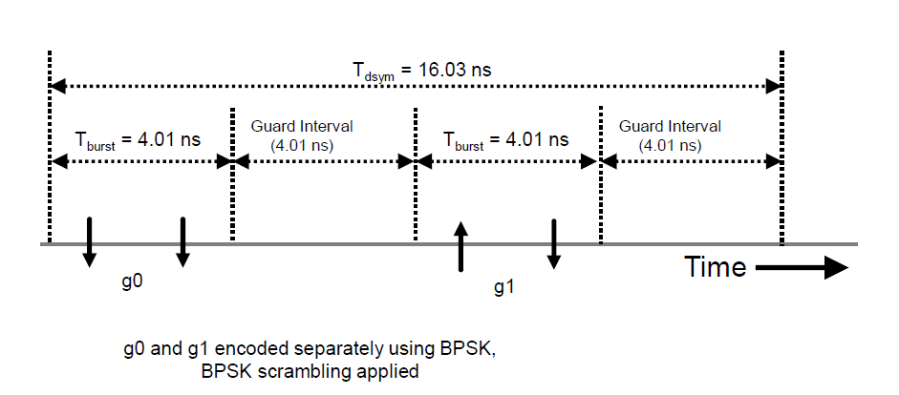
UWB modulation and data rates
For interoperability, 15.6ma will adopt the 15.4ab UWB modulation and high data rates [15-22-0517-00-4ab]:
Two bursts of pulses (BPSK) per symbol, with mean PRF=249.6 MHz @ 64.2 Mb/s

Slide 3
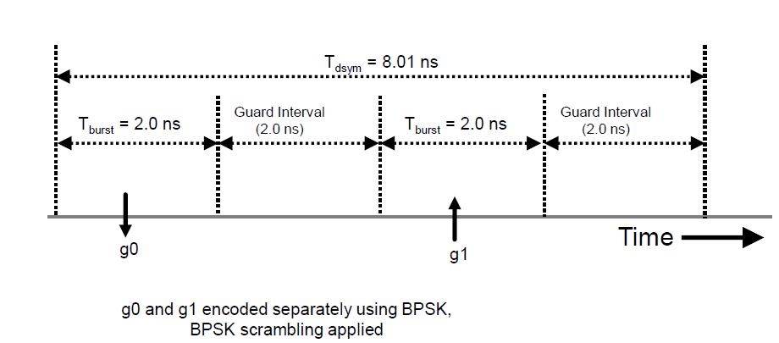
UWB modulation and data rates
Two bursts of pulses (BPSK) per symbol, with mean PRF=249.6 MHz @ 124.8 Mb/s
15.6ma max and min [PHY,MAC] frame sizes are TBD.
Complemented with other data rates, 6ma will address communication use cases and ranging use cases.

Slide 4
FEC
Due to 15.6ma requirements, 6ma will specify HARQ with different levels of QoS in terms of PER and latency.
6ma will have with 3 levels of operation:
Level 1: single BAN compatible with 15.4ab FEC.
Level 2: multiple BANs operating within TX range.
Level 3: multiple BANs coexisting with other wireless systems within TX range.
Level 1 will be compatible with 4ab mandatory BCC of rate ½ and K=7.
An optional LDPC code is contemplated.
Details such as coding rate, block length, etc. are TBD.

Slide 5
FEC
Level 2 and level 3 will specify a HARQ scheme to address higher dependability.
See doc.: [15-22-0561].

