Slide 1
Project: IEEE P802.15 Working Group for Wireless Personal Area Networks (WPANs)
Submission Title: Narrowband Channel Hopping for NB-Assisted UWB
Date Submitted: November 14, 2022
Source: Pooria Pakrooh, Bin Tian, Steve Shellhammer (Qualcomm)
Email: {ppakrooh, btian, sshellha}@qti.qualcomm.com
Abstract: Proposals on efficient NB channel hopping in NB-assisted UWB
Notice: This document has been prepared to assist the IEEE P802.15. It is offered as a basis for discussion and is not binding on the contributing individual(s) or organization(s). The material in this document is subject to change in form and content after further study. The contributor(s) reserve(s) the right to add, amend or withdraw material contained herein.
Release: The contributor acknowledges and accepts that this contribution becomes the property of IEEE and may be made publicly available by P802.15.

Slide 2
PAR Objective | Proposed Solution (how addressed)
Safeguards so that the high throughput data use cases will not cause significant disruption to low duty-cycle ranging use cases
Interference mitigation techniques to support higher density and higher traffic use cases
Other coexistence improvement
Backward compatibility with enhanced ranging capable devices (ERDEVs)
Improved link budget and/or reduced air-time
Additional channels and operating frequencies
Improvements to accuracy / precision / reliability and interoperability for high-integrity ranging
Reduced complexity and power consumption
Hybrid operation with narrowband signaling to assist UWB | Proposals on efficient NB channel hopping in NB-assisted UWB
Enhanced native discovery and connection setup mechanisms
Sensing capabilities to support presence detection and environment mapping
Low-power low-latency streaming
Higher data-rate streaming allowing at least 50 Mbit/s of throughput
Support for peer-to-peer, peer-to-multi-peer, and station-to-infrastructure protocols
Infrastructure synchronization mechanisms

Slide 3
Overview of NBA-UWB
NB-assisted UWB has been proposed in 15.4ab as a method to improve UWB link budget. It consists of three phases:
  Phase I: Initial synchronization
    Setting up and provide initial timing and frequency synchronization for phase II
    Open interface to support different technologies, e.g., BLE, UWB SHR, 15.4 O-QPSK PHY
  Phase II: UWB Measurement
    Multiple 1ms segments to allow combining for link budget gain
  Phase III: Measurement report
    Use the same technology as phase 1
NB proposal mainly targets O-QPSK (Zigbee PHY, clause 12 in 15.4) with potential improvements, in UNII-3 and UNII-5 bands
  250 channels introduced across UNII-3 and UNII-5 bands, with frequency hopping.
In this presentation, we share high level suggestions on NB channel hopping
  Priority channel lists in UNII-3 and UNII-5 bands to avoid interference with Wi-Fi
  Defining channel hopping distance for diversity and avoiding interference with Wi-Fi
Slide 3
Pakrooh et al. (Qualcomm)

Slide 4

NB Channel Hopping Proposals
Proposals for NB channel hopping sequence generation
  Channel switching sequence via AES-128 PRNG, with pre-shared key/nonce among RAN participants [1]
    AES based switching achieves white noise a-like frequency diversity over set of allowed channels
    AES output can be deterministically biased to optimize coexistence
  Use LFSR to generate pseudo random channel index, check with block list [2]
$\left\lceil \log_{2}{M}\right\rceil$ binary
Channel index in [0, M-1]
Convert to decimal number and mod M
No
Initial seed
LFSR
in block list?
Channel index
Yes

Slide 5
NB Hopping Rules and Cadence
We recommend to do NB channel hopping only when there is NB transmission failure or when NB channel is busy
  Efficient in spectrum usage, as it does not enforce unnecessary hopping
What if NB transmission from one direction succeeds and the other direction fails?
  If both NB message transmissions succeed (initiator → responder and initiator → responder ), no NB channel hopping is done.
  If the first NB message and/or the second NB message do not go through, then UWB fragments are not transmitted.
    If the failure happens in initialization phase (phase I), then NB channel hopping is done in the next round, and NB message is retransmitted from initiator to responder. This process is repeated until initiator receives an ACK NB message from the responder.
    If the failure happens in measurement report phase (phase III), then NB channel hopping is done in the next round and the measurement report is included in the initialization phase of the next round.

Slide 6
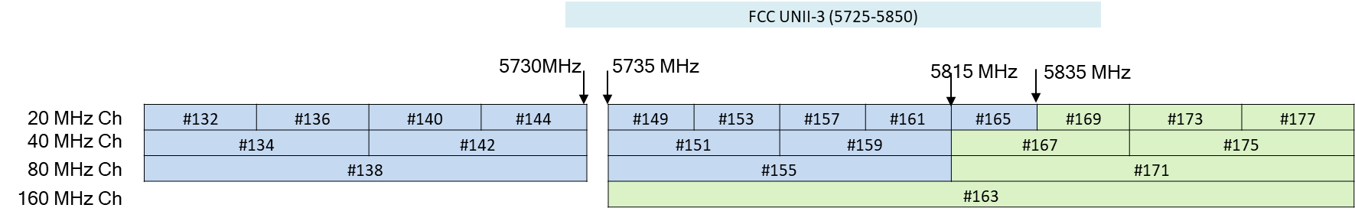
NB Hopping Channel List
To reduce interference, priority NB channel lists can be defined in UNII-3 and UNII-5 for NBA-UWB [3].
NB channel selection starts from priority channel list. Start by selecting a random channel from the priority list.
  Example of priority channel list for UNII-3 band:
    5730-5735MHz: 5MHz
    5725-5730MHz (part of Ch#144): 5MHz
  Example of priority channels for UNII-5 band can be defined based on regulatory rules.
    We are considering 5925-5945MHz. However, it is not still allowed in EU, and the regulatory rules in US are not clearly specified yet. Will be tracking the regulatory aspect.

Slide 7
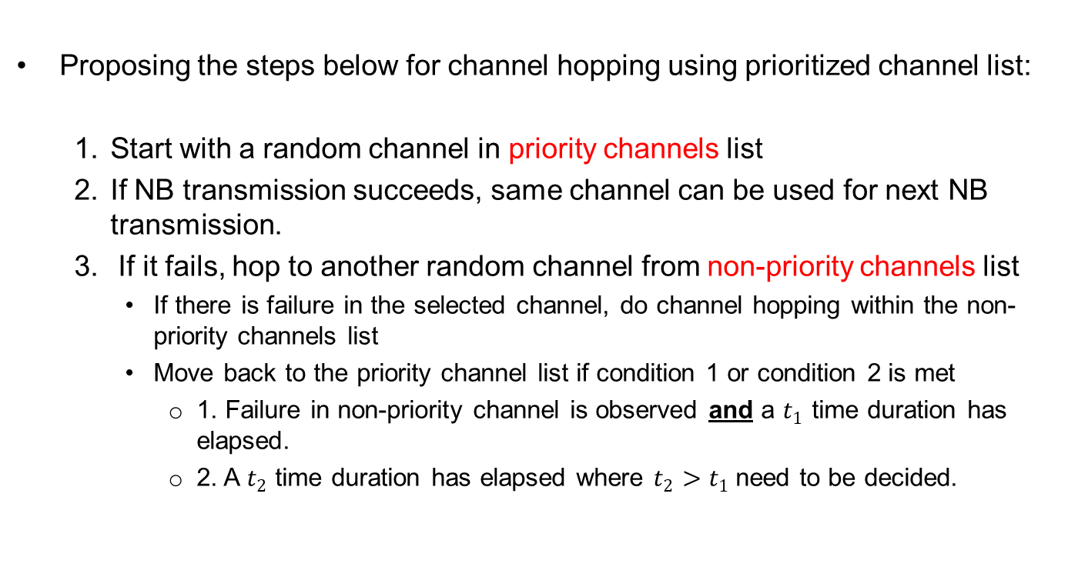
NB Hopping Rule
Proposing the steps below for channel hopping using prioritized channel list:
  Start with a random channel in priority channels list
  If NB transmission succeeds, same channel can be used for next NB transmission.
  If it fails, hop to another random channel from non-priority channels list
    If there is failure in the selected channel, do channel hopping within the non-priority channels list
    Move back to the priority channel list if condition 1 or condition 2 is met
      1. Failure in non-priority channel is observed and a $t_{1}$ time duration has elapsed.
      2. A $t_{2}$ time duration has elapsed where $t_{2}$ $>t_{1}$need to be decided.

Slide 8
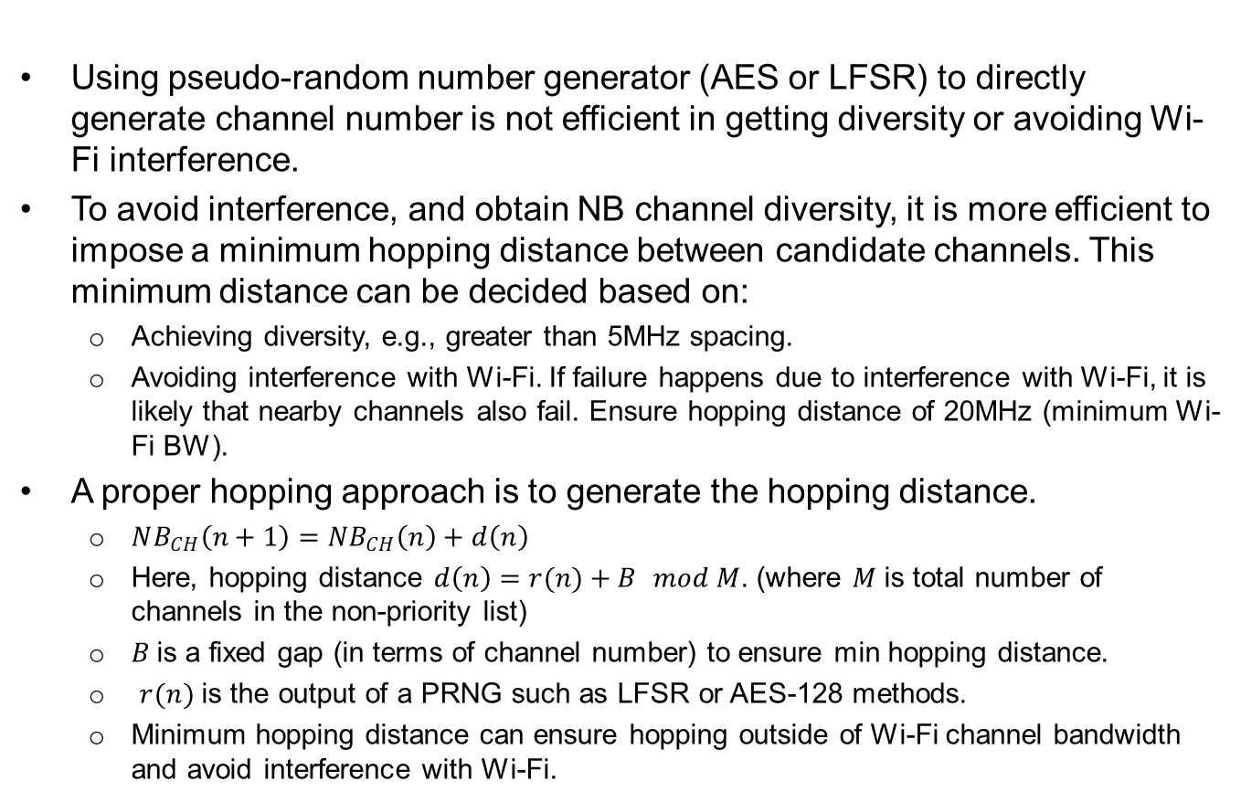
NB Hopping Distance
Using pseudo-random number generator (AES or LFSR) to directly generate channel number is not efficient in getting diversity or avoiding Wi-Fi interference.
To avoid interference, and obtain NB channel diversity, it is more efficient to impose a minimum hopping distance between candidate channels. This minimum distance can be decided based on:
  Achieving diversity, e.g., greater than 5MHz spacing.
  Avoiding interference with Wi-Fi. If failure happens due to interference with Wi-Fi, it is likely that nearby channels also fail. Ensure hopping distance of 20MHz (minimum Wi-Fi BW).
A proper hopping approach is to generate the hopping distance.
  $NB_{CH}\left(n+1\right)=NB_{CH}\left(n\right)+d\left(n\right)$
  Here, hopping distance $d\left(n\right)=r(n)+B$ $mod M$. (where $M$ is total number of channels in the non-priority list)
  $B$is a fixed gap (in terms of channel number) to ensure min hopping distance.
  $r(n)$ is the output of a PRNG such as LFSR or AES-128 methods.
  Minimum hopping distance can ensure hopping outside of Wi-Fi channel bandwidth and avoid interference with Wi-Fi.

Slide 9
References
  [1] Narrowband Channel Access and Interference Mitigation for NBA-MMS-UWB, IEEE doc. 15-22-0340-01-04ab
  [2] NB considerations for NBA-MMS UWB, IEEE doc. 15-22-0420-00-04ab
  [3] Discussion on NB-Assisted UWB, IEEE doc. 15-22-0156-00-04ab

