Slide 1
Project: IEEE P802.15 Working Group for Wireless Personal Area Networks (WPANs)
Submission Title: [Header IE Extension]
Date Submitted: [November 15, 2022]
Source: [Alexander Krebs, Moche Cohen, Santhosh Kumar Mani, Xiliang Luo, Yong Liu, Lochan Verma, Jinjing Jiang, SK Yong (Apple)]
Email: krebs@apple.com
Re: [Input to the Working Group]
Abstract: [Proposal of an efficient MAC control signal format suitable for a baseline feature set supported by low-rate O-QPSK narrowband PHYs.]
Purpose: []
Notice: This document has been prepared to assist the IEEE P802.15. It is offered as a basis for discussion and is not binding on the contributing individual(s) or organization(s). The material in this document is subject to change in form and content after further study. The contributor(s) reserve(s) the right to add, amend or withdraw material contained herein.
Release: The contributor acknowledges and accepts that this contribution becomes the property of IEEE and may be made publicly available by P802.15.

Slide 2
PAR Objective | Proposed Solution (how addressed)
Safeguards so that the high throughput data use cases will not cause significant disruption to low duty-cycle ranging use cases
Interference mitigation techniques to support higher density and higher traffic use cases
Other coexistence improvement
Backward compatibility with enhanced ranging capable devices (ERDEVs)
Improved link budget and/or reduced air-time
Additional channels and operating frequencies
Improvements to accuracy / precision / reliability and interoperability for high-integrity ranging
Reduced complexity and power consumption
Hybrid operation with narrowband signaling to assist UWB | Signaling, control, and information elements (IEs) for hybrid operation and multi-millisecond ranging mode
Enhanced native discovery and connection setup mechanisms
Sensing capabilities to support presence detection and environment mapping
Low-power low-latency streaming
Higher data-rate streaming allowing at least 50 Mbit/s of throughput
Support for peer-to-peer, peer-to-multi-peer, and station-to-infrastructure protocols
Infrastructure synchronization mechanisms

Slide 3
Agenda
Optimized Header IE format for broadcast signaling
Consideration of 500k/1M O-QPSK PHY for control signaling

Slide 4
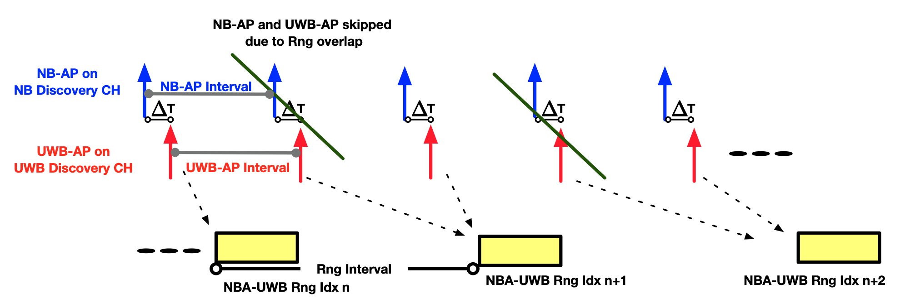
Header IE: Application Example
Discovery channel [4,6]
  NB-AP, UWB-AP
    Broadcast traffic, unencrypted
    Shared among use cases (ranging, sensing, data, …)

Slide 5
Header IE Optimization: Why?
IEs in 802.15.4z
  Payload nested IEs inflict overhead (32-38% frame duration, as discussed in [2])
  (Unencrypted) Header IEs are used less in 4z in comparison to Nested Payload IEs
    236 remaining Header IE Element IDs (vs. 57 remaining nested IE Sub-IDs)
Applications where Header IEs could be used
  Broadcast traffic
    => emphasis on cross-device interoperability
      Non-recurring, sporadic traffic achieve less energy saving by PSDU compression [2]
    => mostly unencrypted => no gain over MIC/CRC redundancy
  If needed, encryption can be added on a per field basis

Slide 6
Current Header IE Format
No MLME header (as needed for nested payload IEs)
IE Length field may be redundant for simple IEs

Slide 7
Proposed Header IE Range Change
No MLME header (as needed for nested payload IEs)
IE Length field may be redundant for simple Ies
Reduce range of legacy 15.4a-z header IEs to 0-127
  (only 20 out of 256 used as of 15.4z)

Slide 8
Header IE Optimization: Proposal
Maintain legacy signaling for Header IEs 0-127
Header IEs 128-255 => strip IE length field
Example: translation of compressed PSDU format to proposed Header IE

Slide 9
Header IE Optimization: Summary
Enables ”compressed PSDU design principles” within legacy 15.4 PSDU
  2-octed more than compressed PSDU [2]
  Works for simple IEs, that do not require explicit LEN field
  More interoperability, scalability, and modularity provided by 15.4 MHR
  Combines w Header IEs 0-127, and/or Nested Payload IEs in the same PSDU, if needed
  Encryption can added on a per field basis
At least 3 octets shorter than existing 4z nested payload IE format

Slide 10
Consideration of 500k/1M O-QPSK PHY for control signaling

Slide 11
O-QPSK uncoded 250k/500k/1M
250k O-QPSK uncoded
  6.8dB excess link budget over MMS UWB with 8 fragments [3]
  Needed to balance link budget of 32-fragment MMS-UWB [3,5]
Additional O-QPSK PHYs 500k (coded) and 1M (coded, uncoded) (CC, r=1/2, K=7) newly proposed in [1] for 802.15.4ab
  500k: 46% frame duration reduction for 10-bytes PSDU over 250k
  1M: 64% shorter 10-byte PSDU frames

Slide 12
Summary
Header IE Format Optimization Proposal
  Backward compatible with 802.15.4a-z header IE format
  Proposed format optimization reduces overhead by 3 bytes over 4z nested IE
  Most beneficial for cross-session/broadcast communication (e.g., discovery)
O-QPSK 500k/1M (coded)
  2x/4x PSDU capacity => extended baseline application support (security, AoA, …)
  We want to encourage the discussion in the group on whether or not 500k CC coded is a superior choice over 250k O-QPSK uncoded for NBA-MMS-UWB and should therefore play a more prominent role in 15.4ab

Slide 13
References
[1] X. Luo (Apple Inc), F. Leong (NXP), M. Lee (Samsung Electronics), et al., “NBA-UWB Technical Framework Proposal”, 15-22-0571-01-04ab.
[2] A. Krebs et al., “NBA-MMS-UWB Compressed PSDU”, 15-22-0604-00-04ab.
[3] E. Ekrem et al., “Link budget analysis for narrowband assisted multi-millisecond UWB”, 15-22-0074-00-04ab.
[4] L. Verma (Apple), M. Lee (Samsung), W. Kuchler (NXP), et al., “UWB Channel Usage Coordination for better UWB Coexistence”, 15-22-0456-00-04ab.
[5] E. Ekrem (Apple) et al., “More on narrowband assisted multi-millisecond UWB”, 15-21-0593-01-04ab.
[6] L. Verma (Apple) et al., ”Follow-up on UWB Channel Usage Coordination”, 15-22-0573-00-04ab.

