Slide 1
Project: IEEE P802.15 Working Group for Wireless Specialty Networks (WSN)
Submission Title: Spectrum Sensing Based Deferral Evaluation and Enhancement
Submitted: November 12, 2022
Source: Peng Liu, Ziyang Guo (Huawei Technologies)
E-Mail: Jeremy.liupeng@huawei.com
Abstract: Simulation evaluation on Spectrum Sensing Based Deferral (SSBD) channel access and propose an enhancement idea in hidden node scenario.
Purpose: enhanced channel access to reduce latency and perform better performance in hidden node scenarios
Notice: This document has been prepared to assist the IEEE 802. It is offered as a basis for discussion and is not binding on the contributing individual(s) or organization(s). The material in this document is subject to change in form and content after further study. The contributor(s) reserve(s) the right to add, amend or withdraw material contained herein.
Release: The contributor acknowledges and accepts that this contribution becomes the property of IEEE and may be made publicly available by 802.15.
Notes:
Jul 12, 2010
Page 1

Slide 2
PAR Objective | Proposed Solution (how addressed)
Safeguards so that the high throughput data use cases will not cause significant disruption to low duty-cycle ranging use cases | SSBD uses channel sensing (CCA) and time bounded deferral to reduce collision, enhanced in hidden node scenario, by enlarging contention window when collisions happen
Interference mitigation techniques to support higher density and higher traffic use cases | enlarging contention window when collisions happen
Other coexistence improvement | Can improve coexistence in the presence of UWB and non-UWB spectrum users.
Backward compatibility with enhanced ranging capable devices (ERDEVs) | Has no impact on backward compatibility. It is an optional feature in 4ab capable devices.
Improved link budget and/or reduced air-time | reduce air-time by reducing collisions
Additional channels and operating frequencies
Improvements to accuracy / precision / reliability and interoperability for high-integrity ranging | Reliability can be enhanced by deferral transmission
Reduced complexity and power consumption
Hybrid operation with narrowband signaling to assist UWB
Enhanced native discovery and connection setup mechanisms
Sensing capabilities to support presence detection and environment mapping
Low-power low-latency streaming | Reducing latency via linear backoff and reducing collisions
Higher data-rate streaming allowing at least 50 Mbit/s of throughput
Support for peer-to-peer, peer-to-multi-peer, and station-to-infrastructure protocols
Infrastructure synchronization mechanisms

Slide 3
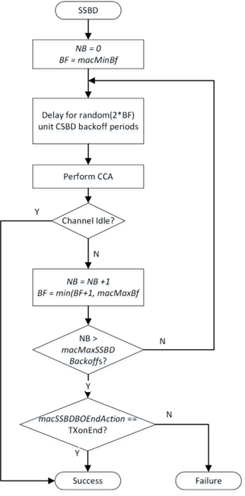

SSBD Algorithm Review and Evaluation
Bounded channel access latency:
  -- Linear back-off
  -- optionally, revert to Aloha on failure
$2^{BE}−1$ for CSMA
In this submission, we evaluate SSBD by simulation, in terms of
  -- Linear backoff (LB) vs Binary exponential backoff (BEB)
  -- With Aloha or Without Aloha
Evaluation Metrics
  -- Mean Latency and Jitter (Standard Deviation of Latency)
  -- Mean Throughput (0~100%)
Not transmit for without Aloha
SSBD Algorithm [1]

Slide 4
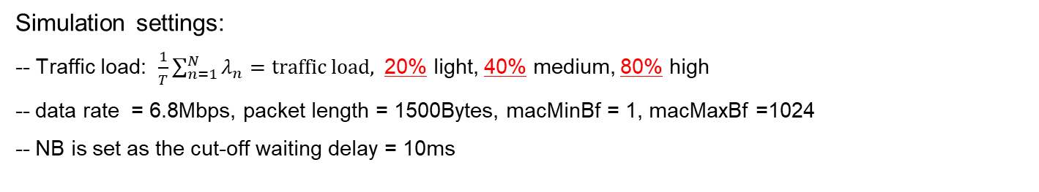
Mean Latency
Light Traffic Load
Medium Traffic Load
High Traffic Load
Mean Latency (s)
Mean Latency (s)
Mean Latency (s)
Simulation settings:
-- Traffic load: $\frac{1}{T}\sum_{n=1}^{N}{λ_{n}}=traffic load,$ 20% light, 40% medium, 80% high
-- data rate = 6.8Mbps, packet length = 1500Bytes, macMinBf = 1, macMaxBf =1024
-- NB is set as the cut-off waiting delay = 10ms
For mean latency, LB is lower than BEB, with Aloha $≈$ without Aloha

Slide 5
Jitter
Light Traffic Load
Medium Traffic Load
High Traffic Load
Jitter(s)
Jitter(s)
Jitter(s)
For Jitter, LB is lower than BEB, with Aloha $≈$ without Aloha

Slide 6
Mean Throughput
Light Traffic Load
Medium Traffic Load
High Traffic Load
Mean Throughput
Mean Throughput
Mean Throughput
For throughput, LB $≈$ BEB, with Aloha $≈$ without Aloha at light traffic load and medium traffic load scenarios, with Aloha is lower than without Aloha at high traffic load scenario

Slide 7
Summary of Evaluation
Linear backoff is able to reduce mean latency and jitter compared with binary exponential backoff, which is aligned to the simulation results in [2].
When the network traffic load is high, using Aloha might reduce throughput in non-cooperated homogeneous cases because the number of collisions increases
In practice, how to use Aloha option may need to further evaluation.

Slide 8
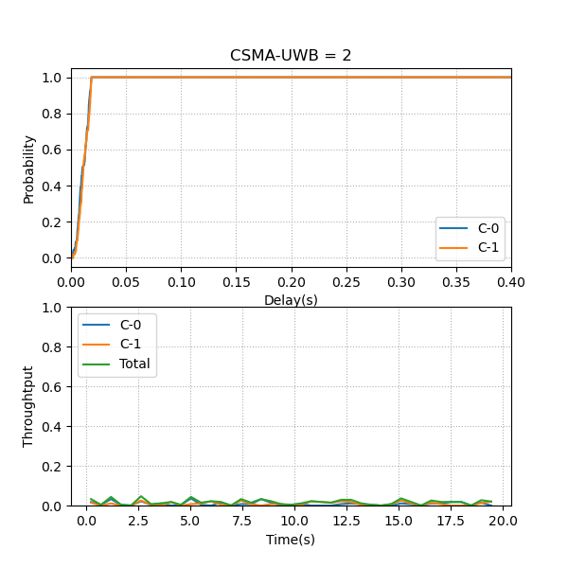
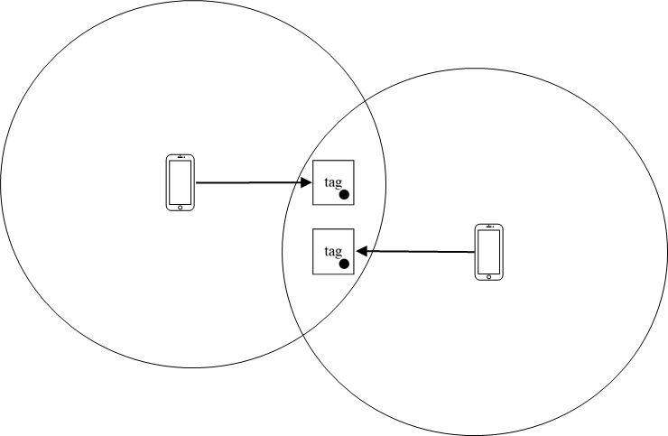
SSBD Enhancement (1)
SSBD cannot work well in hidden terminal cases. The reason is that random backoff (Deferral) is only associated with CCA. If CCA is not aware of spectrum usage, it can result in a large number of collisions and very low throughput
Link #1
Link #2

Slide 9
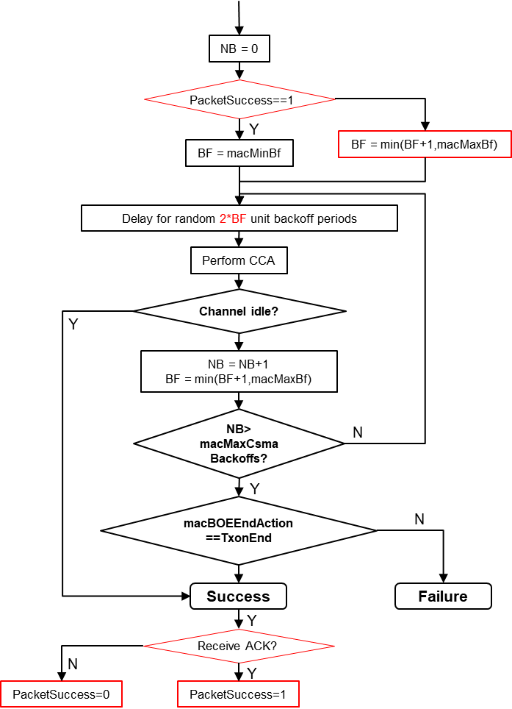
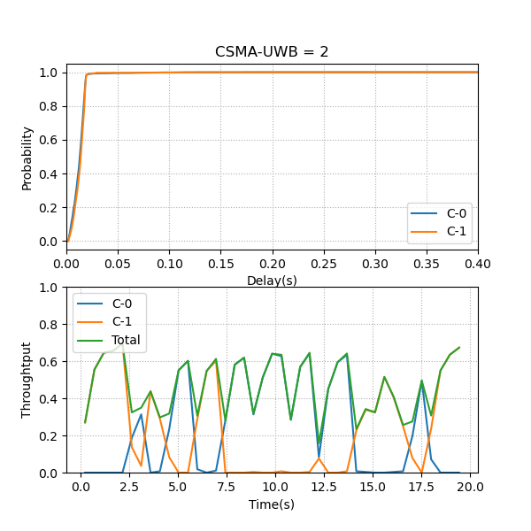
SSBD Enhancement (2)
SSBD can be enhanced by introducing a conflict resolution mechanism, which expands the backoff window after a packet fails to be transmitted (no ACK is received).
SSBD+

Slide 10
Summary
Linear Backoff is a very good idea to reduce latency (both mean latency and jitter)
In practice, when/how to use Aloha option may need to further discussion.
SSBD+: Enlarge Backoff window after unsuccessful packet transmission to further resolve collisions in hidden terminal scenarios

Slide 11
Reference
15-22-0485-01-04ab-Spectrum Sensing Based Deferral
15-22-0558-02-04ab-ssbd-latency-analysis

