Slide 1
Project: IEEE P802.15 Working Group for Wireless Specialty Networks (WSN)
Submission Title: TG 15.4ab November 2022 Interim Session Meeting Slides
Date Submitted: 12 September 2022
Source: Benjamin A. Rolfe (Blind Creek Associates)
Contact:
Voice: +1 408 395 7207, E-Mail: ben.rolfe @ ieee.org
Re: Task Group 4ab: 802.15.4 UWB Next Generation
Abstract: Teleconference (WebEx) Agenda and Meeting Slides
Purpose: Emulate organization, encourage participation and make further progress
Notice: This document has been prepared to assist the IEEE P802.15. It is offered as a basis for discussion and is not binding on the contributing individual(s) or organization(s). The material in this document is subject to change in form and content after further study. The contributor(s) reserve(s) the right to add, amend or withdraw material contained herein.
Release: The contributor acknowledges and accepts that this contribution becomes the property of IEEE and may be made publicly available by P802.15.
Notes:
Jul 12, 2010
Page 1

Slide 2
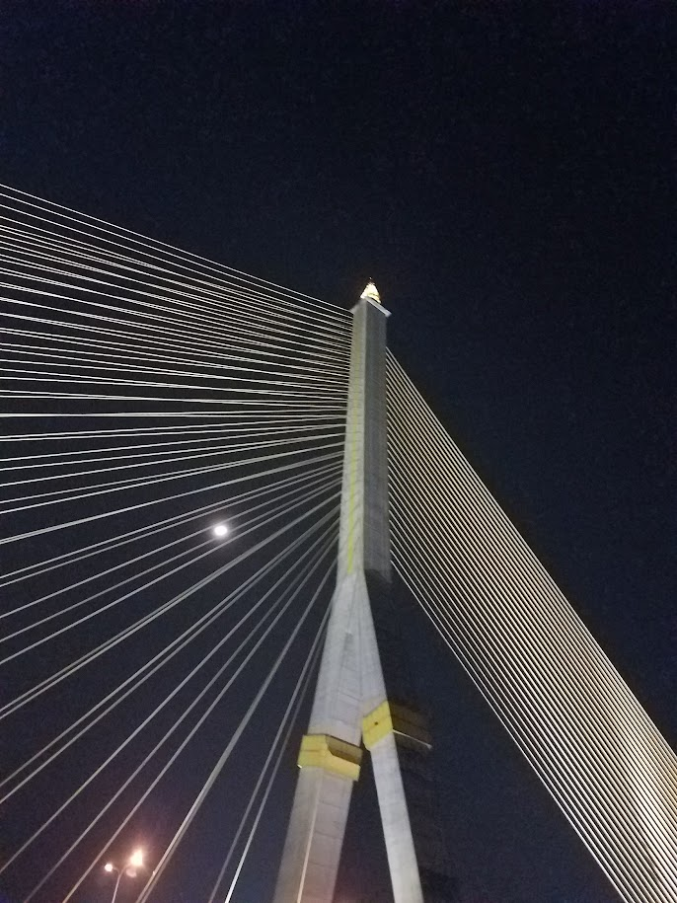
Mixed Mode Interim, Live from Bangkok Thailand November 2022
Task Group 15.4ab
Next Generation UWB Amendment

Slide 3
Hybrid Meeting Note (Plea)
If you are in the room, you don’t need to join the Webex
If you join the Webex from inside the meeting room, you MUST assure that you join without audio on your device
In-room Webex with audio enabled will disrupt the meeting!
Failure to comply with these requests will disrupt the meeting and consume time better spent on technical discussions
Thank you very much!

Slide 4
Registration for 802 LMSC Plenaries and 802 Wireless Interims
This 802.15 meeting is part of the IEEE 802 Plenary session
You must pay the registration fee in order to attend virtually or in person
If you have not already done so please register:
https://web.cvent.com/event/840c257d-5d52-4eff-94b4-39d2aafda56b/summary
If you do not intend to register for this session you must leave this meeting and, if you have logged attendance on IMAT, email the appropriate WG chair or vice chairs to have your attendance cancelled

Slide 5
Deadbeat Consequences (Deadbeat: in default of paying registration fee for a prior mtg.)
No participation credit will be granted for said session.
Any participation credit acquired before said session toward membership in any IEEE 802 LMSC group is revoked.
Membership in any IEEE 802 LMSC group is terminated.
No participation credit will be granted for attendance at any subsequent IEEE 802 LMSC session until the individual has complied with the registration requirements for all previously attended IEEE 802 LMSC sessions by the start of said subsequent session.

Slide 6
Task Group 15.4ab Next Generation UWB Amendment
Objective: enhancements to 802.15.4 Ultra Wideband (UWB) physical layers (PHYs) medium access control (MAC) and associated ranging techniques while retaining backward compatibility with enhanced ranging capable devices (ERDEVs).

Slide 7
5.2.b Scope of the project (As approved):
This amendment enhances the Ultra Wideband (UWB) physical layers (PHYs) medium access control (MAC), and associated ranging techniques while retaining backward compatibility with enhanced ranging capable devices (ERDEVs). Areas of enhancement include:
additional coding, preamble and modulation schemes to additional coding, preamble and modulation schemes to support improved link budget and/or reduced air-time relative to IEEE Std 802.15.4 UWB;
additional channels and operating frequencies;
interference mitigation techniques to support greater device density and higher traffic use cases relative to the IEEE Std 802.15.4 UWB;
improvements to accuracy, precision and reliability and interoperability for high-integrity ranging; schemes to reduce complexity and power consumption;
definitions for tightly coupled hybrid operation with narrowband signaling to assist UWB;
enhanced native discovery and connection setup mechanisms;
sensing capabilities to support presence detection and environment mapping;
and mechanisms supporting low-power low-latency streaming as well as high data-rate streaming allowing at least 50 Mb/s of throughput.
Support for peer-to-peer, peer-to-multi-peer, and station-to-infrastructure protocols are in scope, as are infrastructure synchronization mechanisms. This amendment includes safeguards so that the high throughput data use cases do not cause significant disruption to low duty-cycle ranging use cases.
https://development.standards.ieee.org/myproject-web/app#viewpar/9081

Slide 8
Task Group Organization
Chair: Benjamin Rolfe (BCA)¹
Vice Chair: Clint Powell (Meta)
Vice Chair: Clint Chaplin (SRA)
Vice Chair and Recording Secretary: David Xun Yang (Huawei)
Lead Technical Editor: Billy Verso (Qorvo)
Thank you to all the volunteers!
¹ Affiliation Details here: https://mentor.ieee.org/802-ec/dcn/22/ec-22-0061-00-00EC-rolfe-affiliations-by-802-activity.pdf

Slide 9
Task Group Rules
Discussion: Everyone present is welcome
Straw polls: Everyone present may vote
Formal motions: WG voters
To make, second and vote
Patent policy for PAR activities applies
All the usual rules of conduct
Please identify yourself on first contact with name and affiliation

Slide 10
IEEE-SA Patent, Copyright, and Participation Policies
See: https://grouper.ieee.org/groups/802/sapolicies.shtml
IEEE-SA Patent Slides for Standards Development Meetings (.pdf)
https://development.standards.ieee.org/myproject/Public/mytools/mob/slideset.pdf
IEEE-SA Standards Board Patent Committee (PatCom) home page
https://standards.ieee.org/content/ieee-standards/en/about/sasb/patcom/index.html
IEEE-SA Participation Policy meeting slide set - individual method (.pdf)
https://standards.ieee.org/content/dam/ieee-standards/standards/web/documents/other/Participant-Behavior-Individual-Method.pdf
Working Group Copyright Materials
https://standards.ieee.org/ipr/copyright-materials.html
https://standards.ieee.org/content/dam/ieee-standards/standards/web/documents/other/ieee-sa-copyright-policy-2019.pdf

Slide 11
IEEE 802 Ground Rules
Respect … give it, get it
NO product pitches
NO corporate pitches
NO prices
NO restrictive notices – (no confidentially notices in email)
Presentations must be openly available

Slide 12
Task Group Agenda
https://mentor.ieee.org/802.15/dcn/22/15-22-0541-04-04ab-tg4ab-agenda-november-2022.xlsx
Bangkok | 13-Nov-2022 |  | 14-Nov-2022 |  |  |  | 15-Nov-2022 |  |  |  | 16-Nov-2022 |  |  |  | 17-Nov-2022
 | Virtual Rm 1 |  | Virtual Rm 1 | Virtual Rm 2 | Virtual Rm 3 | Virtual Rm 4 | Virtual Rm 1 | Virtual Rm 2 | Virtual Rm 3 | Virtual Rm 4 | Virtual Rm 1 | Virtual Rm 2 | Virtual Rm 3 | Virtual Rm 4 | Virtual Rm 1 | Virtual Rm 2 | Virtual Rm 3 | Virtual Rm 4
07:00-07:30 |  |  | CONTINENTAL BREAKFAST |  |  |  | CONTINENTAL BREAKFAST |  |  |  | CONTINENTAL BREAKFAST |  |  |  | CONTINENTAL BREAKFAST
07:30-08:00 |  |  |  |  |  |  |  |  |  |  | 802.15 AC Meeting (Virtual Rm 1)
08:00-08:30 |  |  | 802 EC OPENING MEETING |  |  |  | TG4ab NG-UWB |  | TG3mb HDR |  |  |  |  |  | TG4ab NG-UWB | SC IETF |  | TG6ma BAN/ VAN
08:30-09:00 |  |  |  |  |  |  |  |  |  |  |  | TG4me | TG3mb HDR
09:00-09:30
09:30-10:00
10:00-10:30 |  |  | Break |  |  |  | Break |  |  |  | Break |  |  |  | Break
10:30-11:00 |  |  | 802.15 WG Opening Plenary (Virtual Rm 1) |  |  |  |  | TG4me | SC-M | TG6ma BAN/ VAN | 802.15 WG Midweek Plenary (Virtual Rm 1) |  |  |  | TG4ab NG-UWB | TG6ma BAN/ VAN | SC-M | TG13 OWC
11:00-11:30
11:30-12:00 |  |  |  |  |  |  |  |  |  |  | WNG (Virtual Rm 1)
12:00-12:30
12:30-13:00 |  |  | LUNCH ON YOUR OWN |  |  |  | LUNCH ON YOUR OWN |  |  |  | LUNCH ON YOUR OWN |  |  |  | LUNCH ON YOUR OWN
13:00-13:30
13:30-14:00 |  |  | TG4ab NG-UWB | IG Privacy |  | TG7a OCC | 802 LMSC ISO JTC1 Rm TBD |  | TG16t LicNB | TG13 OWC | TG6ma BAN/ VAN | TG4me | TG16t LicNB | TG7a OCC | TG4ab NG-UWB | IG Privacy | TG16t LicNB | TG7a OCC
14:00-14:30
14:30-15:00
15:00-15:30
15:30-16:00 |  |  | Break |  |  |  | Break |  |  |  | Break |  |  |  | Break
16:00-16:30 | WIRELESS CHAIRS MEETING |  | TG4ab NG-UWB | TG4me |  |  | TG4ab NG-UWB |  | TG3mb HDR |  | TG4ab NG-UWB |  | TG3mb HDR | TG13 OWC |  | TG4me |  | TG7a OCC
16:30-17:00
17:00-17:30
17:30-18:00 | 802.15 AC MEETING (Virtual Rm 1)
18:00-18:30 |  |  | Break |  |  |  | Break |  |  |  | Break |  |  |  | Break
18:30-19:00 | Dinner on your own |  | Tutorial 1 |  | Dinner on your own |  | 802.15/802.1 Joint Mtg (Virtual Rm 1) |  |  |  | Social |  |  |  | 802.15 WG Closing Plenary (Virtual Rm C)
19:00-19:30
19:30-20:00 |  |  |  |  |  |  | Dinner on your own
20:00-20:30 |  |  | Tutorial 2
20:30-21:00 |  |  |  |  |  |  |  |  |  |  | Dinner on your own
21:00-21:30
21:30-22:00 |  |  | Tutorial 2
22:00-22:30
22:30-23:00

Slide 13
Agenda
Motion to approve agenda contained in document 15-22-0541r5
Moved by Clint Powell (Meta)
Second by Clint Chaplin (SRA)
Discussion:

Slide 14
Approvals of Minutes
Motion to approve minutes contained in documents 15-22-0533r0 and 15-22-0586r0
Moved by: David Xun Yang
Second by: Clint Chaplin
TG4ab Sep Interim Mins: https://mentor.ieee.org/802.15/dcn/22/15-22-0533-00-04ab-tg4ab-sep-interim-mins.docx
TG4ab Conf Call Mins Sep to Nov 2022: https://mentor.ieee.org/802.15/dcn/22/15-22-0586-00-04ab-tg4ab-conf-call-mins-sep-to-nov-2022.docx

Slide 15
Session Objectives
Hear technical contributions and develop technical content for the draft
Converge and build consensus
Consider proposed text for draft
Map the path to a technically complete draft

Slide 16
Hybrid Meeting Conduct: Queues
In room:
Que up at the 2 microphones
Advise the chair if you need the mic to be brought to you
Remote attendees won’t hear you unless you use the microphone!
Remote:
Que via chat
Please mute until recognized
Queue manager will interleave
1 question or comment per que slot; requeue as needed
Keep (question + answer) to 2 minutes
For more in-depth discussion use the reflector.

Slide 17
Hybrid Meeting Conduct: Other
In room breakouts (if needed):
Will be difficult for remote attendees – use ad-hoc methods (adapt)
Loop in remote attendees when able (email reflector, etc)
We will do the best we can!
Presenting:
VC-CC will “drive” presentations
Please cue as needed
Please upload early so Clint can pre-que!

Slide 18
We have a full agenda!
You are reminded NOW that all the 802 and IEEE rules you heard at the opening plenary apply to every meeting. This is your final reminder!
Meetings will start ON TIME as shown on the schedule – arrive early, finish nesting, get comfortable
We will need to be disciplined to get through everything
Questions and discussions time may be limited: Use the email reflector to continue discussion!
Take advantage of coffee breaks and other ad hoc time as well as the reflector
Don’t forget about remote attendees

Slide 19
Time Management
We will need to stay within the allocated time to get through everything
If less than the allocated time is used in a time slot, we’ll start the next time slot (accumulate any unused time to the end of the meeting)
Accumulated time will be used to continue discussion

Slide 20
Recap

Slide 21
Project Schedule (working baseline)
Proposed project schedule | Nov-21 | Dec-21 | Jan-22 | Feb-22 | Mar-22 | Apr-22 | May-22 | Jun-22 | Jul-22 | Aug-22 | Sep-22 | Oct-22 | Nov-22 | Dec-22 | Jan-23 | Feb-23 | Mar-23 | Apr-23 | May-23 | Jun-23 | Jul-23 | Aug-23 | Sep-23 | Oct-23 | Nov-23 | Dec-23 | Jan-24 | Feb-24 | Mar-24 | Apr-24 | May-24 | Jun-24 | Jul-24 | Aug-24 | Sep-24 | Oct-24 | Nov-24
Call for proposals
Hear and evaluate proposals
Cut-off for new proposals, PHY
Cut-off for new proposals, MAC
Integrate poposals/contributions into TFD
Develop draft from TFD
Draft 0
TG draft review and revision
Working group pre-ballot review
Pre-ballot review and comment resolution
First letter ballot |  |  |  |  |  |  |  |  |  |  |  |  |  |  |  |  | LB
LB Comment Resolution
WG Recirculatoin |  |  |  |  |  |  |  |  |  |  |  |  |  |  |  |  |  |  |  |  | LB-R
Comment resolution, 1st recirc
Conditional approval for SA ballot
WG Recirculatoin |  |  |  |  |  |  |  |  |  |  |  |  |  |  |  |  |  |  |  |  |  |  | LB-R
Comment resolution, 2nd recirc and final recirc
First SA ballot |  |  |  |  |  |  |  |  |  |  |  |  |  |  |  |  |  |  |  |  |  |  |  |  | SA
Comment resolution, first SA ballot
SA Resirculation |  |  |  |  |  |  |  |  |  |  |  |  |  |  |  |  |  |  |  |  |  |  |  |  |  |  |  | SA-R
Comment resolution, SA recirculation
SA Resirculation |  |  |  |  |  |  |  |  |  |  |  |  |  |  |  |  |  |  |  |  |  |  |  |  |  |  |  |  |  |  | SA-R
Comment resolution, 2nd SA recirc
Conditional or unconditional approval to RevCom |  |  |  |  |  |  |  |  |  |  |  |  |  |  |  |  |  |  |  |  |  |  |  |  |  |  |  |  | ?? |  |  |  | ??
Optional 3rd SA recirc if needed |  |  |  |  |  |  |  |  |  |  |  |  |  |  |  |  |  |  |  |  |  |  |  |  |  |  |  |  |  |  |  |  | SA-R
RevCom meets |  |  |  |  |  |  |  |  |  |  |  |  |  |  |  |  |  |  |  |  |  |  |  |  |  |  |  |  |  |  |  |  |  | ` |  |  |  | `
You are Here >
Notes: SASB/RevCom schdule for 2024 a guess

Slide 22
Schedule Major Milestones
Near Term Working Milestones
Call for proposals | November 2021
Cut-off for new features (high level feature set), PHY | May 2022
Cut-off for new features (high level feature set), MAC | July 2022
Draft 0 | Post-November 2022
TG draft review and revision complete | November-January 2022
Working group pre-ballot review commence | January-Feb 2022 (following Jan meeting)
First letter ballot | March 2023 (following meeting)
…
Progress as of Nov 1st:
As per review in the interim closing, about 1 meeting cycle from our initial schedule goals
Most areas need further technical development
Collaboration and convergence continues

Slide 23
Progress: TFD submissions
Some TFD Text already submitted:
https://mentor.ieee.org/802.15/dcn/22/15-22-0262-01-04ab-nba-uwb-technical-framework-proposal.docx
https://mentor.ieee.org/802.15/dcn/22/15-22-0291-01-04ab-proposal-of-sensing-framework.docx
https://mentor.ieee.org/802.15/dcn/22/15-22-0341-02-04ab-nba-uwb-technical-framework-proposal-2022-july.docx
https://mentor.ieee.org/802.15/dcn/22/15-22-0490-01-04ab-dl-tdoa-based-location-service-technical-specification.docx
https://mentor.ieee.org/802.15/dcn/22/15-22-0514-00-04ab-non-coherent-phy-layer-proposal-for-15-4ab-tfd.docx
https://mentor.ieee.org/802.15/dcn/22/15-22-0538-02-04ab-proposal-of-sensing-framework.docx
https://mentor.ieee.org/802.15/dcn/22/15-22-0486-00-04ab-ssbd-channel-access-tfd-text.docx

Slide 24
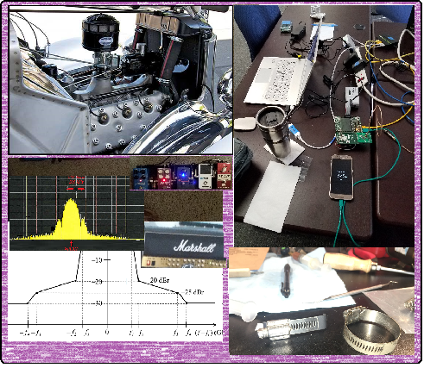
Technical Presentations

Slide 25
Presentations
1 | 15-22-0593 | https://mentor.ieee.org/802.15/dcn/22/15-22-0593-00-04ab-flexible-block-structure-updates.ppt
2 | 15-22-0585 | https://mentor.ieee.org/802.15/dcn/22/15-22-0585-00-04ab-one-to-many-ranging-using-nba-mms.pptx
3 | 15-22-0568 | https://mentor.ieee.org/802.15/dcn/22/15-22-0568-01-04ab-improvements-on-scheduling-ie-design-in-802-15-4ab.pptx
4 | 15-22-0588 | https://mentor.ieee.org/802.15/dcn/22/15-22-0588-00-04ab-time-domain-mask-for-pulse-shape-in-802-15-4ab.pptx
5 | 15-22-0604 | https://mentor.ieee.org/802.15/dcn/22/15-22-0604-00-04ab-nba-mms-uwb-compressed-psdu.pptx
6 | 15-22-0592 | https://mentor.ieee.org/802.15/dcn/22/15-22-0592-00-04ab-pulse-burst-sensing-phase-noise-proof-supercomplementary-set-of-sequences.pptx
7 | 15-22-0602 | https://mentor.ieee.org/802.15/dcn/22/15-22-0602-00-04ab-sensing-sequence-metrics.pptx
8 | 15-22-0606 | https://mentor.ieee.org/802.15/dcn/22/15-22-0606-00-04ab-spectrum-sensing-based-deferral-evaluation-and-enhancement.pptx
9 | 15-22-0506 | https://mentor.ieee.org/802.15/dcn/21/15-21-0506-04-04ab-advanced-coding-for-data-comm.pptx
10 | 15-22-0608 | https://mentor.ieee.org/802.15/dcn/22/15-22-0608-01-04ab-header-ie-extension.pptx

Slide 26
Presentations
11 | 15-22-0609 | https://mentor.ieee.org/802.15/dcn/22/15-22-0609-00-04ab-nb-channel-hopping-for-nb-assisted-uwb.pptx
12 | 15-22-0547 | https://mentor.ieee.org/802.15/dcn/22/15-22-0574-00-04ab-channels-for-frequency-stitching.pptx
13 | 15-22-0573 | https://mentor.ieee.org/802.15/dcn/22/15-22-0573-00-04ab-follow-up-on-uwb-channel-usage-coordination.pptx
14 | 15-22-0593 | https://mentor.ieee.org/802.15/dcn/22/15-22-0593-00-04ab-flexible-block-structure-updates.ppt
15 | 15-22-0632 | https://mentor.ieee.org/802.15/dcn/22/15-22-0632-00-04ab-scz-code-blocks-a-good-candidate-for-the-sensing-sequences-in-4ab.pptx
16 | 15-22-0613 | https://mentor.ieee.org/802.15/dcn/22/15-22-0613-00-04ab-co-scheduling-ranging-and-sensing-continued.ppt
17 | 15-22-0570 | https://mentor.ieee.org/802.15/dcn/22/15-22-0570-00-04ab-rsf-and-mmrs-in-multi-millisecond-uwb.pptx
18 | 15-22-0514 | https://mentor.ieee.org/802.15/dcn/22/15-22-0514-01-04ab-non-coherent-phy-layer-proposal-for-15-4ab-tfd.docx
19 | 15-22-0642 | https://mentor.ieee.org/802.15/dcn/22/15-22-0642-01-04ab-ssbd-enabled-uwb-radio-coexistence-with-wi-fi-6e-demo.pptx
20 | 15-22-0645 | https://mentor.ieee.org/802.15/dcn/22/15-22-0645-00-04ab-inter-frame-spacing-follow-up.pptx

Slide 27
Presentations
21 | 15-22-0646 | https://mentor.ieee.org/802.15/dcn/22/15-22-0646-00-04ab-uwb-in-band-discovery.ppthttps://mentor.ieee.org/802.15/dcn/22/15-22-0646-00-04ab-uwb-in-band-discovery.ppt
22 | 15-22-0650 | https://mentor.ieee.org/802.15/dcn/22/15-22-0650-02-04ab-consensus-on-uwb-sensing-for-802-15-4ab.pptx
23 | 15-22-0651 | https://mentor.ieee.org/802.15/dcn/22/15-22-0651-00-04ab-recap-and-new-considerations-on-nba-mms-ranging-integrity-fragments.pptx
24 | 15-22-0649 | https://mentor.ieee.org/802.15/dcn/22/15-22-0649-00-04ab-coherent-phy-layer-proposal-for-15-4ab-tfd.docx
25 | 15-22-0659 | https://mentor.ieee.org/802.15/dcn/22/15-22-0659-01-04ab-further-thoughts-on-the-mac-of-the-nba-mms-uwb.pptx
26 | 15-22-0616 | https://mentor.ieee.org/802.15/dcn/22/15-22-0616-00-04ab-interference-analysis-of-initial-synchronization-sequence.pptx
27 | 15-22-0616 | https://mentor.ieee.org/802.15/dcn/22/15-22-0616-00-04ab-interference-analysis-of-initial-synchronization-sequence.pptx
28 | 15-22-0660 | https://mentor.ieee.org/802.15/dcn/22/15-22-0660-00-04ab-code-length-selection-of-11n-based-ldpc-codes-for-15-4ab.pptx
29 | 15-22-0571 | https://mentor.ieee.org/802.15/documents?is_dcn=571&is_group=04ab
30 | 15-22-0654 | https://mentor.ieee.org/802.15/dcn/22/15-22-0654-00-04ab-draft-text-for-uwb-wake-up-radio.pdf
31 | 15-22-0653 | https://mentor.ieee.org/802.15/dcn/22/15-22-0653-00-04ab-an-updated-phy-header-proposal.pptx

Slide 28
Next Steps

Slide 29
Interim Webex Schedule
November '22
S | M | T | W | T | F | S
 |  | 1 | 2 | 3 | 4 | 5
6 | 7 | 8 | 9 | 10 | 11 | 12
13 | 14 | 15 | 16 | 17 | 18 | 19
20 | 21 | 22 | 23 | 24 | 25 | 26
27 | 28 | 29 | 30
December '22
S | M | T | W | T | F | S
 |  |  |  | 1 | 2 | 3
4 | 5 | 6 | 7 | 8 | 9 | 10
11 | 12 | 13 | 14 | 15 | 16 | 17
18 | 19 | 20 | 21 | 22 | 23 | 24
25 | 26 | 27 | 28 | 29 | 30 | 31
First Call @ 0600 PT
Proposed: Weekly on Tuesday
Alternating time: 06:00 PT and 22:00 PT
Commence 29-November-2022 at 06:00 PT

Slide 30
Interim Webex Schedule
January ‘23
S | M | T | W | T | F | S
1 | 2 | 3 | 4 | 5 | 6 | 7
8 | 9 | 10 | 11 | 12 | 13 | 14
15 | 16 | 17 | 18 | 19 | 20 | 21
22 | 23 | 24 | 25 | 26 | 27 | 28
29 | 30 | 31
Wireless Interim

Slide 31
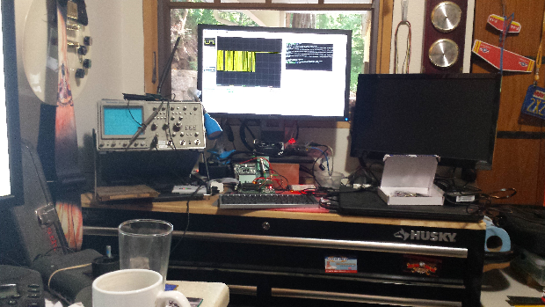
Other Business

Slide 32
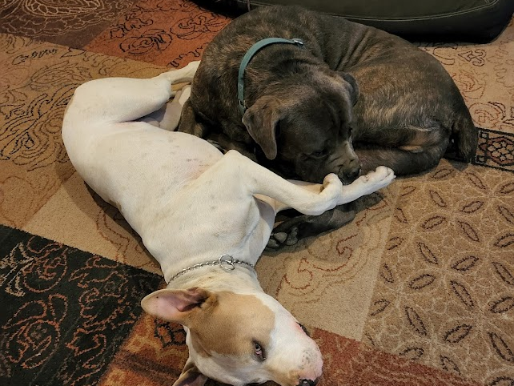
Adjourned Thanks

