Slide 1
Project: IEEE P802.15 Working Group for Wireless Personal Area Networks (WPANs)
Submission Title: [Sensing Sequence Metrics]
Date Submitted: [14 Nov, 2022]
Source: [Jan Roar Pleym, Håkon A. Hjortland, Nikolaj Andersen, Kristian Granhaug, Dries Neirynck, Dag T. Wisland] Company [Novelda AS]
E-mail: [jan.roar.pleym@novelda.com]
Re: [Working Group input]
Abstract: [Sensing sequence metrics input for TG4ab.]
Purpose: []
Notice: This document has been prepared to assist the IEEE P802.15. It is offered as a basis for discussion and is not binding on the contributing individual(s) or organization(s). The material in this document is subject to change in form and content after further study. The contributor(s) reserve(s) the right to add, amend or withdraw material contained herein.
Release: The contributor acknowledges and accepts that this contribution becomes the property of IEEE and may be made publicly available by P802.15.

Slide 2
PAR Objective | Proposed Solution (how addressed)
Safeguards so that the high throughput data use cases will not cause significant disruption to low duty-cycle ranging use cases
Interference mitigation techniques to support higher density and higher traffic use cases
Other coexistence improvement
Backward compatibility with enhanced ranging capable devices (ERDEVs)
Improved link budget and/or reduced air-time
Additional channels and operating frequencies
Improvements to accuracy / precision / reliability and interoperability for high-integrity ranging
Reduced complexity and power consumption
Hybrid operation with narrowband signaling to assist UWB
Enhanced native discovery and connection setup mechanisms
Sensing capabilities to support presence detection and environment mapping | Sequence selection metrics
Low-power low-latency streaming
Higher data-rate streaming allowing at least 50 Mbit/s of throughput
Support for peer-to-peer, peer-to-multi-peer, and station-to-infrastructure protocols
Infrastructure synchronization mechanisms

Slide 3
Sensing Sequence Metrics

Slide 4
Related TG4ab Contributions
15-22-0061-00-04ab-sensing-continued
15-22-0248-00-04ab-privacy-preserving-and-performance-enhancement-for-uwb-sensing
15-22-0280-01-04ab-deterministic-sts-for-sensing-applications
15-22-0083-01-04ab-uwb-sensing-concepts
15-22-0175-00-04ab-sensing-device
15-22-0308-00-04ab-air-time-efficiency-improvements
15-22-0335-00-04ab-air-time-efficiency-improvements-update
15-22-0489-00-04ab-uwb-sensing-sequence-selection

Slide 5
Introduction / Motivation
Metrics for selecting sensing sequence were presented in 15-22-0489-00-04ab-uwb (Leong et. al.)
Achievable ACF maximum side lobe level
CCF maximum
Unambiguous range
Correlator complexity
For sensing, range and Doppler are fundamental parameters influencing use-case performance
Doppler performance may be significantly affected under influence of interference (simulated) and phase-noise (15-22-0592-00-04ab-pulse-burst-sensing-pn-proof-sss)

Slide 6
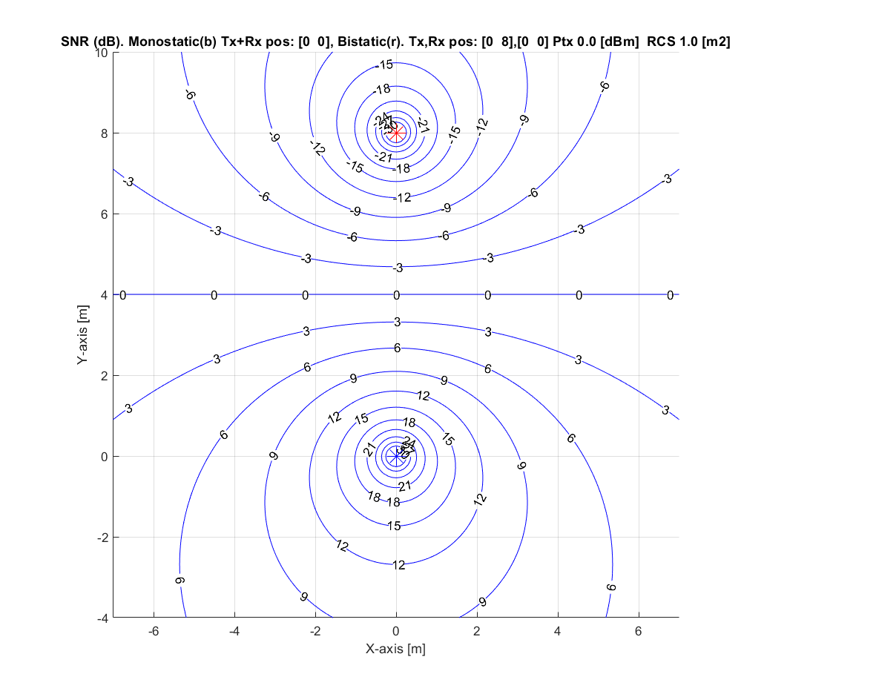
Combistatic configuration (Mono+Bi) Walking target @ x=7m,y=4m vx=-1 m/s, vy = 0

Slide 7
Use-case example description
Combistatic (Mono- and bi-static) scenario
TX and RX separated by 8 meters
Target at 8 meter (walking person)
Combistatic increases coverage
CIR detection for short range
Range Doppler for long range/low RCS
4 code example variations
Constant SNR (18-22.7 dB) over all codes
Periodic Ipatov length 31
M-sequence, length 31
Pulse Burst Sensing (PBS) Ipatov, length 4
Pulse Burst Sensing (PBS) Walsh length 4

Slide 8
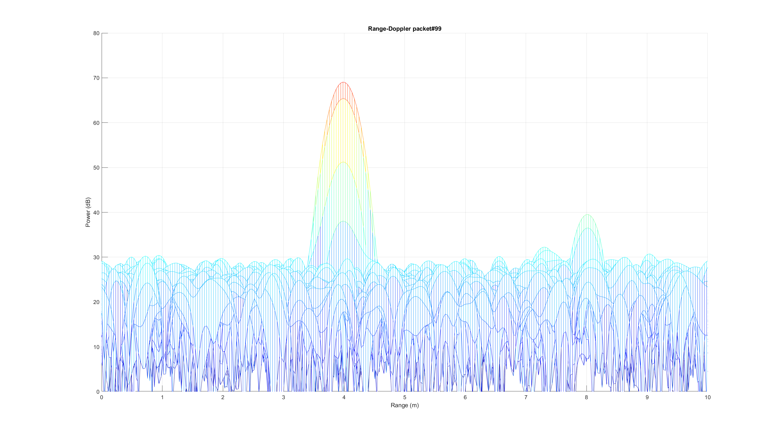
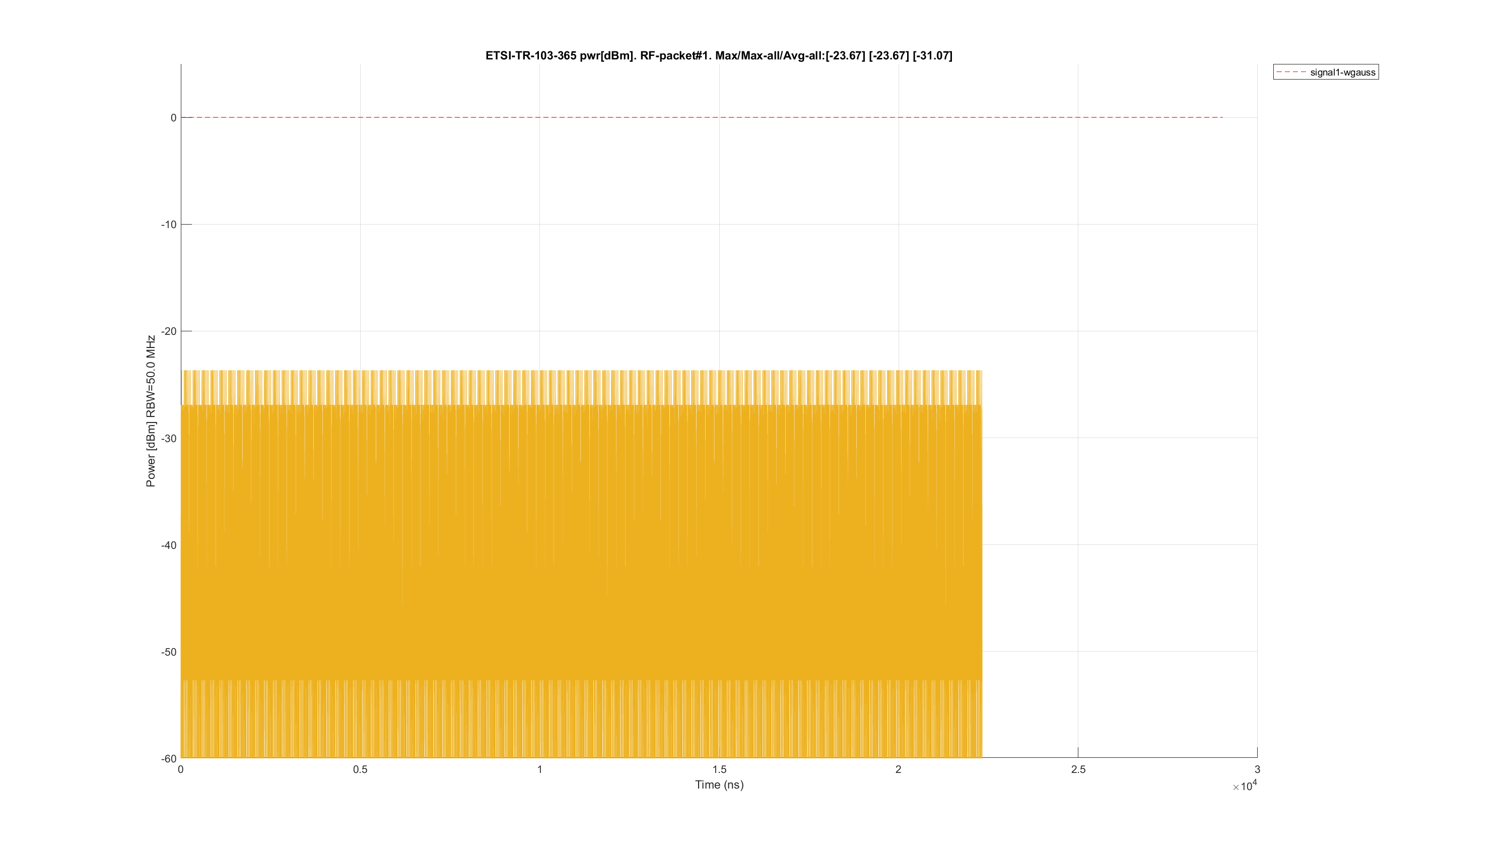
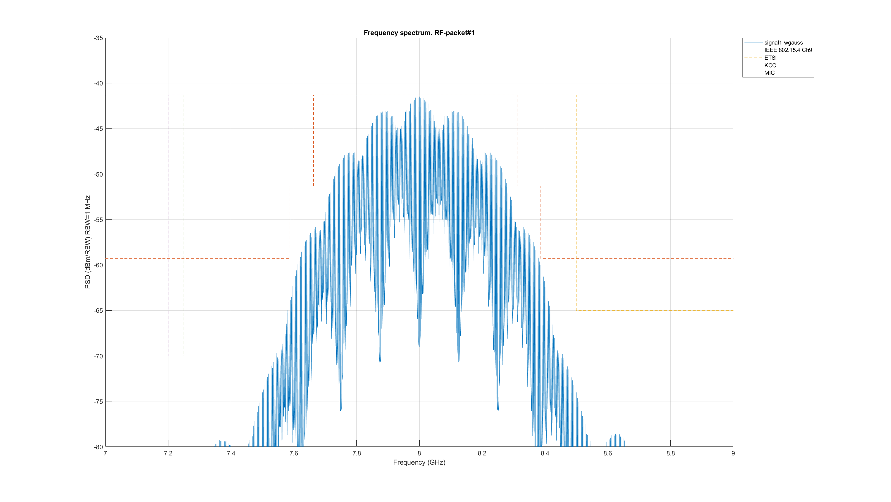
Link budget examples : CIR and Range-Doppler(RD) with 100 packets (SNR +20 dB)

Slide 9
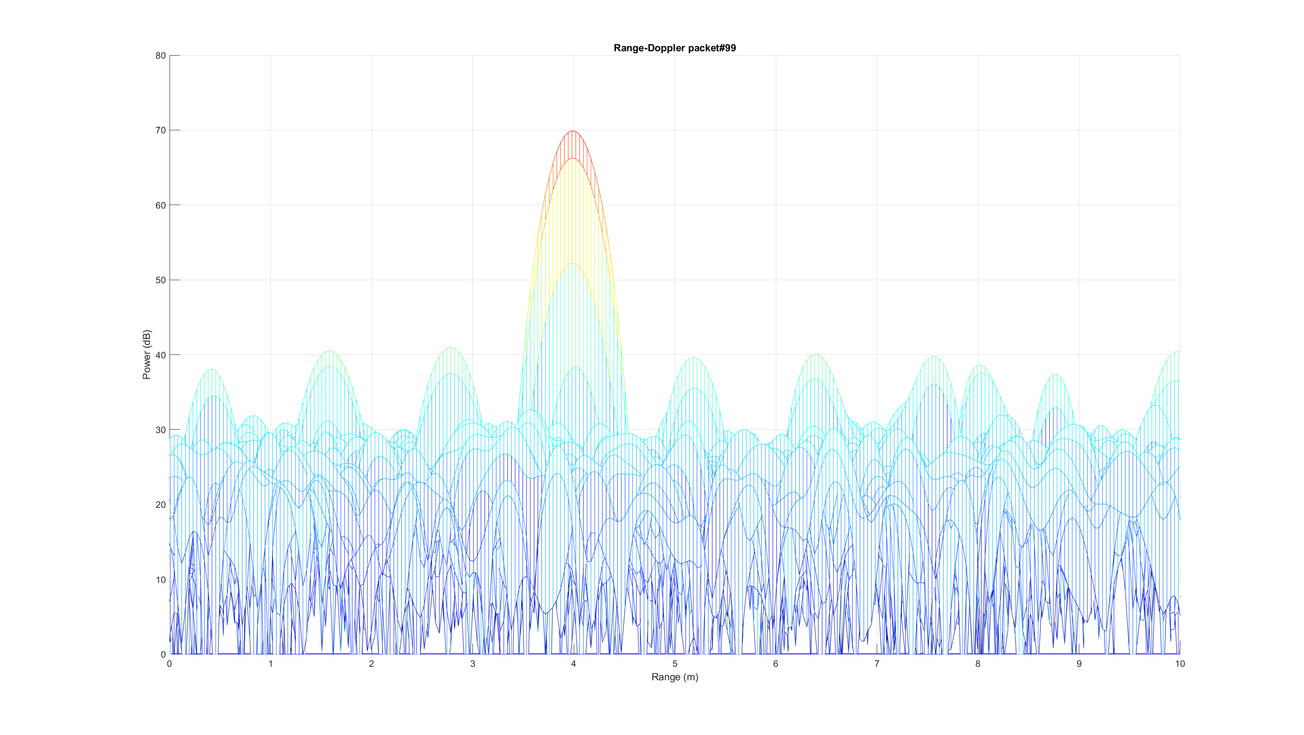
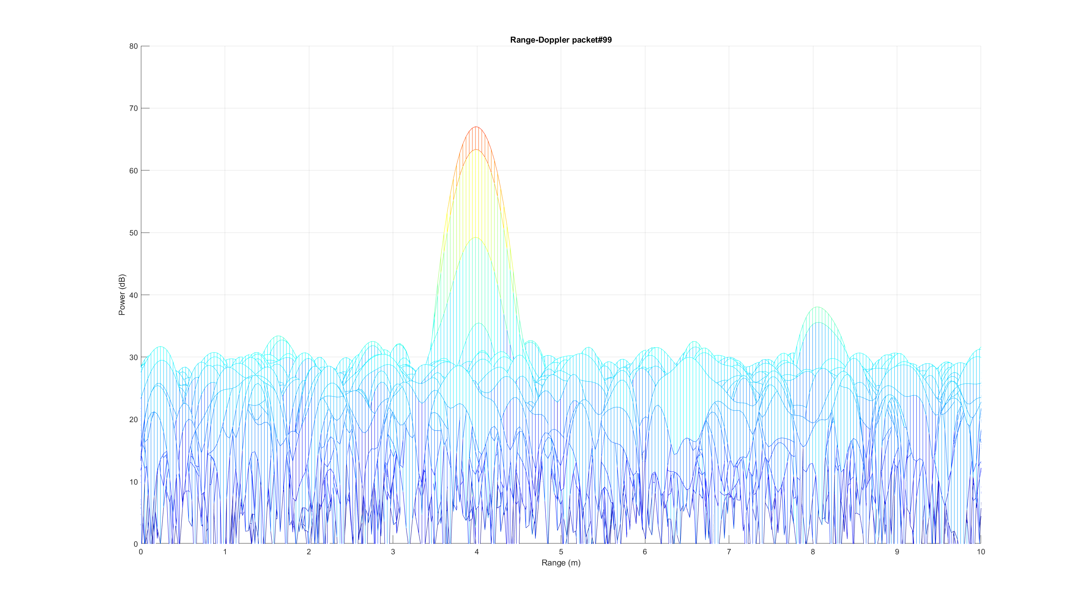
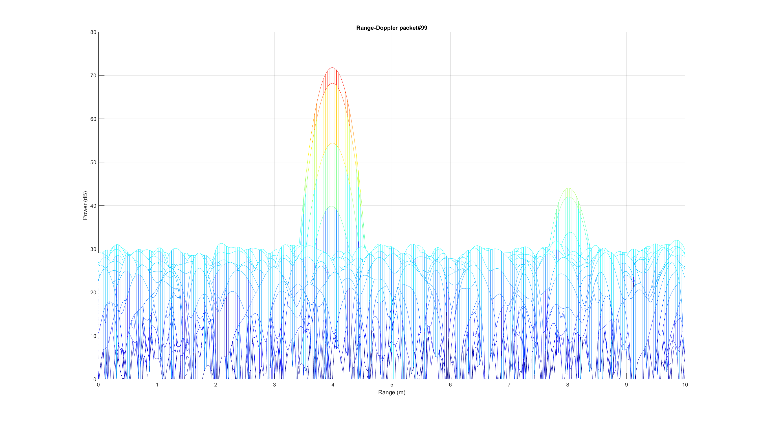
Link budget examples Rx noise SNR 22.0, 21.0, 18.0, 22.7 dB
1) Ipatov-31
2) Mseq-31
3) PBS + Ipatov-4
4) PBS + Walsh-4

Slide 10
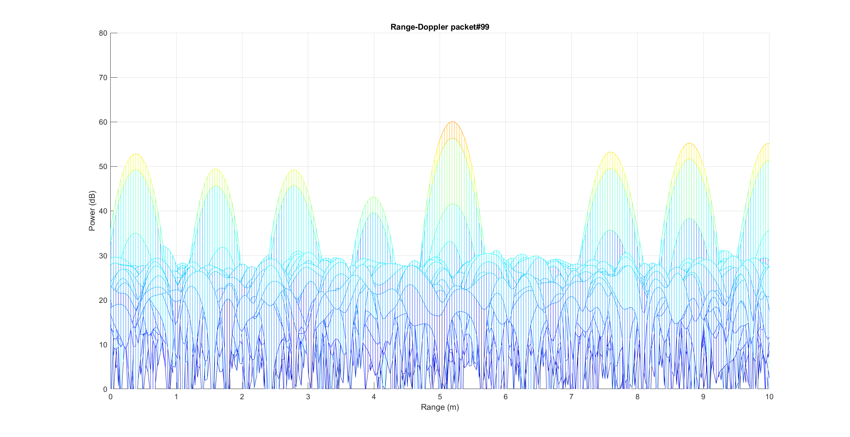
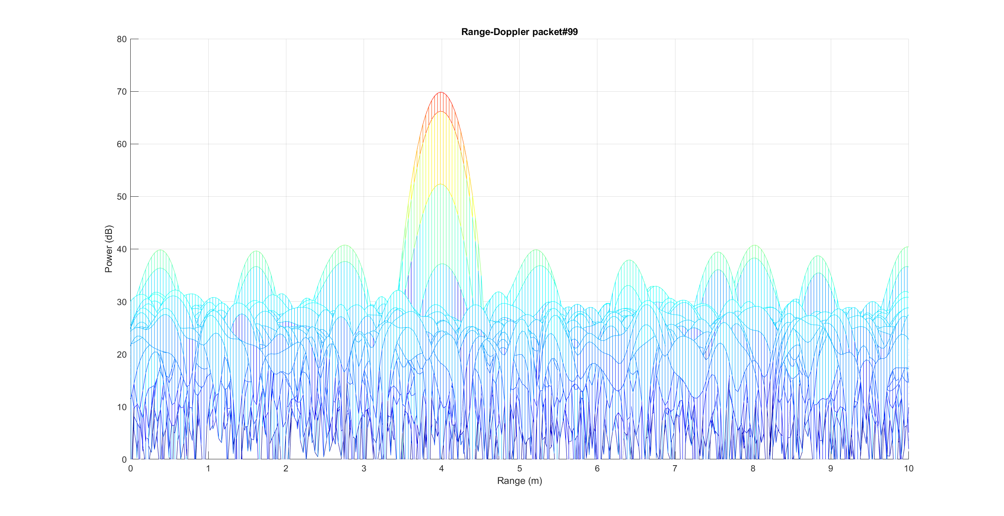
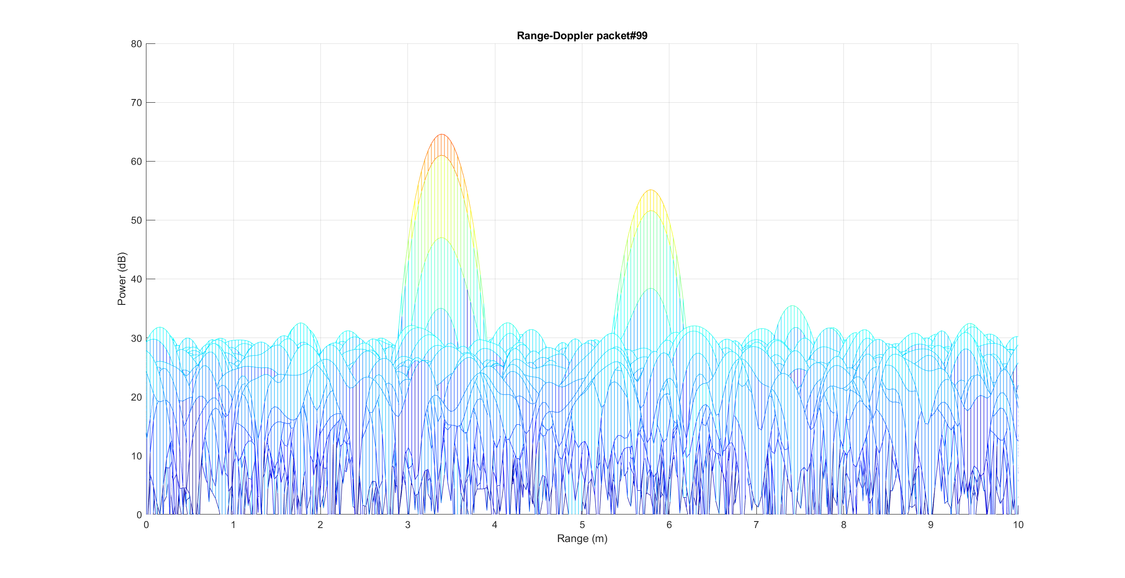
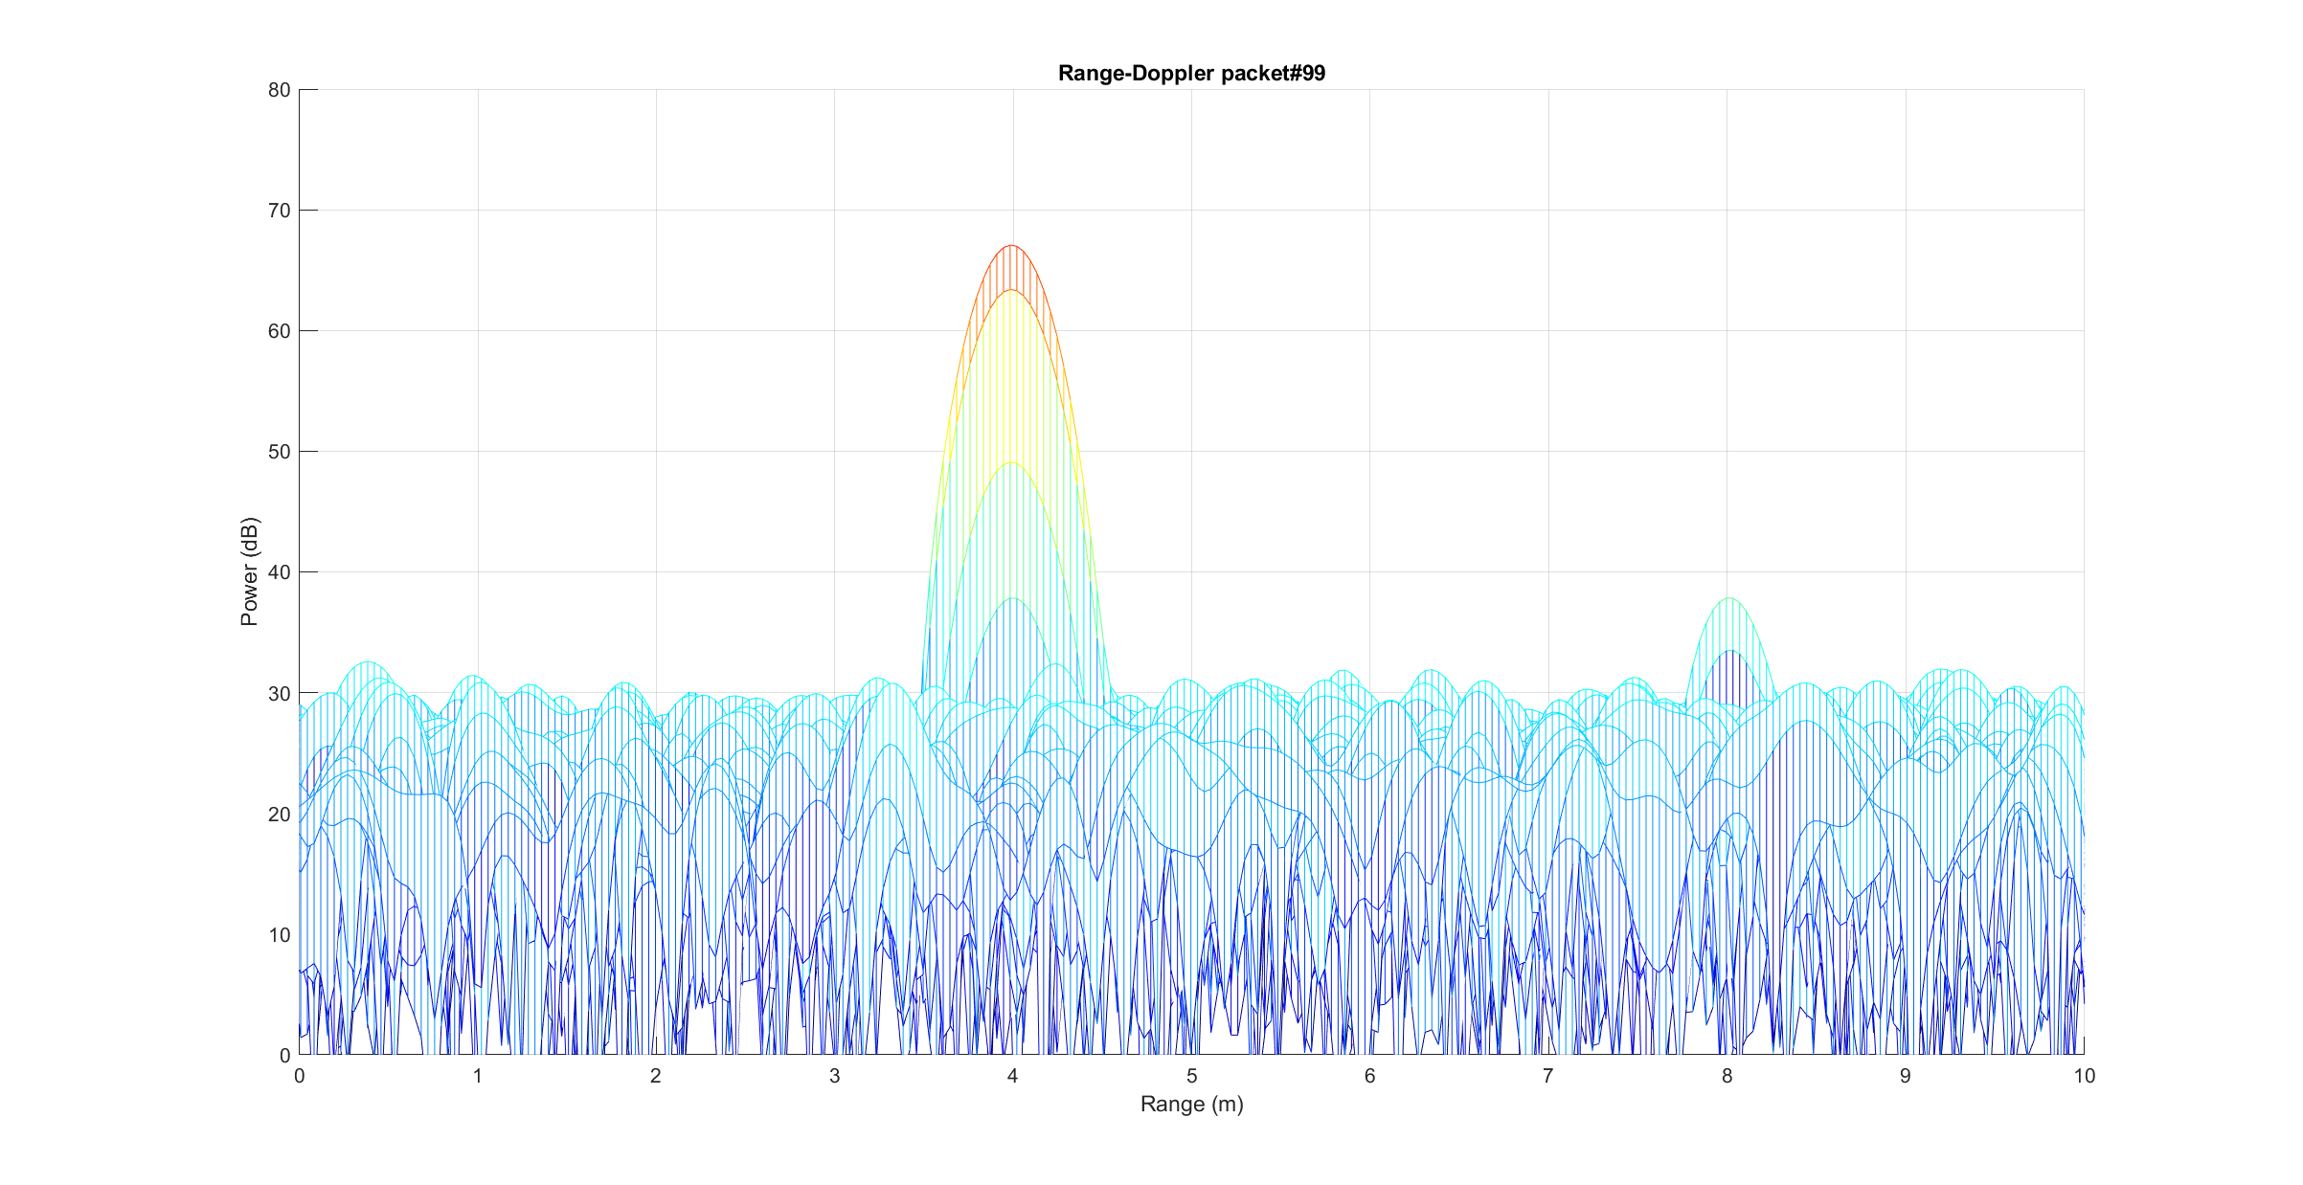
Link budget examples Interference (same code group) from bistatic Tx (x=0,y=8)
1) Ipatov-31
2) Mseq-31
Range view
3) PBS + Ipatov-4
4) PBS + Walsh-4

Slide 11
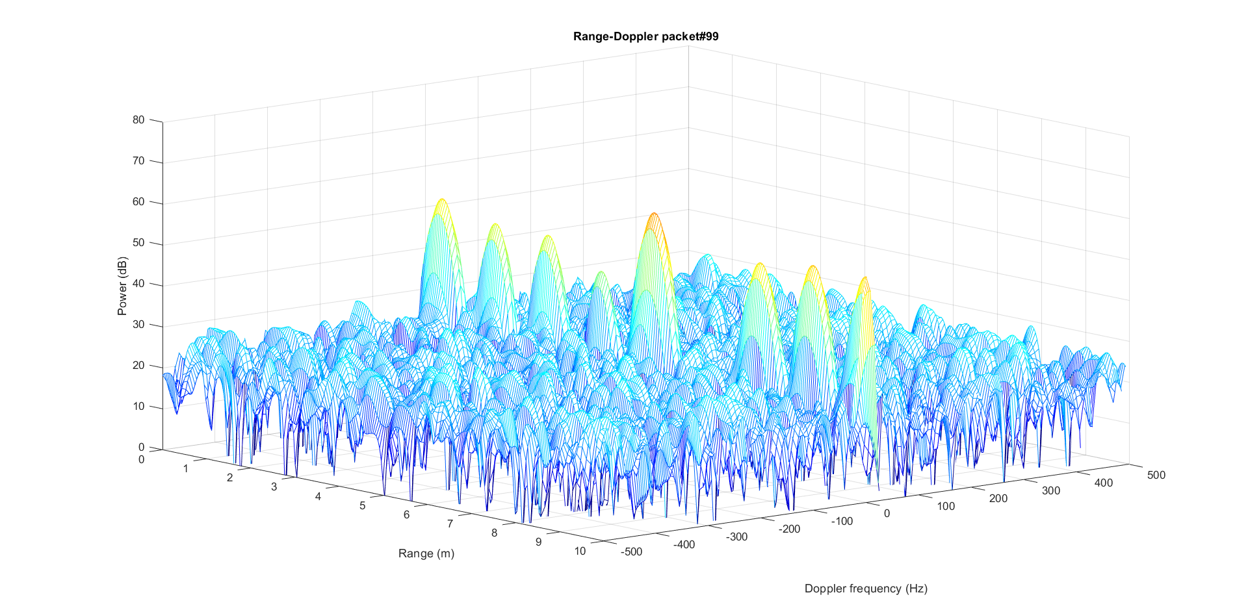
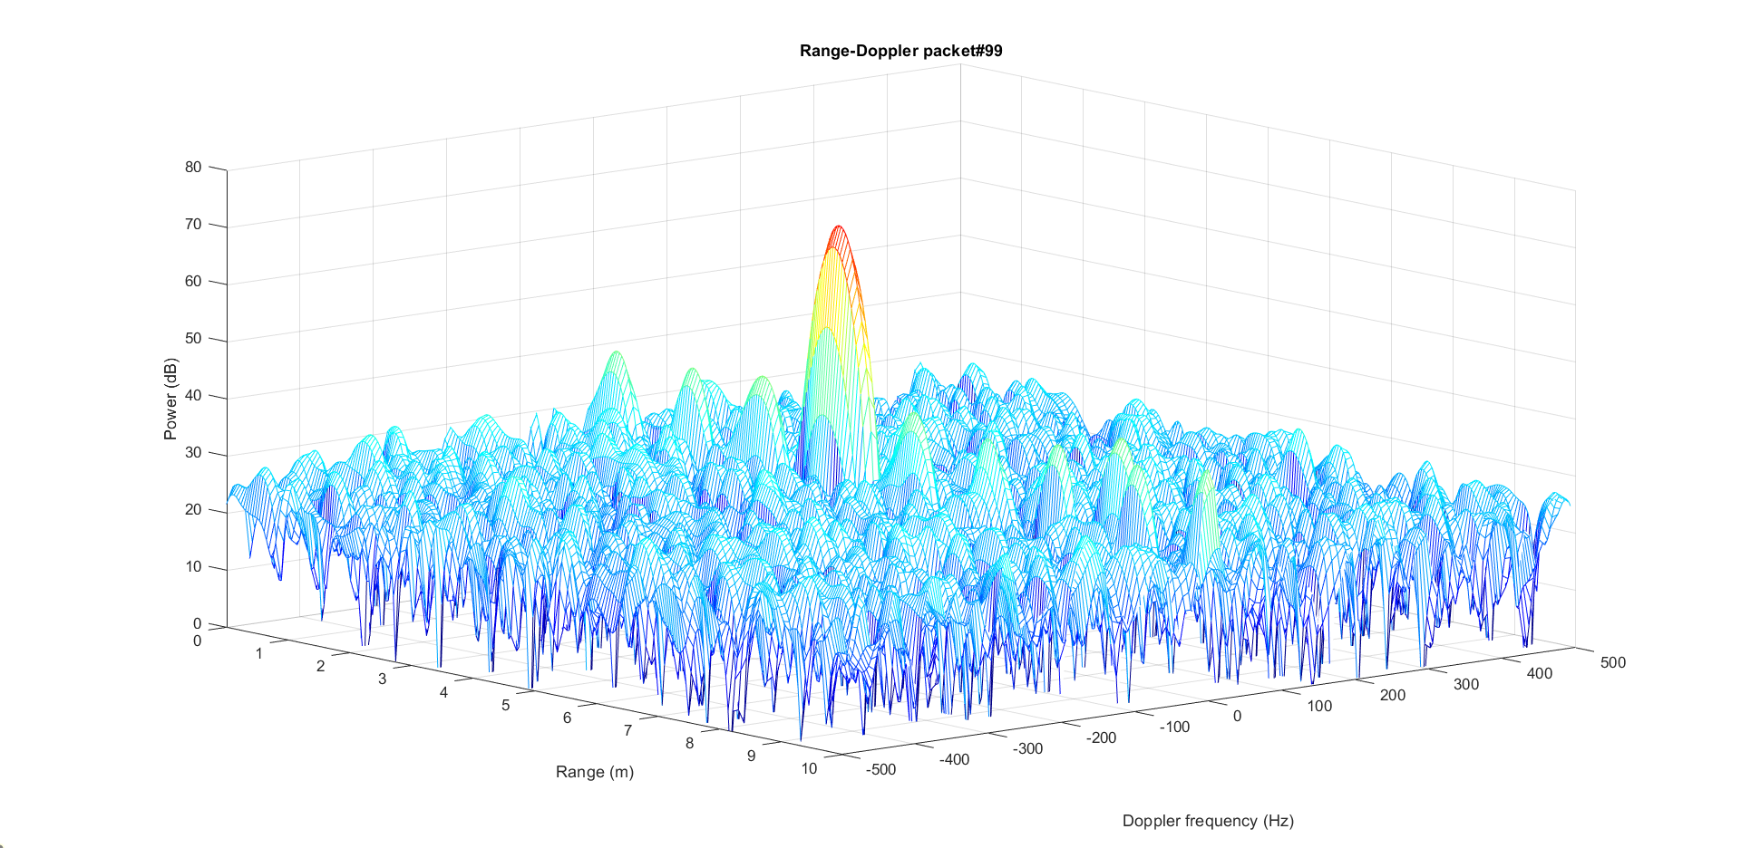
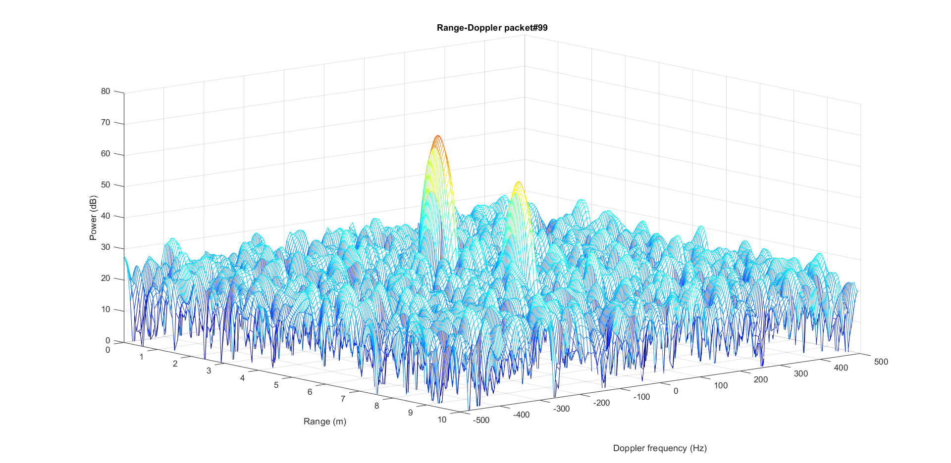
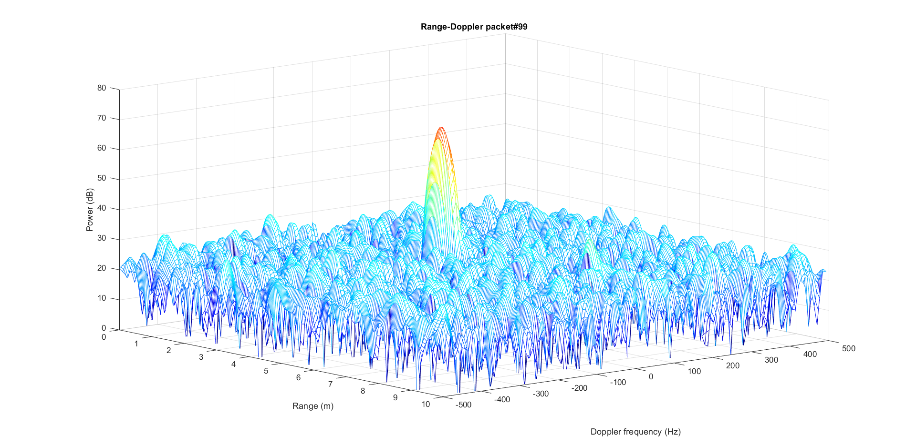
Link budget examples Interference (same code group) from bistatic Tx (x=0,y=8)
1) Ipatov-31
2) Mseq-31
3D
view
3) PBS + Ipatov-4
4) PBS + Walsh-4

Slide 12
Summary
Single-CIR sensing may be used in sensing for short range use cases
Range-Doppler is essential for sensing use-cases with long range and low RCS (walking targets, stand-still respiration ..)
Doppler performance is critical for sensing use-cases
Interference from neighbor transmitters needs proper rejection
In bi-static configurations, phase noise may strongly impact Doppler performance
Add Doppler performance to the metrics for evaluating sensing sequence

