Slide 1
Project: IEEE P802.15 Working Group for Wireless Personal Area Networks (WPANs)
Submission Title: [Pulse Burst Sensing - Phase Noise Proof Supercomplementary Set of Sequences]
Date Submitted: [13 Nov, 2022]
Source: [Håkon A. Hjortland, Nikolaj Andersen, Kristian Granhaug, Dries Neirynck, Jan Roar Pleym, Dag T. Wisland] Company [Novelda AS]
E-mail: [haakon.hjortland@novelda.com]
Re: [Working Group input]
Abstract: [High-PRF bistatic sensing results in extra noisy regions every PRI in the CIR. Pulse burst sensing fixes this problem. Pulse burst sensing is furthermore a supercomplementary set of sequences, which makes it robust against signal deformations.]
Purpose: []
Notice: This document has been prepared to assist the IEEE P802.15. It is offered as a basis for discussion and is not binding on the contributing individual(s) or organization(s). The material in this document is subject to change in form and content after further study. The contributor(s) reserve(s) the right to add, amend or withdraw material contained herein.
Release: The contributor acknowledges and accepts that this contribution becomes the property of IEEE and may be made publicly available by P802.15.

Slide 2
PAR Objective | Proposed Solution (how addressed)
Safeguards so that the high throughput data use cases will not cause significant disruption to low duty-cycle ranging use cases
Interference mitigation techniques to support higher density and higher traffic use cases
Other coexistence improvement
Backward compatibility with enhanced ranging capable devices (ERDEVs)
Improved link budget and/or reduced air-time | High mean PRF, reduced impact of phase noise, combined monostatic and bistatic sensing
Additional channels and operating frequencies
Improvements to accuracy / precision / reliability and interoperability for high-integrity ranging
Reduced complexity and power consumption
Hybrid operation with narrowband signaling to assist UWB
Enhanced native discovery and connection setup mechanisms
Sensing capabilities to support presence detection and environment mapping | Good sensitivity at long ranges, channel diversity from combined monostatic and bistatic sensing
Low-power low-latency streaming
Higher data-rate streaming allowing at least 50 Mbit/s of throughput
Support for peer-to-peer, peer-to-multi-peer, and station-to-infrastructure protocols
Infrastructure synchronization mechanisms

Slide 3
Pulse Burst Sensing
Phase Noise Proof Supercomplementary Set of Sequences

Slide 4
Related TG4ab Contributions
15-22-0061-00-04ab-sensing-continued
15-22-0248-00-04ab-privacy-preserving-and-performance-enhancement-for-uwb-sensing
15-22-0280-01-04ab-deterministic-sts-for-sensing-applications
15-22-0083-01-04ab-uwb-sensing-concepts
15-22-0175-00-04ab-sensing-device
15-22-0308-00-04ab-air-time-efficiency-improvements
15-22-0335-00-04ab-air-time-efficiency-improvements-update

Slide 5
Pulse Burst Sensing
Send bursts of pulses with listening gaps between the bursts
The key feature is the bursts, not the exact sequence
Different sequence designs are possible
SZC, shifted-Ipatov-code, etc.
Pulse burst sensing is a Supercomplementary Set of Sequences (SSS)
Robust against frequency offset, clipping, and other deformations
Implementation: Same number of correlator taps as other sensing sequences, just spaced differently in time

Slide 6
Monostatic / Bistatic / Combistatic Sensing
Monostatic:
Node only transmits to itself, so the sensing sequence does not need to be standardized
Try to avoid collision with known preamble sequences, etc.
Bistatic:
Bistatic-only misses out on monostatic "for free" using the already transmitted energy and is therefore a bit wasteful
If having both bistatic and monostatic data is not necessary, it will probably be easier to perform monostatic sensing instead of bistatic sensing
Combistatic:
Combistatic sensing is simultaneous monostatic and bistatic sensing using the same transmitted energy
This is an important and distinct case, so we introduce the term "combistatic" to describe it
Combistatic is more relevant than monostatic-only and bistatic-only for 802.15.4ab due to the reasons given above

Slide 7
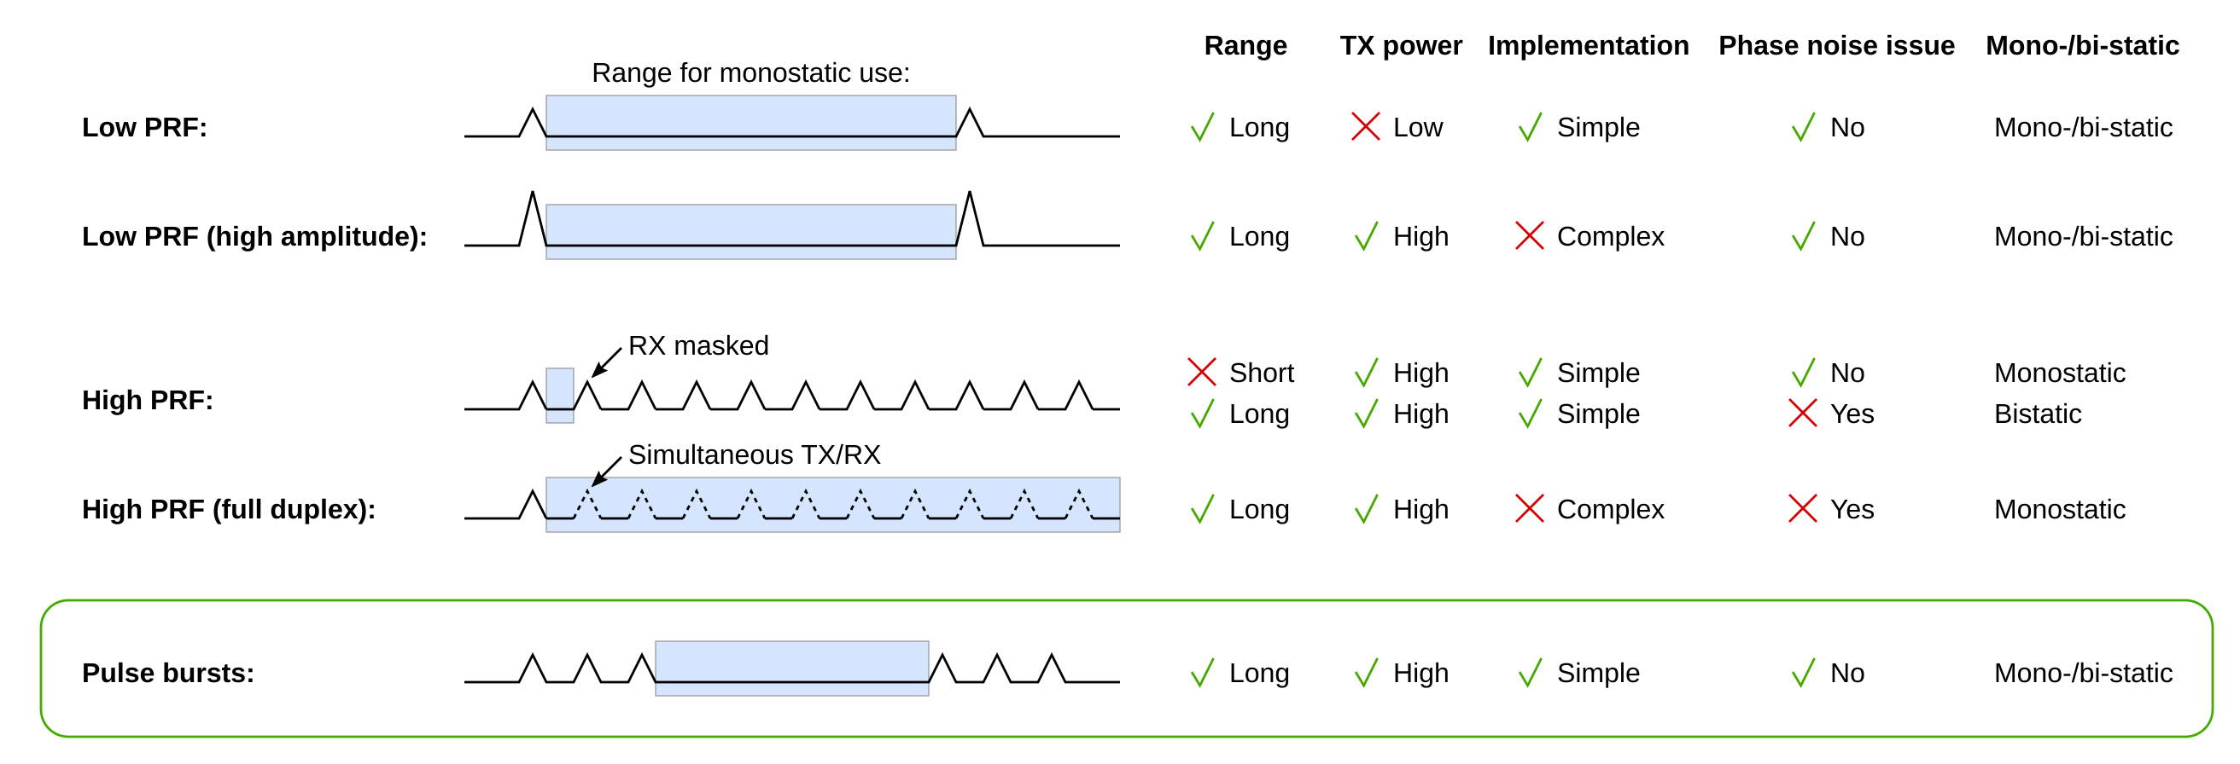
Low PRF, High PRF, and Pulse Bursts Properties

Slide 8
High-PRF Sensing Phase Noise Issue
Bistatic:
TX node and RX node clocks have phase noise
The zero autocorrelation values of e.g. an Ipatov sequence will not actually be zero when there is phase noise, i.e. there will be sidelobe regrowth
This means that e.g. a strong Line of Sight (LOS) pulse will result in sidelobe noise every Pulse Repetition Interval (PRI) in the Channel Impulse Response (CIR)
When the two bistatic nodes are closer than a certain critical distance, this noise will dominate over the thermal noise
Monostatic:
A perfectly reflecting wall X meters away from the monostatic node gives the same received pulse amplitude as with two bistatic nodes 2X meters apart
The phase noise will be lower than for bistatic since TX and RX clocks are correlated

Slide 9
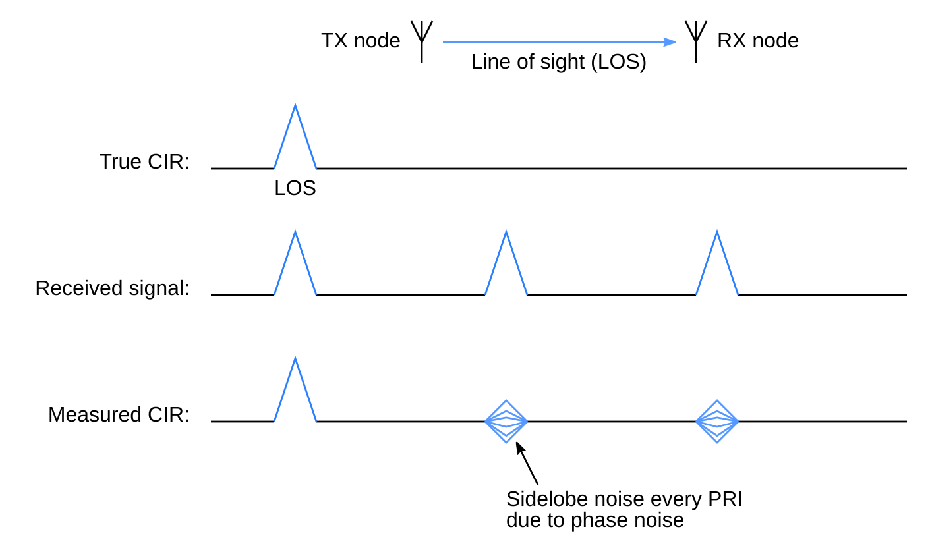
High-PRF Bistatic Sensing Phase Noise Issue

Slide 10
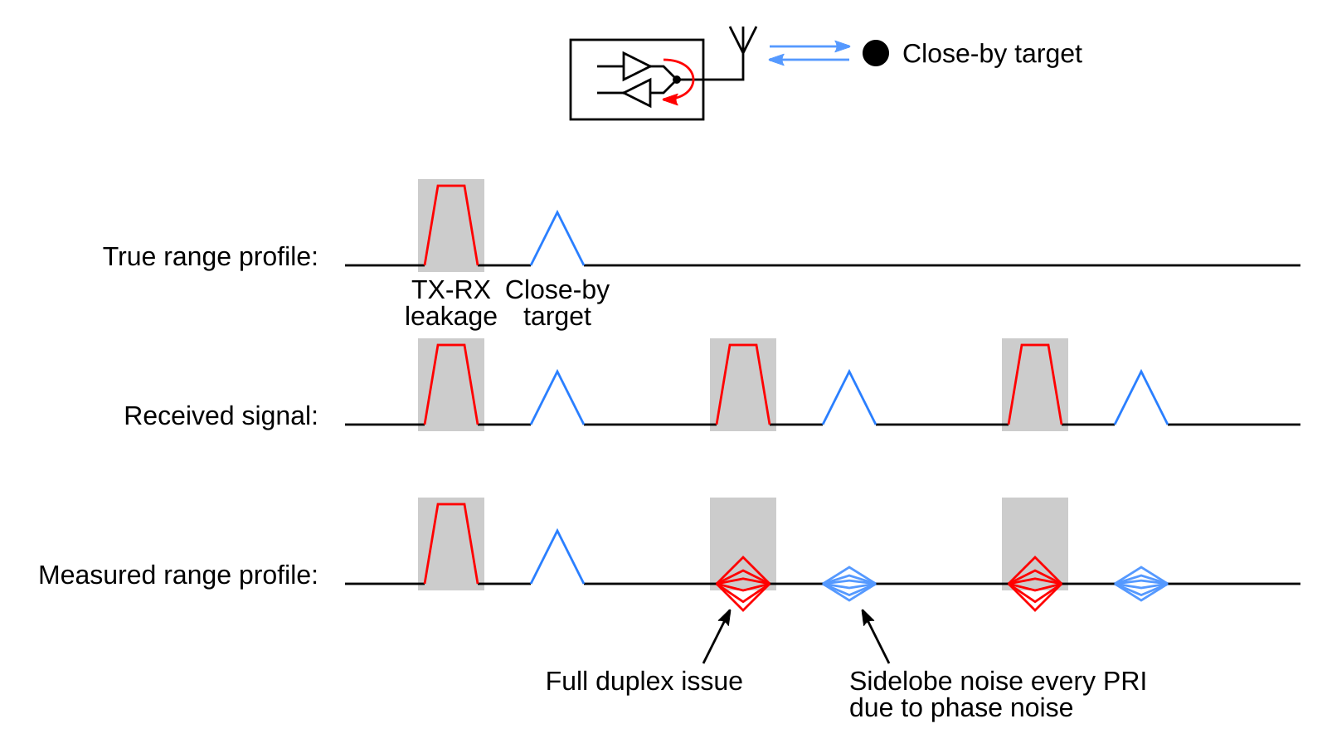
High-PRF Monostatic Sensing Phase Noise Issue

Slide 11
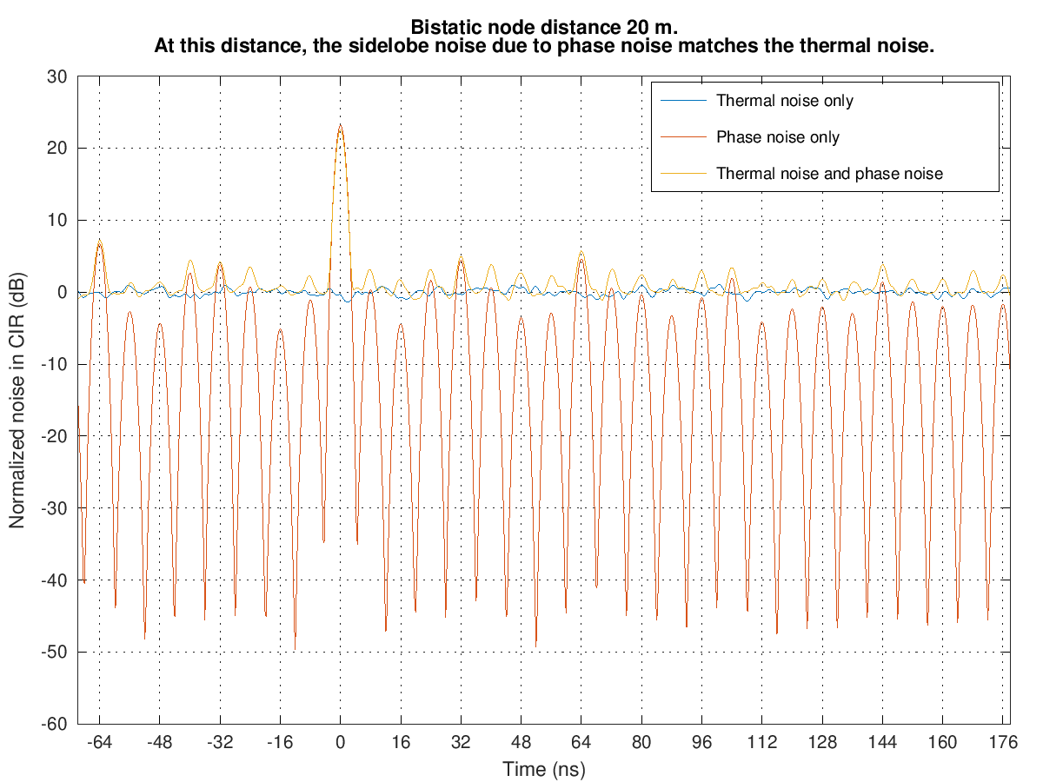
Simulation of Critical Distance

Slide 12
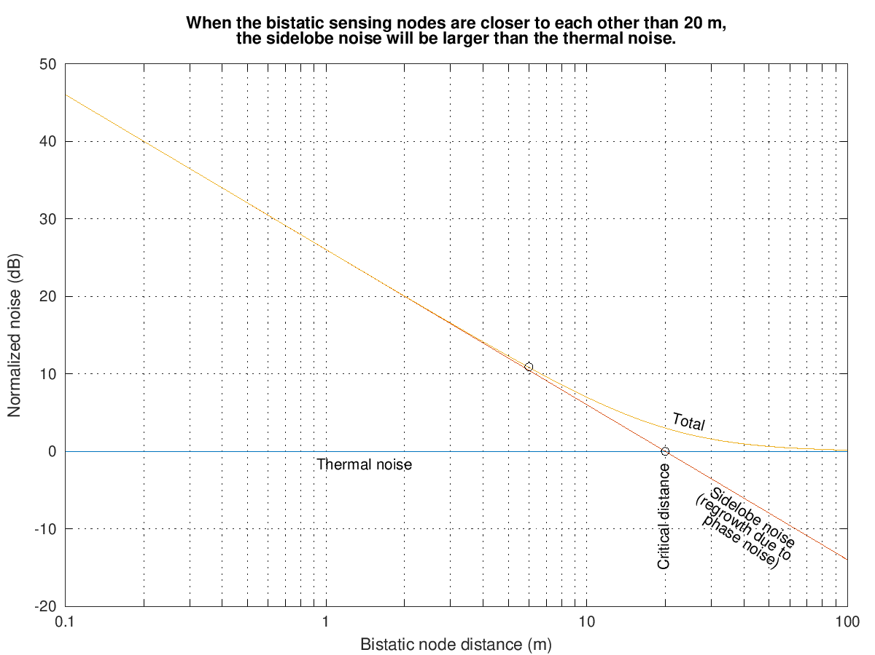
Sidelobe Noise vs. Distance

Slide 13
Some Factors That Affect the Phase Noise Issue
More phase noise increases the sidelobe noise
Larger E_{p} / N₀ in the receiver increases the sidelobe noise
Transmitted energy per pulse
Antenna gains
Distance between TX node and RX node
Constructive pulse interference
Blocked LOS
Receiver noise figure
Sensing sequence
Each autocorrelation offset taps the jitter vector with a different pattern of +1, 0, and –1 taps. This means the phase noise is filtered differently for each autocorrelation offset, resulting in different amounts of noise for each of the sidelobes in the CIR.

Slide 14
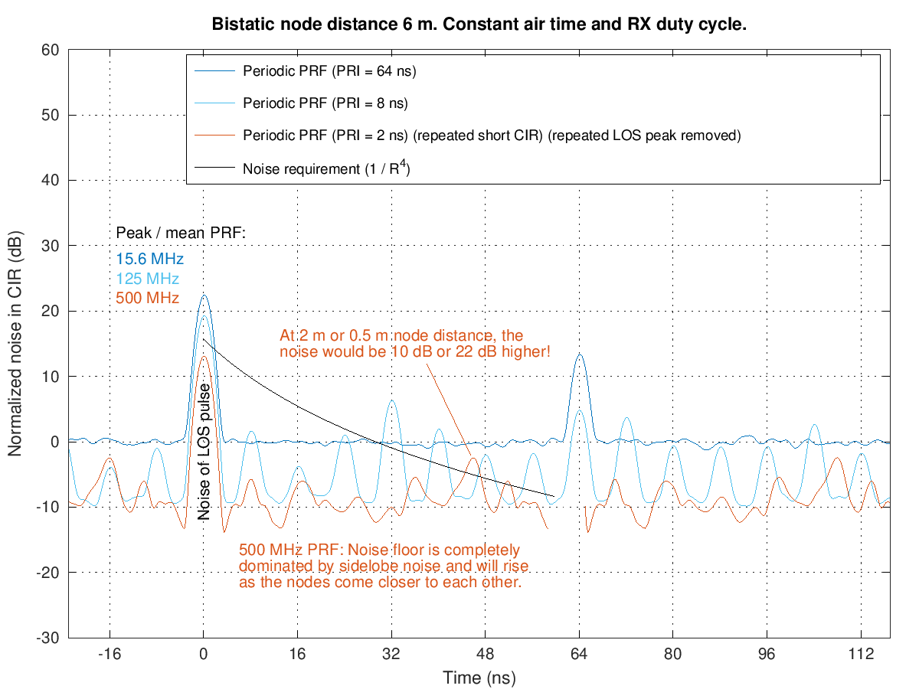
Simulation of Periodic PRF With Thermal and Phase Noise

Slide 15
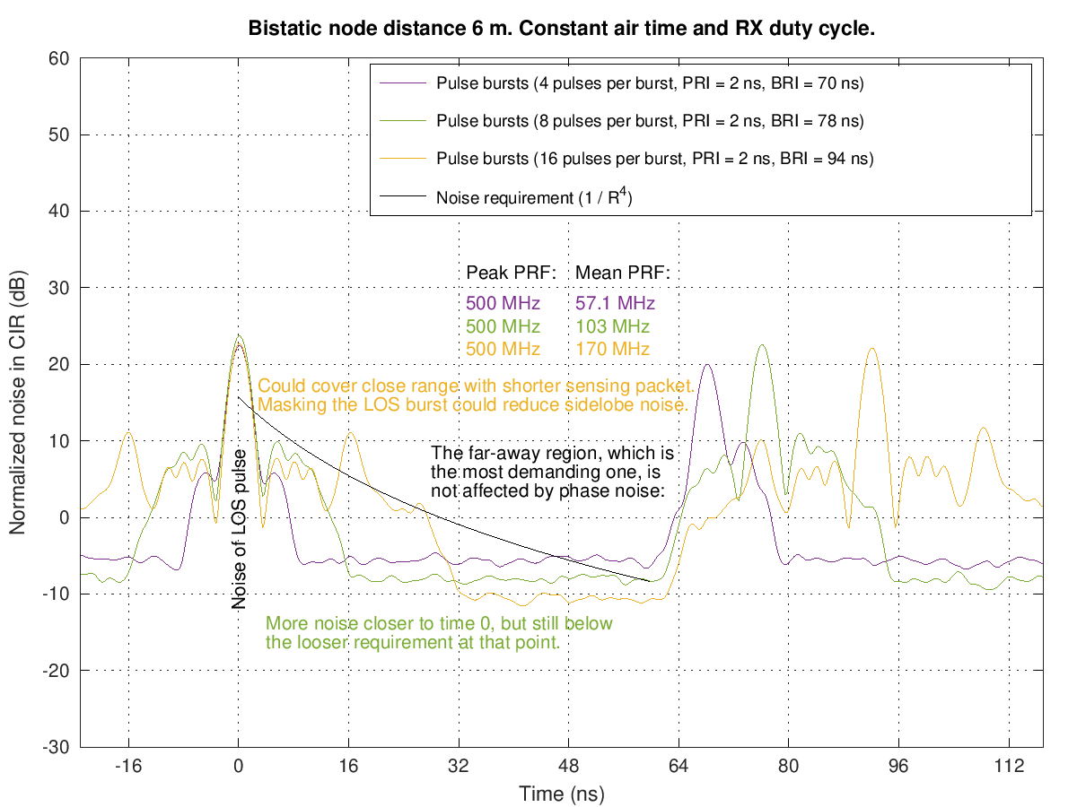
Simulation of Pulse Bursts With Thermal and Phase Noise

Slide 16
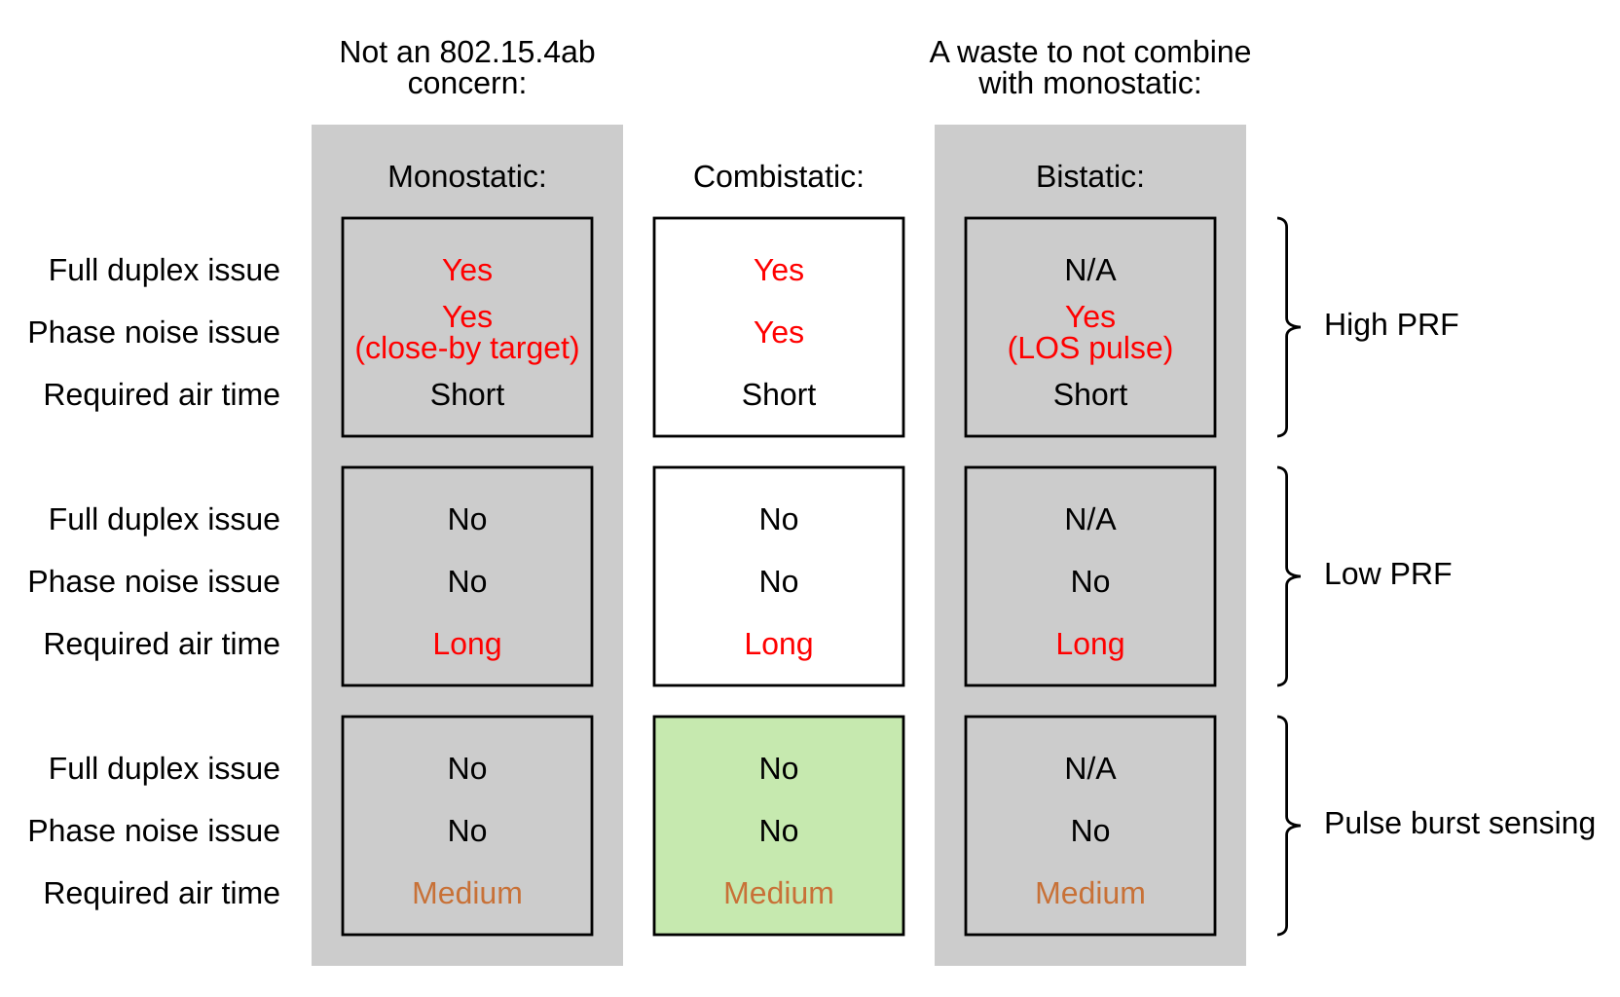
Summary Table

Slide 17
Summary
High-PRF bistatic sensing results in extra noise every PRI in the CIR because of phase noise
Pulse burst sensing:
Solves the phase noise issue
Long gap for undisturbed listening (like low PRF)
Still low air-time usage (like high PRF)
Useful for monostatic / bistatic / combistatic sensing
Is a Supercomplementary Set of Sequences (SSS)

