Slide 1
Project: IEEE P802.15 Working Group for Wireless Personal Area Networks (WPANs)
Submission Title: Challenges in Short-Range and Middle-Range Wireless Communications using the 300GHz-Band
Date Submitted:14 November 14 2022
Source: Tetsuya Kawanishi, Kazuhiko Tamesue, Takuro Sato,
Waseda University
3-4-1, Okubo, Shinjuku-ku, Tokyo 169-8555, Japan
Voice: +81 3 5286 3386, E-Mail: kawanishi@waseda.jp
Iwao Hosako, National Institute of Information
and Communications Technology (NICT)
4-2-1, Nukui-Kitamachi, Koganei, Tokyo 184-8795, Japan
E-Mail: hosako@nict.go.jp
Re: n/a
Abstract: Overviews of applications and challenges in shared use of short-range and middle-range 300GHz transmission.
Purpose: Informing SC THz on key technologies for 300GHz transmission by addressing various applications and interference for discussion in future THz standardization
Notice: This document has been prepared to assist the IEEE P802.15. It is offered as a basis for discussion and is not binding on the contributing individual(s) or organization(s). The material in this document is subject to change in form and content after further study. The contributor(s) reserve(s) the right to add, amend or withdraw material contained herein.
Release: The contributor acknowledges and accepts that this contribution becomes the property of IEEE and may be made publicly available by P802.15.
Takuichi Hirano, Tokyo City University
1-28-1, Tamazutsumi, Setagaya-ku, Tokyo,
158-8557, JAPAN
E-mail: thirano@tcu.ac.jp

Slide 2
Challenges in Short-Range and Middle-Range Wireless Communications using the 300GHz-Band
Tetsuya Kawanishi, Kazuhiko Tamesue, Takuro Sato,
Takuichi Hirano, and Iwao Hosako
Waseda University, Japan
Tokyo City University, Japan
National Institute of Information and Communications Technology (NICT), Japan

Slide 3
Outline of this contribution
Use-cases of short-range and middle-range WPAN
System configuration and features of 300 GHz wireless communication
  The short-range WPAN system
  The middle-range WPAN system
Interference between short-range and middle-range wireless communication

Slide 4


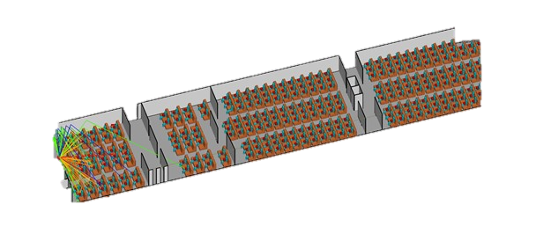

Applications for short-rage and middle-range WPAN
High speed wireless communication for personalized 8K videos
Short-range communication to cover indoor space
Medium-range communication to cover stadium or aircraft cabin
Use case 3:
-Aircraft cabin
-In-flight video services
-8K video stream (middle range)
Use case 1:
-Indoor
-Virtual experiences
-8K video stream
(short range)
300GHz
100Gbps
3m
300GHz
20Gbps 100 users
70m
Use case 2:
-Stadium
-Personalized video services
-8K video stream
(middle-range)
300GHz
20Gbps 100 users ( 1 channel )
70m
Tetsuya Kawanishi, Waseda Univ., et al

Slide 5
A short-range wireless communication system
Target
  - Throughput 100 Gbps
  - Bandwidth 25 GHz
  - Distance 3 m
  - Beam scan 30deg
Key Features
  - 16-QAM
  - Beamforming
  - A small size TX module for a compact access point
Access Point
Beam forming
WT
Directivity (dBi)
90
Azimuth (xy-plane)
120
60
Elevation (xz-plane)
1
0
150
0
30
-
1
0
-
2
0
0°
-
180
3
0
0
19 dBi
-150
-30
-120
-60
-90
Tetsuya Kawanishi, Waseda Univ., et al

Slide 6
Link budget for short-range WPAN
40dBm
(EIRP)
15dBi
(Ant. Gain)
25dBm
(Tx Pow.)
-46.5dBm
(Rx Pow.)
-91.5dB (3m)
(Free Space Loss)
3m: -91.5dB
5m: -96.dB
10m: -102dB
20m: -108dB
50m: -115dB
5dBi
(Ant. Gain)
-51.5dBm
Noise Floor (-73.8dBm)
Tetsuya Kawanishi, Waseda Univ., et al

Slide 7
A middle-range wireless communication system
Target
  - Throughput 20 Gbps per channel
  - Spectral efficiency 10 bps/Hz
  - Bandwidth 2.16 GHz per channel
  - Distance 70 m
Key Specification
  - 3x3 MIMO
  - CP-OFDM 64-QAM subcarriers and LDPC (1440, 1344)
  256-QAM subcarriers and LDPC (1440, 1056)
Changing the third stream from LP to RHCP or LHCP reduces the number of interfering stream from (1,1,2) to (1,0,1) in stream1/2/3.
Transmitter
3x3MIMO
Receiver
RHCP
ANT
RHCP
ANT
LHCP
ANT
Interference
LHCP
ANT
IP data
IP data
QSFP+
I/F
PHY
RHCP
ANT
Interference
RHCP
ANT
PHY
QSFP+
I/F
precoder
equalizer
feedback precoding weights
RHCP Right-handed circular polarization
LHCP Left-handed circular polarization

Slide 8
A middle-range wireless communication system
MIMO operation
  Crosstalk between RHCP and LHCP
  If the XPD between antennas is enough, the D/U ratio is ensured.
  Crosstalk between RHCP and RHCP
  D/U ratio is ensured by the null point due to the array antennas.
8x8 array antenna
Peak Gain: 22.9dBi
HPBW: 12.0°
FNBW: 32.0°
16x16 array antenna
Peak Gain: 28.9dBi
HPBW: 6.0°
FNBW: 16.0°
XPD：Cross Polarization Discrimination
HPBW : Half Power Beam Width
FNBW : First Null Beam Width

Slide 9
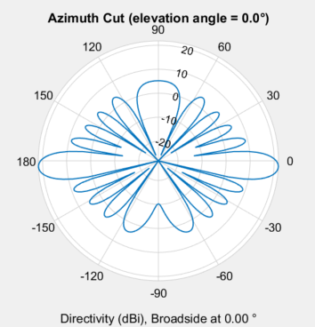
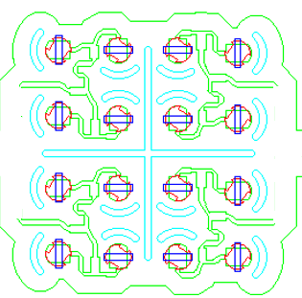
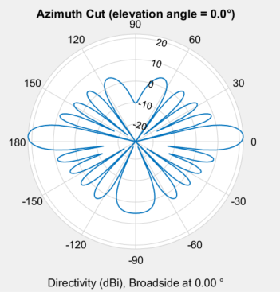
D/U ratio vs. Antenna distance
Assumption
Tx antennas are in same position
antenna main lobes opposite each other
height of TX and RX antenna is same
1path LoS communication
Rx
Top view
RHCP array antenna
Tx
RHCP array antenna
10m
D
2.86° @d=1m
d
θ
U
10m
16x16 array antenna
RHCP array antenna
8x8 array antenna
D/U ratio [dB]
desired D/U ratio is 3dB higher than desired SINR for demodulation.
256-QAM
64-QAM
16-QAM
Antenna distance d[m]

Slide 10
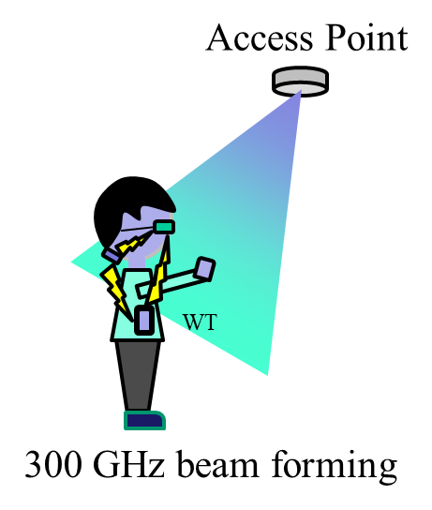
Interference between short-range and middle-range wireless communication
  From the link budget, the receiver level -68dBm is necessary for 64-QAM demodulation. In this case, desired interference level from short range system to middle-range system receiver should be lower than -90dBm.
  If the transmit EIRP of a short-range system is 40 dBm, distance attenuation is insufficient.
  Ideas to reduce interference
    To realize different coverage areas, arrange two TXs by changing the height or direction of antennas. Utilization of narrow beam and/or absorbers is another solution.
    Reshaping the radiation pattern of the short-range BS antenna to reduce interference.
    Use CSMA/CA compliant protocol (data link layer) and carrier sensing.
Short-range assumption
Tx Power 25dBm
Antenna Gain 15dBi
RHCP array antenna
RHCP array antenna
70m
Tx
20m
Rx
desired interference level for 64-QAM

Slide 11
Summary and Discussion
Use-cases of short-range and middle-range WPAN
System configuration and features of 300 GHz wireless communication
  The short-range WPAN will covers a narrow (3m) range with high throughput
  The middle-range WPAN will covers a longer 70 m range for multiple users
Interference reduction between short-range and middle-range wireless communications
  Considered interference when both systems use the same frequency band
  Ideas to reduce interference are discussed

