Slide 1
Project: IEEE P802.15 Working Group for Wireless Personal Area Networks (WPANs)
Submission Title: Propagation Characteristics of UWB Communication Applications for Passengers Bus Use Case
Date Submitted: November 13th, 2022
Source: Daisuke Anzai, Nagoya Institute of Technology
Address Gokiso-cho, Showa-ku, Nagoya, 466-8555, Japan
Voice: +81-52-735-5389, FAX: +81-52-735-5389, E-Mail: anzai@nitech.ac.jp
Re: In response to call for technical contributions
Abstract: This provides of fundamental propagation characteristics including path loss characteristics for UWB communication applications for passengers bus use case.
Purpose: Material for discussion in P802.15.6a TG corresponding to comments in EC Meeting
Notice: This document has been prepared to assist the IEEE P802.15. It is offered as a basis for discussion and is not binding on the contributing individual(s) or organization(s). The material in this document is subject to change in form and content after further study. The contributor(s) reserve(s) the right to add, amend or withdraw material contained herein.
Release: The contributor acknowledges and accepts that this contribution becomes the property of IEEE and may be made publicly available by P802.15.

Slide 2
Propagation Characteristics of UWB Communication Applications for Passengers Bus Use Case
Daisuke Anzai
Nagoya Institute of Technology

Slide 3
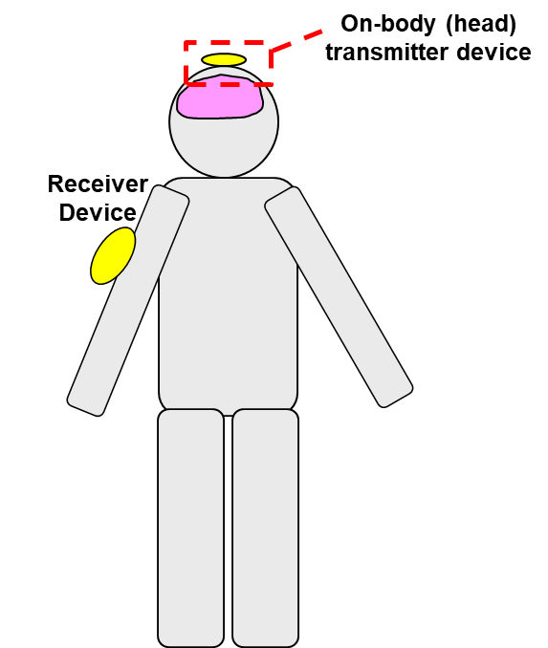
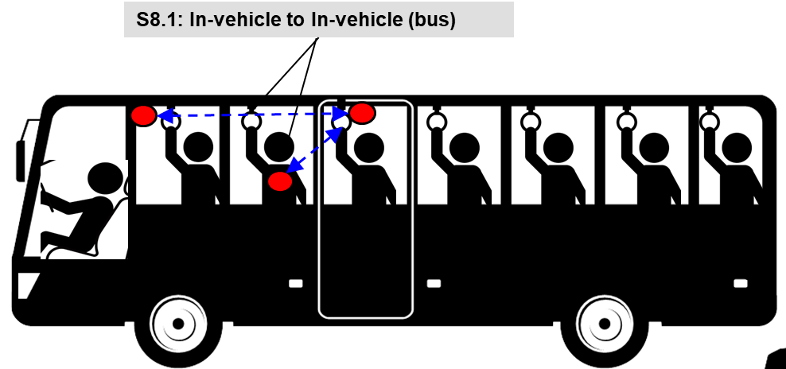
UWB communication applications
Vehicle BAN (VBAN)
Human BAN (HBAN)
Passengers bus model^{[1]}
Brain-computer interface (BCI) model^{[1]}
^{[1]}IEEE 802.15-22-0344-02-006a

Slide 4
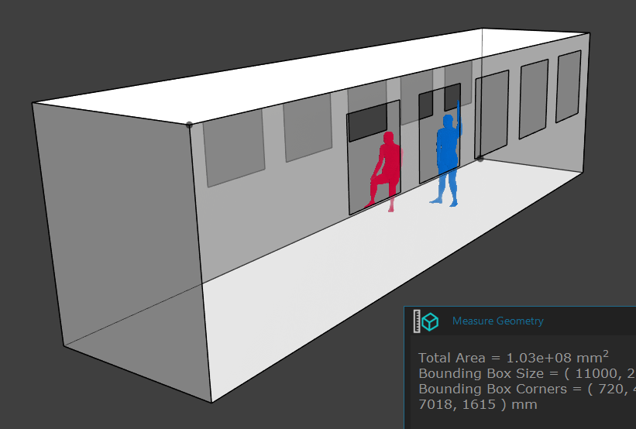
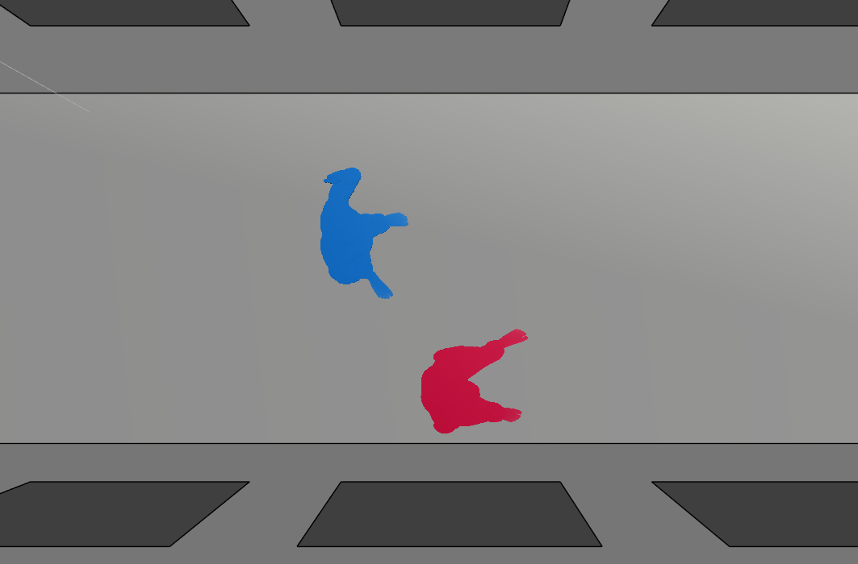
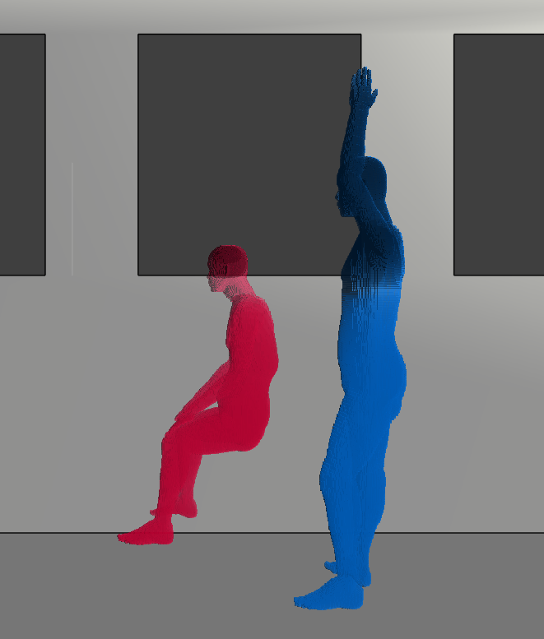
Passenger bus model
Passenger bus model^{[1]}
^{[1]} IEEE 802.15-22-0344-02-006a

Slide 5

Simulation model for HBAN in passenger bus
Frequency: 3.4 – 4.8 GHz
Frequency-dependent FDTD method
Multi-size voxel model (min. size: 0.5 mm)
Cylinder model employed as a human model for simplification of FDTD calculation
HBAN node on the chest of the human model
$${PL_{dB}(f)=10log}_{10}\left[\frac{P_{t}\left(f\right)\left(1−{\left|S_{11}\left(f\right)\right|}^{2}\right)}{P_{r}\left(f\right)}\right]$$
Setting A

Slide 6
Simulation model for HBAN in passenger bus
HBAN
Setting A

Slide 7
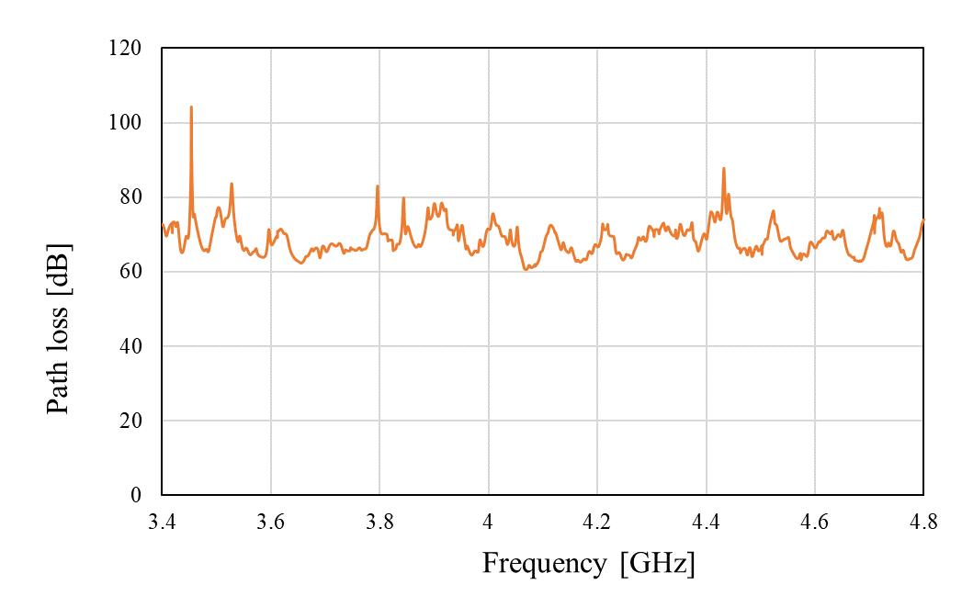
Path loss characteristics
Setting A

Slide 8
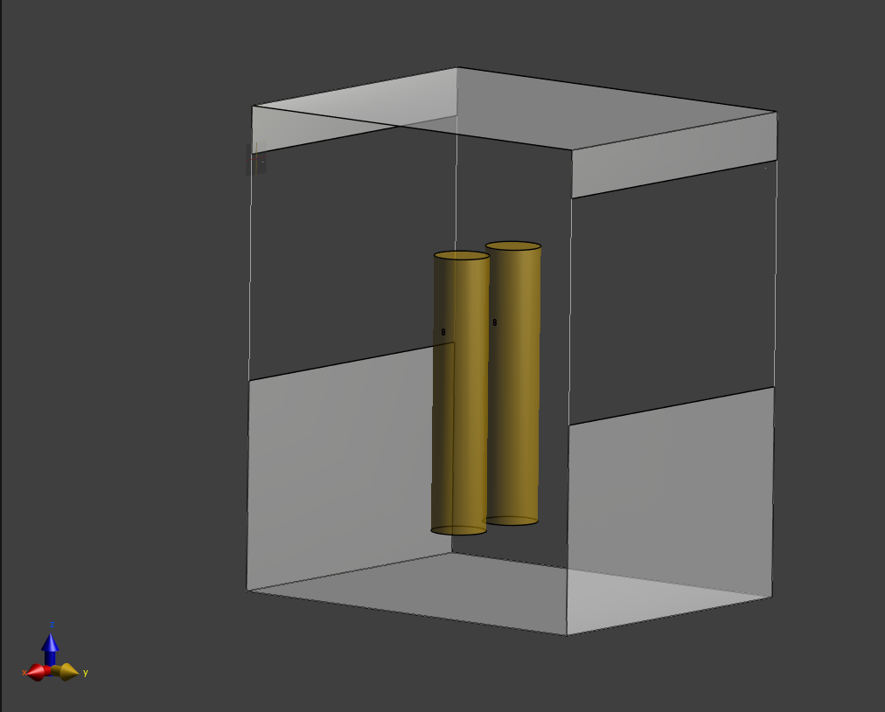
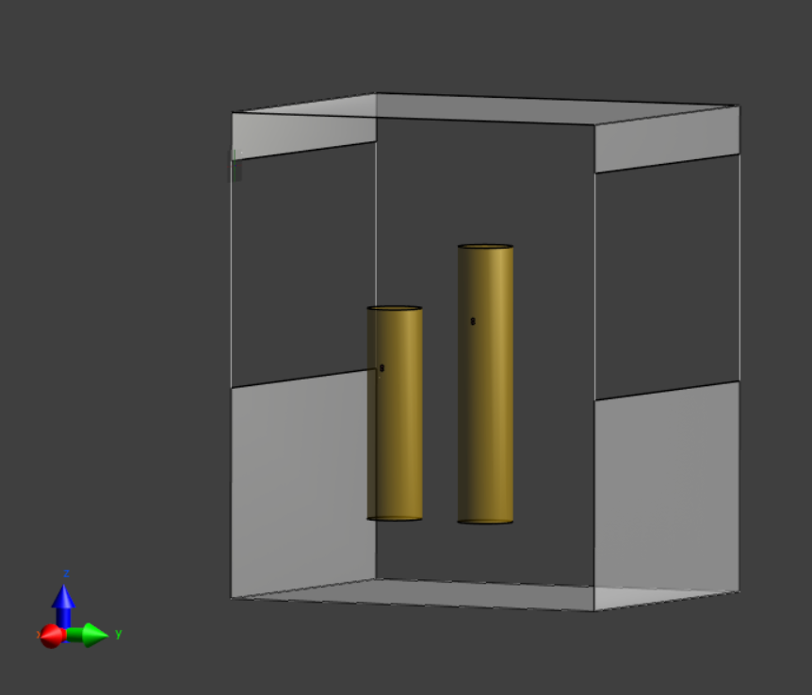
Other simulation settings for HBAN path loss analysis in bus model
HBAN
HBAN
Setting B
Setting C

Slide 9
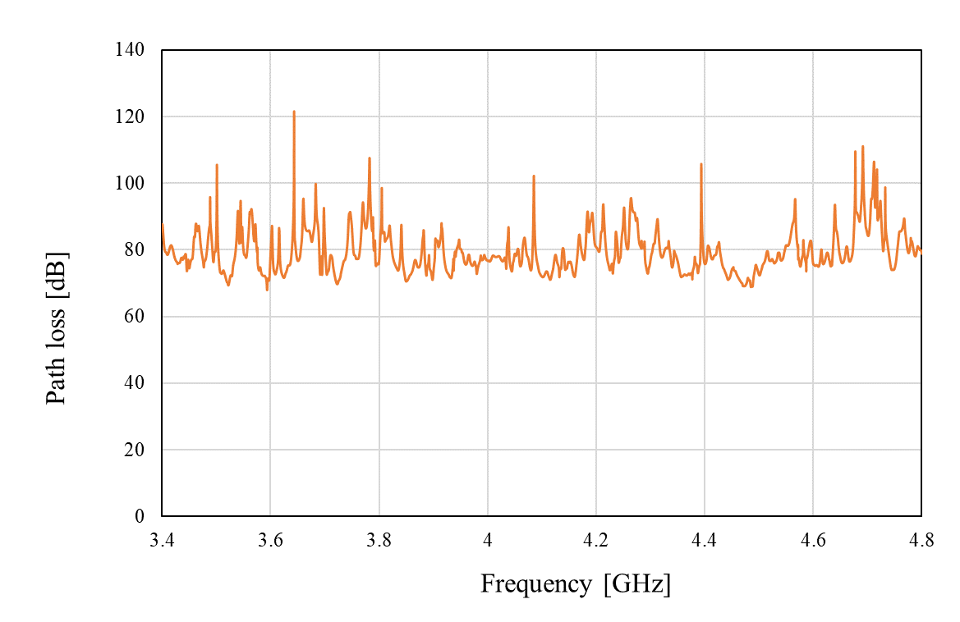
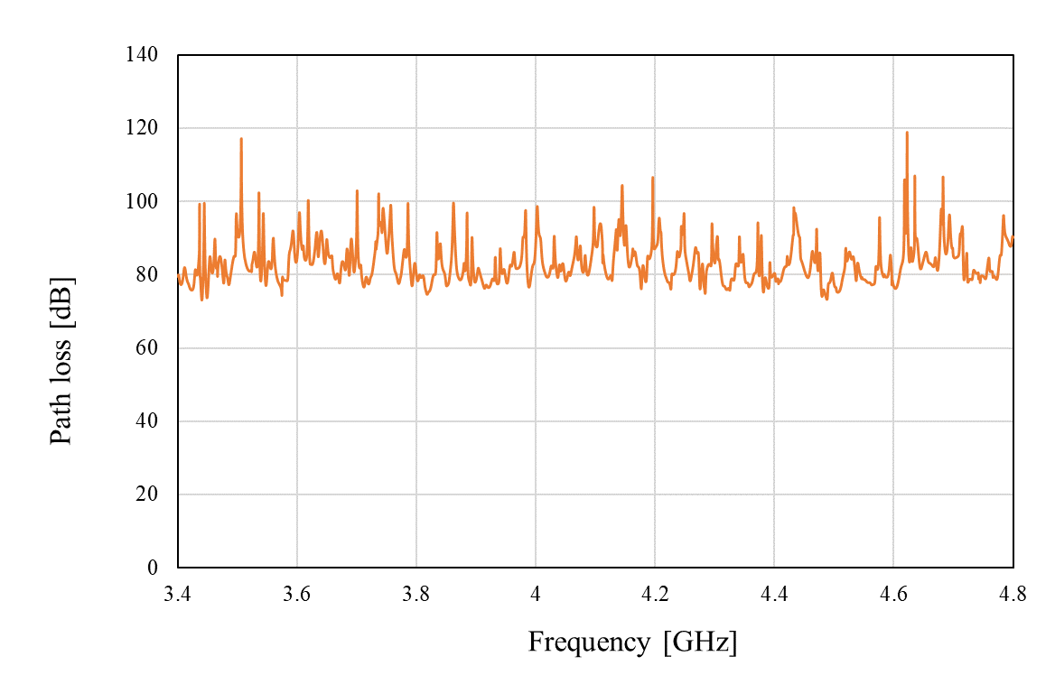
Path loss analysis results
Setting B
Setting C

Slide 10
Path loss analysis for HBAN to VBAN link
VBAN
coordinator #2
VBAN
coordinator #1
VBAN
coordinator

Slide 11
Path loss of a link from HBAN to VBAN
Setting A
VBAN #1
VBAN #2

Slide 12
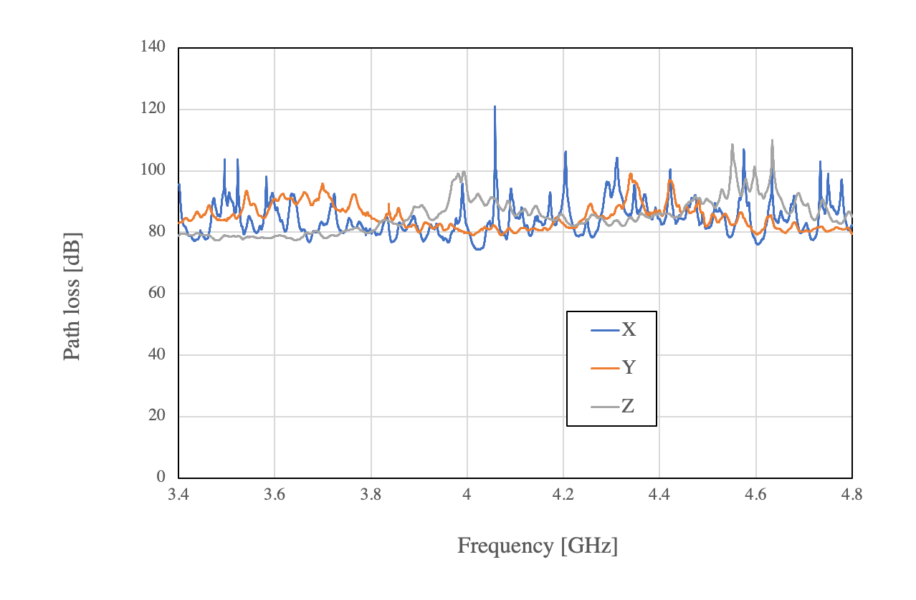
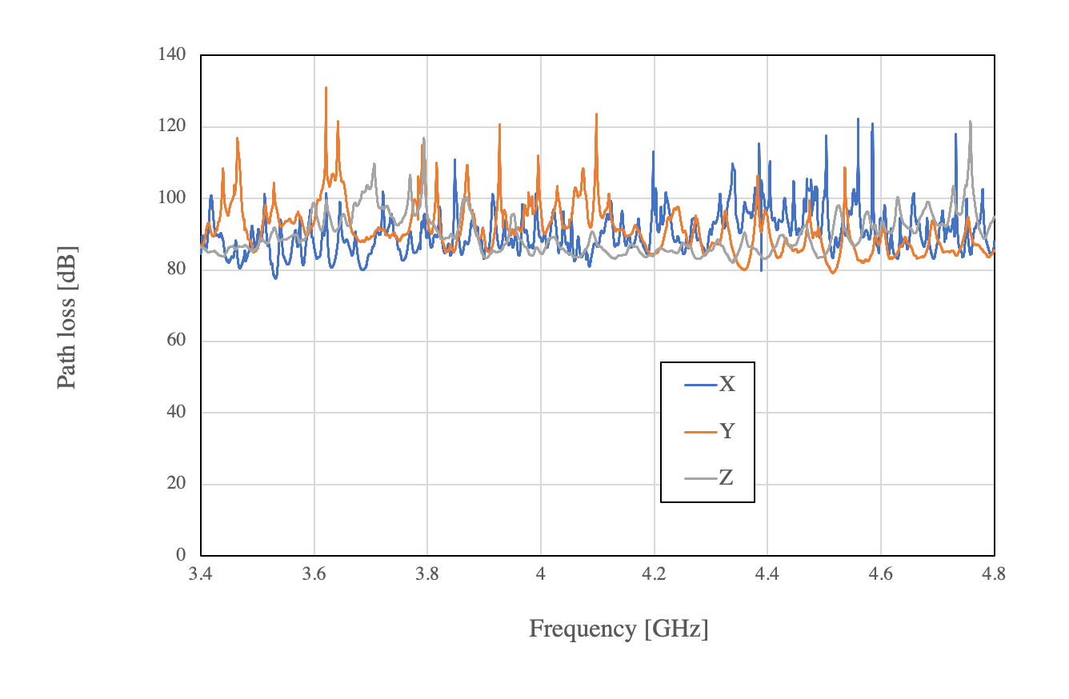
Path loss of a link from HBAN to VBAN
Setting B
VBAN #1
VBAN #2

Slide 13
References
D. Anzai, I. Balasingham, G. Fischer, J. Wang, “Reliable and High-Speed Implant Ultra-Wideband Communications with Transmit–Receive Diversity,” EAI/Springer Innovations in Communication and Computing, pp. 27-32, March 2020.
Y. Shimizu, D. Anzai, R. C-Santiago, P. A. Floor, I. Balasingham, and J. Wang, “Performance evaluation of an ultra-wideband transmit diversity in a living animal experiment” IEEE Trans. Microw. Theory Tech., vol. 65, no. 7, pp. 2596-2606, July 2017.
D. Anzai, K. Katsu, R. Chavez-Santiago, Q. Wang, D. Plettemeier, J. Wang, and I. Balasingham, “Experimental evaluation of implant UWB-IR transmission with living animal for body area networks,” IEEE Trans. Microw. Theory Tech., vol. 62, no. 1, pp. 183-192, Jan. 2014.
J. Shi, D. Anzai, and J. Wang, “Channel modeling and performance analysis of diversity reception for implant UWB wireless link,” IEICE Trans. Commun., no. E95-B, vol. 10, pp. 3197-3205, Oct. 2012.

