Slide 1
Project: IEEE P802.15 Working Group for Wireless Personal Area Networks (WPANs)
Submission Title: Propagation Characteristics of UWB Communication Applications for BCI Use Case
Date Submitted: November 13th, 2022
Source: Daisuke Anzai, Nagoya Institute of Technology
Address Gokiso-cho, Showa-ku, Nagoya, 466-8555, Japan
Voice: +81-52-735-5389, FAX: +81-52-735-5389, E-Mail: anzai@nitech.ac.jp
Re: In response to call for technical contributions
Abstract: This provides of fundamental propagation characteristics including path loss characteristics for UWB communication applications for BCI use case.
Purpose: Material for discussion in P802.15.6a TG corresponding to comments in EC Meeting
Notice: This document has been prepared to assist the IEEE P802.15. It is offered as a basis for discussion and is not binding on the contributing individual(s) or organization(s). The material in this document is subject to change in form and content after further study. The contributor(s) reserve(s) the right to add, amend or withdraw material contained herein.
Release: The contributor acknowledges and accepts that this contribution becomes the property of IEEE and may be made publicly available by P802.15.

Slide 2
Propagation Characteristics of UWB Communication Applications for
BCI Use Case
Daisuke Anzai
Nagoya Institute of Technology

Slide 3
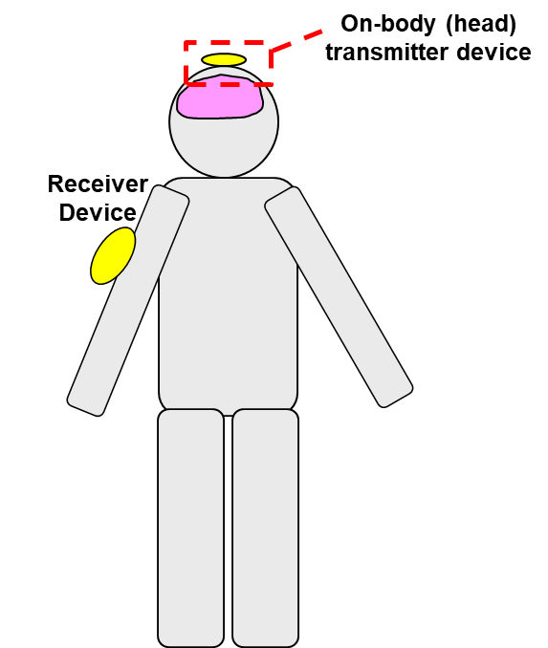
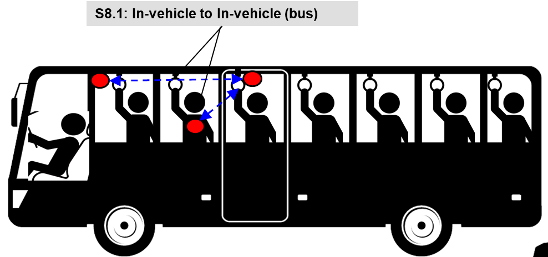
UWB communication applications
Vehicle BAN (VBAN)
Human BAN (HBAN)
Passengers bus model^{[1]}
Brain-computer interface (BCI) model^{[1]}
^{[1]}IEEE 802.15-22-0344-02-006a

Slide 4
Path loss analysis for BCI model

Slide 5
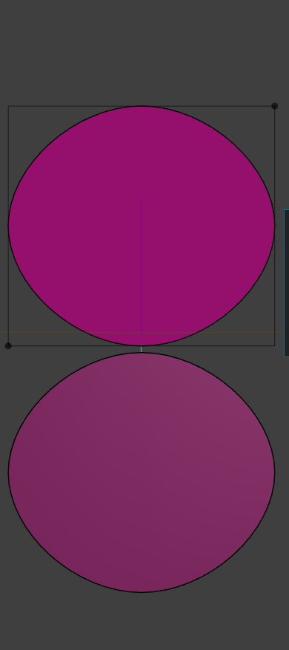
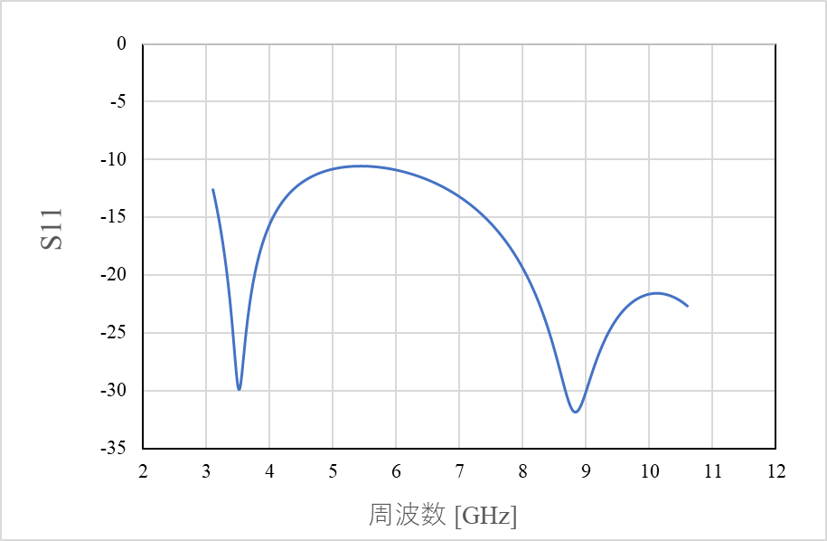
UWB antenna at 3.1 - 10.6 GHz band
20 mm
Frequency: 3.1 – 10.6 GHz
Planar elliptical dipole antenna
Element size: 20 mm x 18 mm x 1 mm
Interval between each element: 0.5 mm
18 mm
|S₁₁| [dB]
Frequency [GHz]

Slide 6
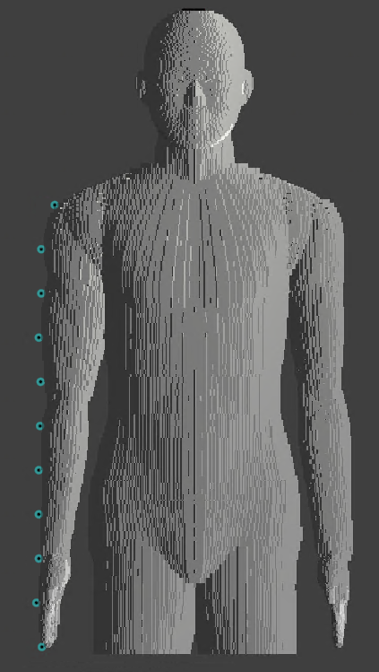



Simulation model
UWB antenna
(transmit antenna)
Frequency: 3.4 – 4.8 GHz
Frequency-dependent finite-different time-domain (FDTD) method
Multi-size voxel model (min. size: 0.5 mm)
Homogeneous human model (Japanese male developed by NICT, Japan)
11 receiving points on the right-side arm
Measurement
point
#1
#2
…
…
$$z$$
#10
#11
Transmitted signal waveform
$$x$$
$$y$$

Slide 7
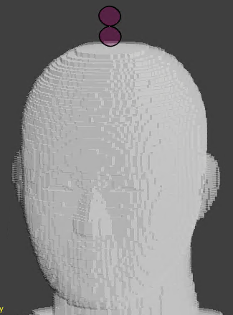
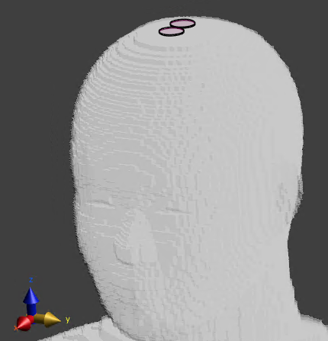
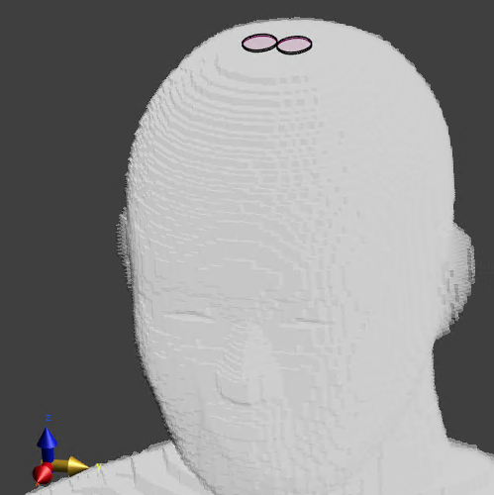
Antenna placement
x-axis direction
y-axis direction
z-axis direction

Slide 8
Dielectric constants of human model
Relative permittivity
Conductivity

Slide 9
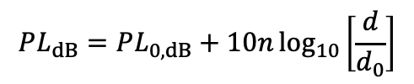

Path loss analysis results
$$PL_{dB}=PL_{0,dB}+10n\log_{10}\left[\frac{d}{d_{0}}\right]$$
Transmit antenna direction: z-axis
Transmit antenna | Received components | PL₀ [dB] | n
x | x y z | 109.8 100.8 118.5 | 2.22 3.12 1.23
y | x y z | 103.9 85.3 101.4 | 0.85 3.02 2.16
z | x y z | 87.2 68.2 84.7 | 0.91 3.27 2.23
$d_{0}=0.408$ m

Slide 10
Path loss analysis results
Transmit antenna direction: x-axis
Transmit antenna direction: y-axis

Slide 11
Frequency dependency of path loss characteristics
Transmit antenna direction: z-axis

Slide 12
Frequency dependency of path loss characteristics
Transmit antenna direction: z-axis

Slide 13
Frequency dependency of path loss characteristics
Transmit antenna direction: z-axis

Slide 14
Frequency dependency of path loss characteristics
Transmit antenna direction: z-axis

Slide 15
References
D. Anzai, I. Balasingham, G. Fischer, J. Wang, “Reliable and High-Speed Implant Ultra-Wideband Communications with Transmit–Receive Diversity,” EAI/Springer Innovations in Communication and Computing, pp. 27-32, March 2020.
Y. Shimizu, D. Anzai, R. C-Santiago, P. A. Floor, I. Balasingham, and J. Wang, “Performance evaluation of an ultra-wideband transmit diversity in a living animal experiment” IEEE Trans. Microw. Theory Tech., vol. 65, no. 7, pp. 2596-2606, July 2017.
D. Anzai, K. Katsu, R. Chavez-Santiago, Q. Wang, D. Plettemeier, J. Wang, and I. Balasingham, “Experimental evaluation of implant UWB-IR transmission with living animal for body area networks,” IEEE Trans. Microw. Theory Tech., vol. 62, no. 1, pp. 183-192, Jan. 2014.
J. Shi, D. Anzai, and J. Wang, “Channel modeling and performance analysis of diversity reception for implant UWB wireless link,” IEICE Trans. Commun., no. E95-B, vol. 10, pp. 3197-3205, Oct. 2012.

