Slide 1
Project: IEEE P802.15 Working Group for Wireless Personal Area Networks (WPANs)
Submission Title: Channels for Frequency Stitching
Date Submitted: November 8, 2022
Source: Steve Shellhammer, Pooria Pakrooh, Bin Tian, and Koorosh Akhavan (Qualcomm)
E-Mail:{sshellha, ppakrooh, btian, kakhavan}@qti.qualcomm.com
Abstract: We propose channels for Frequency Stitching in RF Sensing.
Notice: This document has been prepared to assist the IEEE P802.15. It is offered as a basis for discussion and is not binding on the authoring individual(s) or organization(s). The material in this document is subject to change in form and content after further study. The authors(s) reserve(s) the right to add, amend or withdraw material contained herein.

Slide 2
PAR Objective | Proposed Solution (how addressed)
Safeguards so that the high throughput data use cases will not cause significant disruption to low duty-cycle ranging use cases
Interference mitigation techniques to support higher density and higher traffic use cases
Other coexistence improvement
Backward compatibility with enhanced ranging capable devices (ERDEVs)
Improved link budget and/or reduced air-time
Additional channels and operating frequencies
Improvements to accuracy / precision / reliability and interoperability for high-integrity ranging
Reduced complexity and power consumption
Hybrid operation with narrowband signaling to assist UWB
Enhanced native discovery and connection setup mechanisms
Sensing capabilities to support presence detection and environment mapping | We propose a channel for Frequency Stitching for RF Sensing.
Low-power low-latency streaming
Higher data-rate streaming allowing at least 50 Mbit/s of throughput
Support for peer-to-peer, peer-to-multi-peer, and station-to-infrastructure protocols
Infrastructure synchronization mechanisms

Slide 3
Background
To increase the bandwidth for RF Sensing a proposal for Frequency Stitching was made in [1, 2]
This allows for increased bandwidth by stitching together frequency overlapping frequency segments
Here is a figure from [2]
Control on Main UWB Channel
SF
CM = Control Message SF = Sensing Fragment
Frequency
SF
CM
SF
Time
The sensing fragments (SFs) overlap sufficiently so that it is possible to stitch them together and increase the effective bandwidth
The required total bandwidth is larger than the 499.2 MHz channel bandwidth

Slide 4
Background (cont.)
To address the wider bandwidth, it was proposed in [3] to support overlapping channels
Channel Number | Center Freq, MHz | Nominal Width, MHz | Start | End
5 | 6489.6 | 499.2 | 6240.0 | 6739.2
15 | 6614.4 | 499.2 | 6364.8 | 6864.0
16 | 6739.2 | 499.2 | 6489.6 | 6988.8
17 | 6864.0 | 499.2 | 6614.4 | 7113.6
6 | 6988.8 | 499.2 | 6739.2 | 7238.4
18 | 7113.6 | 499.2 | 6864.0 | 7363.2
19 | 7238.4 | 499.2 | 6988.8 | 7488.0
20 | 7363.2 | 499.2 | 7113.6 | 7612.8
8 | 7488.0 | 499.2 | 7238.4 | 7737.6
21 | 7612.8 | 499.2 | 7363.2 | 7862.4
22 | 7737.6 | 499.2 | 7488.0 | 7987.2
23 | 7862.4 | 499.2 | 7612.8 | 8112.0
9 | 7987.2 | 499.2 | 7737.6 | 8236.8
24 | 8112.0 | 499.2 | 7862.4 | 8361.6
25 | 8236.8 | 499.2 | 7987.2 | 8486.4
26 | 8361.6 | 499.2 | 8112.0 | 8611.2
10 | 8486.4 | 499.2 | 8236.8 | 8736.0
27 | 8611.2 | 499.2 | 8361.6 | 8860.8
28 | 8736.0 | 499.2 | 8486.4 | 8985.6
29 | 8860.8 | 499.2 | 8611.2 | 9110.4
12 | 8985.6 | 499.2 | 8736.0 | 9235.2
30 | 9110.4 | 499.2 | 8860.8 | 9360.0
31 | 9235.2 | 499.2 | 8985.6 | 9484.8
32 | 9360.0 | 499.2 | 9110.4 | 9609.6
13 | 9484.8 | 499.2 | 9235.2 | 9734.4
33 | 9609.6 | 499.2 | 9360.0 | 9859.2
34 | 9734.4 | 499.2 | 9484.8 | 9984.0
35 | 9859.2 | 499.2 | 9609.6 | 10108.8
14 | 9984.0 | 499.2 | 9734.4 | 10233.6
36 | 10108.8 | 499.2 | 9859.2 | 10358.4
37 | 10233.6 | 499.2 | 9984.0 | 10483.2
 | Current Channels
 | 75% overlap new
 | 50% overlap new
 | 25% overlap new

Slide 5
Alternative Proposal
Overlapping channels for communications can make sharing the spectrum difficult
The probability of packet collision increases with overlapping channels
In 802.11 within the 2.4 GHz the industry ultimately focused on the non-overlapping channels (e.g., Channels 1, 6 and 11)
However, we do need wider channels for Frequency Stitching of Sensing Fragments
There currently exists several wider channels which can support Frequency Stitching

Slide 6
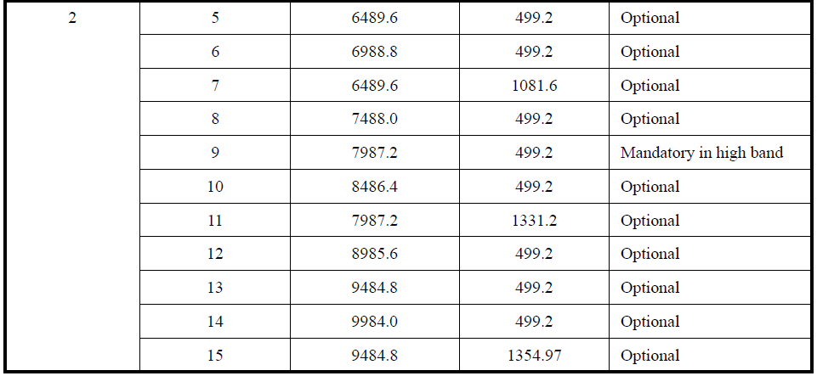
Current Channel Plan (From [3])
Channel width more than double 499.2 MHz
Can support Frequency Stitching for RF Sensing

Slide 7
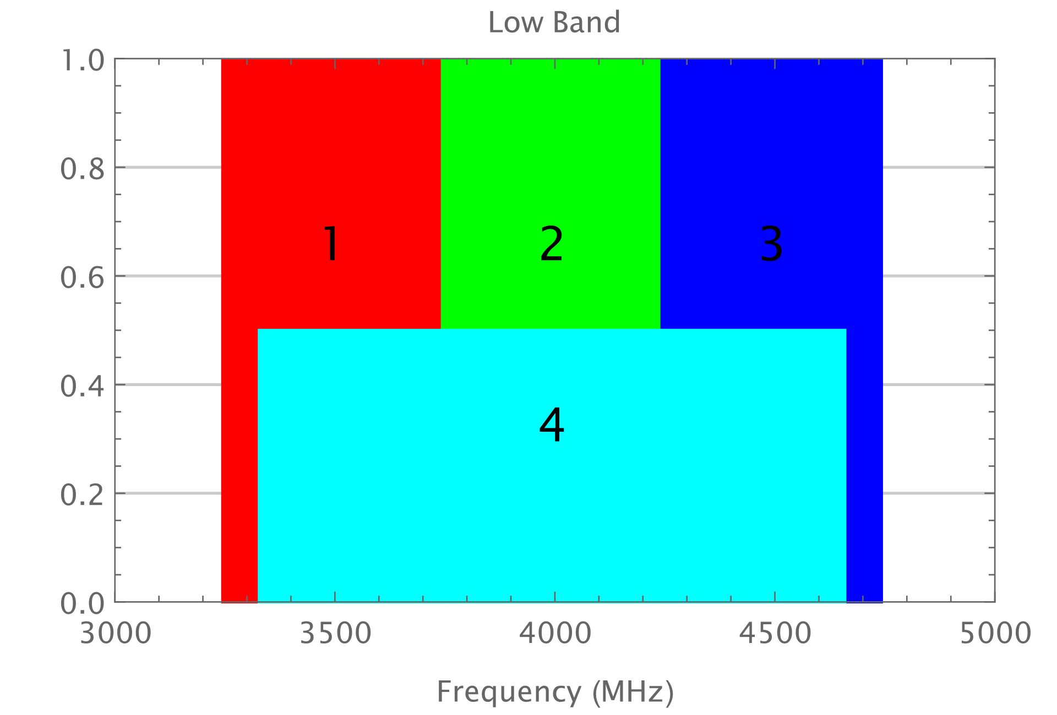
Low Band Channels

Slide 8
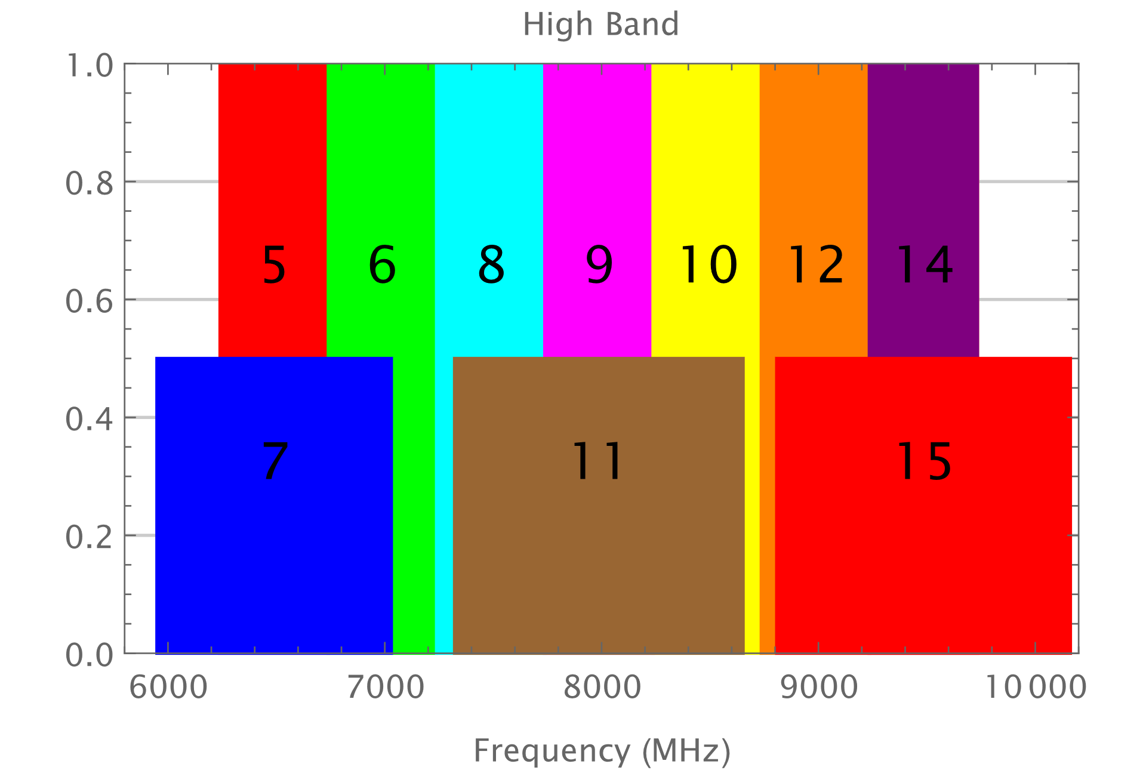
High Band Channels

Slide 9
Discussion on Channels
Additional Info
We expect Channels 5, 6, 8, and 9 to be widely supported
Observations
The wideband channels overlap all the 499.2 MHz channels
We propose supporting Frequency Stitching in Channel 4 (Low Band) and Channel 15 (High Band)

Slide 10
Summary
As an alternative to overlapping frequency channels, we proposed supporting Frequency Stitching in the wider channels already defined
Channel 4 (Low Band) and Channel 15 (High Band)
This avoids the overlapping channels for communications which can make sharing of the spectrum difficult

Slide 11
References
Frank Leong, Wolfgang Küchler, Riku Pirhonen, “Sensing Continued,” IEEE 802.15/22-061r0, January 2022
Frank Leong, Wolfgang Küchler, Riku Pirhonen, “UWB Sensing - Scheduling,” IEEE 802.15/22-422r0, July 2022
Ben Rolfe, “Expanded HRP channel plan,” IEEE 802.15-22/520r1, September 2022

