Slide 1
Project: IEEE P802.15 Working Group for Wireless Personal Area Networks (WPANs)
Submission Title: [Follow-up on UWB Channel Usage Coordination]
Date Submitted: [Nov 2022]
Source: Lochan Verma, Robert Golshan, Alexander Krebs[Apple]
E-Mail: [lochan_verma, rgolshan, a_krebs] @apple.com
Abstract: Further details on UWB channel usage coordination for better UWB coexistence
Purpose:
Notice: This document has been prepared to assist the IEEE P802.15. It is offered as a basis for discussion and is not binding on the contributing individual(s) or organization(s). The material in this document is subject to change in form and content after further study. The contributor(s) reserve(s) the right to add, amend or withdraw material contained herein.
Release: The contributor acknowledges and accepts that this contribution becomes the property of IEEE and may be made publicly available by P802.15.

Slide 2
PAR Objective | Proposed Solution (how addressed)
Safeguards so that the high throughput data use cases will not cause significant disruption to low duty-cycle ranging use cases | UWB channel usage coordination
Interference mitigation techniques to support higher density and higher traffic use cases | UWB channel usage coordination
Other coexistence improvement | UWB channel usage coordination
Backward compatibility with enhanced ranging capable devices (ERDEVs)
Improved link budget and/or reduced air-time
Additional channels and operating frequencies
Improvements to accuracy / precision / reliability and interoperability for high-integrity ranging
Reduced complexity and power consumption
Hybrid operation with narrowband signaling to assist UWB
Enhanced native discovery and connection setup mechanisms
Sensing capabilities to support presence detection and environment mapping
Low-power low-latency streaming
Higher data-rate streaming allowing at least 50 Mbit/s of throughput
Support for peer-to-peer, peer-to-multi-peer, and station-to-infrastructure protocols
Infrastructure synchronization mechanisms

Slide 3
Introduction
UWB CH usage coordination for better UWB coexistence is nice to have
In [1] we presented UWB CH usage coordination method that is usable by both standalone UWB and NBA UWB transceivers
Outline for this presentation
Recap of [1]
AP (Acquisition Packet) content
More on miscellaneous AP topics

Slide 4
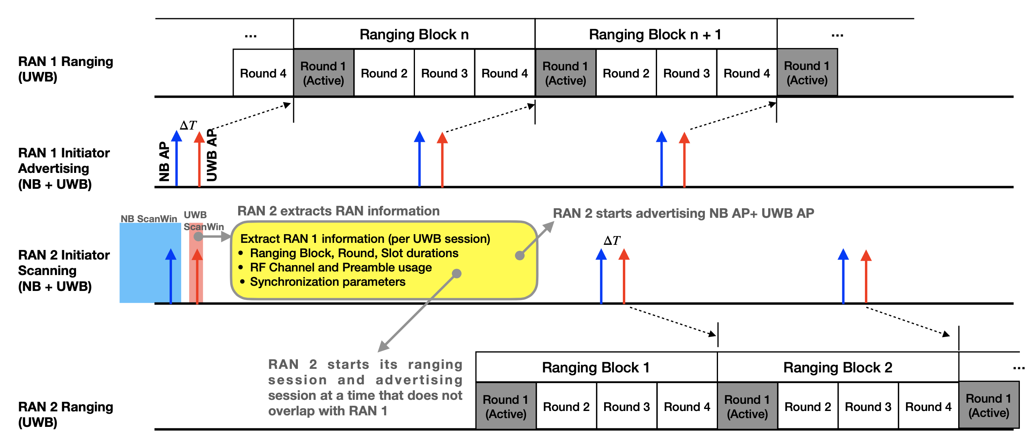
Recap of UWB CH Usage Coordination [1]

Slide 5
Key Observations on [1]
Ambitious goal is that RANs time synchronize with other RANs to avoid colliding with each others' transmissions
For privacy purposes be mindful of the advertised timing information of the RAN
Each RAN drifts over time and will need to re-sync with other RANs
Modest goal is that RANs coordinate information and DO NOT time synchronize with other RANs
Advertised RAN information such as CH, Preamble, and Block duration enable the observing RAN to intelligently configure itself to minimize interference effects
Privacy concerns are mitigated by advertising limited information about the RAN
NO NEED to re-sync with other RANs
We describe AP content for both ambitious and modest goals
Our preference is Modest goal

Slide 6
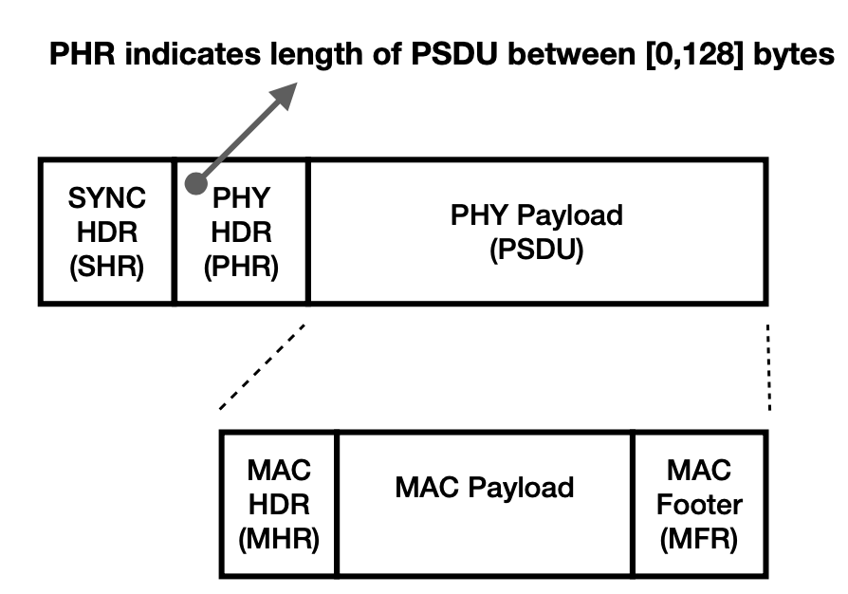
NB AP and UWB AP Format
Packet Type | Comment
NB AP | O-QPSK [250Kb/s] [1]
UWB AP | BPRF Data Packet (STS Packet Config 0, HRP ERDEV PPDU) [1]
Next, more on MHR and MAC Payload for AP

Slide 7
MHR Fields in AP
MHR |  | Bits | Bytes | Value | Comments
Frame Control | Frame Type | 3 | 2 | 1 | Data
 | Security Enabled | 1 |  | 0 | Security disabled
 | Frame Pending | 1 |  | 0 | Unused
 | AR | 1 |  | 0 | Ack frame unused
 | PAN ID Compress | 1 |  | 1 | No PAN ID
 | RFU | 1 |  | 0 | unused
 | SeqN Supress | 1 |  | 1 | enabled
 | IE Present | 1 |  | 0 | IE not used
 | Dst Addr Mode | 2 |  | 3 | EUI-64 bit address
 | Frame Version | 2 |  | 2 | 802.15.4-2020
 | Src Addr Mode | 2 |  | 3 | EUI-64 bit address
Dst Addr |  | 64 | 8 | FF FF FF FF FF FF FF FF | Broadcast address
Src Addr |  | 64 | 8 | variable | Local MAC address
MHR size = 18 Bytes Max MAC Payload = 108 Bytes
MFR size = 2 Bytes

Slide 8
Ambitious Goal: UWB AP MAC Payload
MAC Payload |  | Bits | Bytes | Comments
Common Info field | AP Type | 3 | 1 | 0: Coordination UWB AP 1:8: RFU (Reserved For Future)
 | RFU | 5 |  | Unused
Per-Session Info field 1 | Next Block Interval | 32 | 4 | Time remaining in RSTU until start of the next block relative to the start of the current packet
 | Next Round Interval | 16 | 2 | Time remaining in RSTU until the start of the next active round relative to the start of the next block
 | Block Index | 16 | 2 | Next block index
 | Block Dur | 24 | 3 | In RSTU (Ranging Scheduling Time Unit)
 | Round Dur | 8 | 1 | In units of ranging slots
 | Slot Dur | 16 | 2 | In RSTU
 | Session Type | 2 | 1 | 0: ranging; 1: AP; 2: RFU; 3: RFU
 | Session CH | 5 |  | UWB CH used by session
 | Hop Mode | 1 |  | 0: no hopping; 1: Hopping. Hopping sequence known a-priori to all devices
 | Preamble Code |  | 1 | Preamble code used by session
[0,6] Per-Session Info fields can be present in one Coordination UWB AP

Slide 9
Modest Goal: UWB AP MAC Payload
MAC Payload |  | Bits | Bytes | Comments
Common Info field | AP Type | 3 | 1 | 0: Coordination UWB AP 1:8: RFU (Reserved For Future)
 | RFU | 5 |  | Unused
Per-Session Info field 1 | Block Dur | 24 | 3 | In RSTU (Ranging Scheduling Time Unit)
 | Session CH | 5 | 1 | UWB CH used by session
 | RFU | 3 |  | Unused
 | Preamble Code | 8 | 1 | Preamble code used by session
[0,18] Per-Session Info fields can be present in one Coordination UWB AP
New starting RAN can choose ‘slightly’ (e.g., $±5$ ms) different Block Dur relative to the existing RANs in the neighborhood to avoid time grid alignment
We prefer Modest Goal UWB AP MAC Payload
Meets the privacy expectations
Offers useful information to the observing RANs to minimize interference effects
Smaller AP sizes
Lesser burden to broadcast AP

Slide 10
NB AP MAC Payload
MAC Payload |  | Bits | Bytes | Comments
Common Info field | AP Type | 3 | 1 | 0: Coordination NB AP 1: Compressed Coordination NB AP 2:8: RFU
 | UWB AP Present | 1 |  | 0: No UWB AP follows the NB AP 1: UWB AP follows the NB AP
 | RFU | 4 |  | Unused
UWB AP Info field | Delta T | 16 | 2 | Time remaining in RSTU until the start of the next UWB AP relative to the start of the current packet
 | UWB CH | 5 | 1 | UWB CH number on which the UWB AP occurs after Delta T
 | RFU | 3 |  | Unused
 | Preamble Code |  | 1 | Preamble code used by UWB AP
Compressed Coordination NB AP packet DOES NOT carry Per-Session Info field(s)
Per-Session Info field(s) are carried in Coordination UWB AP
Coordination NB AP carries Per-Session Info field(s)
Per-Session Info field(s) can be duplicated in Coordination UWB AP
UWB AP Info field is present if UWB AP Present is 1. Otherwise, not present

Slide 11
Miscellaneous Discussions
Topic | Comments
Value of NB Discovery CH | Prefer to define UNII3 band edge CH (where 802.11 does not operate). Subject to regulatory domain
NB AP transmission require CCA? | Follow identical Tx rules of other NB frames Subject to regulatory domain
Value of UWB Discovery CH | Spec can recommend CH 9 NB AP carries the value of UWB Discovery CH
Value of UWB AP Interval | UWB AP Interval, scan window, and scan interval are subject to applications and Device Types Subject to regulatory domain

Slide 12
Summary
This presentation provided further details on UWB CH usage coordination through AP [1]
Contents of AP were described
More information on miscellaneous AP topics
We prefer that AP carry minimal information (described as modest goal in the presentation) about the RAN to facilitate coordination between RANs

Slide 13
References
[1] 15-22-0456-00-04ab, UWB Channel Usage Coordination for better UWB Coexistence

