Slide 1
Project: IEEE P802.15 Working Group for Wireless Personal Area Networks (WPANs)
Submission Title: Updates for the Multiple Transmissions in a Ranging Slot
Date Submitted: 11 November, 2022
Source: [Taeyoung Ha, Mingyu Lee, Youngwan So, Aniruddh Rao Kabbinale, Ankur Bansal, Clint Chaplin] Company [Samsung Electronics]
E-Mail: ty1115.ha@samsung.com
Abstract: Updates of multiple transmissions in a ranging slot scenario
Notice: This document has been prepared to assist the IEEE P802.15. It is offered as a basis for discussion and is not binding on the authoring individual(s) or organization(s). The material in this document is subject to change in form and content after further study. The authors(s) reserve(s) the right to add, amend or withdraw material contained herein.

Slide 2
PAR Objective | Proposed Solution (how addressed)
Safeguards so that the high throughput data use cases will not cause significant disruption to low duty-cycle ranging use cases
Interference mitigation techniques to support higher density and higher traffic use cases
Other coexistence improvement
Backward compatibility with enhanced ranging capable devices (ERDEVs)
Improved link budget and/or reduced air-time | Transmit packets in a slot to reduce air-time
Additional channels and operating frequencies
Improvements to accuracy / precision / reliability and interoperability for high-integrity ranging
Reduced complexity and power consumption
Hybrid operation with narrowband signaling to assist UWB
Enhanced native discovery and connection setup mechanisms
Sensing capabilities to support presence detection and environment mapping
Low-power low-latency streaming
Higher data-rate streaming allowing at least 50 Mbit/s of throughput
Support for peer-to-peer, peer-to-multi-peer, and station-to-infrastructure protocols
Infrastructure synchronization mechanisms

Slide 3
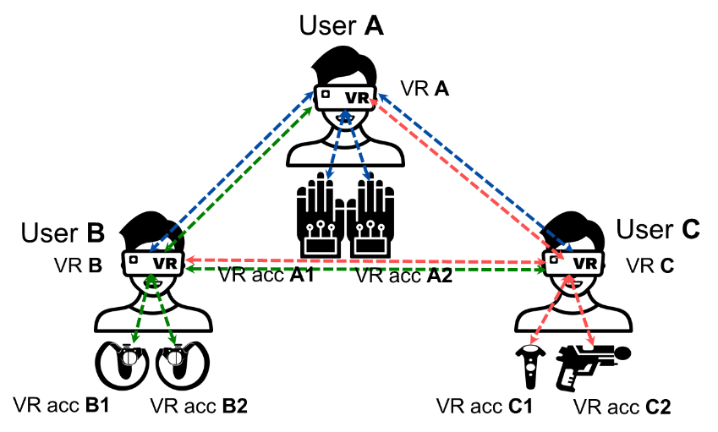
Previous Proposal
To enhance the slot efficiency, multiple transmission of preambles in a ranging slot was proposed
The number of multiple transmission can be determined by the performance of preamble code sequence
If two preambles are allowed at the same slot, the air time will be reduced about half
Slot 0
Slot 1
Slot 2
Slot 3
VR A
RCM w/ RDM IE
Preamble
time
VR acc A1
Preamble
VR acc A2
time
Preamble
time
VR B
Preamble
time
VR C
Preamble
[ Example of Time Diagram ]
time

Slide 4
Problems in preamble only packet
Due to varying wireless channel environment and clock drift, the received preamble only packets are not perfectly overlapped at the receiver
It assumed that the preamble 1 is the target preamble, and preamble 2 is sent at the same slot (i.e., It acts as interference preamble)
Partial preamble 2 (i.e., head or tail of preamble) will be added to the target preamble. Due to this, the peak value of auto-correlation can not appear at the expected time, or the peak value of auto-correlation can not exceed the threshold value

Slide 5
Proposed Multiple transmissions
Instead of a preamble only packet, a successive (preamble/MMR) sequence is proposed to use at this scenario
By using the successive sequences, cross-correlation performances can be enhanced than preamble only packets even though interference (Preamble/MMR) sequences are partially overlapped with the target (Preamble/MMR) sequences
Cyclic preamble can suppress the cross-correlation of interference sequence

Slide 6
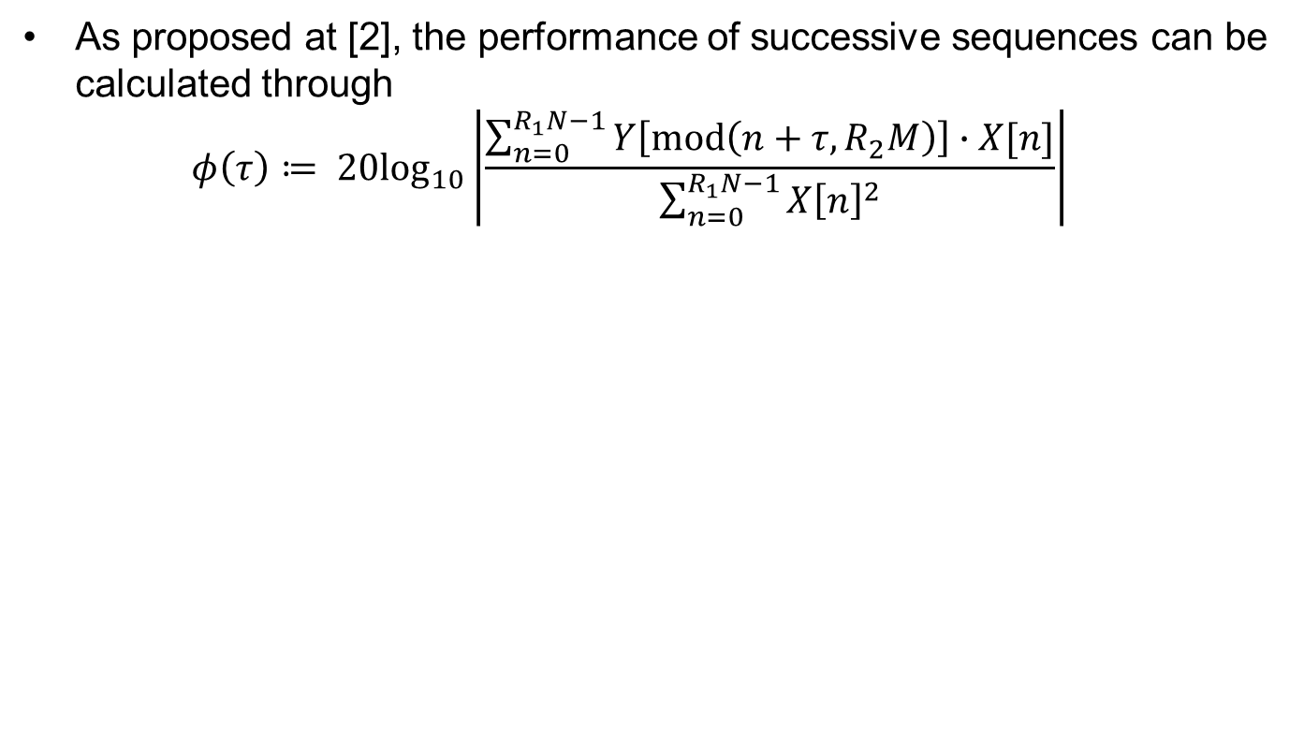
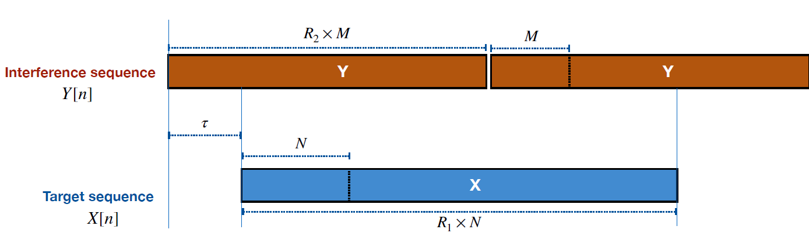
Feasibility of proposed scenario

Slide 7
Feasibility of proposed scenario
The performance of successive (Preamble/MMR) sequences (5 or 10 successive sequences) has better performance compared to the preamble only packet
Target sequence: {Golay 64 + 64, 64 codes}
Interference sequence: {Ipatov 91, Ipatov 127, Golay 64+64}
Target sequence: {Ipatov 127, 16 codes}
Interference sequence: {Ipatov 91, Ipatov 127, Golay 64+64}

Slide 8

Conclusions
Enhance the performance of preamble code sequence (performance index is $φ(τ)$ in page 6), successive (preamble/MMR) sequence can be used
There will be tradeoff between the number of repetition sequence and performance (correlation, energy consumption, air time, etc.)

Slide 9
References
[1] 15-21-0377-02 Preamble codes for Data Communications in 802.15.4ab
[2] 15-22-0446-01 Simulation Framework for Recommending Preambles for 4ab
[3] 15-22-0470-01 More on 4ab preambles: apEval results and recommendations

Slide 10
Thank You

