Slide 1
Project: IEEE P802.15 Working Group for Wireless Personal Area Networks (WPANs)
Submission Title: Improvements on scheduling IE design in 802.15.4ab
Date Submitted: November, 2022
Source: Kuan Wu, Lei Huang, Bin Qian, David Xun Yang (Huawei Technologies), Kangjin Yoon, Chunyu Hu, Carlos Aldana, Claudio da Silva (Meta Platforms, Inc.), Mingyu Lee (Samsung)
Email: wukuan2@huawei.com, kyoon@meta.com, mg0218.lee@samsung.com
Abstract: Discussing several improvements on scheduling IE design in 802.15.4ab
Purpose: To mitigate the flexibility and message redundancy drawbacks in current scheduling IE design
Notice: This document has been prepared to assist the IEEE P802.15. It is offered as a basis for discussion and is not binding on the contributing individual(s) or organization(s). The material in this document is subject to change in form and content after further study. The contributor(s) reserve(s) the right to add, amend or withdraw material contained herein.
Release: The contributor acknowledges and accepts that this contribution becomes the property of IEEE and may be made publicly available by P802.15.

Slide 2
PAR Objective | Proposed Solution (how addressed)
Safeguards so that the high throughput data use cases will not cause significant disruption to low duty-cycle ranging use cases
Interference mitigation techniques to support higher density and higher traffic use cases
Other coexistence improvement
Backward compatibility with enhanced ranging capable devices (ERDEVs)
Improved link budget and/or reduced air-time | Further improvement on Scheduling IE design to reduce message overhead
Additional channels and operating frequencies
Improvements to accuracy / precision / reliability and interoperability for high-integrity ranging
Reduced complexity and power consumption
Hybrid operation with narrowband signaling to assist UWB
Enhanced native discovery and connection setup mechanisms
Sensing capabilities to support presence detection and environment mapping
Low-power low-latency streaming
Higher data-rate streaming allowing at least 50 Mbit/s of throughput
Support for peer-to-peer, peer-to-multi-peer, and station-to-infrastructure protocols
Infrastructure synchronization mechanisms

Slide 3
Previous Contributions and references
DCN 501r0 (September 2022) “New Scheduling IE for 4ab applications”
Bitmap-based scheduling is proposed to reduce the overhead of control messages for applications that requires many slots, as compared to legacy 4z RDM IE
IEEE Standard for Low-Rate Wireless Networks–Amendment 1: Enhanced Ultra Wideband (UWB) Physical Layers (PHYs) and Associated Ranging Techniques, IEEE Standard 802.15.4z-2020 (Amendment to IEEE Standard 802.15.4-2020), IEEE SA, pp. 1–174, Aug. 25, 2020
DCN 205r0 (March 2022) “Multi-millisecond Ranging”
Non-interlacing MMS ranging is proposed for long-range line-of-sight, and short-range highly attenuated first path
DCN 404r1 (July 2022) “Co-scheduling Ranging and Sensing”
Proposing to design new control message with IEs to schedule ranging and sensing
DCN 257r0 (May 2022) “CIR feedback scheme for UWB sensing - continue”
To support target tracking, long time continuous sensing is required
DCN 255r1 (May 2022) “MAC considerations on unified control for UWB sensing and ranging”
Preliminary study on unified MAC design for UWB sensing and ranging

Slide 4
Recap: Bitmap-based scheduling IE design
A bitmap-based scheduling IE design [1] is proposed to address the drawbacks of RDM IE in legacy 4z [2].
Given a total of S slots for each device and a total of N devices, the size of the bitmap-based scheduling IE yields:
For size of short addresses (2 bytes): 1+N*(3+⌈S/8⌉) bytes
For size of extended addresses (8 bytes): 1+N*(9+⌈S/8⌉) bytes
Octets: 1 | Variable
Control field | Scheduling List
Bits: 0 | 1-7
Address Type | Scheduling List Length
Bits: 0-1 | 2-7 | Octets: Variable | 2 or 8
Bitmap Size | Reserved | Bitmap | Address
Bitmap Size field value | Meaning | Number of slots S that applies | Message Size in bytes (short address) | Message Size in bytes (extended address)
0 | 8 bits bitmap | 1$≤S≤8$ | 1+4*N | 1+10*N
1 | 16 bits bitmap | 1$≤S≤16$ | 1+5*N | 1+11*N
2 | 32 bits bitmap | 1$≤S≤32$ | 1+7*N | 1+13*N
3 | 64 bits bitmap | 1$≤S≤64$ | 1+11*N | 1+17*N
Observations:
The length of the bitmap size increases in the magnitude of octets with respect to S →variable list element size.

Slide 5
Recap: Bitmap-based scheduling IE design (cont.)
Slots used for control message with scheduling IE
Slots used for transmitting UWB ranging signal
Ranging Round
0 | 1 | 2 | 3 | 4 | 5 | 6 | 7 | 8 | 9 | 10 | 11 | 12 | 13 | 14 | 15
Initiator
Responder
Example 1: Non-interlacing MMS ranging [3]
In this example of non-interlacing MMS ranging
The initiator transmits the MMS fragments at slots 1~4, while the responder transmits the MMS fragments at slots 6~9
The control message shall still require a 2-octets (16 bits) length bitmap to accomplish the scheduling according to the current design. → Unnecessary message size (outlined in red boxes) may still be required to accomplish the scheduling
Observations:
The un-assigned slots may still be reflected in the bitmap→ Bitmap-based scheduling alone may still not be flexible or efficient in terms of message size overhead

Slide 6
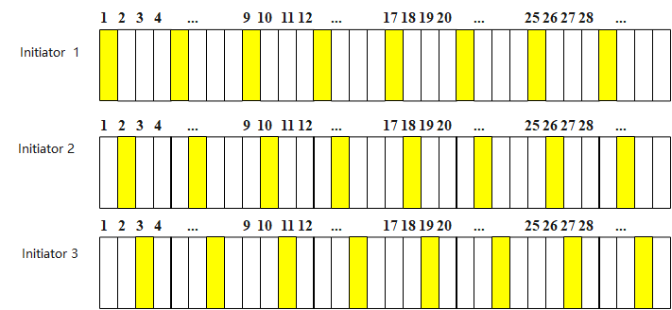
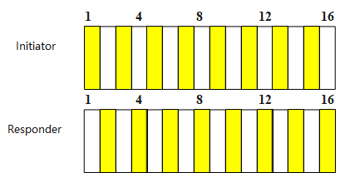
Recap: Bitmap-based scheduling IE design (cont.)
For applications such as long continuous sensing/long MMS ranging, the transmission pattern may be recurring periodically.
Ranging Round
Ranging Round
Example 2, Sensing scheduling
Example 3, long MMS ranging
Observations & Problems:
Huge message size overhead may be incurred by simply using bitmap-based scheduling method for applications with recurring periodic transmission pattern with a larger number of slots S.

Slide 7
Motivation
In this contribution, we propose to improve the bitmap-based scheduling IE design by addressing the aforementioned drawbacks in terms of flexibility and message redundancy
Introducing a bitmap offset field in the scheduling list element
Introducing the periodic scheduling for applications with recurring periodic transmission pattern

Slide 8
Proposal 1: Scheduling IE with bitmap offset
Introducing the Bitmap Offset field in scheduling list element format to mitigate the message overhead
The Bitmap Offset field represents the number of unassigned/unused slots before the first actual transmission slot per device →Reducing the representation of the unnecessary slots by bitmap
The Bitmap Offset field can be in the units of slots, e.g., 0~15
The Bitmap Offset field and the Bitmap field jointly determines the transmission order per device
The Bitmap Offset field is triggered by the Bitmap Offset Presence field, i.e., the Bitmap Offset field is present when Bitmap Offset Presence = 1
Octets: 1 | Variable
Control field | Scheduling List
Bits: 0-1 | 2 | 3-7 | Octets: Variable | 2 or 8 | 1
Bitmap Size | Bitmap Offset Presence | Reserved | Bitmap | Address | Bitmap Offset

Slide 9
Proposal 1: Scheduling IE with bitmap offset (cont.)
Example, reducing the bitmap size of 2 octets to 1 octet by making use of the Bitmap Offset field
For the responder, the number of unassigned slots shall be presented in Bitmap Offset field in the scheduling list element rather than in the Bitmap, i.e., setting Bitmap Offset = 6
Bits: 0-1 | 2 | 3-7 | Octets: Variable | 2 or 8 | 1
Bitmap Size | Bitmap Offset Presence | Reserved | Bitmap | Address | Bitmap Offset
Ranging Round
0 | 1 | 2 | 3 | 4 | 5 | 6 | 7 | 8 | 9 | 10 | 11 | 12 | 13 | 14 | 15
Initiator
Responder
(a) Original scheduling with a bitmap size of 2 octets
6 unassigned slots before the first transmission
Ranging Round
0 | 1 | 2 | 3 | 4 | 5 | 6 | 7
Initiator
Responder
(b) Improved scheduling with a bitmap size of 1 octet

Slide 10
Proposal 2: Periodic scheduling
Introducing the Scheduling List Type field in the Control field
If Scheduling List Type = 0, invoking the bitmap-based scheduling mode [1].
If Scheduling List Type = 1, invoking Starting slot index field, Scheduling Step field and Scheduling Repetition field for scheduling.
Starting Slot Index field marks the first transmission slot in the recurring periodic transmission pattern, in unit of slots, similar to the role of the Ranging Slot Index field defined in RDM IE in legacy 4z
Scheduling Step field represents the period of the transmission pattern, such as 4, 8, 16, 32, 64, in unit of slots
Scheduling Repetition field represents the number of repetitions of the transmission pattern, such as 2, 4, 8, 16, 32, in unit of slots
Octets: 1 | Variable | … | Variable
Control field | Scheduling List element # 1 | … | Scheduling List element # N
Bits: 0 | 1-6 | 7
Address Size | Scheduling List Length | Scheduling List Type
Bits: 0-6 | 7-10 | 11-15 | Octets: 2 or 8
Starting Slot Index | Scheduling Step | Scheduling Repetition | Address

Slide 11
Proposal 2: Periodic scheduling (cont.)
Comparison on the size of different scheduling IEs for UWB 4ab applications with recurring periodic transmission pattern
 | short address (bytes) | extended address (bytes)
Bitmap scheduling [1] | 1+N*(3+⌈S/8⌉) bytes | 1+N*(9+⌈S/8⌉) bytes
Periodic scheduling | 1+N*4 bytes | 1+N*10 bytes
The size of the proposed periodic scheduling IE does not increase with respect to slots S
→ Less message overhead as compared with bitmap-based scheduling in [1]
The proposed Period Mode scheduling IE has less flexibility in scheduling control as compared with bitmap-based scheduling IE [1]
→ Tradeoff between scheduling flexibility and message overhead
Octets: 1 | Variable | … | Variable
Control field | Scheduling List element # 1 | … | Scheduling List element # N
Bits: 0 | 1-6 | 7
Address Size | Scheduling List Length | Scheduling List Type
Bits: 0-6 | 7-10 | 11-15 | Octets: 2 or 8
Starting Slot Index | Scheduling Step | Scheduling Repetition | Address

Slide 12
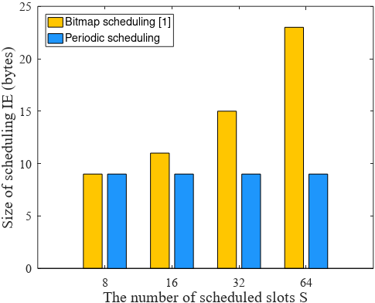
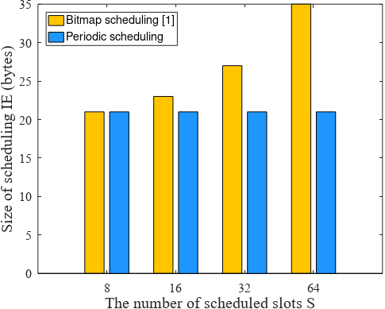
Proposal 2: Periodic scheduling (cont.)
Comparison on the message size of scheduling IEs for UWB 4ab applications with recurring periodic transmission pattern
 | short address (bytes) | extended address (bytes)
Bitmap scheduling [1] | 1+N*(3+⌈S/8⌉) bytes | 1+N*(9+⌈S/8⌉) bytes
Periodic scheduling | 1+N*4 bytes | 1+N*10 bytes
Supposing the number of devices is 2
(Short address devices)
Supposing the number of devices is 2
(Extended address devices)

Slide 13
Further discussions
For 4ab new devices, the scheduling process can only use one type of scheduling IE, i.e, new IE or legacy 4z RDM IE
Once the device detects itself inside either one type of scheduling IE, the device may ignore the other type if it is also received during the control phase, to avoid unnecessary power consumption in decoding the IE

Slide 14
Summary
In this contribution, we propose to improve the bitmap-based scheduling IE design in terms of flexibility and message overhead redundancy by the following aspects:
Introducing the bitmap offset field in the scheduling list element
Introducing the periodic scheduling format for applications with recurring periodic transmission pattern

