Slide 1
Project: IEEE P802.15 Working Group for Wireless Personal Area Networks (WPANs)
Submission Title: Measurement and Characterization of 300 GHz Channel in a Conference Room
Date Submitted: 9 November 2022
Source: Anirban Ghosh, Riku Takahashi, Kosuke Shibata, Minseok Kim, Shigenobu Sasaki
Graduate School of Science and Technology, Niigata University, 8050 Ikarashi 2-no-cho, Nishi-ku, Niigata, Niigata, Japan
Voice:+81-25-262-7478, E-Mail: anirban.g@eng.niigata-u.ac.jp
Re: N/A
Abstract: In the face of increasing demand for higher data rates and ultra-reliable communication with low latency, the terahertz (THz) band (with frequencies upward of 100 GHz) has garnered a lot of interest. In this proposal a novel 300 GHz channel sounder is first presented along with its validation results. In the sequel an extensive elucidation of a measurement campaign conducted with the described sounder in a conference room is reported. The obtained data in the different transmitter (Tx)-receiver (Rx) positions are further processed to generate the power delay profiles (PDPs), angular delay power spectrum (ADPS) and angular power spectrum (APS). An environment geometry aided intuitive ray tracing validated by simulation is used to understand the cluster formation from the generated results. The large-scale parameters (LSP) such as K-factor, delay and angle (azimuth/elevation spread of arrival/departure) spreads are also evaluated to assist channel model development. Finally, the calculation of cross-correlation between the large-scale parameters provides some interesting observations which would apparently seem to contrast with intuition.
Purpose: Information document for IEEE 802.15 SC THz
Notice: This document has been prepared to assist the IEEE P802.15. It is offered as a basis for discussion and is not binding on the contributing individual(s) or organization(s). The material in this document is subject to change in form and content after further study. The contributor(s) reserve(s) the right to add, amend or withdraw material contained herein.
Release: The contributor acknowledges and accepts that this contribution becomes the property of IEEE and may be made publicly available by P802.15.
Notes:
A measurement campaign was carried out using a novel 300 GHz channel sounder in a conference room. The campaign was conducted for five receiver positions placed on a table top at a height of 1.15m from the floor whereas the transmitter was kept fixed at a height of 2.1m from the floor. The results from the campaign are delineated in the form of power delay profiles, angular delay power spectrum and angular power spectrum. Furthermore, an intuitive ray tracing is performed to understand the signal propagation and cluster formation. The large scale parameters such as K-factor, delay and angle (azimuth/elevation spread of arrival/departure) are also evaluated to gain further insights. The analysis of the measurement data is concluded by finding the cross-correlation between large scale parameters.

Slide 2
Measurement and Characterization of 300 GHz Channel in a Conference Room
Anirban Ghosh, Riku Takahashi, Kosuke Shibata, Minseok Kim, Shigenobu Sasaki
Niigata University, Japan

Slide 3
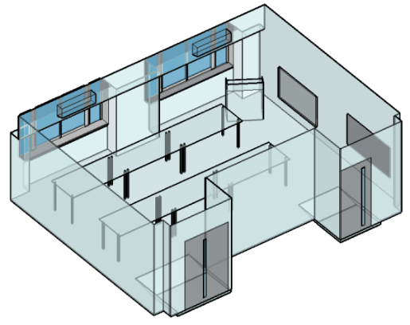
Motivation
Beyond 5G Communication requirements
  Ubiquitous connection for a heterogenous network
  High data rate: upwards of 100 Gbps
    Tens of GHz worth bandwidth available in 0.1-10 THz
  Ultra-reliable communication for life-critical applications
  Low latency to support real-time application
Our Effort
  Channel measurement at 300 GHz in conference room
  Contribute measurement results
Notes:
In recent times many new applications have emerged which would require ubiquitous connection over heterogenous network. In addition, critical applications like automated driving, intelligent sensing and notification would require low latency and high reliability. The prior requirements are further supplemented by the requirement of higher data rates to the tune of tera bits per second. The current implementations using spectrum below 100 GHz cannot achieve such high data rate and hence the need to foray into spectrum beyond 100 GHz.
In order to properly understand the propagation characteristics of any new band, extensive measurement campaigns in various environments are required. In this context, we conducted a campaign in a conference room at 300 GHz emulating a scenario where an access point (like a Wi-Fi router) tries to communicate with a mobile station (like a laptop or cell phone on a table)

Slide 4
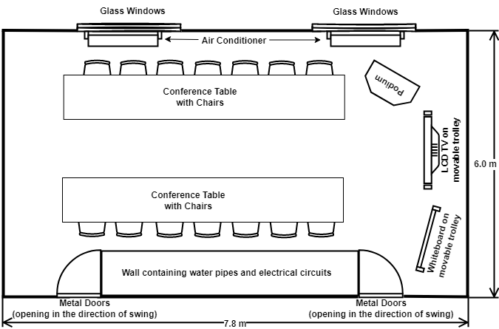
Outline
300-GHz Double-Directional Channel Sounder Development
  Instruments-based frequency domain sounder
  System parameters and specifications
Conference Room Channel Measurement and Results
  Power Delay Profile, Angular Delay Power Spectrum, Angular Power Spectrum generation.
  Ray tracing results
  LSP evaluation
  Cross-correlation calculation
Notes:
The outline of the presentation is as follows
The development of the channel sounder is described first in terms of its architecture, the sounding signal used, system parameters, link budget and dynamic range
The measurement scenario is described next in conjunction with the directional measurement parameters
The post processing and data analysis of the measurement data is followed by dissemination of insights gained from the results and environment embedded ray tracing
The presentation is concluded by presenting the evaluated large scale parameters and their cross-correlations

Slide 5
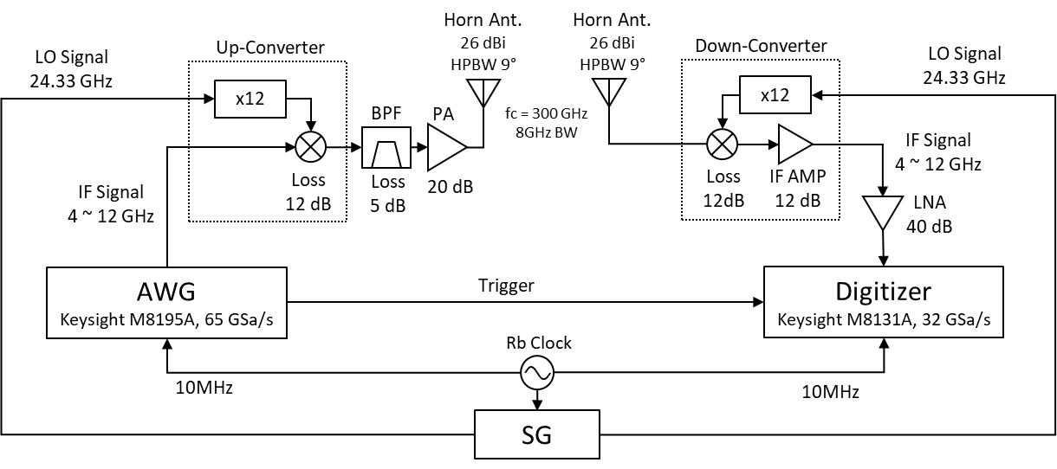
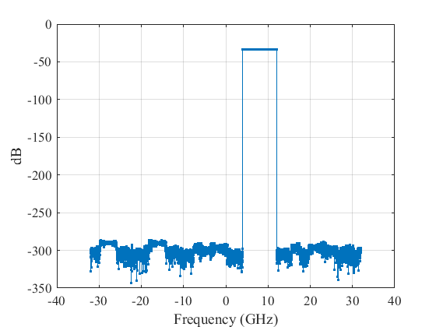
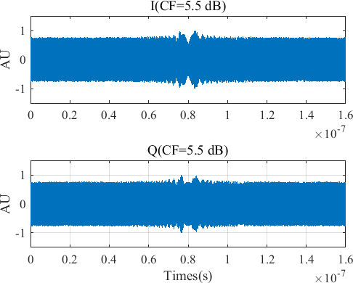

Sounder Architecture and Sounding Signal
Super-heterodyne architecture with IF stage
Sounding Signal*
$$s\left(t\right)=\frac{1}{\sqrt{N}}\sum_{k=−N/2}^{\frac{N}{2}−1}{exp⁡(j2π∆_{F}t+jφ_{k})}$$
8 GHz
Up- Conversion
BPF
280~288
GHz
296~304
GHz
8
f [GHz]
284
292 300 (LOx12)
< RF stage >
f [GHz]
< IF stage >
300 GHz Freq. Conversion
8 GHz
160 ns
𝑁 ：Number of tones Δ_{𝐹} = 𝐵/𝑁：Tone interval
𝐵：Signal bandwidth 𝜙_{𝑘} = 𝑘²𝜋/𝑁： Newman phase
160 ns
*Minseok Kim, Shuaiqin Tang, Keiichiro Kumakura, “Fast Double-Directional Full Azimuth Sweep Channel Sounder Using Low-Cost COTS Beamforming RF Transceivers,” IEEE Access, Vol.9, pp. 80288-80299, Jun. 2021
Notes:
The super-heterodyne architecture of the novel channel sounder is shown here with the following features
At the transmitter
The LO signal generated by the signal generator (SG) is passed through a times 12 frequency multiplier and mixed with a IF signal of bandwidth 8 GHz generated by the arbitrary waveform generator (AWG)
In order to remove the image frequency after up-conversion the signal is passed through a BPF centred at 300 GHz.
The filtered is passed through a high gain power amplifier (PA) to accommodate for the different losses before being transmitted through a horn antenna with HPBW of 9⁰ and gain of 26 dBi
At the receiver
The signal received through a horn antenna similar to the one used at the transmitter is initially passed through a down-converter whose other input is a LO signal (similar to the one at Tx) after passing through a time 12 frequency multiplier
The down-converted signal is initially passed through an IF amplifier of gain 12 dB and then through a low noise amplifier (LNA) of gain 40 dB to compensate for the losses during propagation and reception
The amplified signal is given as input to the digitizer to obtain the baseband signal.
The AWG, SG and Digitizer are synchronized using a stable Rubidium clock
A Newman phase multitone signal of bandwidth 8 GHz is used as the sounding signal whose frequency and I/Q representation are as shown.

Slide 6
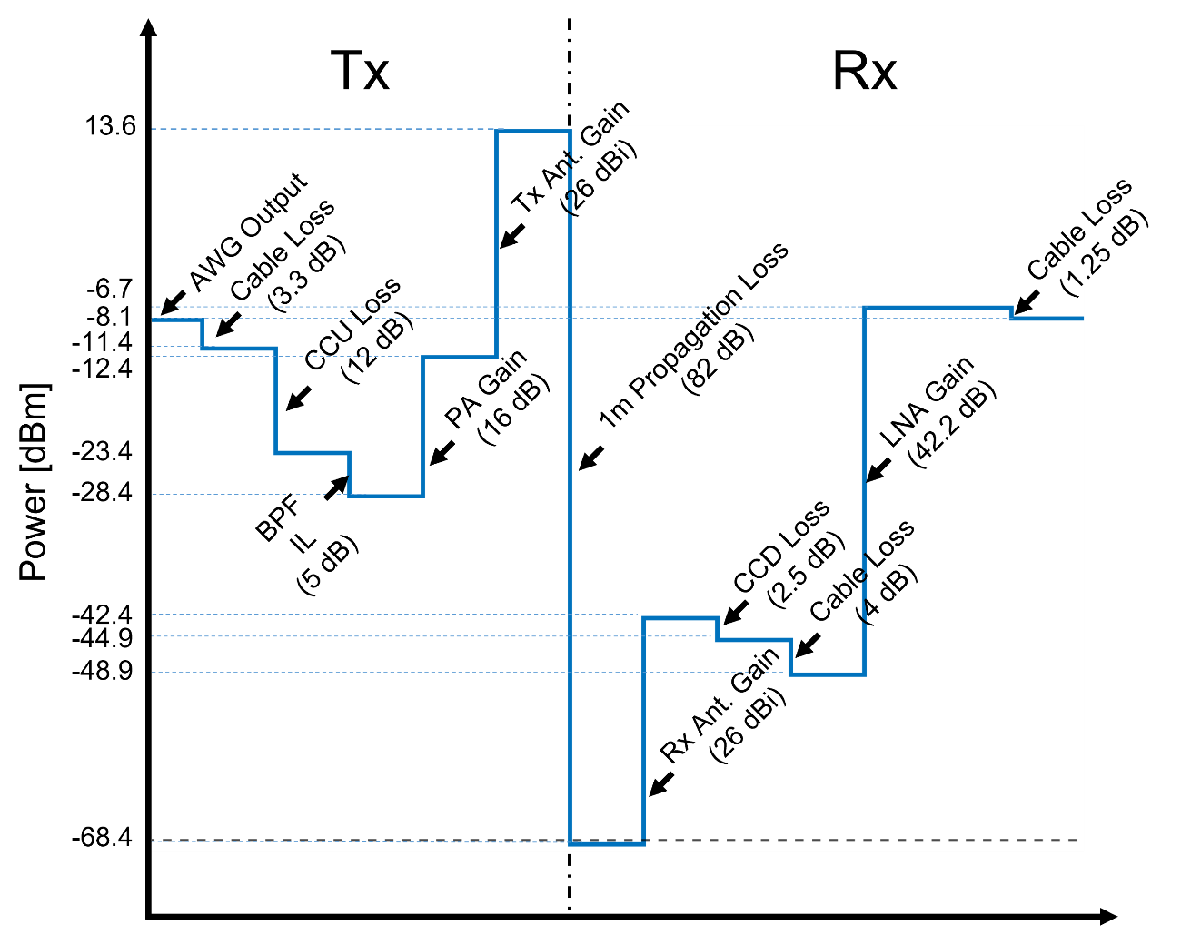
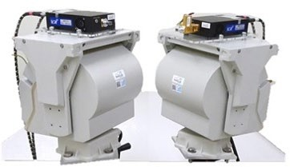
System Parameter and Link Budget
 | 300 GHz
Freq. | 300 GHz
Signal BW | 8 GHz
Sounding signal | 1,280
Delay resolution | 125 ps
Delay span | 160 ns
Ant./Dir Gain | 26 dBi
EIRP | 14 dBm
HPBW | 9°
Dynamic range | 60~80 dB
Notes:
The significant system parameters of the sounder are shown in this slide where
The sounding signal consists of 1280 tones
Has a delay resolution of 125 ps and a total delay span of 160 ns
The dynamic range (which will be discussed in more detail in the next slide) is between 60-80 dB depending on the Tx-Rx separation
The link budget of the sounder is also presented alongside

Slide 7
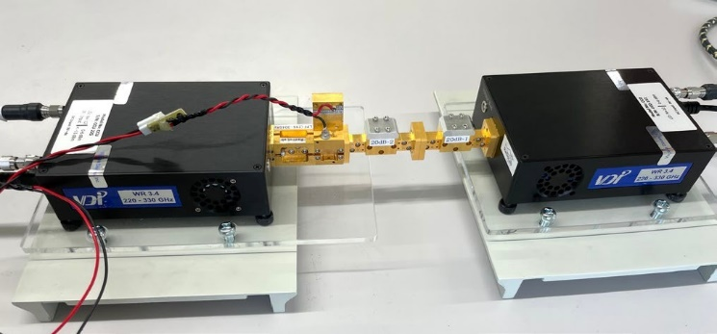
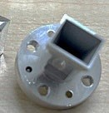
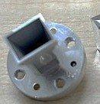

Dynamic Range
Back-to-back evaluation
ATT (20dB)
0.3 m
B2B ATT level = 20+26*2 = 72 dB
FSPL @ 0.3 m = 71.5 dB
Tx Ant. 26 dBi Rx Ant. 26 dBi
20
Channel transfer function (1)
Channel impulse response (1)
w/o | aver | aging
20
0
0
Averaging 1000 snapshots
-20
-20
DR=52dB
Path Gain [dB]
-40
Power [dB]
-60
Calibration point
（Maximum）
-40
-60
-60
-80
-80
-80
-100
-100
-4
-2 0
Freq [GHz]
2
4
-100
-50
0
Delay [ns]
50
PG [dB]
DR~80dB
Channel transfer function (1000)
-120
50dB
Ave. noise
20
w/ | 1000 | snaps | hots
ave | ragin | g
20
Channel impulse response (1000)
-140
30dB
0
0
30 cm
level
10 m
100 m
-20
-20
-160
Path Gain [dB]
-40
Power [dB]
DR=81dB
-40
-180
₁₀ -1
10 ⁰
10 ¹
distance [m]
10 ²
10 ³
-60
-60
Targeted distance of 30 cm~100 m (Indoor/Outdoor) can be covered
-80
-80
-100
-4
2
4
-100
-50
50
Notes:
Back to back calibration is conducted to compensate for the different system response of the filters, amplifiers, etc. used on either side (Tx and Rx). A 20 dB attenuator is used for the process emulating a propagation distance of 0.3m as indicated by the calculations.
The dynamic range is obtained as 52 dB for the said calibration setup. However, with the help of coherent averaging of 1000 snapshots the dynamic range can be improved to 81 dB for the same setup.
Figure on the left bottom corner indicates the variation of dynamic range with separation distance between Tx and Rx where at a separation of even 100 m the sounder provides a dynamic range of 30 dB and hence can be used for measurement.

Slide 8
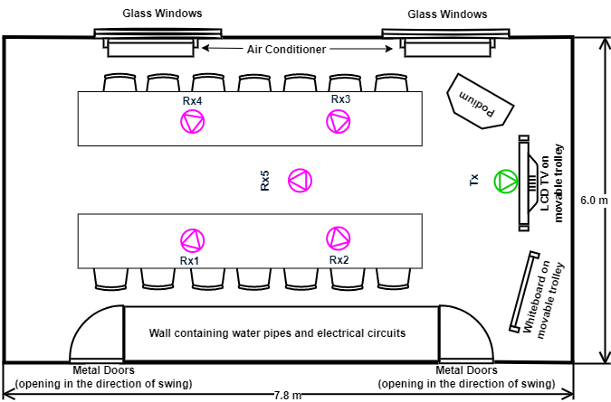
Measurement Scenario
Medium Sized Indoor Space
  Conference Room
    Capacity ~ 20 people
Parameter* | Value*
AP height, H_{tx} | 2.1 m
AP position | Above the LCD TV (Details in Slide )
STA height, H_{rx} | 0.9 m (15 cm from conference table)
Room height | 2.8 m
Room width | 6.0 m
Room length | 7.8 m
Floor material | Concrete
Floor ε_{rf} | 4 + 0.2j
Floor roughness standard deviation σ_{f} | 0.1 mm
Walls material | Concrete
Walls ε_{rw} | 4 + 0.2j
Walls roughness standard deviation σ_{w} | 0.2 mm
Ceiling material | Plasterboard
Ceiling ε_{rc} | 6.25+0.3j
Ceiling roughness standard deviation σ_{c} | 0.2 mm
Notes:
The measurement scenario is a mid-sized conference room that can accommodate approximately 20 people. The environment consists of regular objects such as table, chairs, podium in addition to a television and a whiteboard sitting on a movable trolley. There are two large glass windows on one side of the room and two metal doors on the opposite side. The walls in front and to the side of the Tx are made of concrete and the one behind it is made of plasterboard. The Tx is placed in front of the TV at a height of 2.1m from the floor and the Rx is placed on the table or on a tripod (Rx5) at a height of 1.15m from the floor. 5 different Rx positions are investigated in this campaign while the Tx is fixed. The relevant parameters from the measurement environment are presented in the table.

Slide 9
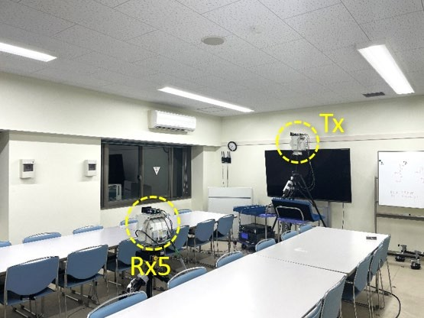
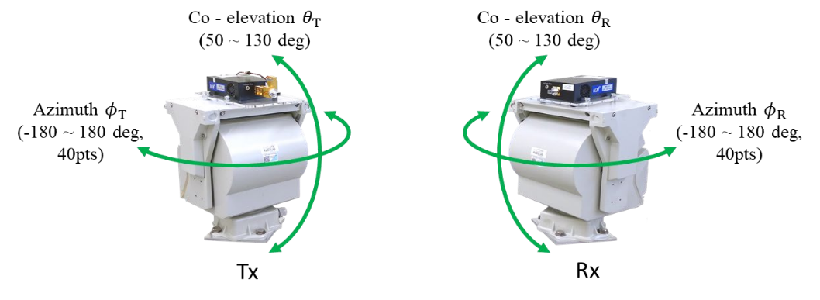
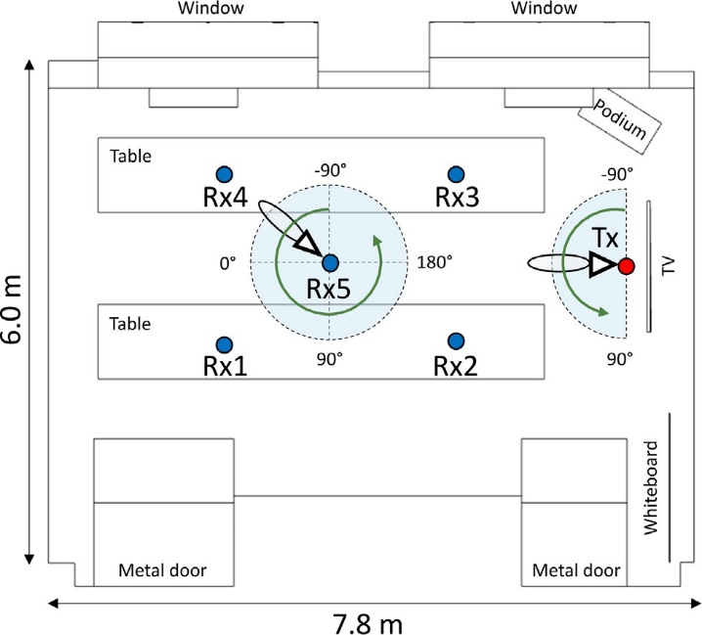
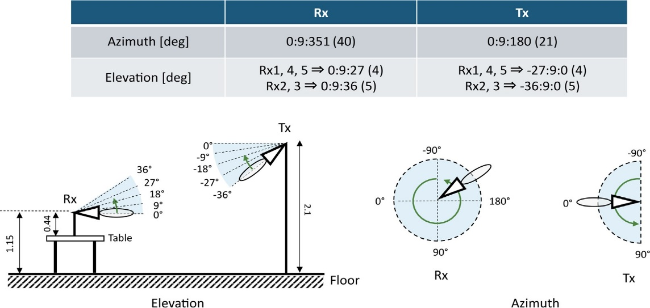
Directional Measurement
Antenna Scanning
  Double-directional pan/tilt
  Measurement time/point ~ 1.5 sec
Notes:
Directional measurement was conducted for the current campaign. While the receiver did a full azimuth sweep, the transmitter rotated in the azimuth range of 0⁰ to 180⁰ in steps of 9⁰. For the receiver positions closer to the Tx (Rx2 and Rx3) 5 elevation samples were considered for both Tx and Rx whereas for the other positions 4 elevation samples were considered. The measurement for a particular azimuth and elevation angle took ~ 1.5 seconds

Slide 10
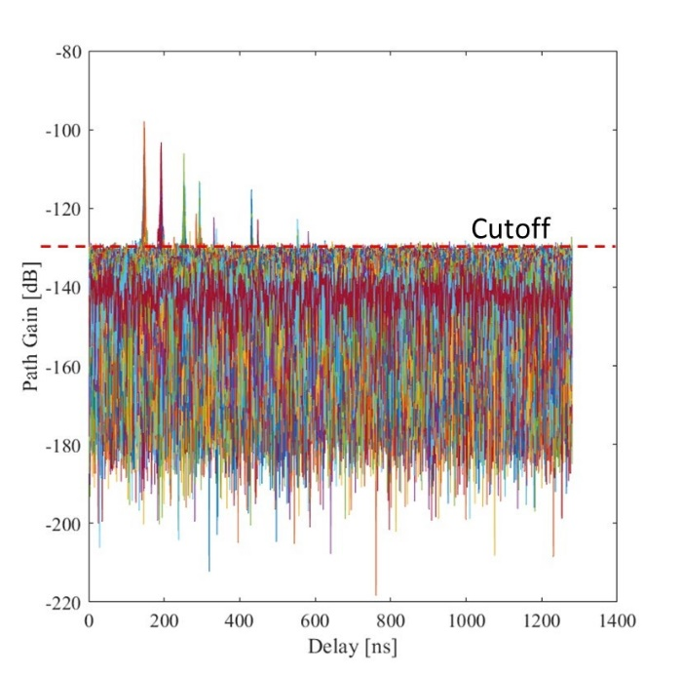
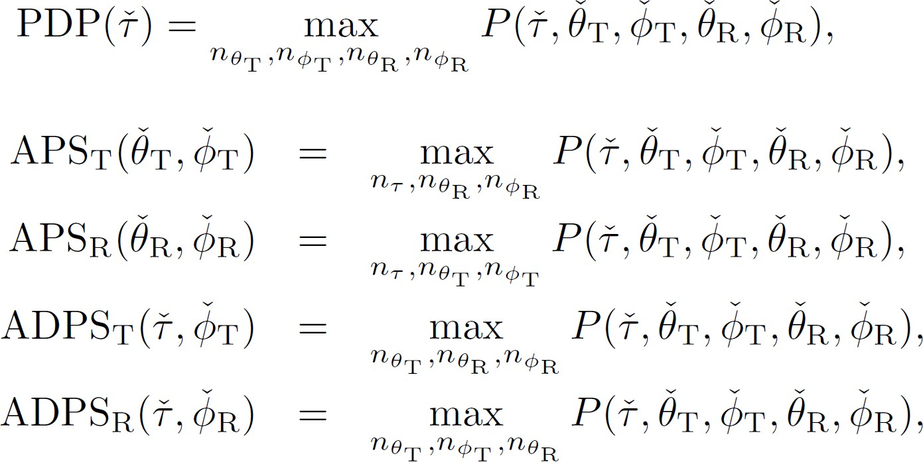
Post – Processing of Measurement Data
Noise filtering
  Cut-off level: set to -134 dB
Spectra Synthesis
Notes:
The obtained resolved channel transfer function (CTF) was first converted into channel impulse response (CIR) using discrete inverse Fourier transform. The double directional angular delay power spectrum (DDADPS) is then approximately obtained by squaring the CIR. The DDADPS is then noise filtered with a cut off-level of -134 dB. The different power spectrum power delay profile, angular power spectrum (at both Tx and Rx) and angular delay power spectrum (at both Tx and Rx) is then evaluated using the formulas as shown.

Slide 11
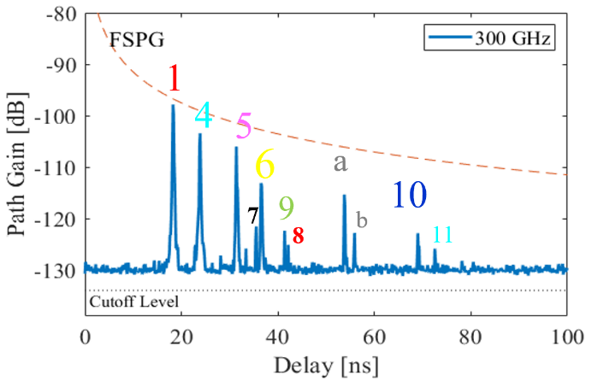
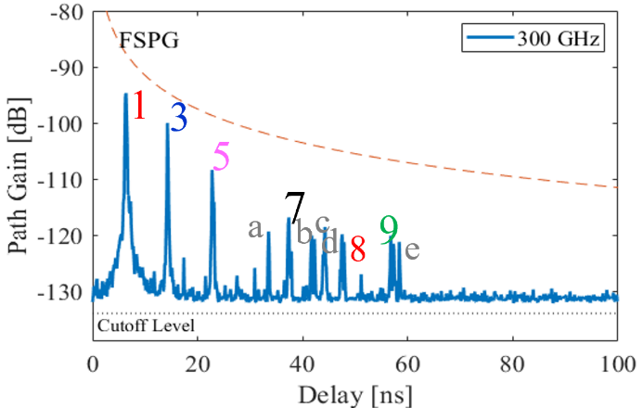
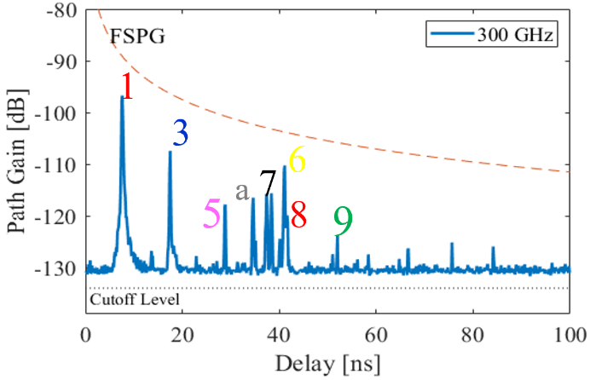
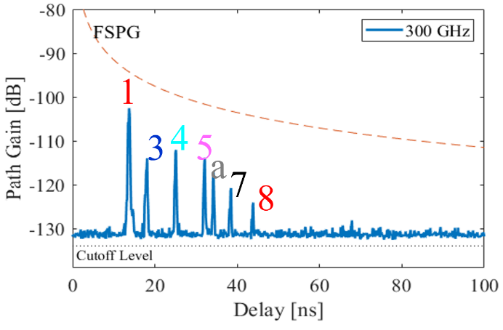
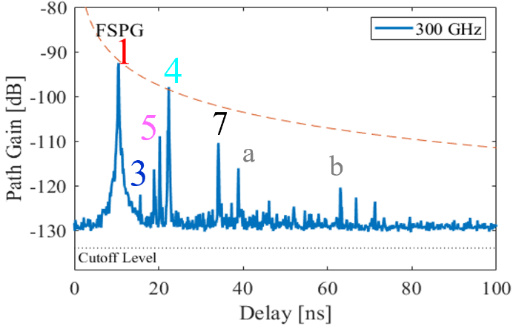
Omnidirectional Power Delay Profile
Rx1
Rx2
Rx3
Rx4
Rx5
Sparse impulse-like Power Delay Profile for all positions
Notes:
The omnidirectional PDP for all the Rx positions are presented in this slide. As can be observed the nature of the PDPs are impulse like and they are sparse. This gives motivation to try and decipher the reason for the peaks from the environment and by using other power spectra. The labels for identified peaks in this slide will be used to identify the signal interaction with the environment and the same clusters in Angular Delay Power Spectrum and Angular Power Spectrum

Slide 12
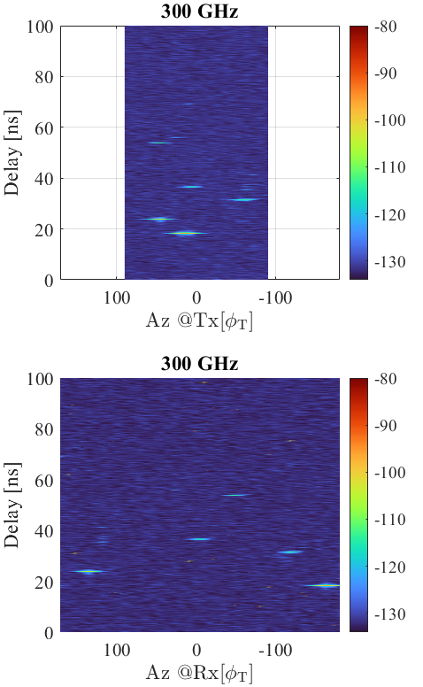
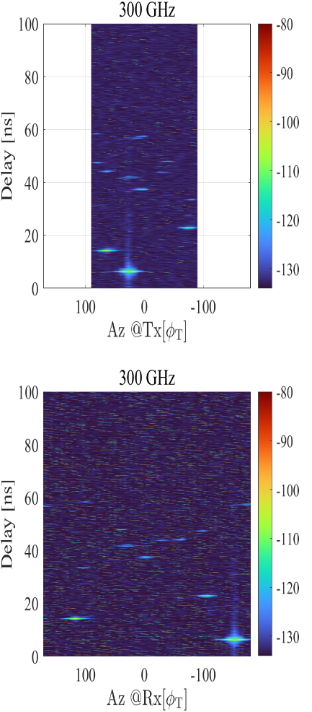
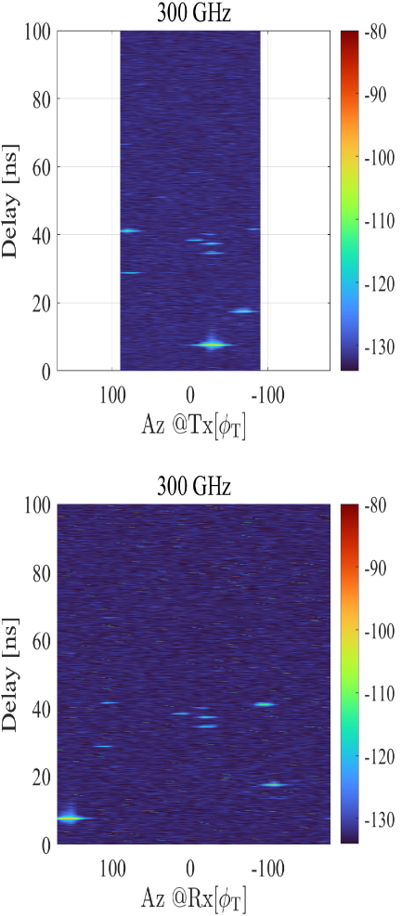
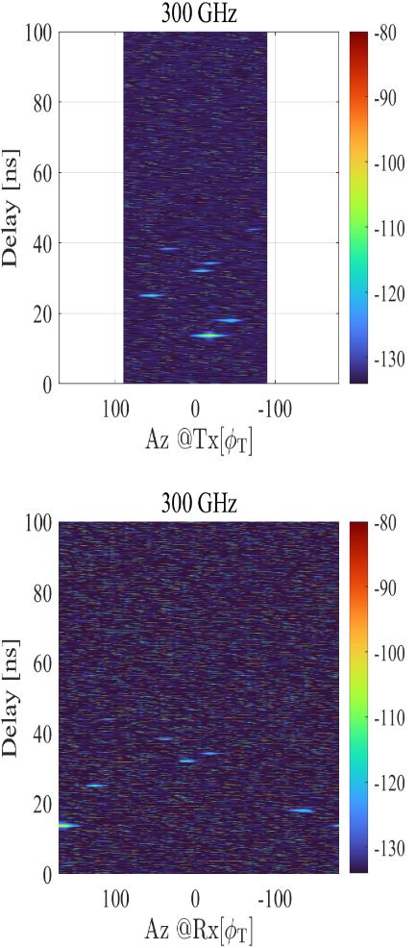
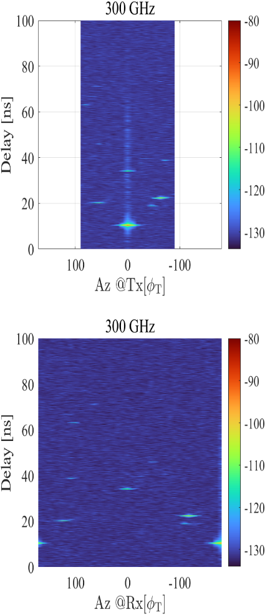
Angular Delay Power Spectrum
11
10
b
b
e
9
9
a
9
8
d
8
7
c
8
8
6
7
b
6
7
a
a
5
7
a
a
5
7
4
1
5
5
4
5
4
3
3
3
1
3
1
1
1
u4
11
10
9
b
a
e
8
9
9
b
8
b
c
d
8
7
6
8
7
7
6
5
a
7
5
a
5
a
a
7
4
1
5
4
3
5
4
3
1
1
3
1
3
1
Rx1
Rx2
Rx3
Rx4
Rx5
The clusters can be easily identified in the Angular Delay Power Spectrum by comparing the delays in the Power Delay Profile
Notes:
The Angular Delay Power Spectrum at the transmitter and receiver for all the five positions are presented. The peaks here are identified from the delays and path gain in the PDPs presented in the previous slide for corresponding positions.

Slide 13
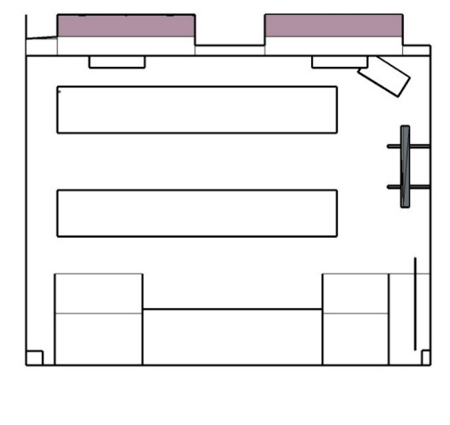
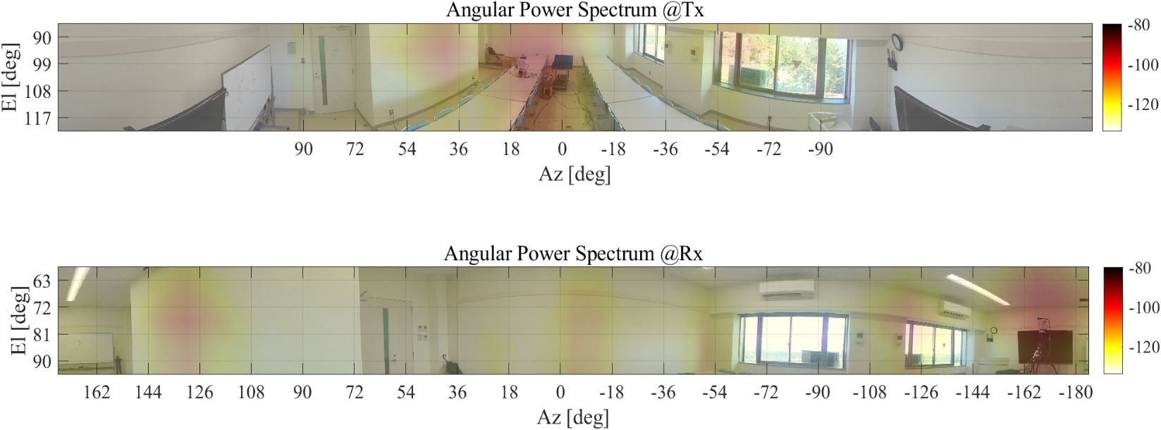
Angular Power Spectrum – Rx1
#7
a
b
10
7
#a
#8
#5
6
11
8
a
Tx
4
1
5
#1
#10
#6
Rx
#11
#4
#b
#9
11
9
7
b
6
5
10
4
8
a
1
Most cluster rich propagation with 11 clusters along with Rx2.
3 single bounce, 6 double bounce and 1 triple bounce paths are identified
Significant angle and delay spread can be expected for this position
Notes:
Here we present the environment embedded Angular Power Spectrum for Rx1. We also present the simulator validated intuitive ray tracing to identify each of the peaks as presented in the corresponding PDP, ADPS and APS. With 11 identified cluster this position was the most scattering rich. 3 single bounce, 6 double bounce and 1 triple bounce paths are identified. Given the nature of the ray tracing result significant angle and delay spread can be expected.

Slide 14
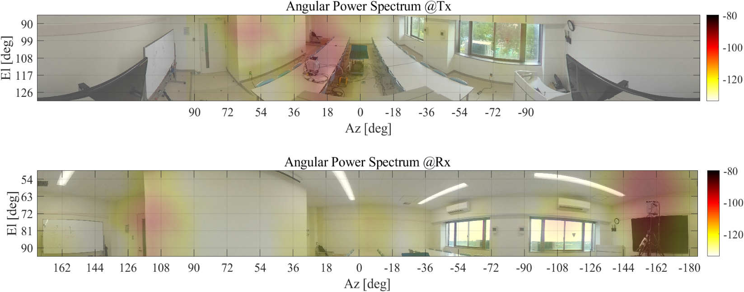
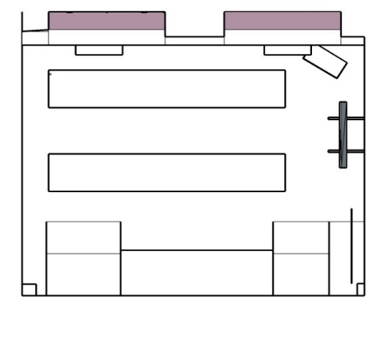
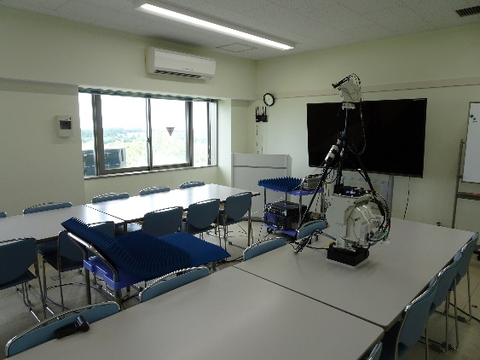
Angular Power Spectrum – Rx2
d
b
7
a
#d
#5
#a
c
9
8
3
5
#8
e
#c
1
Tx
#9
#7
#1
Rx
#b
#e
#3
a
1
e
5
3
b
7
8
c
d
9
Most cluster rich propagation with 11 clusters identified
3 single bounce, 5 double bounce and 2 triple bounce paths are identified
The trajectories indicate possibility of large azimuth angle spread of arrival and departure as well as large delay spread
Tx
Rx2
Notes:
In this slide the APS for Rx2 is presented where 11 clusters are identified again however in this case there is one triple bounce path more than in case of Rx1. It will be interesting to note if the extra triple bounce path increases the angle and delay spread compared to the previous position (Rx1) despite its proximity to transmitter.

Slide 15
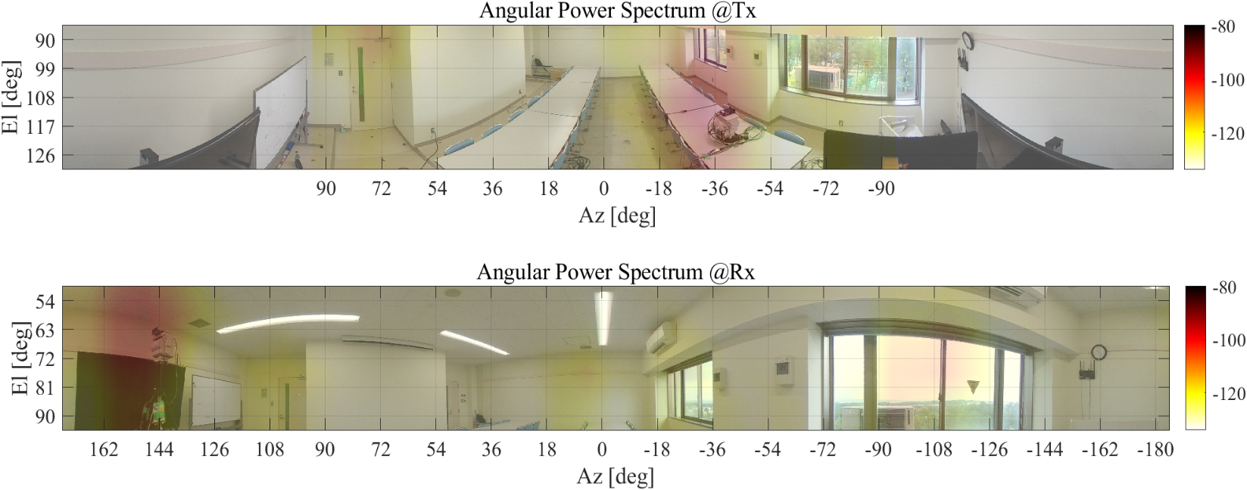
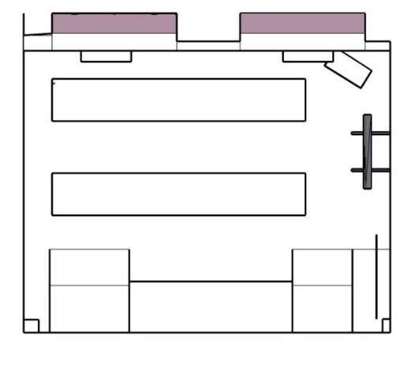
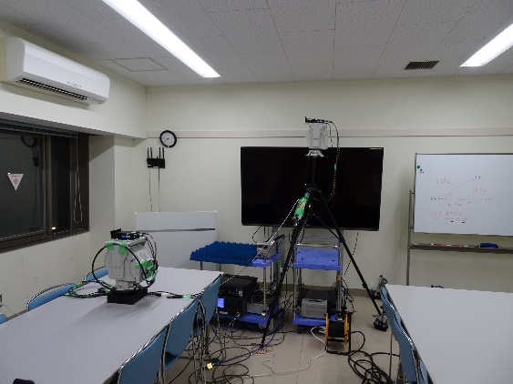
Angular Power Spectrum – Rx3
7
a
3
6
5
8
#9
#3
9
#8
1
#a
Rx
#1
Tx
#7
#6
1
3
#5
5
7
a
9
6
8
3 single bounce paths and 4 double bounce paths can be identified.
Azimuth angular spread can be anticipated to be small due to bulk of paths arriving from or departing to similar direction
No triple bounce path identified.
Tx
Rx3
Notes:
Only 8 paths are identified in this case compared to the previous positions. However, in this case there are no triple bounce path. It will be interesting to note what effect it will have on the large scale parameters.

Slide 16
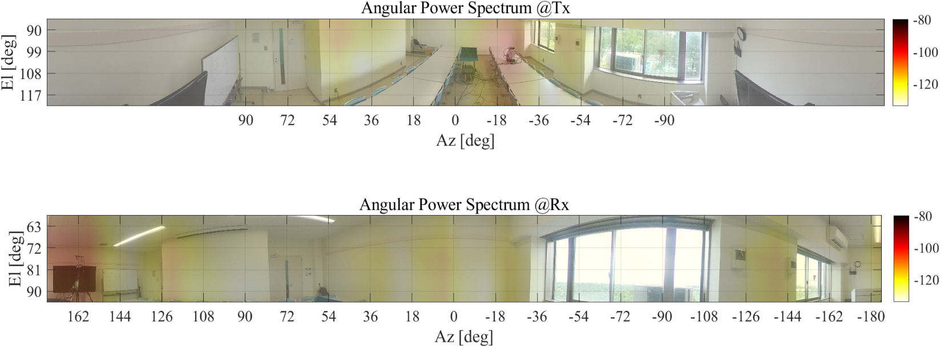
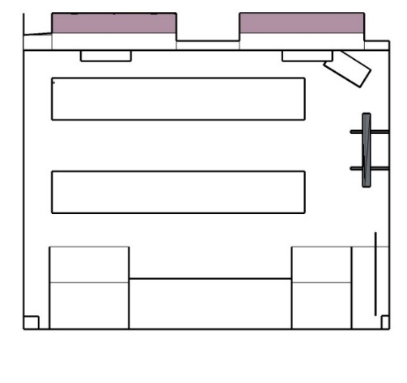
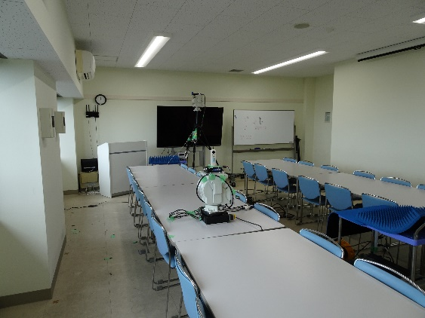
Angular Power Spectrum – Rx4
4
7
5
a
3
8
Rx
#8
#a
#3
1
#1
Tx
#5
#7
#4
1
4
8
7
5
a
3
4 single bounce paths and 2 double bounce paths can be identified.
Given the trajectory of the ray-traced path significant azimuth spread at both Tx and Rx can be expected.
Tx
Rx4
Notes:
Only 7 clusters are identified in this case which makes this position the least scatter rich among the positions presented so far. The direction of departure and arrival from the ray tracing results seems to vary over a wide range and hence it will be interesting to see if that contributes to a larger angular spread

Slide 17
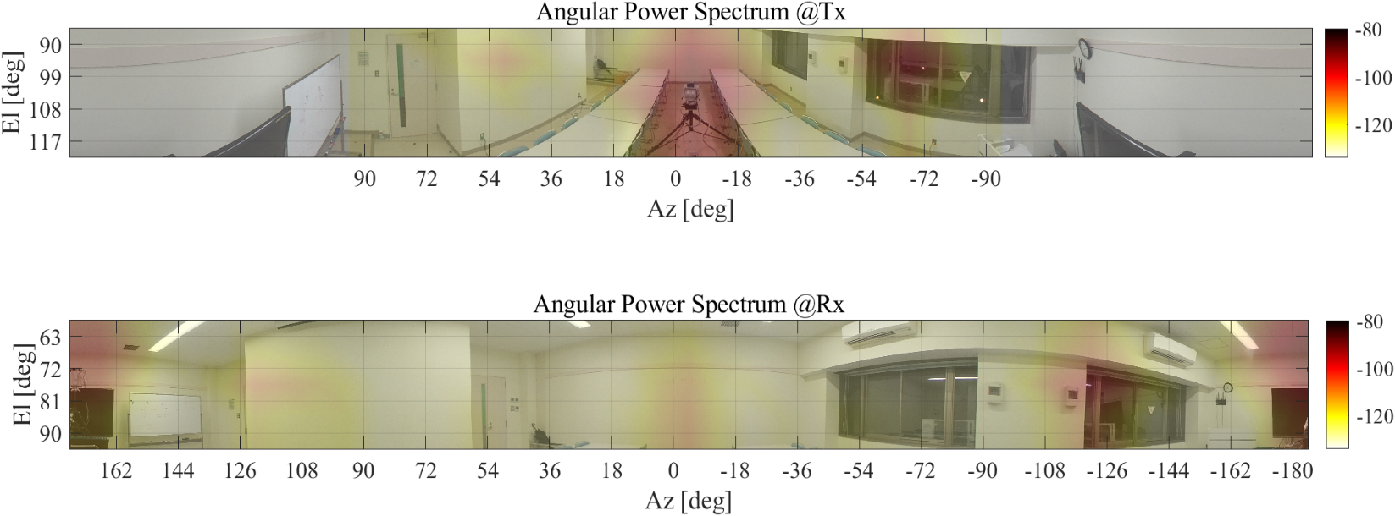

Angular Power Spectrum – Rx5
7
3
a
#3
#4
b
5
4
#a
Tx
1
#1
#7
Rx
#5
#b
5
a
7
3
1
b
4
4 single bounce paths, 1 double bounce path and 1 triple bounce path can be identified.
Despite the presence of a TB path the delay spread might not be too large due to apparent uniform distribution of paths
Notes:
Only 7 clusters like the previous position, but there is one significant triple bounce path identified as #b which is anticipated to have been first reflected from the metal door and then from the glass window. It will be interesting to see how the large scale parameters for this position compare to Rx4 both of which has same number of clusters.

Slide 18
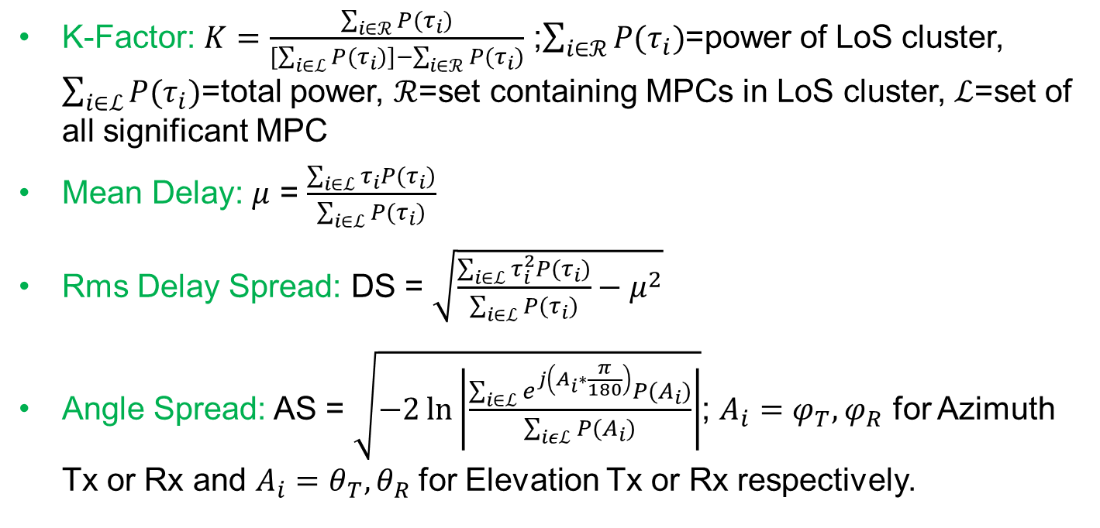
Definitions used for Large Scale Parameter Calculation
K-Factor: $K=\frac{\sum_{i∈ℛ}{P(τ_{i})}}{[\sum_{i∈ℒ}{P(τ_{i})]}−\sum_{i∈ℛ}{P(τ_{i})}}$ ;$\sum_{i∈ℛ}{P(τ_{i})}$=power of LoS cluster, $\sum_{i∈ℒ}{P(τ_{i})}$=total power, $ℛ$=set containing MPCs in LoS cluster, $ℒ$=set of all significant MPC
Mean Delay: $μ$ = $\frac{\sum_{i∈ℒ}{τ_{i}P(τ_{i})}}{\sum_{i∈ℒ}{P(τ_{i})}}$
Rms Delay Spread: DS = $\sqrt{\frac{\sum_{i∈ℒ}{τ_{i}^{2}P(τ_{i})}}{\sum_{i∈ℒ}{P(τ_{i})}}−μ^{2}}$
Angle Spread: AS = $\sqrt{−2\ln\left|\frac{\sum_{i∈ℒ}{e^{j\left(A_{i}∗\frac{π}{180}\right)}P(A_{i})}}{\sum_{iεℒ}{P(A_{i})}}\right|}$; $A_{i}=φ_{T},φ_{R}$ for Azimuth Tx or Rx and $A_{i}=θ_{T},θ_{R}$ for Elevation Tx or Rx respectively.
Notes:
The definitions of the different large scale parameters such as K-factor, RMS delay spread, angle spread (azimuth spread of departure (ASD), elevation spread of departure (ESD), azimuth spread of arrival (ASA) and elevation spread of arrival (ESA)) used for the evaluation is presented in this slide.

Slide 19
Evaluated Large Scale Parameter – Angle Domain Parameters
Azimuth Spread of Departure (ASD): is found to be in the range 24⁰-26⁰
Azimuth Spread of Arrival (ASA): is in the range of ~ 31⁰-42⁰
Elevation Spread of Departure (ESD): is in the range of ~6.5⁰-8.5⁰
Elevation Spread of Arrival (ESA): is in the range of ~6⁰-9⁰
Large ASD and ASA is observed in Rx1, Rx2 and Rx4 as anticipated from ray-trace results.
Small ASD and ASA is observed for Rx3 and Rx5 as was anticipated from ray tracing results.
Parameters | 300 GHz
 | Rx1 | Rx2 | Rx3 | Rx4 | Rx5
ASD | 24.82⁰ | 24.88⁰ | 21.96⁰ | 24.88⁰ | 21.24⁰
ASD_dB | 1.39 | 1.40 | 1.34 | 1.40 | 1.42
ASA | 37.88⁰ | 41.18⁰ | 33.33⁰ | 39.15⁰ | 31.64⁰
ASA_dB | 1.58 | 1.61 | 1.52 | 1.59 | 1.50
ESD | 6.67⁰ | 8.04⁰ | 8.40⁰ | 7.03⁰ | 6.77⁰
ESD_dB | 0.82 | 0.90 | 0.92 | 0.84 | 0.83
ESA | 6.16⁰ | 8.62⁰ | 7.48⁰ | 7.06⁰ | 6.11⁰
ESA_dB | 0.79 | 0.94 | 0.87 | 0.85 | 0.79
Notes:
The range of ASA is quite different and large compared to that of ASD. Whether it is environment dependent or propagation band dependent cannot be ascertained with the current dataset. The ESD and ESA range is almost similar.
As anticipated the ASA and ASD value is large for Rx1, Rx2 and Rx4 whereas the same is low for Rx3 and Rx5.

Slide 20
Evaluated Large Scale Parameters – Power and Delay Domain
Parameters | 300 GHz
 | Rx1 | Rx2 | Rx3 | Rx4 | Rx5
K | 2.29 | 5.05 | 8.20 | 3.77 | 4.84
K_dB | 3.60 | 7.03 | 9.14 | 5.77 | 6.85
Mean Delay | 21.24 ns | 7.97 ns | 9.99 ns | 16.41 ns | 12.58 ns
Mean Delay [dB] | -7.67 | -8.10 | -8.00 | -7.78 | -7.90
rmsDS | 5.72 ns | 4.04 ns | 7.70 ns | 6.02 ns | 4.93 ns
rmsDS_dB | -8.24 | -8.39 | -8.11 | -8.22 | -8.31
K-factor: is found to be in the range of ~ 3.5-9.5 dB
Mean Delay: is in the range of ~ 8-22 ns
Delay Spread: is in the range of ~ 4-8 ns
Large K-factor is observed in Rx3 due to higher ratio of DB paths arriving with less power. It also explains the higher delay spread in Rx3
As anticipated the delay spread in Rx5 is not large due to uniform distribution of multipath clusters.
Notes:
In Rx3, compared to the LoS path the single bounce and double bounce paths are quite long and hence can suffer from larger propagation loss justifying higher K-factor and can arrive at a larger delay accounting for a larger delay spread.
Rx1 and Rx2 both has the same number of identified clusters, yet Rx2 has larger K-factor due to its proximity to Tx which ensures less propagation loss suffered by the LoS path. The larger delay spread in Rx1 can be attributed to the similar power of cluster 4 and 5 (two clusters immediately after LoS) as observed in PDP. In comparison, in Rx2 the power difference between cluster 3 and 5 is quite large and hence contribution to delay spread by cluster 5 is less. This explains the delay spread difference between Rx1 and 2 despite having similar number of clusters
In case of Rx4 and 5 both of them has the same number of clusters but Rx5 is closer to Tx compared to Rx4 which explains the higher K-factor in case of Rx5. The higher delay spread in case of Rx4 can be explained as before where cluster 3, 4 and 5 has comparable power as seen in the corresponding PDP whereas in case of Rx5 only cluster 4 has some significant power. Also the uniform distribution of the ray traced path in Rx5 further validates the lower delay spread.

Slide 21
Cross-correlation between parameters
Positive correlation indicates for larger delay spread propagation is LoS dominant whereas for smaller spread MPCs can have significant power.
 | K | DS | ASA | ESA
K | 1 | - | - | -
DS | 0.3481 | 1 | - | -
ASA | -0.4168 | -0.4327 | 1 | -
ESA | -0.5023 | -0.1822 | 0.5592 | 1
Negative correlation indicates dominance of multiply reflected paths when delay spread is large and vice-versa
Large K-factor means LoS is more dominant thus less power dispersion in angle domain and vice-versa.
Notes:
Positive correlation between K and DS indicates larger delay spread would lead to more LoS dominant propagation and vice-versa. To cite an example Rx1 and Rx4 are in symmetrical positions, yet Rx1 has delay spread of 5.72ns and K-factor of 3.6 dB whereas Rx4 has delay spread of 6.02ns and K-factor of 5.77 dB. Same goes for the other symmetrical positions Rx2 and Rx3
Rx2 – Delay spread: 4.04ns and K-factor: 7.03dB
Rx3 – Delay spread: 7.70ns and K-factor: 9.14dB
Negative relation between K-factor and angle spread (ASA or ESA) indicates for significant LoS dominant there is less power dispersion in the angle domain. So either number of MPCs will be less when K-factor is large as observed in Rx3 (only 8 clusters, K-factor highest) or vice versa as observed in Rx1 (11 clusters, K-factor lowest)
Negative correlation between delay spread (DS) and angle spread (ASA or ESA) dominance of multiply reflected path when angle spread is small and vice versa.

Slide 22
Conclusion
High K-factor indicates a LoS dominant propagation at 300 GHz
Visual investigation of delay profile and spectra (Angular Delay Power Spectrum, Angular Power Spectrum) indicates less number of MPCs per cluster
Further measurement campaign in other indoor environment is required to ascertain the cross-correlation between the parameters
Notes:
With the current dataset and its subsequent analysis the following inferences can be drawn
High K-factor indicates LoS dominant path but as observed from ray-tracing triple bounce path with significant power exists in most of the positions
The impulse like nature of the PDP indicates less number of MPCs per cluster
Further extensive campaign is required to make conclusive statements about the cross-correlation between different large scale parameters

Slide 23
Future works
MPC extraction and clustering to model intracluster parameters
Efforts to model the stochastic processes in signal propagation at THz band
Further extensive campaigns to develop channel models suited to the unique attributes of THz band propagation
Notes:
The logical step would be to
Design a MPC estimation algorithm and compare how it performs with existing algorithm and our manual approach.
Model the stochastic processes in signal propagation at the band of interest (300 GHz). Also find out the intra-cluster parameters.
Develop channel model suited to THz band propagation

